Slide 1

Skeleton Tutorial
Zhao Zhang
Daniel S. Katz
Michael Wilde

Slide 2
Prerequisites
Tested on Mac
Swift:
Requires Swift to run output Swift scripts
Pegasus:
Requires Pegasus to run output Pegasus DAX
Generating workflow images (as described here):
Requires Pegasus dax2dot script, which requires python 2.7 or higher
Requires graphviz - http://www.graphviz.org

Slide 3
Download & Test
git clone https://github.com/applicationskeleton/Skeleton.git
cd Skeleton
python setup.py build
export PYTHONPATH=Path_to_Skeleton/build/lib/
Test case:
bin/aimes-skeleton-generate –i src/aimes/skeleton/sample-input/bag.input –m shell
Should print (the shell commands needed to execute the application):
task serial 1 5 65536 65536 1 1 0 Stage_1_Input/Stage_1_Input_0_1 Stage_1_Output/Stage_1_Output_0_1 4200000
task serial 1 5 65536 65536 1 1 0 Stage_1_Input/Stage_1_Input_0_2 Stage_1_Output/Stage_1_Output_0_2 4200000
task serial 1 5 65536 65536 1 1 0 Stage_1_Input/Stage_1_Input_0_3 Stage_1_Output/Stage_1_Output_0_3 4200000
task serial 1 5 65536 65536 1 1 0 Stage_1_Input/Stage_1_Input_0_4 Stage_1_Output/Stage_1_Output_0_4 4200000

Slide 4
Shell example (create work)
Create the tasks:
bin/aimes-skeleton-generate -i src/aimes/skeleton/sample-input/bag.input -m shell -o workflow -c
This creates
workflow-setup.sh – the script that creates the input and output directories for the tasks, and creates the initial input files
workflow – the script that can be executed to run the workflow

Slide 5
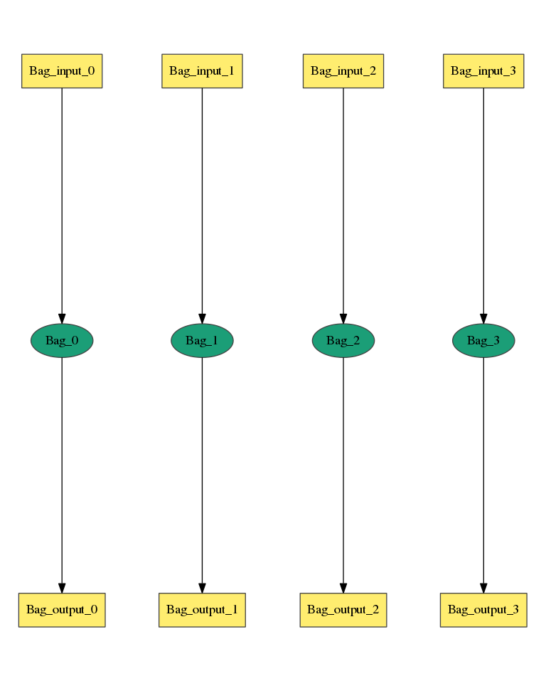
Bag of Task Input
Num_Stage = 1
Stage_Name = Stage_1
Task_Type = serial
Num_Processes = 1
Num_Tasks = 4
Task_Length = uniform 5
Read_Buffer = 65536
Write_Buffer = 65536
Input_Files_Each_Task = 1
Input_1.Source = filesystem
Input_1.Size = uniform 2100000
Output_Files_Each_Task = 1
Output_1.Size = uniform 4200000
Interleave_Option = 0
https://github.com/applicationskeleton/Skeleton/src/aimes/skeleton/sample-input/bag.input

Slide 6
Bag of Tasks
Output of aimes-skeleton-generate (captured in workflow)
task serial 1 5 65536 65536 1 1 0 Stage_1_Input/Stage_1_Input_0_1 Stage_1_Output/Stage_1_Output_0_1 4200000
task serial 1 5 65536 65536 1 1 0 Stage_1_Input/Stage_1_Input_0_2 Stage_1_Output/Stage_1_Output_0_2 4200000
task serial 1 5 65536 65536 1 1 0 Stage_1_Input/Stage_1_Input_0_3 Stage_1_Output/Stage_1_Output_0_3 4200000
task serial 1 5 65536 65536 1 1 0 Stage_1_Input/Stage_1_Input_0_4 Stage_1_Output/Stage_1_Output_0_4 4200000
What this means:
Path_to_Task Task_Type Num_Processes Task_Length Read_Buffer Write_Buffer Num_Input Num_Output Interleave_Option [Input_File] [Output_File Output_Size]

Slide 7
Shell example (run work)
To compile
gcc -o bin/task src/aimes/skeleton/task.c -lm
export PATH=$PATH:$PWD/bin
To run:
sh workflow_setup.sh
sh workflow
Output check
Look in Stage_1_Output for 4 output files, each of size 4200000

Slide 8
Swift example
Create the tasks:
bin/aimes-skeleton-generate -i src/aimes/skeleton/sample-input/bag.input -m swift -o workflow.swift -c
This creates
workflow_setup.sh – the script that creates the input and output directories for the tasks, and creates the initial input files
workflow.swift – the Swift script that can be executed to run the workflow
To setup Swift:
Install Swift: http://swift-lang.org/guides/release-0.94/quickstart/quickstart.html
export PATH=$PATH:$PWD/bin
util/gen-tc-data.sh > ./tc.data
To run:
gcc -o bin/task src/aimes/skeleton/task.c -lm
sh worklow_setup.sh
swift -tc.file tc.data workflow.swift
Output check
Look in Stage_1_Output for 4 output files, each of size 4200000
zhaozhang@stealth:/var/tmp/ApplicationSkeleton/Skeleton/src$ ls -l Stage_1_Output/
total 16416
-rw------- 1 zhaozhang student 4200000 Sep 6 15:54 Stage_1_Output_0_1
-rw------- 1 zhaozhang student 4200000 Sep 6 15:54 Stage_1_Output_0_2
-rw------- 1 zhaozhang student 4200000 Sep 6 15:54 Stage_1_Output_0_3
-rw------- 1 zhaozhang student 4200000 Sep 6 15:53 Stage_1_Output_0_4

Slide 9
Pegasus example (incomplete)
Create the tasks:
bin/aimes-skeleton-generate -i src/aimes/skeleton/sample-input/bag.input -m pegasus -o workflow.dax -c
This creates
workflow_setup.sh – the script that creates the input and output directories for the tasks, and creates the initial input files
workflow.dax – the Pegasus DAX that describes the workflow
To run:
sh workflow_setup.sh
[run Pegasus with workflow.dax]
Output check
Look in Stage_1_Output for 4 output files, each of size 4200000

Slide 10
Bag of Task
Other options:
Num_Stage = 1
Stage_Name = Stage_1
Task_Type = parallel
Num_Processes = 6
Num_Tasks = 4
Task_Length = normal [20, 3]
Read_Buffer = 65536
Write_Buffer = 65536
Input_Files_Each_Task = 1
Input_1.Source = filesystem
Input_1.Size = uniform 2100000
Output_Files_Each_Task = 1
Output_1.Size = uniform 4200000
Interleave_Option = 0
Task_Type as parallel?

Slide 11
Bag of Task
Other options:
Num_Stage = 1
Stage_Name = Stage_1
Task_Type = serial
Num_Processes = 1
Num_Tasks = 4
Task_Length = normal [20, 3]
Read_Buffer = 65536
Write_Buffer = 65536
Input_Files_Each_Task = 1
Input_1.Source = filesystem
Input_1.Size = uniform 2100000
Output_Files_Each_Task = 1
Output_1.Size = uniform 4200000
Interleave_Option = 0
Task_Length as a statistical distribution?

Slide 12
Bag of Task
Other options:
Num_Stage = 1
Stage_Name = Stage_1
Task_Type = serial
Num_Processes = 1
Num_Tasks = 4
Task_Length = polynomial [20, 3] Input_1
Read_Buffer = 65536
Write_Buffer = 65536
Input_Files_Each_Task = 1
Input_1.Source = filesystem
Input_1.Size = uniform 2100000
Output_Files_Each_Task = 1
Output_1.Size = uniform 4200000
Interleave_Option = 0
Task_Length as a polynomial function of input file size?
20*size^3

Slide 13
Bag of Task
Other options:
Output size as a polynomial of task_length?
10*task_length^2
Num_Stage = 1
Stage_Name = Stage_1
Task_Type = serial
Num_Processes = 1
Num_Tasks = 4
Task_Length = normal [20, 3]
Read_Buffer = 65536
Write_Buffer = 65536
Input_Files_Each_Task = 1
Input_1.Source = filesystem
Input_1.Size = uniform 2100000
Output_Files_Each_Task = 1
Output_1.Size = polynomial [10, 2] Length
Interleave_Option = 0

Slide 14
Interleave_option
0
1
2
3

Slide 15
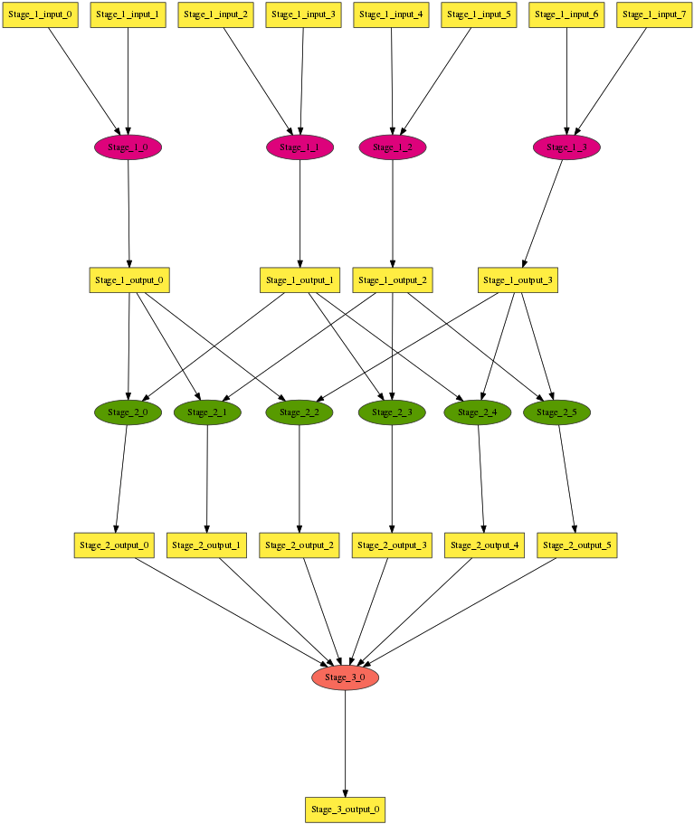
Multi-stage Workflow
Num_Stage = 3
Stage_Name = Stage_1
…
Stage_Name = Stage_2
…
Write_Buffer = 65536
Input_Files_Each_Task = 2
Input_Task_Mapping = combination Stage_1.Output_1 2
…
Stage_Name = Stage_3
…
Input_Files_Each_Task = 6
Input_Task_Mapping = combination Stage_2.Output_1 6
…
https://github.com/applicationskeleton/Skeleton/src/aimes/skeleton/sample-input/multi-stage.input

Slide 16
Mapping Files to Tasks
Do not specify Input_Task_Mapping:
Natural order
8 files, 4 tasks =>
f0, f1 : t0
f2, f3 : t1
f4, f5 : t2
f6, f7 : t3

Slide 17
Mapping Files to Tasks
Specify Input_Task_Mapping:
Input_Task_Mapping = combination Stage_1_output_1 2
4 files, 6 tasks =>
f0, f1 : t0
f0, f2 : t1
f0, f3 : t2
f1, f2 : t3
f1, f3 : t4
f2, f3 : t5
https://github.com/applicationskeleton/Skeleton/src/aimes/skeleton/sample-input/multi-stage.input

Slide 18
Mapping Files to Tasks
Specify Input_Task_Mapping:
Input_Task_Mapping = external sample-input/mapping.sh
cat sample-input/mapping.sh
echo Stage_1_Output_0_1 Stage_1_Output_0_2
echo Stage_1_Output_0_1 Stage_1_Output_0_3
echo Stage_1_Output_0_1 Stage_1_Output_0_4
echo Stage_1_Output_0_2 Stage_1_Output_0_3
echo Stage_1_Output_0_2 Stage_1_Output_0_4
echo Stage_1_Output_0_3 Stage_1_Output_0_4
The ith line maps to the ith task
https://github.com/applicationskeleton/Skeleton/src/aimes/skeleton/sample-input/external-mapper.input
Note: external mapper may require Python3

Slide 19
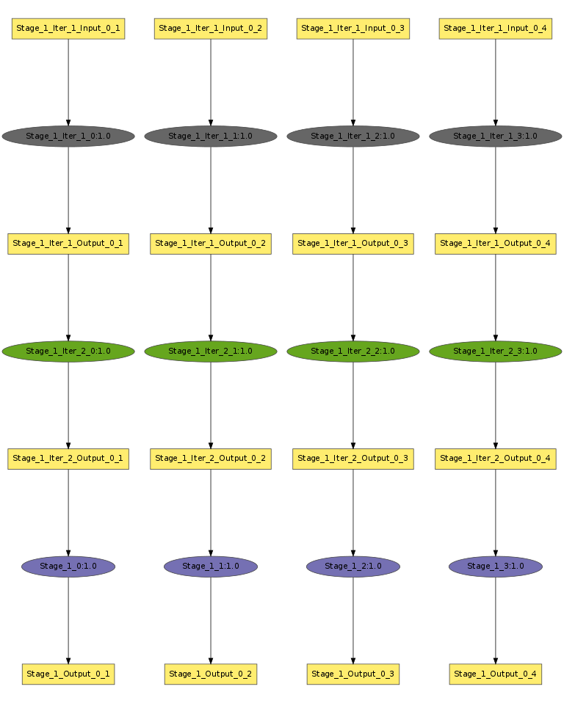
Single Stage Iterative Workflow
Num_Stage = 1
Stage_Name = Stage_1
Task_Type = serial
Num_Tasks = 4
Task_Length = uniform 10
Num_Processes = 1
Read_Buffer = 65536
Write_Buffer = 65536
Input_Files_Each_Task = 1
Input_1.Source = filesystem
Input_1.Size = uniform 1048576
Output_Files_Each_Task = 1
Output_1.Size = uniform 1048576
Interleave_Option = 0
Iteration_Num = 3
Iteration_Stages = Stage_1
Iteration_Substitute = Stage_1.Input_1, Stage_1.Output_1
Stage_1.Input_1 and Stage_1.Output_1 should have IDENTICAL number of files
https://github.com/applicationskeleton/Skeleton/src/aimes/skeleton/sample-input/single-stage-iterative.input

Slide 20
Multi Stage Iterative Workflow
Stage_Name = Stage_3
Task_Type = serial
Num_Tasks = 6
Task_Length = uniform 32
Num_Processes = 1
Read_Buffer = 65536
Write_Buffer = 65536
Input_Files_Each_Task = 1
Input_1.Source = Stage_2.Output_1
Output_Files_Each_Task = 1
Output_1.Size = uniform 1048576
Interleave_Option = 0
Iteration_Num = 3
Iteration_Stages = Stage_3, Stage_4
Iteration_Substitute = Stage_3.Input_1, Stage_4.Output_1
Stage_Name = Stage_4
Task_Type = serial
Num_Tasks = 6
Task_Length = uniform 32
Num_Processes = 1
Read_Buffer = 65536
Write_Buffer = 65536
Input_Files_Each_Task = 1
Input_1.Source = Stage_3.Output_1
Output_Files_Each_Task = 1
Output_1.Size = uniform 1048576
Interleave_Option = 0
Stage_3.Input_1 and Stage_4.Output_1 should have IDENTICAL number of files
https://github.com/applicationskeleton/Skeleton/src/aimes/skeleton/sample-input/multiple-stage-iterative.input

Slide 21
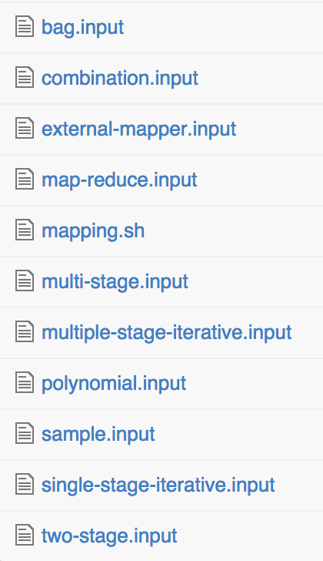
Complete List of Sample Inputs

Slide 22
Using Pegasus to create workflow images
Pegasus dax2dot script requires python 2.7 or higher
Visualizing DAX requires graphviz
Example usage:
cd Skeleton/src
./skeleton.py sample-input/bag.input DAX > bag.dax
../util/plot.sh bag.dax
open bag.png
This is how the images in this presentation have been generated

Slide 23
Conclusion
More information in report/report.pdf
Questions?

