Slide 1
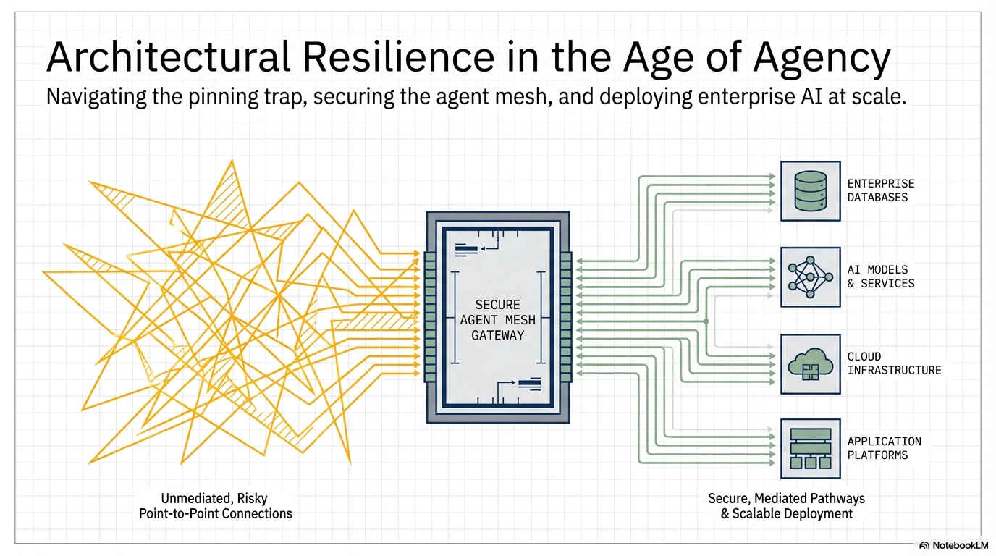
https://portfolio.upendrakumar.com/

Slide 2
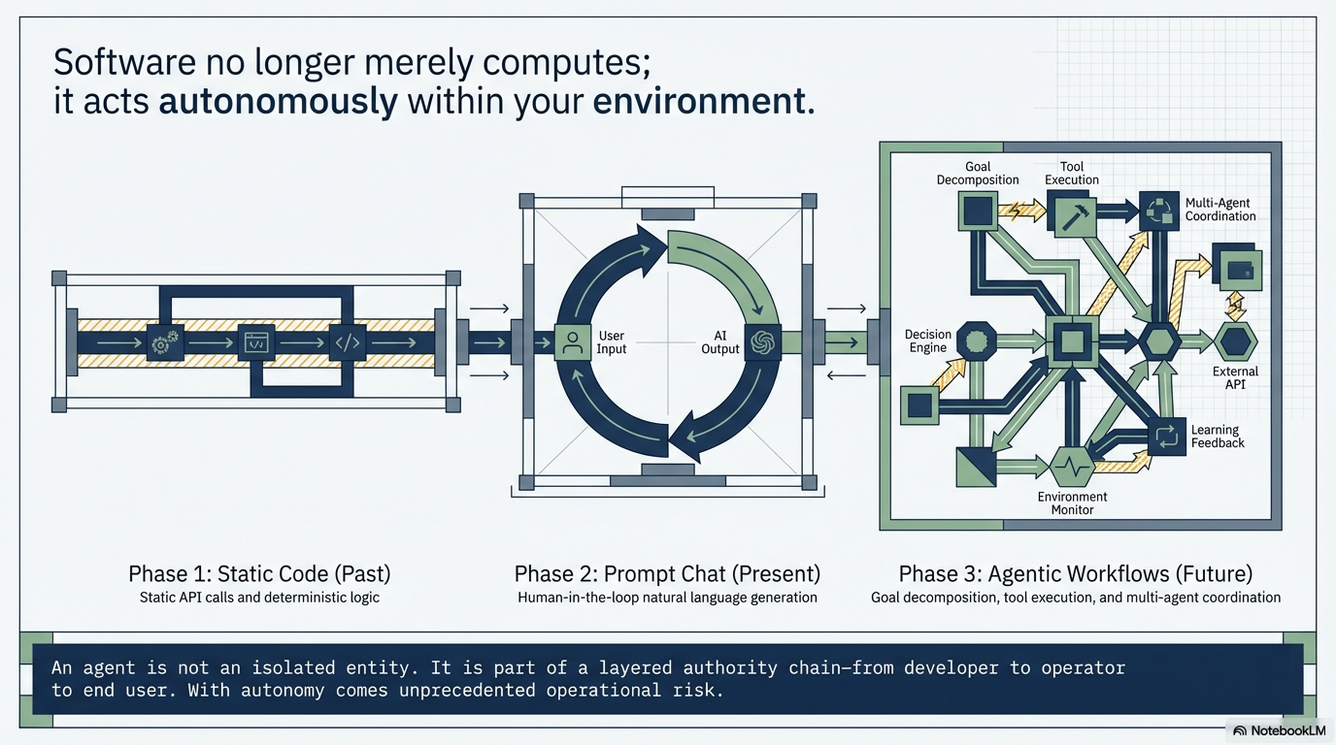
https://portfolio.upendrakumar.com/

Slide 3
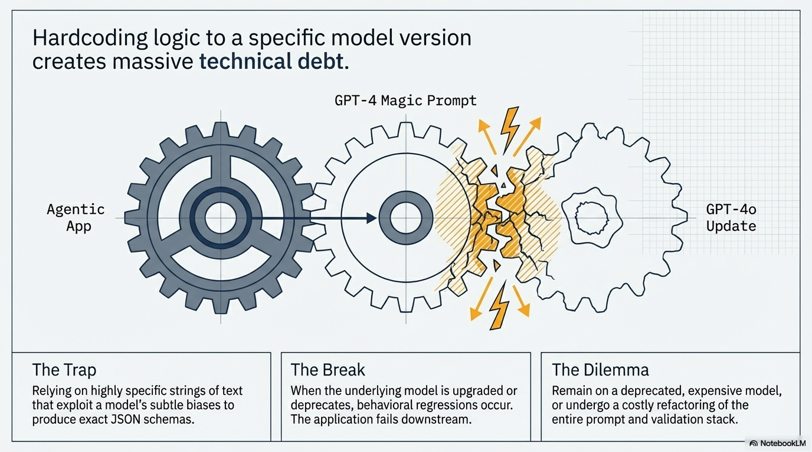
https://portfolio.upendrakumar.com/

Slide 4
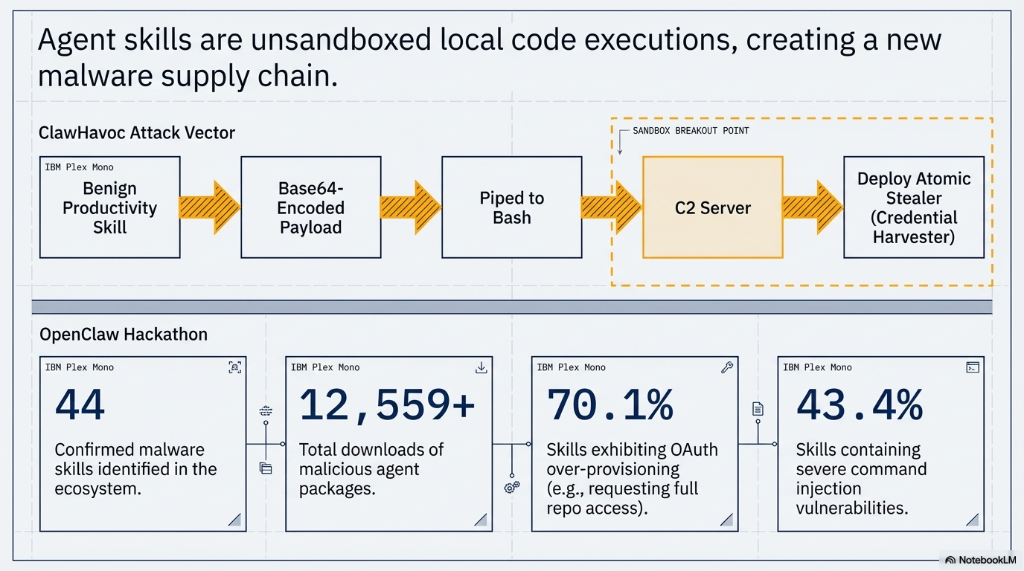
https://portfolio.upendrakumar.com/

Slide 5
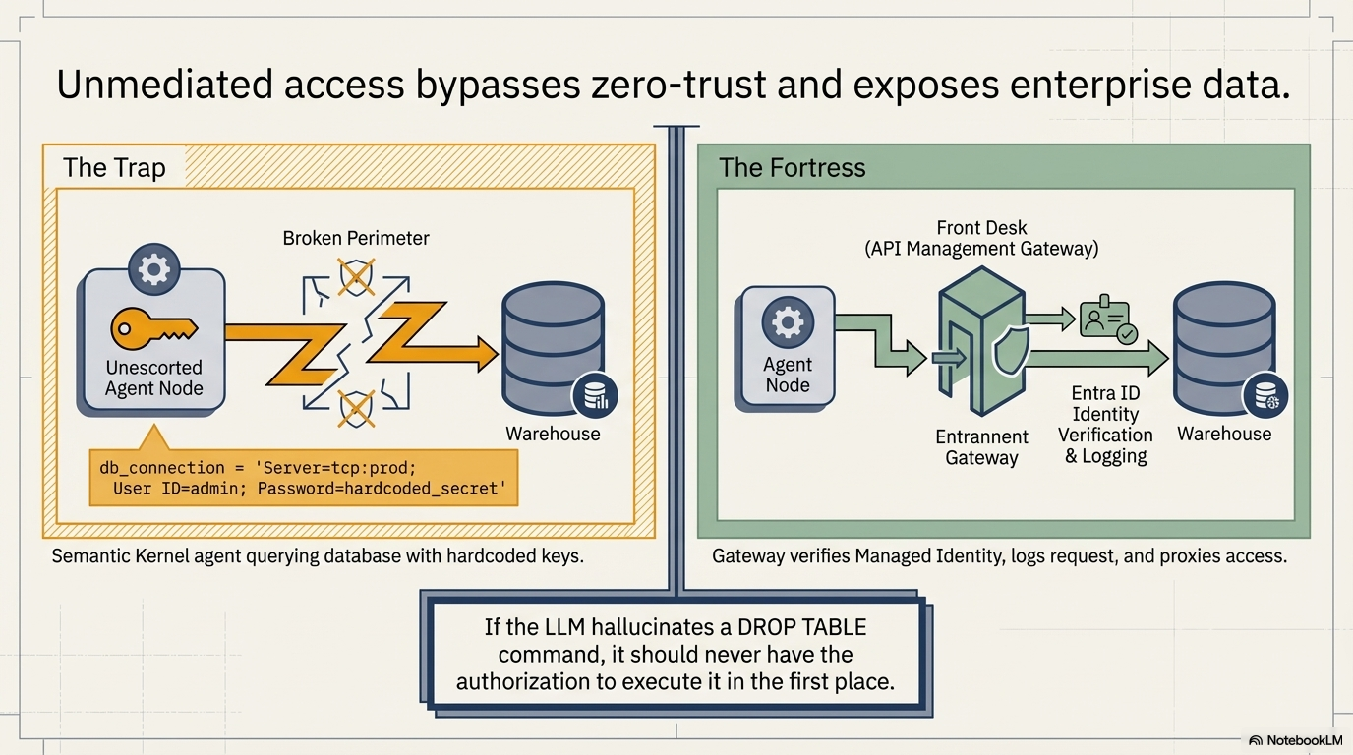
https://portfolio.upendrakumar.com/

Slide 6
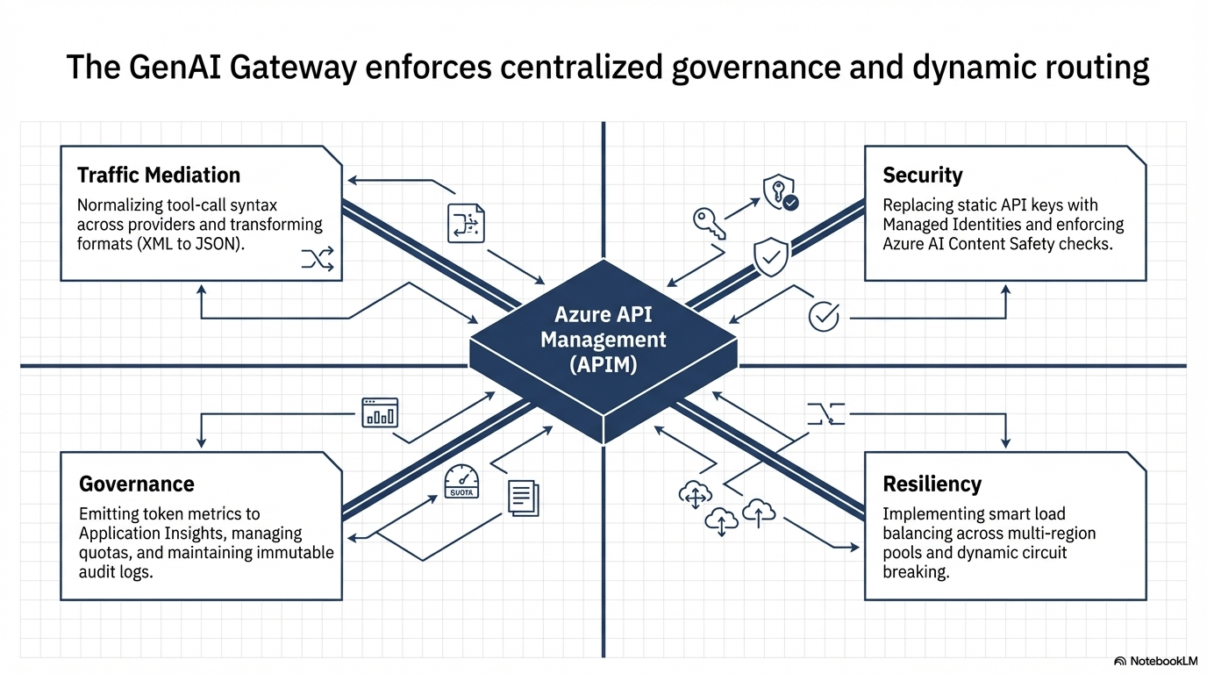
https://portfolio.upendrakumar.com/

Slide 7
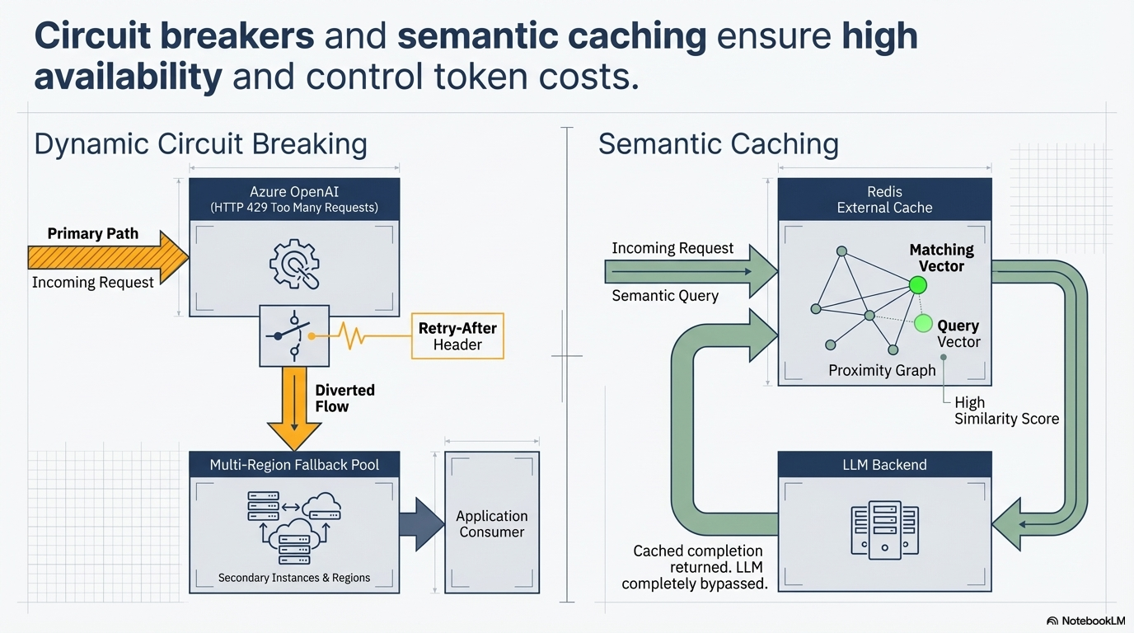
https://portfolio.upendrakumar.com/

Slide 8
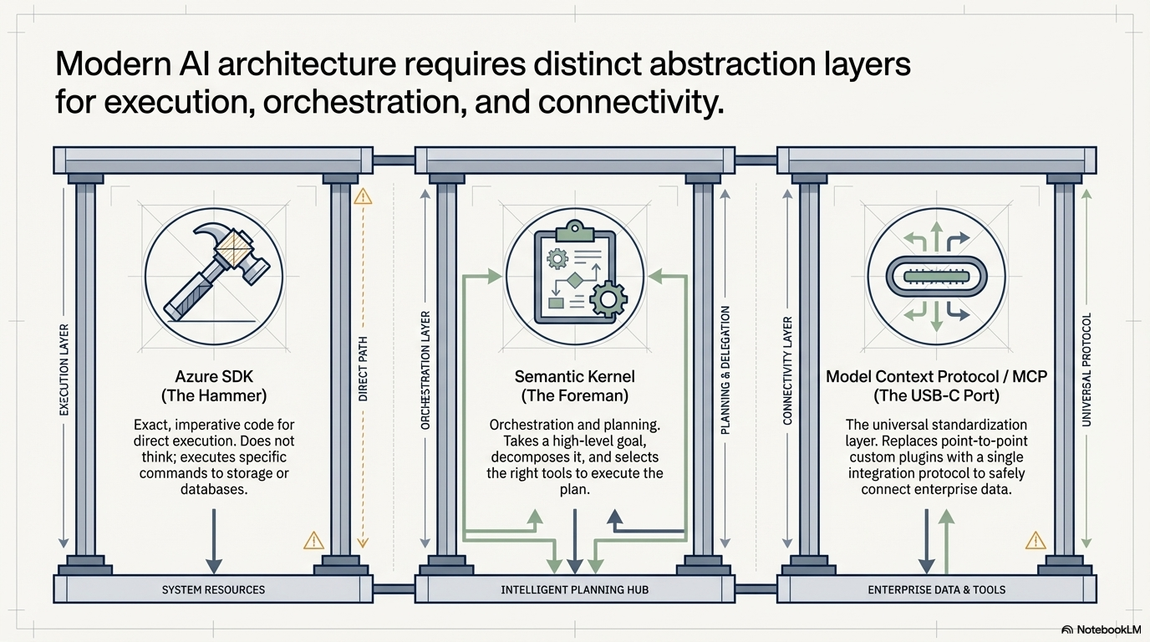
https://portfolio.upendrakumar.com/

Slide 9
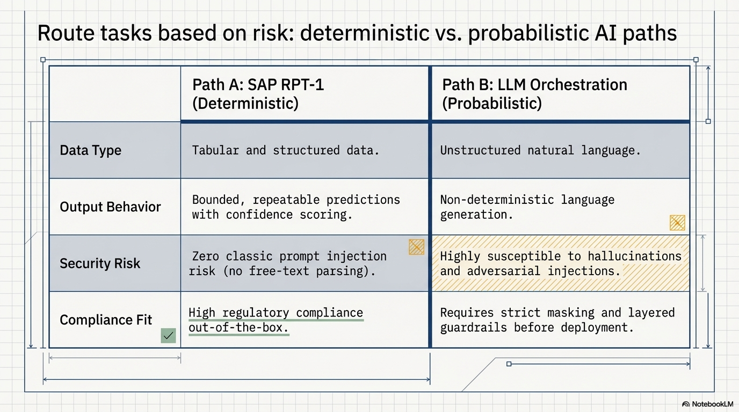
https://portfolio.upendrakumar.com/

Slide 10
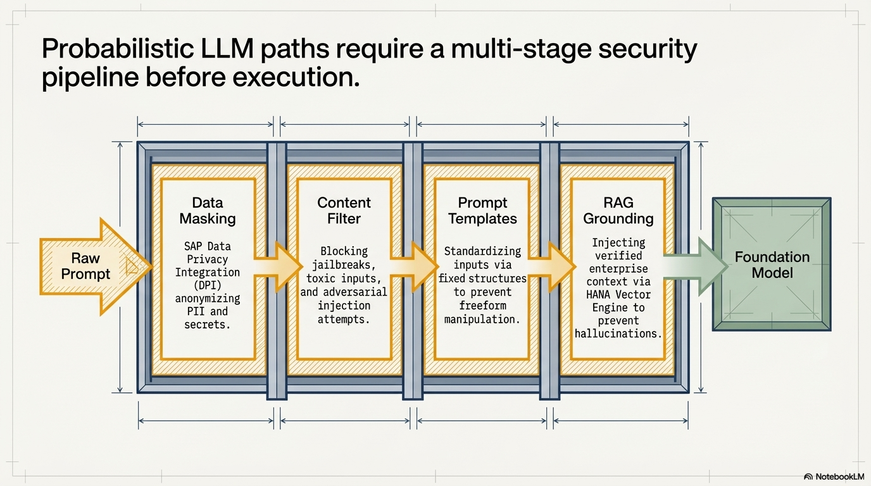
https://portfolio.upendrakumar.com/

Slide 11
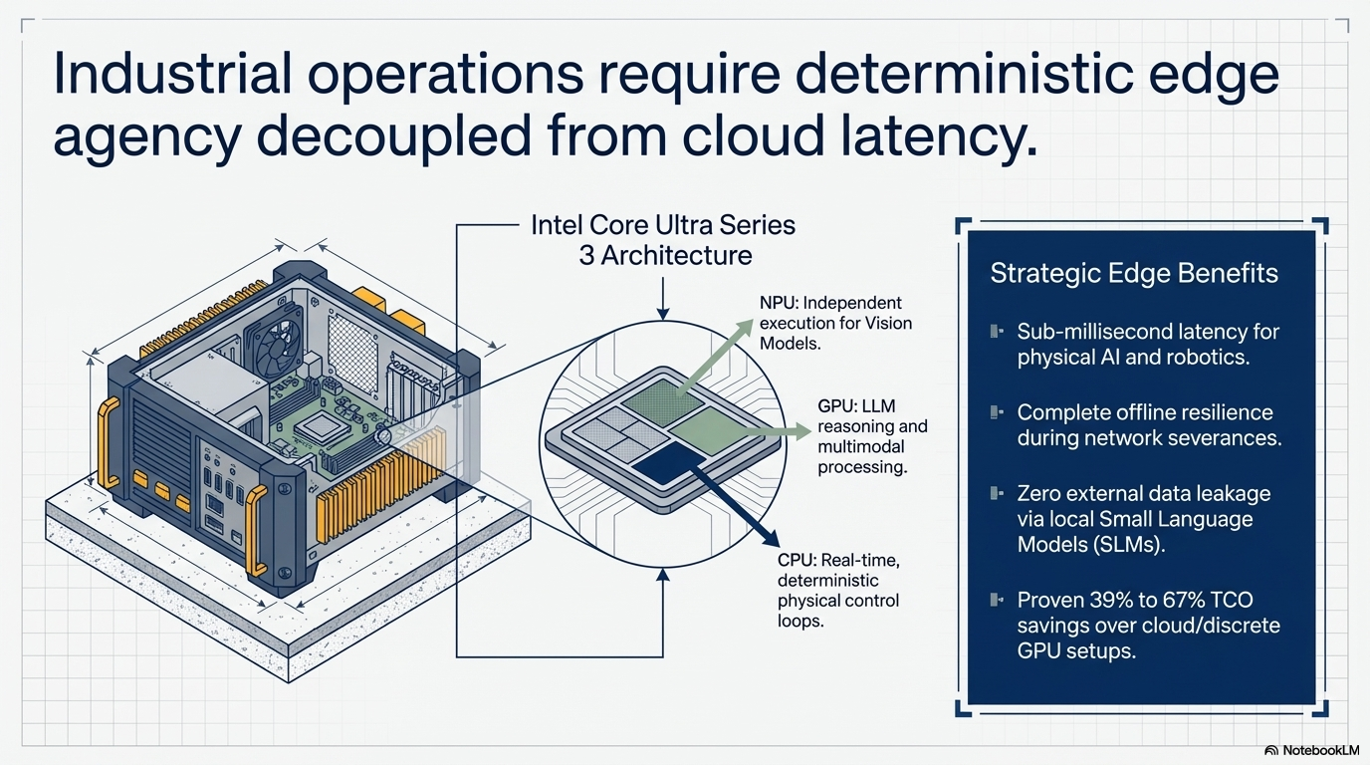
https://portfolio.upendrakumar.com/

Slide 12
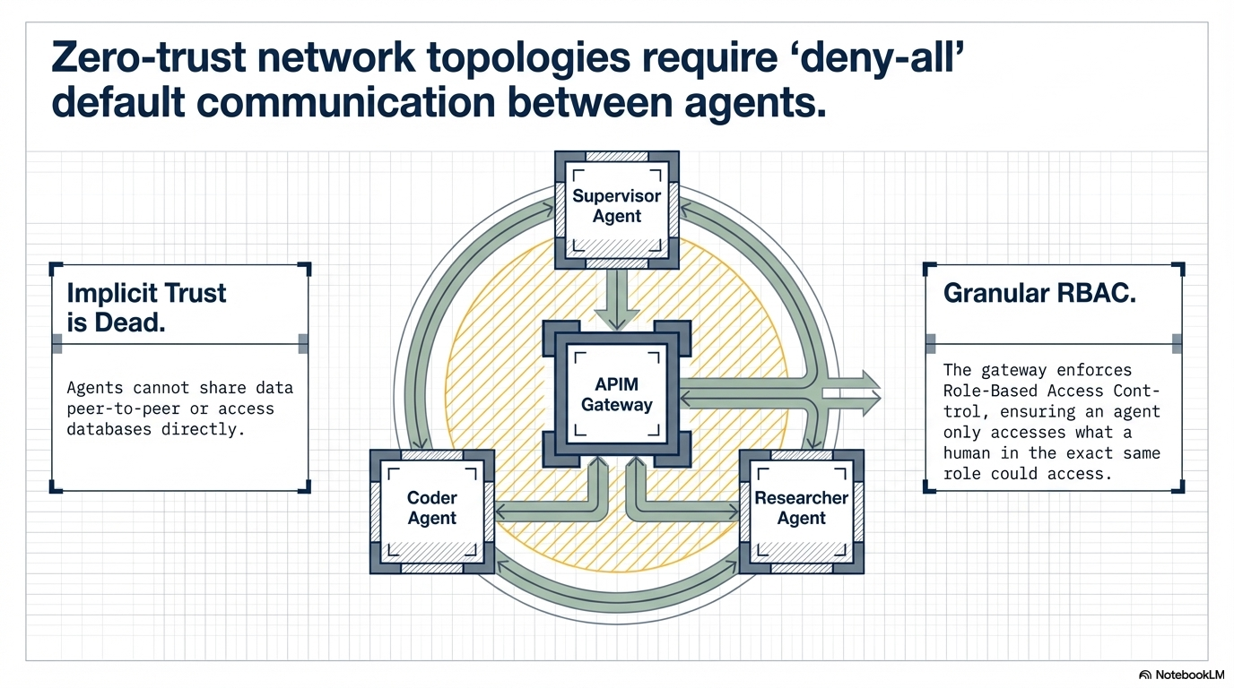
https://portfolio.upendrakumar.com/

Slide 13
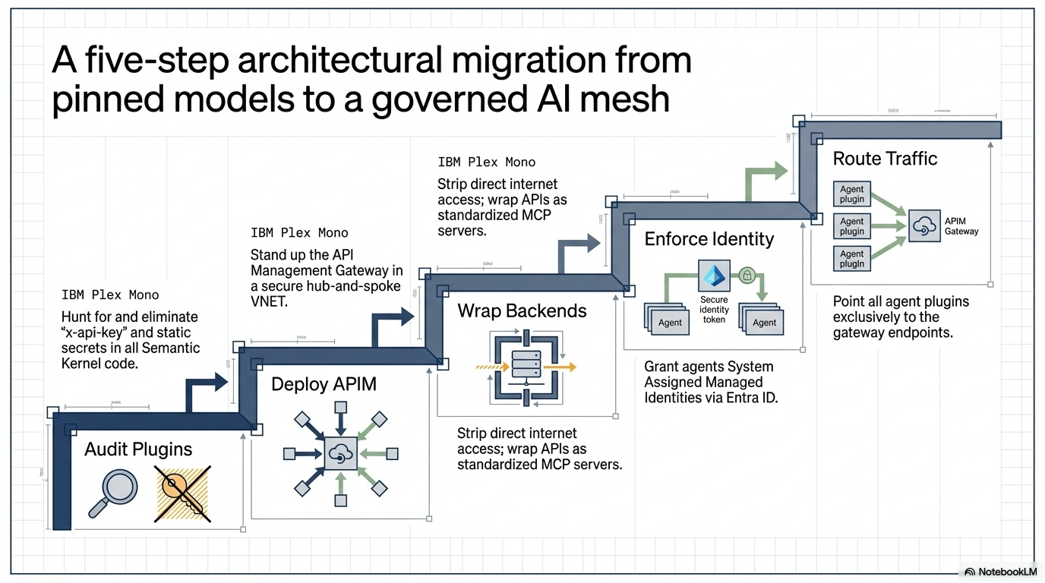
https://portfolio.upendrakumar.com/

Slide 14
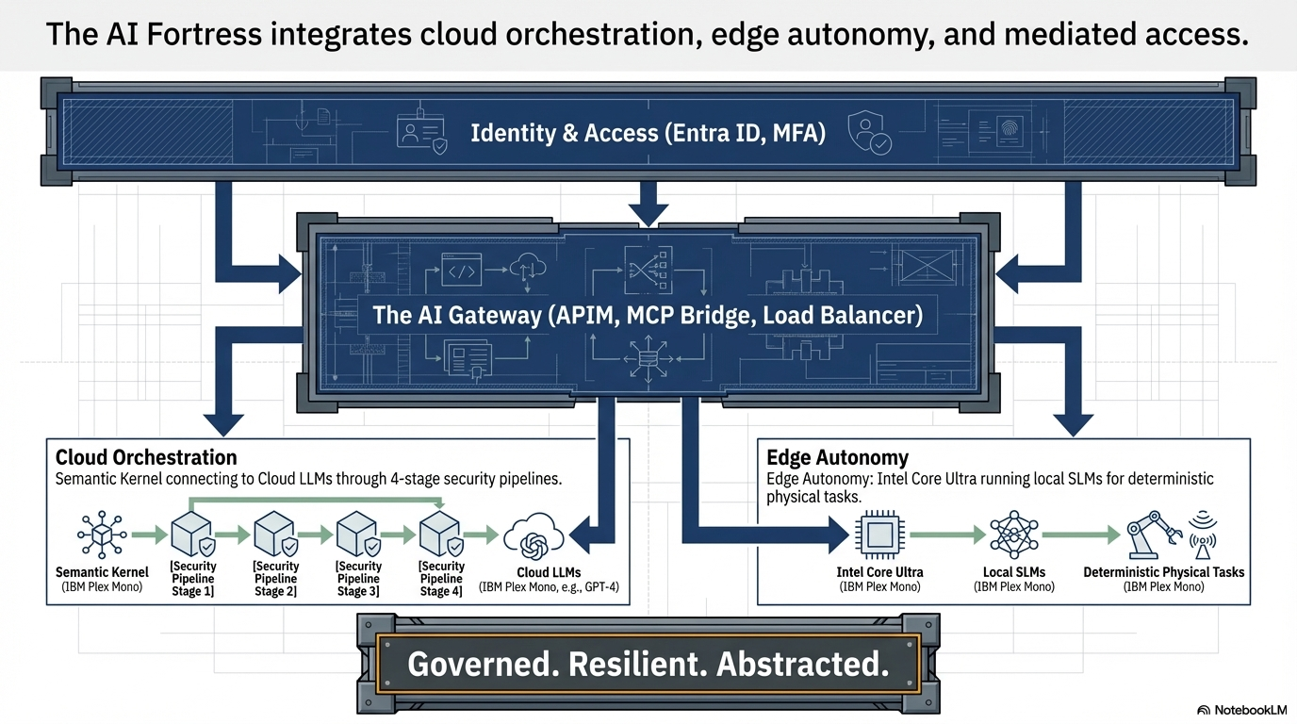
https://portfolio.upendrakumar.com/

Slide 15
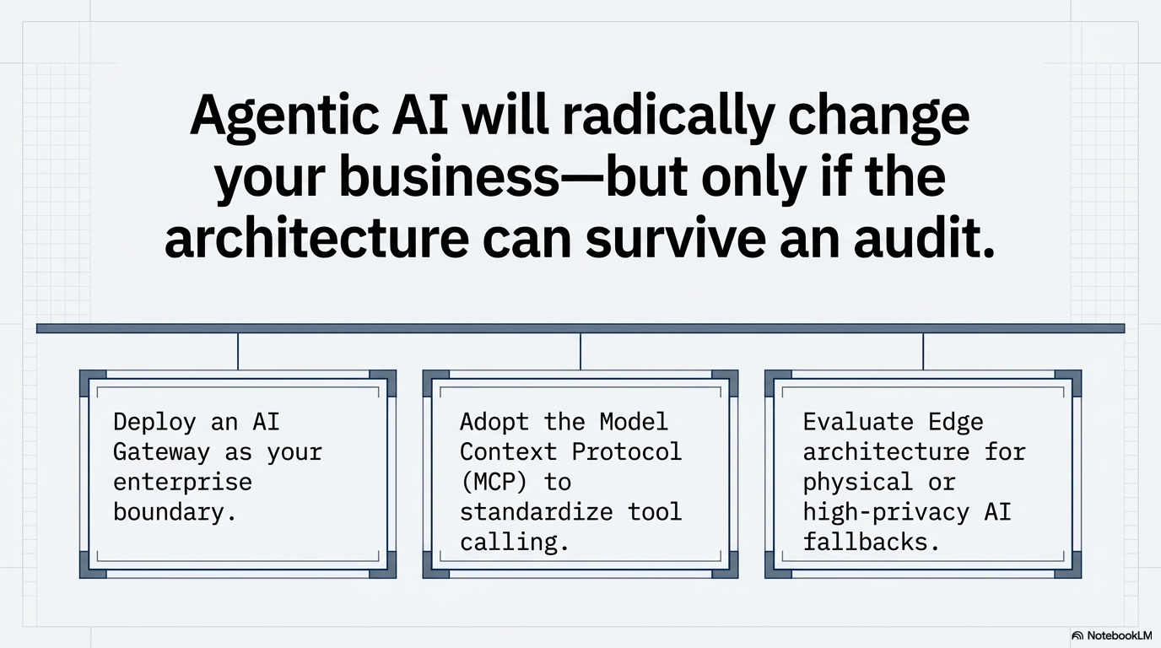
https://portfolio.upendrakumar.com/

