Slide 1

ESG HACK-TO-LEARN
Hack-to-Learn Assess the quality and Completeness of Sustainability reports
Chris Coulthrust
ccoulthrust@microsoft.com

Slide 2
Table of Contents
Agenda
Configuration of the Environment
Configure Services
Azure Search
Azure SQL
Azure Synapse
App Services
Azure Functions
All other Services
Train and Test Cognitive Services Model
(extra credit)Deploy Notebooks
Configure Notebooks to use services
Define the pipeline
Run the examples
Attempt to parse some different PDFs
Write to the Azure Search Index
Notes:
We also need to be able to govern the data no matter where it is stored, whether it’s at the edge in a data center, or in various types of databases, or across multiple clouds.

Slide 3
Agenda
Day 1
Overview of sustainability reporting frameworks
Review the use case of ESG data extraction
Review of the workshop technical approach and architecture
Training, deployment and observations of custom models
Deployment and testing of custom functions
Deployment and testing of individual services eg Azure Search
Integration of custom skills to Azure Search
Setup of the UI Application
Observation and testing of the end-to-end solution
Examples of extending and customizing the solution
Day 2
OpenAI
Notes:
We also need to be able to govern the data no matter where it is stored, whether it’s at the edge in a data center, or in various types of databases, or across multiple clouds.

Slide 4
The Problem Statement
Sustainability reports and their presentation and data are inconsistent
The relevant data in the reports can be difficult to extract.
Assessing the completeness and quality of the report is subjective.
Data engineers need a flexible and extensible platform for processing and evaluating sustainability documents.
Notes:
We also need to be able to govern the data no matter where it is stored, whether it’s at the edge in a data center, or in various types of databases, or across multiple clouds.

Slide 5

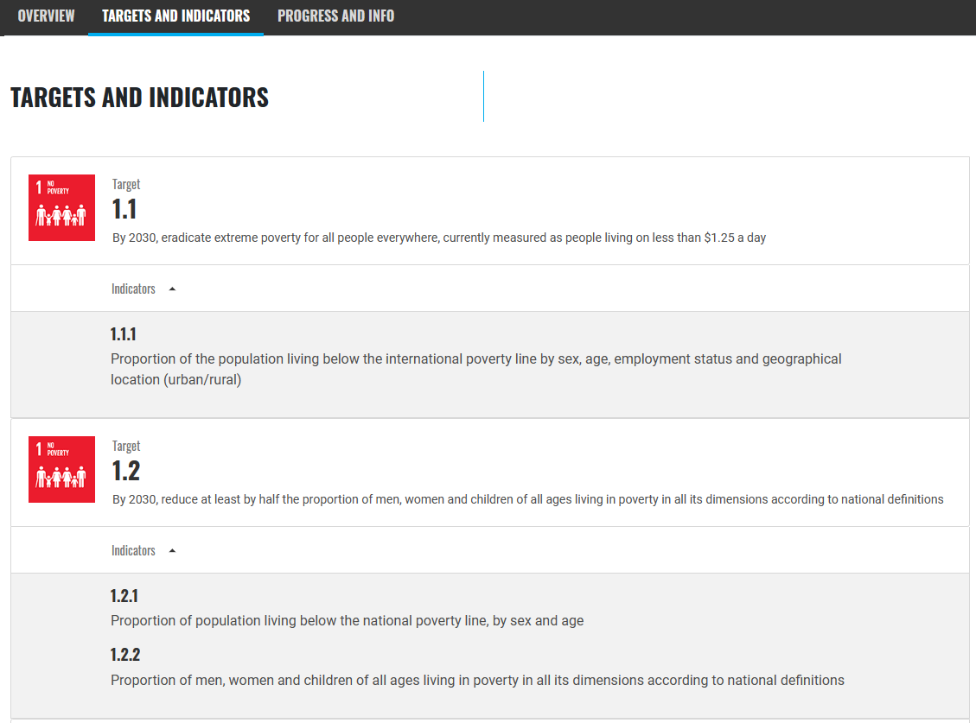
Understanding ESG Reporting Frameworks
The UN SDG (Sustainability Development Goals) are divided into 17 Goals , each goal has targets and indicators , these target is a what the goal is trying to achieve and the indicators is the count or proportion of the target achieved by the entity. The goal of these goals and targets is to measure the adherence of an entity to UN SDG Goals.
Certain UN SDG Goals universally to all entities and other goals are specific to the sector that the company operates in eg Manufacturing vs Healthcare will have different specific goals that may apply.
THE 17 GOALS | Sustainable Development (un.org)
Other reporting frameworks operate in a similar manner :
https://www.globalreporting.org
Task Force on Climate-Related Financial Disclosures | TCFD) (fsb-tcfd.org)
Task Force on Climate-Related Financial Disclosures | TCFD) (fsb-tcfd.org)
Notes:
We also need to be able to govern the data no matter where it is stored, whether it’s at the edge in a data center, or in various types of databases, or across multiple clouds.

Slide 6
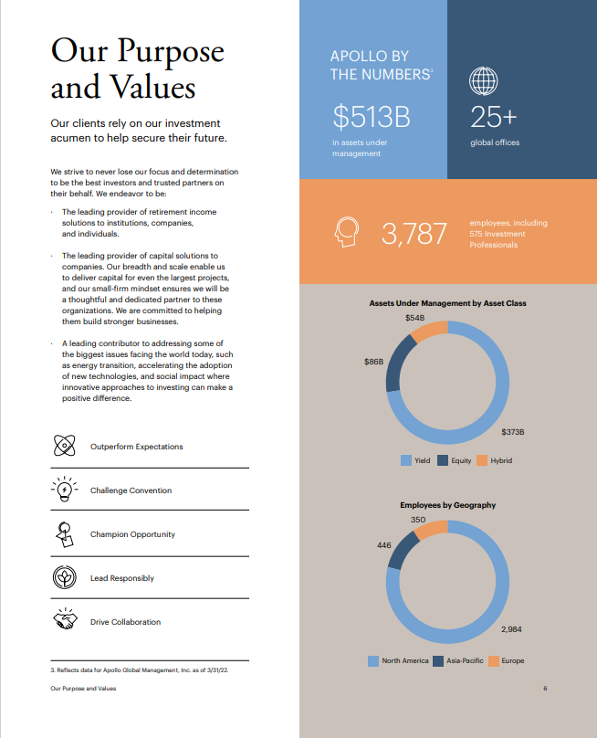

Sustainability Report Example
https://esg.apollo.com/_downloads/apollo-2021-esg-report-final.pdf
The challenges for data extraction and find reporting framework targets and indicators in the report are:
Key metrics expressed as info-graphics
Some indicators are embedded in text others in tables.
No standardization of visual reporting styles typical in unstructured data.
Document has references to other documents eg Apollo 2021 Form 10k with important data.
Need to summarize key facts and metrics required by reporting frameworks.
Localization & Language
Lots of other edge cases
Notes:
We also need to be able to govern the data no matter where it is stored, whether it’s at the edge in a data center, or in various types of databases, or across multiple clouds.

Slide 7
Data Extraction Example
OpenAI Prompt
##content##
Text from Document Here
#####
Please make a table summarizing Asset Under Management by Asset Class from the content Above |Asset Class|Value|
Structured Output
|Asset Class | Value |
|Yield|$373B|
|Equity|$86B|
|Hybrid|$54B|
https://esg.apollo.com/_downloads/apollo-2021-esg-report-final.pdf
Notes:
We also need to be able to govern the data no matter where it is stored, whether it’s at the edge in a data center, or in various types of databases, or across multiple clouds.

Slide 8
Classification Example
OpenAI Prompt
##content##
Text from Document Here
#####
Please classify the content with the top 3 of the of the following categories: [ Employee Allocation ,CEO Statement, Financial Reporting, Corporate Office, Branch Locations,]
Structured Output
[Financial Reporting,Employee Allocation]
https://esg.apollo.com/_downloads/apollo-2021-esg-report-final.pdf
Notes:
We also need to be able to govern the data no matter where it is stored, whether it’s at the edge in a data center, or in various types of databases, or across multiple clouds.

Slide 9
About the Architecture
This hack leverages several Azure services to demonstrate how services can integrated to produce an end to end solution. The architecture presented provides a framework for adding additional “skills” that
can derive insights about the documents and interrogate the document using the guidance of the different
reporting frameworks.
This workshop attempts to inspire the art of the possible by showing how Azure services can be orchestrated to develop a proof of value that can quickly scale to production. Some of the key features are :
Demonstrating Azure services that enable the building of data processing pipelines
Cracking documents with Azure Cognitive Search to quick create a data processing pipeline.
Using Azure Cognitive Services AI to train and deploy custom models into a pipeline.
Incorporating various services and tools into the pipeline to extract insights
Using structured rules to extract data from unstructured data
Notes:
We also need to be able to govern the data no matter where it is stored, whether it’s at the edge in a data center, or in various types of databases, or across multiple clouds.

Slide 10
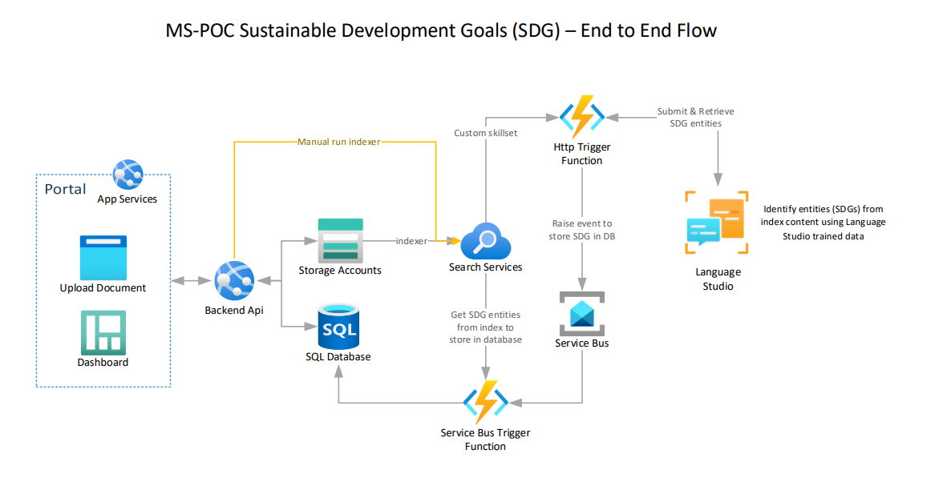
Explain the Architecture
Notes:
We also need to be able to govern the data no matter where it is stored, whether it’s at the edge in a data center, or in various types of databases, or across multiple clouds.

Slide 11
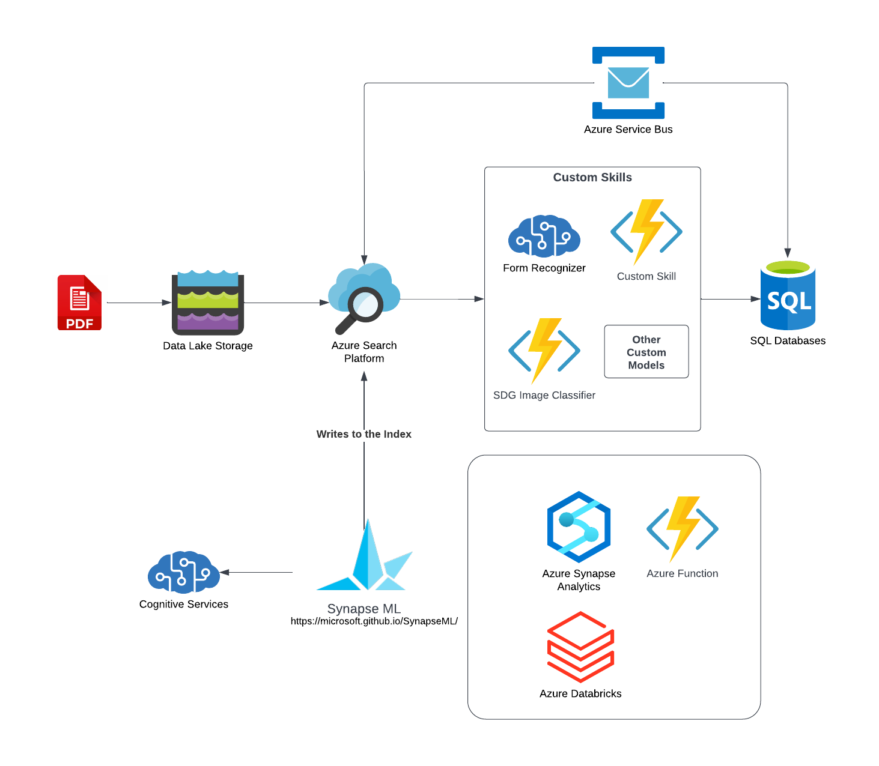
Version 2 : SynapseML + OpenAI
This architecture leverages SynapseML and OpenAI to process documents and extract insight and structured data. Python notebooks are provided with examples of how to integrate OpenAI with SynapseML to take data processing to another level.
Notes:
We also need to be able to govern the data no matter where it is stored, whether it’s at the edge in a data center, or in various types of databases, or across multiple clouds.

Slide 12
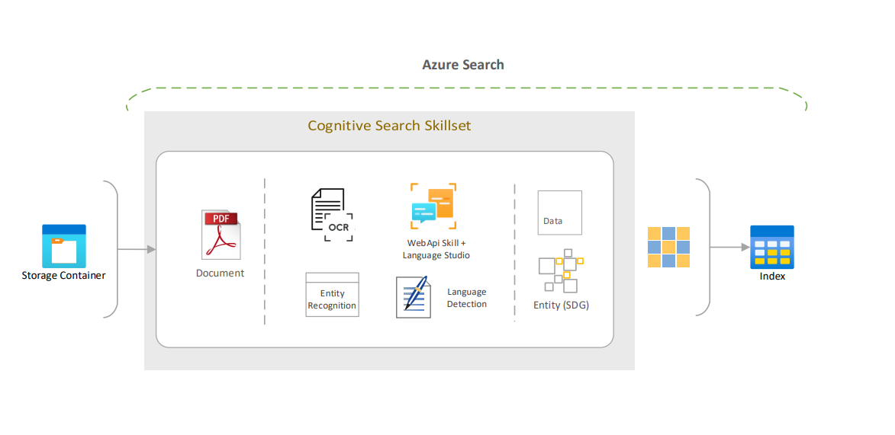
Explain the Architecture: Azure Search
Notes:
We also need to be able to govern the data no matter where it is stored, whether it’s at the edge in a data center, or in various types of databases, or across multiple clouds.

Slide 13
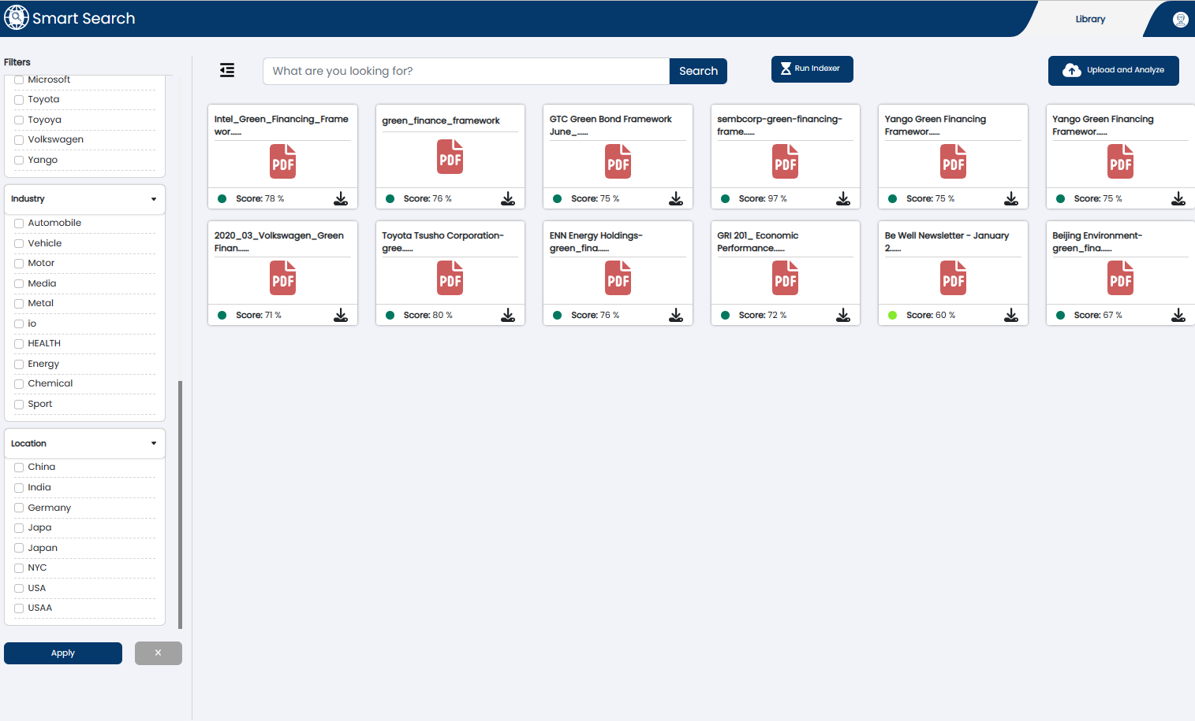
The Smart Search UI
The Smart Search UI
Deploying this UI is part of the lab. This UI will provide an interface to interact this the systems and deliver insights extracted from the Trained Model. This application can be customized as needed.
Notes:
We also need to be able to govern the data no matter where it is stored, whether it’s at the edge in a data center, or in various types of databases, or across multiple clouds.

Slide 14
Purpose of Azure Components
A quick overview of each of the Azure service and purpose of that serivice in the architecture
Azure App Services
Dash board and Document Uploading to Storage
Host Backend API Web Services
Azure Storage
General storage for documents and other data
Azure SQL Database
Storage of immediate data for the UI
Azure Search Services
Document processing pipeline
Document enrichment & Custom Search Skills
Search Interface
Azure Function
Creating Custom Skills for Azure Search
Azure Service Bus
Messaging Layer
Azure Cognitive Services
Custom AI Models for Azure Search Custom Skill
Databricks+ SynapseML
An additional technique for creating pipeline processing using SynapseML
Notes:
We also need to be able to govern the data no matter where it is stored, whether it’s at the edge in a data center, or in various types of databases, or across multiple clouds.

Slide 15
Lab Tasks Description
Deploy and Configure Azure Components
The lab guides are in the github repository for this project
Azure Search
Create a search service in the portal - Azure Cognitive Search | Microsoft Learn
Store Search Key and URL Endpoint
Service Bus
Deploy Service Bus
Link for Service Bus Here
Azure Functions
Deploy Function for Custom Skill
Deploy Service Bus Trigger Function
Azure Cognitive Services
Deploy Cognitive Language Services
Azure Storage
Create an Azure Storage Account
Notes:
We also need to be able to govern the data no matter where it is stored, whether it’s at the edge in a data center, or in various types of databases, or across multiple clouds.

Slide 16
Lab Tasks
Deploy and Configure
6. Azure SQL Database
Deploy Azure SQL Database
App Services
App Services
Link for App Services
Azure Synapse (extra)
a. Used for pipeline processing using SynapseML
Notes:
We also need to be able to govern the data no matter where it is stored, whether it’s at the edge in a data center, or in various types of databases, or across multiple clouds.

Slide 17
The Tools & Technique
Ingest and crack documents with Azure Search & Azure Cognitive Services
Use Azure Search Custom Skills & Azure Functions enhance data.
The SDG Guidelines are used as “rules” to assess the completeness and quality of reports
The interface shows how to bring together the extracted and enhanced data to assess ESG report quality using ESG framework guidelines.
The platform can be extended with more skills and other processing techniques to improve the assessments.
(extra) Using SynapseML to extract document insights and write to search index & data store.
The sustainability frameworks guidelines are translated into rules with which the sustainability documents are evaluated. With this technique gaps in the reporting can be identified
Notes:
We also need to be able to govern the data no matter where it is stored, whether it’s at the edge in a data center, or in various types of databases, or across multiple clouds.

Slide 18
Lab Tasks
Upload Artifacts
1. Azure SQL Database
Setup necessary permissions
Run Script to hydrate database
App Services
Deploy the Web Services and Web Site
Azure Functions
Configure and Deploy the functions
Azure Language
Using Language Studio
Upload training data
Upload tags
Train and Deploy Model
Notes:
We also need to be able to govern the data no matter where it is stored, whether it’s at the edge in a data center, or in various types of databases, or across multiple clouds.

Slide 19
Remaining Items for the Lab
1. ARM Template
Azure SQL (need)
Azure Synapse (need)
Service Bus (have)
other Services (have)
App Services
App Services (have)
Link for App Services
Database Scripts (need)
Azure Function Code (need)
Notebooks for Extra Credit (in dev)
Training and Labelling instructions (have data need instructions
Notes:
We also need to be able to govern the data no matter where it is stored, whether it’s at the edge in a data center, or in various types of databases, or across multiple clouds.

Slide 20
Appendix
Links
Links are in the lab.
Stretch Goal
Tutorial: Index at scale (Spark) - Azure Cognitive Search | Microsoft Learn
Notes:
We also need to be able to govern the data no matter where it is stored, whether it’s at the edge in a data center, or in various types of databases, or across multiple clouds.

Slide 21
Appendix
Create and Hydrate a Data Catalog
Tutorial: Index at scale (Spark) - Azure Cognitive Search | Microsoft Learn
Hydrate the data glossary with your example data
Modify the code to point the extracted GRI into the Data Glossary
Hydrate the Data Glossary from the parsed data
Notes:
We also need to be able to govern the data no matter where it is stored, whether it’s at the edge in a data center, or in various types of databases, or across multiple clouds.

Slide 22
Notebook 3
Custom Vision Pipeline
Objective : To Identify SDG Icons in a document and tag the document with the metadata of the identified images.
Find the icons in the document ontology
Train a Custom Vision Model with the SDG Icons
Upload Images
Tag Images
Deploy Model
Use the Model in the document extraction process to add the SDG logo tags into the document.
Notes:
We also need to be able to govern the data no matter where it is stored, whether it’s at the edge in a data center, or in various types of databases, or across multiple clouds.

Slide 23



Popular transaction processing applications that companies are now running on the cloud
Employees
Front Office
Operations
BackOffice
Marketing
Finance
Product line 1
Sales
Credit verification
Product line 2
Procurement
Supply Chain
…
Customers, partners, devices
Suppliers
Service
Product line n
HR
Planning
Shipping
Equipment

Slide 24
Data Governance Operating Model
Data Governance vision and strategy
People
Processes
Policies
Technology
Data
Create
Protect
Store
Use
Maintain
Archive
Destroy
 | Ungoverned | Fully governed
People | Roles and responsibilities of data stewards, IT ops and security left undefined | Data steward roles and responsibilities defined and collaboration with IT and security teams operational
Policies | No data governance classification schemes on confidentiality & retention | Data governance classification scheme for both confidentiality and retention
 | No policies & rules to govern data quality, access, privacy or retention | Policies & rules consolidated in the data catalog using classification schemes and enforced everywhere
Tech | No data catalog with auto data discovery, profiling & sensitive data detection, or lineage captured | Data catalog with auto data discovery, profiling & sensitive data detection and lineage is captured automatically and is always kept up to date
 | Data curation is done manually using multiple tools and process oriented | Data stewardship tools available as part of the data fabric software
 | Data access or privacy enforcement is done manually in ad-hoc manner | Data access and privacy enforced in all systems in an automated way
Notes:
So what is a data governance framework?
It’s an end-to-end solution that can govern data through its entire lifecycle across all stores in the edge, data centers, and multiple clouds.
If you read this model from top to bottom, you see that a framework starts with a vision and strategy, then you put your people, processes, policies, and technology in place to govern the data throughout the lifecycle. And along the bottom you see the technologies that support the framework.

Slide 25
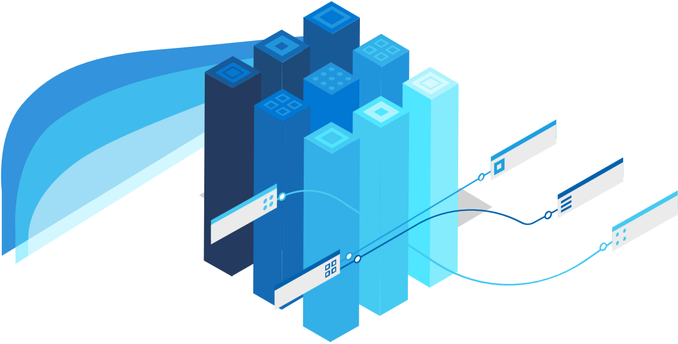

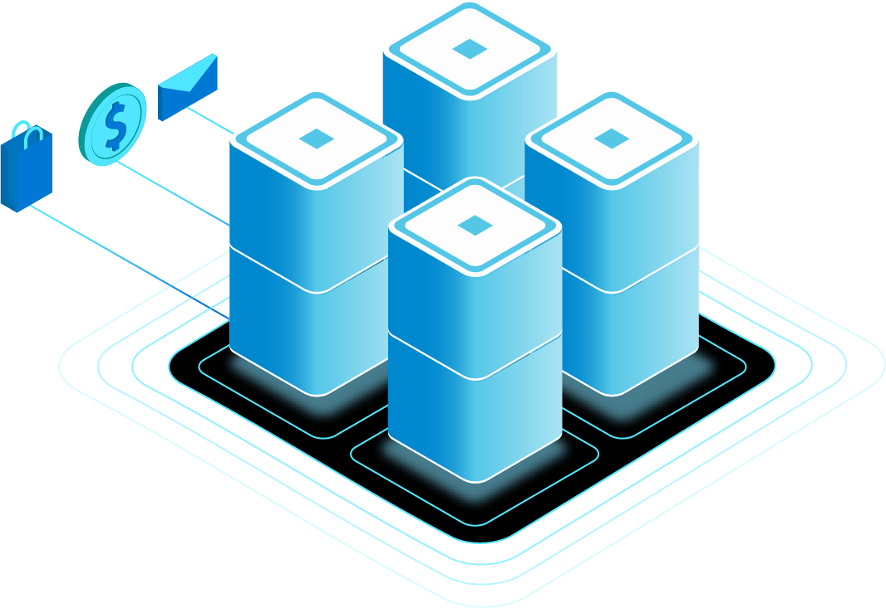
Azure Purview
UNIFIED DATA GOVERNANCE
Create a unified map of your data across hybrid sources
On-prem
Discover data that powers business insights
Multicloud
Gain insight into sensitive data across your organization
SaaS

Slide 26



Automated Scanning and Classification at Cloud Scale
Approach
Serverless, fully managed, horizontally scaled cloud run-time
Self-hosted run-time for on-prem system within corp. firewalls
Metadata
Data + Metadata
Data Map
Scale
60B+
Data Assets Discovered
Serverless Cloud
Run-time
Azure
On-prem
Self-hosted
Run-time
On-prem
Other Clouds
Cloud
SaaS
Applications
Microsoft Confidential: Content is shared under NDA
Notes:
See all the customer related data in different storage such as azure data lake, 6 in Teradata, 3 power BI report.

Slide 27
Notebook 2
Create and Hydrate a Data Catalog
Create a Data Glossary
Create an example hierarchy to send into the Data Glossary
Hydrate the data glossary with your example data
Modify the code to point the extracted GRI into the Data Glossary
Hydrate the Data Glossary from the parsed data
Notes:
We also need to be able to govern the data no matter where it is stored, whether it’s at the edge in a data center, or in various types of databases, or across multiple clouds.

Slide 28
GRI Guideline Structure
Notes: DO NOT USE THIS SLIDE
Explain the GRI Guidelines and how it will be used
Explain how other reporting frameworks can be used
Explain the usage of the data dictionary
Old Version
Ingest and Extract the GRI Reporting guideline documents
Store GRI guidelines into the Purview Data Glossary
Ingest the list of company information with sectors etc.
Use Bing Search API to find Sustainability reports
Evaluate Sustainability reports against the rules
Show the pipeline of rule
Notes:
We also need to be able to govern the data no matter where it is stored, whether it’s at the edge in a data center, or in various types of databases, or across multiple clouds.

