Slide 1


ESG HACK-TO-LEARN
In Partnership with
Hack-to-Learn Assess the quality and Completeness of Sustainability reports
Hack Development Team
Sreenivas Vemulapalli
sreenivas.v@emtecinc.com
Sachin Ghaisas
sachin.ghaisas@emtecinc.com
Naresh Kothur
naresh.kothur@emtecinc.com
Sandeep Warankar
sandeep.warankar@emtecinc.com
Chris Coulthrust
ccoulthrust@microsoft.com

Slide 2













Emtec at a glance
Empowering organizations to thrive via digital technology and process transformation for over 25 years using our ‘Client for Life’ approach
25+ years in business | 10k+ clients | 1600+ consultants 300 in US & Canada 1300+ in India
$140m in revenue | 100+ active engagements | 2.5k+ projects
Industries
Finance
Energy & Utilities
Retail
Manufacturing
Logistics
Government
Education
Functions
Finance
Operations
Human Resource
C-Suite
Sales & Marketing
Information Technology

Slide 3






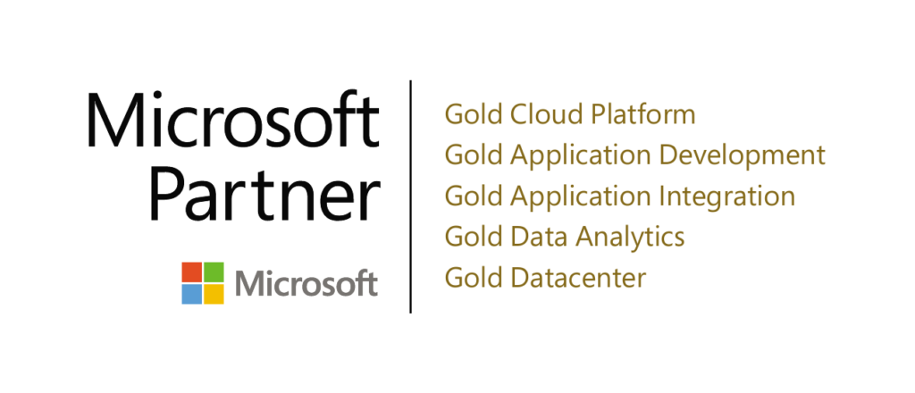




Emtec Microsoft Practice
3M+
1M+
50+
500+
Azure certified professionals
Man-hours of work in Microsoft platform
Man-hours of work in Microsoft Azure Platform
Microsoft developers
10+
20+
5+
CRM Implementations
Enterprise Integration Projects
Enterprise Data Lake Implementations
Expertise
Azure Data Factory
DataBricks
Kafka
Business Intelligence – Power BI, Tableau, Qliksense etc.
ADLS Gen 1 & 2
Delta Lakes
Security & Insights
Data Flows
Data Warehouse – YellowBrick, Synapse, Redshift etc.
Spark Streaming
Enterprise Integration – Logic Apps, Dell Boomi, Mule Soft etc.
Data Governance – Azure Purview, Informatica, Profisee, Alation etc.
Partnerships

Slide 4
The Problem Statement
Sustainability reports and their presentation and data are inconsistent
The relevant data in the reports can be difficult to extract.
Assessing the completeness and quality of the report is subjective.
Data engineers need a flexible and extensible platform for processing and evaluating sustainability documents.
Notes:
We also need to be able to govern the data no matter where it is stored, whether it’s at the edge in a data center, or in various types of databases, or across multiple clouds.

Slide 5
Agenda
Day 1
Overview of sustainability reporting frameworks
Review the use case of ESG data extraction
Review of the workshop technical approach and architecture
Training, deployment and observations of custom models
Deployment of Web API and UI
Discussion Integration of custom skills to Azure Search
Observation and testing of the end-to-end solution
Examples of how to extend and customizing the solution
Day 2
Continue Hack from Day 1
OpenAI & SynapseML Document Processing
Notes:
We also need to be able to govern the data no matter where it is stored, whether it’s at the edge in a data center, or in various types of databases, or across multiple clouds.

Slide 6

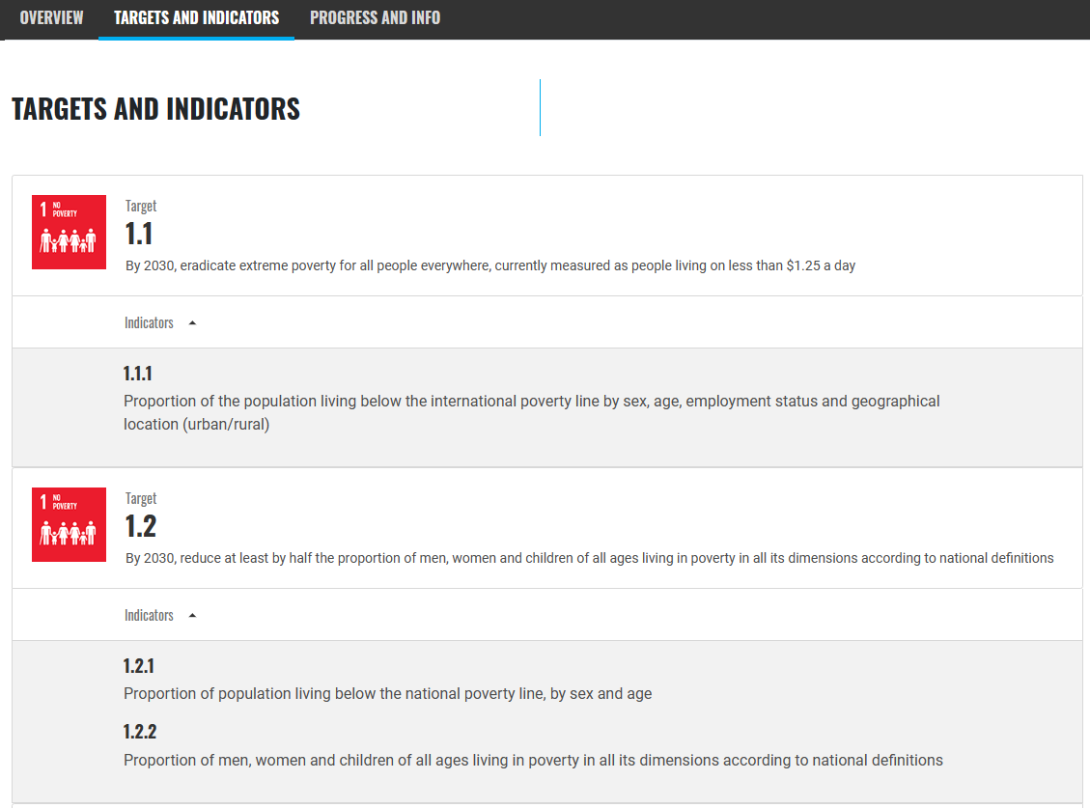
Understanding ESG Reporting Frameworks
The UN SDG (Sustainability Development Goals) are divided into 17 Goals , each goal has targets and indicators , these target is a what the goal is trying to achieve and the indicators is the count or proportion of the target achieved by the entity. The goal of these goals and targets is to measure the adherence of an entity to UN SDG Goals.
Certain UN SDG Goals universally to all entities and other goals are specific to the sector that the company operates in eg Manufacturing vs Healthcare will have different specific goals that may apply.
THE 17 GOALS | Sustainable Development (un.org)
Other reporting frameworks operate in a similar manner :
https://www.globalreporting.org
Task Force on Climate-Related Financial Disclosures | TCFD) (fsb-tcfd.org)
Task Force on Climate-Related Financial Disclosures | TCFD) (fsb-tcfd.org)
Notes:
We also need to be able to govern the data no matter where it is stored, whether it’s at the edge in a data center, or in various types of databases, or across multiple clouds.

Slide 7
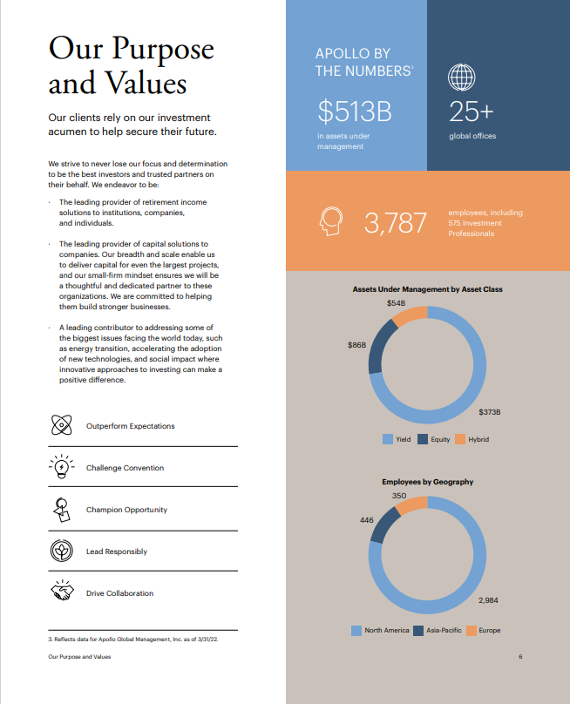

Sustainability Report Example
https://esg.apollo.com/_downloads/apollo-2021-esg-report-final.pdf
The challenges for data extraction and find reporting framework targets and indicators in the report are:
Key metrics expressed as info-graphics
Some indicators are embedded in text others in tables.
No standardization of visual reporting styles typical in unstructured data.
Document has references to other documents eg Apollo 2021 Form 10k with important data.
Need to summarize key facts and metrics required by reporting frameworks.
Localization & Language
Lots of other edge cases
Notes:
We also need to be able to govern the data no matter where it is stored, whether it’s at the edge in a data center, or in various types of databases, or across multiple clouds.

Slide 8
Data Extraction Example
OpenAI Prompt
##content##
Text from Document Here
#####
Please make a table summarizing Asset Under Management by Asset Class from the content Above |Asset Class|Value|
Structured Output
|Asset Class | Value |
|Yield|$373B|
|Equity|$86B|
|Hybrid|$54B|
https://esg.apollo.com/_downloads/apollo-2021-esg-report-final.pdf
Notes:
We also need to be able to govern the data no matter where it is stored, whether it’s at the edge in a data center, or in various types of databases, or across multiple clouds.

Slide 9
Classification Example
OpenAI Prompt
##content##
Text from Document Here
#####
Please classify the content with the top 3 of the of the following categories: [ Employee Allocation ,CEO Statement, Financial Reporting, Corporate Office, Branch Locations,]
Structured Output
[Financial Reporting,Employee Allocation]
https://esg.apollo.com/_downloads/apollo-2021-esg-report-final.pdf
Notes:
We also need to be able to govern the data no matter where it is stored, whether it’s at the edge in a data center, or in various types of databases, or across multiple clouds.

Slide 10
About the Architecture
This hack leverages Azure Cloud Services deliver and end to end solution ESG document processing solution. The architecture presented provides a framework for adding additional “skills” that can derive insights about the documents and interrogate the document using the guidance of the different reporting frameworks.
This workshop attempts to inspire the art of the possible by showing how Azure Cloud , Azure Cognitive Services + OpenAI can be orchestrated into a proof of value that can quickly scale to production. Key features are :
Demonstrating Azure Cognitive Services that enable the building of data processing pipelines
Cracking & Enhancing documents with Azure Cognitive Search
Using Azure Cognitive Services AI to train and deploy custom models into a pipeline.
Incorporating various services and tools into the pipeline to extract insights
Using OpenAI + Structured Prompts + Rules to extract data from unstructured data and classify documents
Notes:
We also need to be able to govern the data no matter where it is stored, whether it’s at the edge in a data center, or in various types of databases, or across multiple clouds.

Slide 11
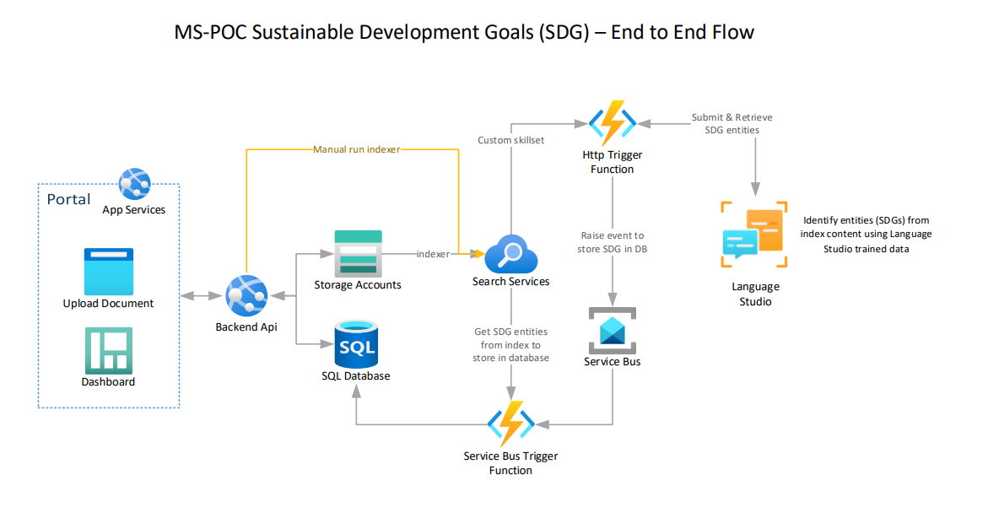
Explain the Architecture
Notes:
We also need to be able to govern the data no matter where it is stored, whether it’s at the edge in a data center, or in various types of databases, or across multiple clouds.

Slide 12
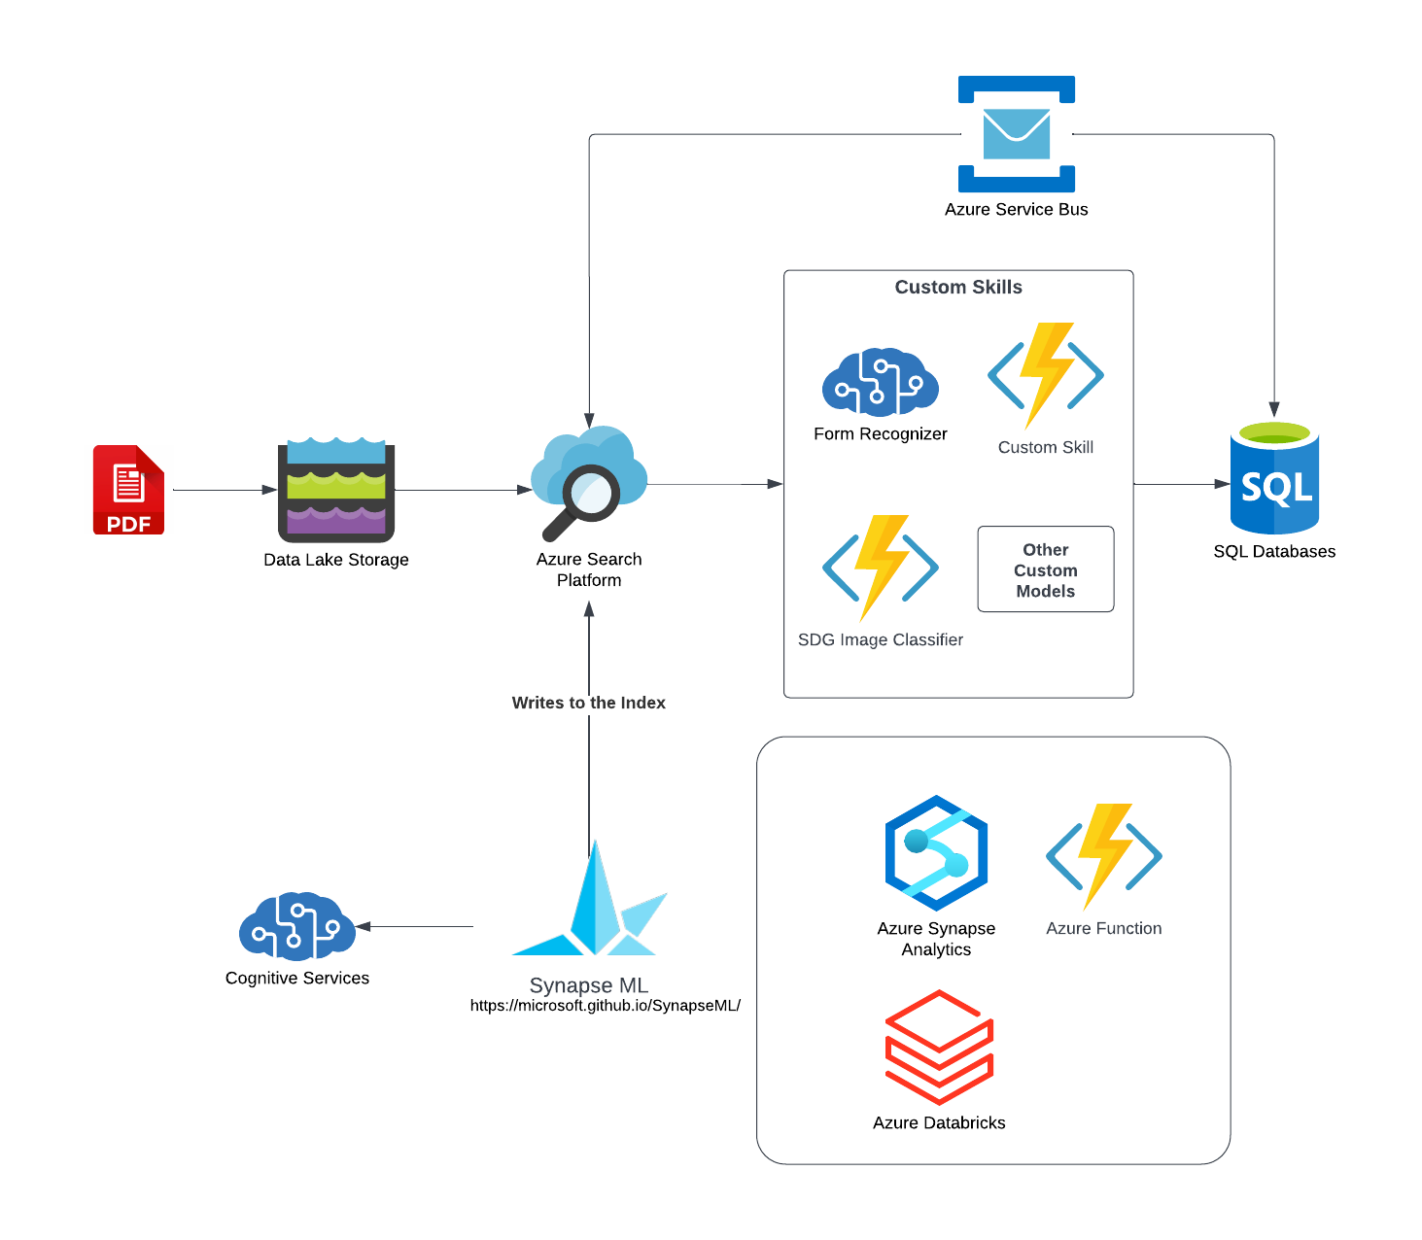
Day 2 : SynapseML + OpenAI
This architecture leverages SynapseML and OpenAI to process documents and extract insight and structured data. Python notebooks are provided with examples of how to integrate OpenAI with SynapseML to take data processing to another level.
Notes:
We also need to be able to govern the data no matter where it is stored, whether it’s at the edge in a data center, or in various types of databases, or across multiple clouds.

Slide 13
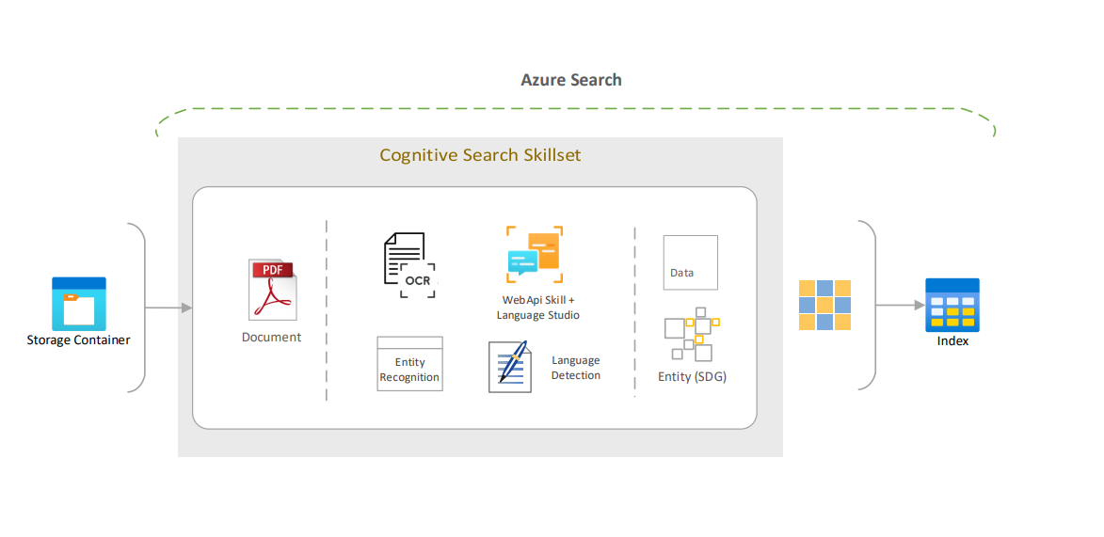
Explain the Architecture: Azure Search
Notes:
We also need to be able to govern the data no matter where it is stored, whether it’s at the edge in a data center, or in various types of databases, or across multiple clouds.

Slide 14
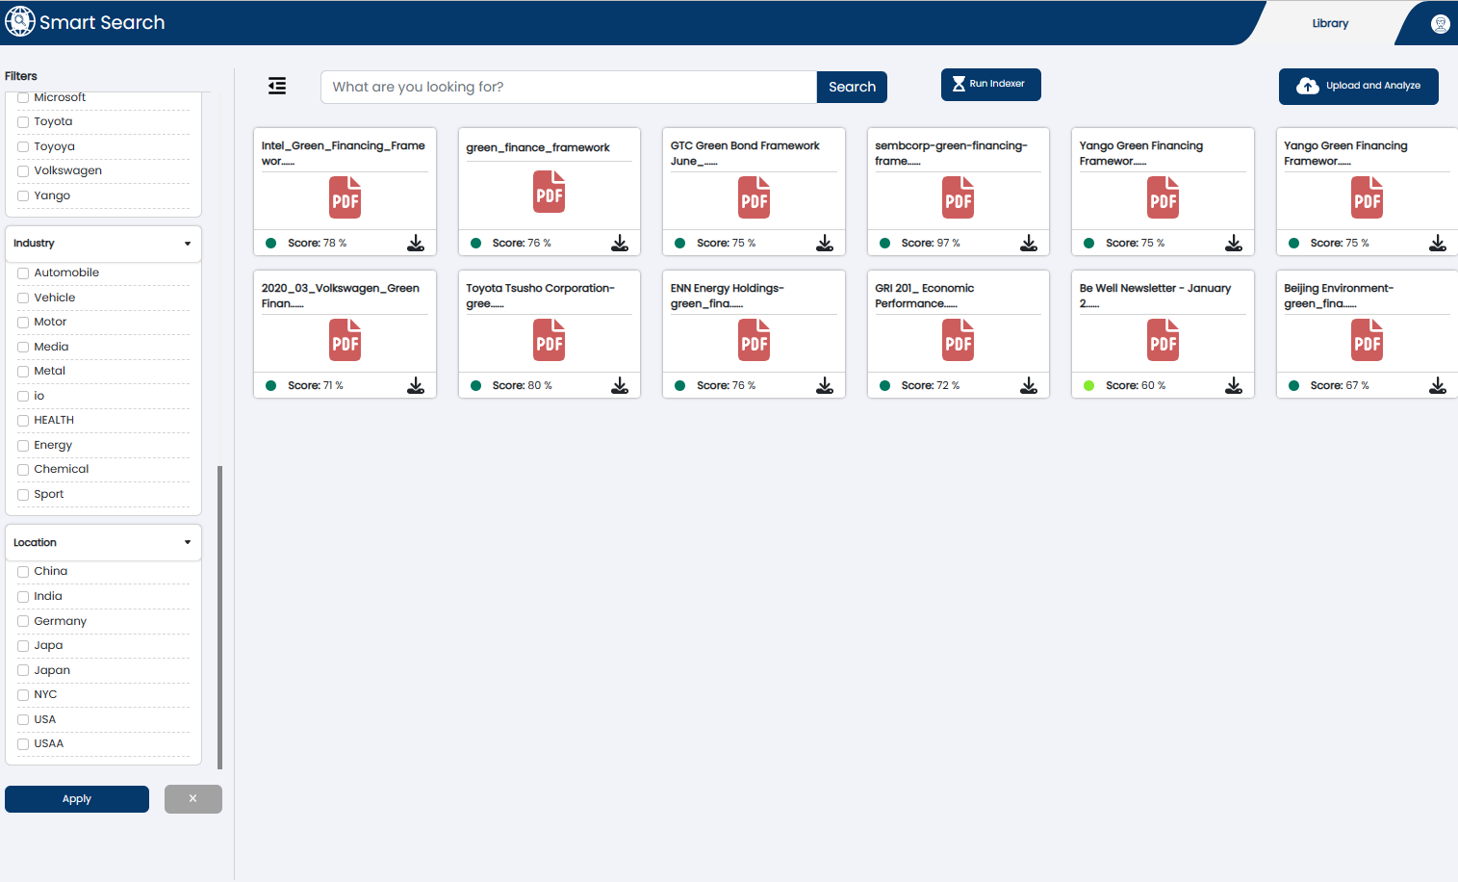
The Smart Search UI
The Smart Search UI
Deploying this UI is part of the lab. This UI will provide an interface to interact this the systems and deliver insights extracted from the Trained Model. This application can be customized as needed.
Notes:
We also need to be able to govern the data no matter where it is stored, whether it’s at the edge in a data center, or in various types of databases, or across multiple clouds.

Slide 15
Start Hacking !
Deploy and Configure Azure Components
The lab guides are in the GitHub repository for this project
https://github.com/appliedcognetics/esgWorkshop/tree/main/src/workshop
Notes:
We also need to be able to govern the data no matter where it is stored, whether it’s at the edge in a data center, or in various types of databases, or across multiple clouds.

Slide 16
Appendix : Purpose of Azure Components
A quick overview of each of the Azure service and purpose of that serivice in the architecture
Azure App Services
Dash board and Document Uploading to Storage
Host Backend API Web Services
Azure Storage
General storage for documents and other data
Azure SQL Database
Storage of immediate data for the UI
Azure Search Services
Document processing pipeline
Document enrichment & Custom Search Skills
Search Interface
Azure Function
Creating Custom Skills for Azure Search
Azure Service Bus
Messaging Layer
Azure Cognitive Services
Custom AI Models for Azure Search Custom Skill
Databricks+ SynapseML
An additional technique for creating pipeline processing using SynapseML
Notes:
We also need to be able to govern the data no matter where it is stored, whether it’s at the edge in a data center, or in various types of databases, or across multiple clouds.

Slide 17
Appendix: The Tools & Technique
Ingest and crack documents with Azure Search & Azure Cognitive Services
Use Azure Search Custom Skills & Azure Functions enhance data.
The SDG Guidelines are used as “rules” to assess the completeness and quality of reports
The interface shows how to bring together the extracted and enhanced data to assess ESG report quality using ESG framework guidelines.
The platform can be extended with more skills and other processing techniques to improve the assessments.
(extra) Using SynapseML to extract document insights and write to search index & data store.
The sustainability frameworks guidelines are translated into rules with which the sustainability documents are evaluated. With this technique gaps in the reporting can be identified
Notes:
We also need to be able to govern the data no matter where it is stored, whether it’s at the edge in a data center, or in various types of databases, or across multiple clouds.

Slide 18
Appendix
Future Item : Create and Hydrate a Data Catalog
Tutorial: Index at scale (Spark) - Azure Cognitive Search | Microsoft Learn
Hydrate the data glossary with your example data
Modify the code to point the extracted GRI into the Data Glossary
Hydrate the Data Glossary from the parsed data
Notes:
We also need to be able to govern the data no matter where it is stored, whether it’s at the edge in a data center, or in various types of databases, or across multiple clouds.

Slide 19
Lab Tasks
Deploy and Configure
Azure Search
Create a search service in the portal - Azure Cognitive Search | Microsoft Learn
Store Search Key and URL Endpoint
Service Bus
Deploy Service Bus
Link for Service Bus Here
Azure Functions
Deploy Function for Custom Skill
Deploy Service Bus Trigger Function
Azure Cognitive Services
Deploy Cognitive Language Services
Azure Storage
Create an Azure Storage Account
6. Azure SQL Database
Deploy Azure SQL Database
App Services
App Services
Link for App Services
Azure Synapse (extra)
a. Used for pipeline processing using SynapseML
Notes:
We also need to be able to govern the data no matter where it is stored, whether it’s at the edge in a data center, or in various types of databases, or across multiple clouds.

Slide 20
Notebook 3
Custom Vision Pipeline
Objective : To Identify SDG Icons in a document and tag the document with the metadata of the identified images.
Find the icons in the document ontology
Train a Custom Vision Model with the SDG Icons
Upload Images
Tag Images
Deploy Model
Use the Model in the document extraction process to add the SDG logo tags into the document.
Notes:
We also need to be able to govern the data no matter where it is stored, whether it’s at the edge in a data center, or in various types of databases, or across multiple clouds.

