Slide 1



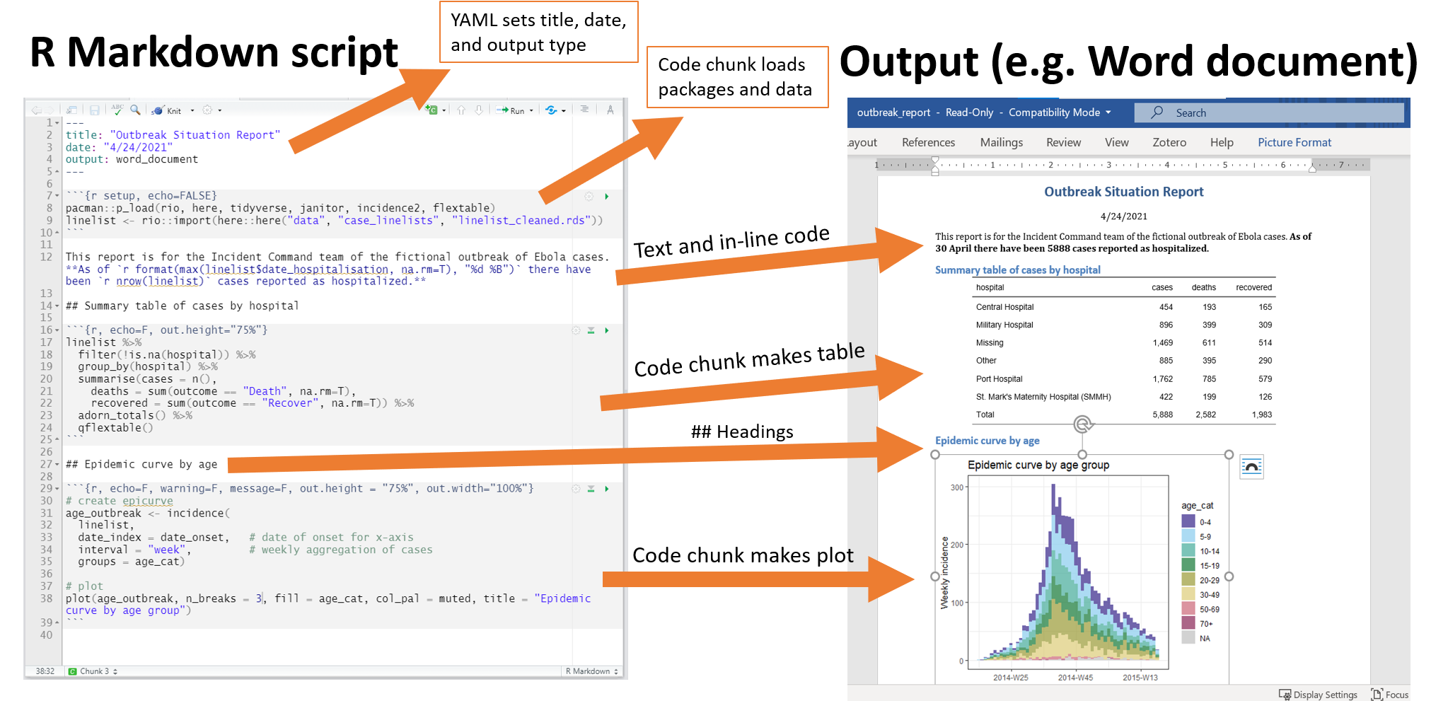
Explain
Demonstrate
Guide
Evaluate
The “EDGE” acronym for teaching/learning

Slide 2


