Slide 1
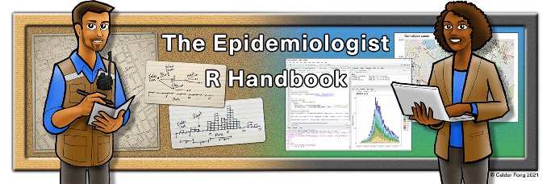


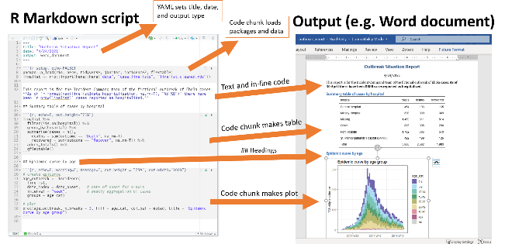
Explain
Demonstrate
Guide
Evaluate
The “EDGE” acronym for teaching/learning

Slide 2


Slide 3












MRAN
Microsoft purchased Revolution analytics

Slide 4









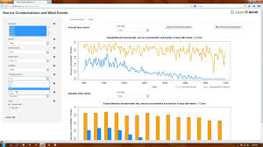

Slide 5
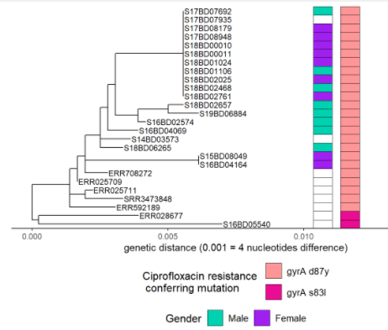
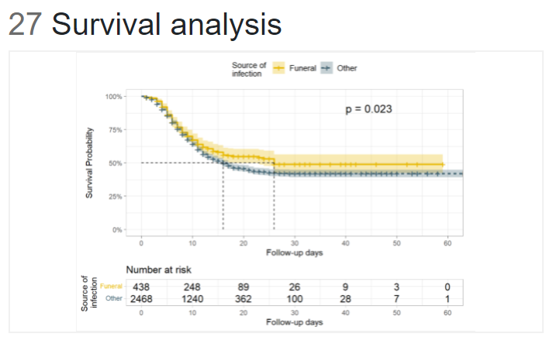
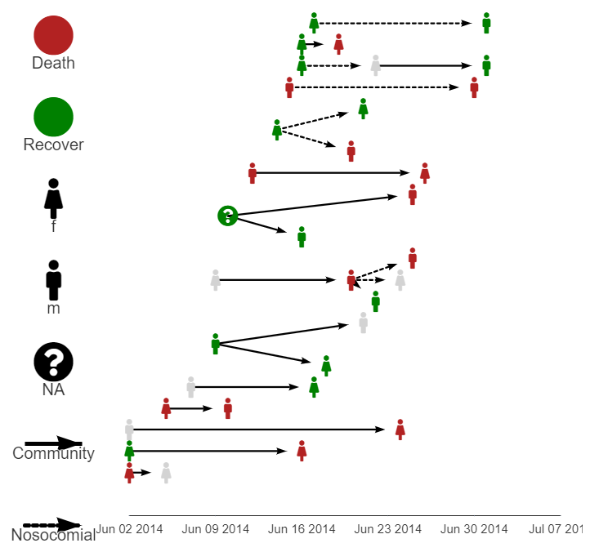
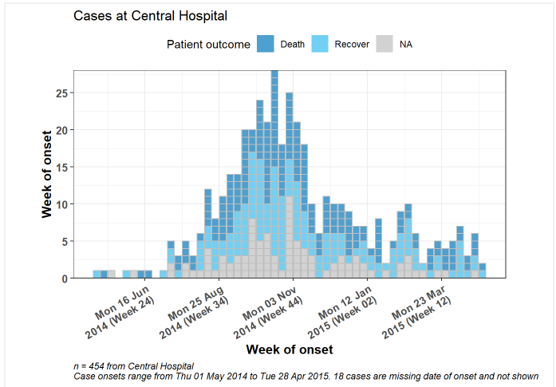
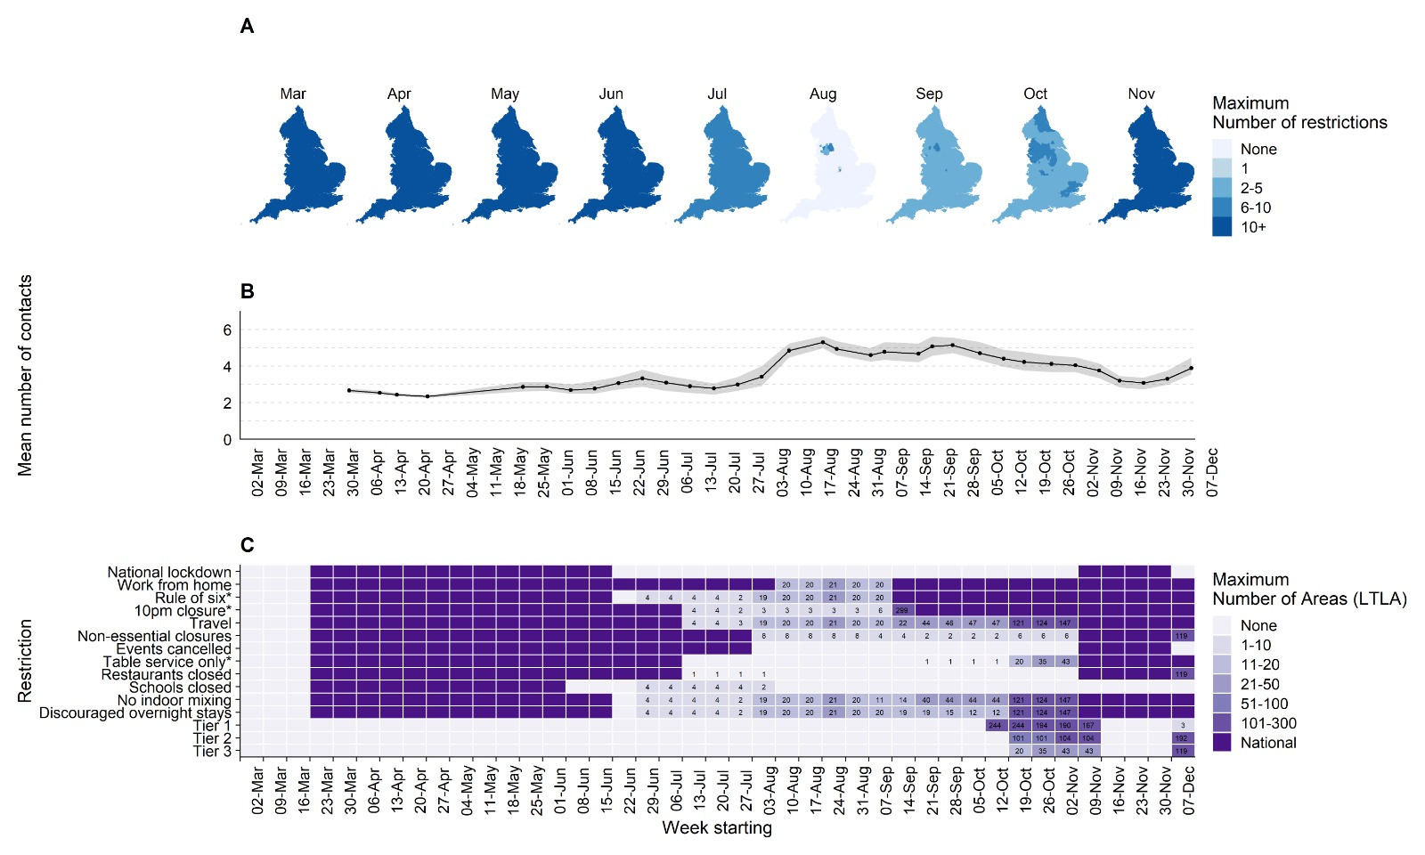
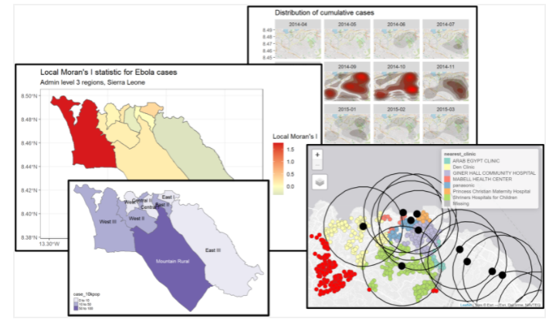
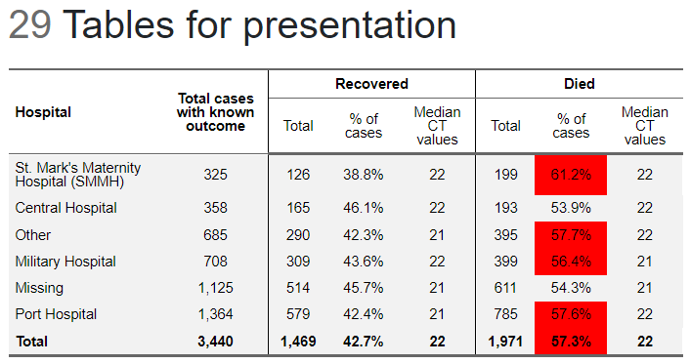
SOURCE: R epi handbook; survival analysis
SOURCE: R epi handbook; phylogenetic trees
SOURCE: R epi handbook; transmission chains
SOURCE: R epi handbook; epidemic curves
SOURCE: R epi handbook; tables for presentation
SOURCE: Jarvis et al, The impact of local and national restrictions in response to COVID-19 on social contacts in England: a longitudinal natural experiment
SOURCE: R epi handbook; GIS basics
Notes:
Data visualization Network diagrams, maps, heat maps, integrated figures, the list goes on... Data viz really essential to understand disease surveillance trends and outbreaks.
Image shows how a network diagram with transmission links, to help us understand how infection spreads in an outbreak, for example between who and within what time frames. Featured in epiR handbook.

Slide 6

Notes:
Automated disease surveillance outputs
Daily COVID-19 epidemiology reports to 317 local authorities in England
Another important example is the use of R in epidemiology to produce reports at scale. This is an example from my workplace. In England, local authorities, all 317 of them, want to access COVID-19 information daily to guide their local interventions. So my team used R markdown to produce a report bringing in case data, testing data, mortality, and many other details related to covid, but loop through local authorities to produce a report for each.
It’s not a fancy report, it’s a flat word document that caters to their specific needs. For example they liked a report which they could then edit, copy images from, and integrate with their own local reports.
But it’s actually a really key example of local intelligence and there is no way we could do this without the power of R.

Slide 7
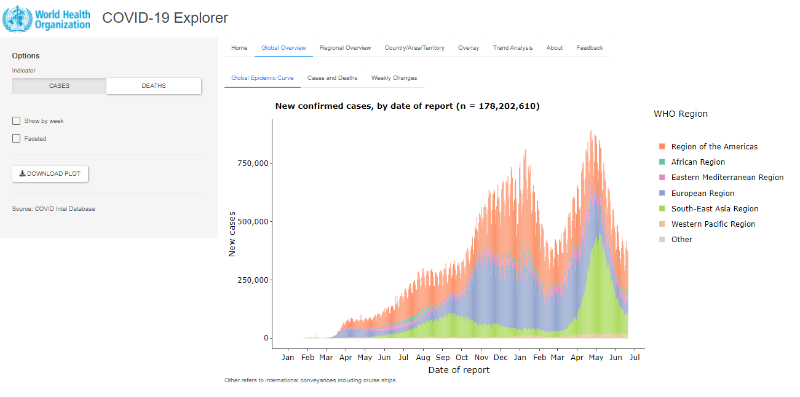
https://worldhealthorg.shinyapps.io/covid/
Notes:
Automated surveillance outputs
WHO COVID-19 dashboard (Shiny) One example of use of R in Epidemiology is the WHO COVID-19 public-facing dashboard. This is made with R Shiny, which is an R package that is used to build interactive web apps and dashboard. You can see the toggles and interactive tabs. It pulls from dozens of data sources to display data submitted by different national public health bodies to the WHO. The R handbook has a section on R shiny.

