Slide 1
ECRC COVID-19 Training
EpiRHandbook Team

Slide 2
Introduction
Hello our name is
blabla
blabla
Notes:
This is a speaker note.
Use basic Markdown
like this list
and inline formatting

Slide 3
Visualisation
Note to selves: I think the way this presentation breaks down ggplots line by line is probably the way to go!

Slide 4
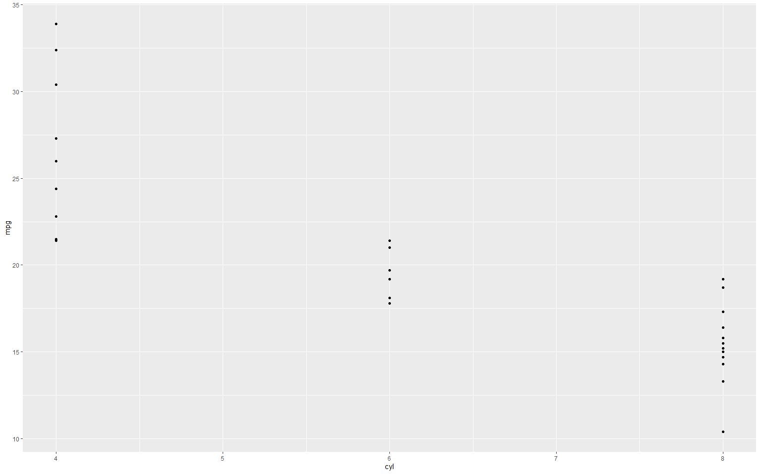
side by side code outputs
## this shows the code that we use to create plot (nb. echo = TRUE) our_plot <- ggplot(mtcars, aes(x = cyl, y = mpg)) + geom_point()

Slide 5
side by side text
testing
bla
bla
testing
testing
testing
testing
testing

