Slide 1



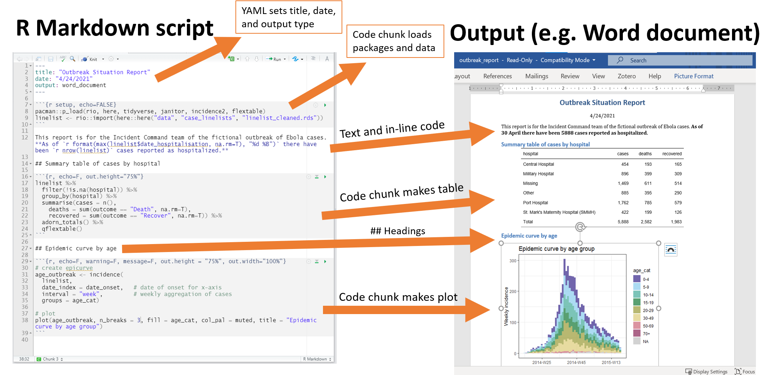
The “EDGE” acronym for teaching/learning
Explain
Demonstrate
Guide
Evaluate

