Slide 1


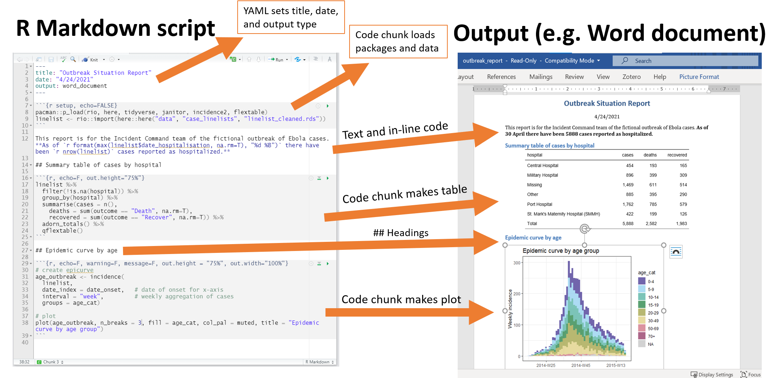

Explain
Demonstrate
Guide
Evaluate

