Slide 1
Outbreak Situation Report

Slide 2
This report is for the Incident Command team of the fictional outbreak of Ebola cases. As of 30 April there have been 5888 cases reported as hospitalized.

Slide 3
Summary table of cases by hospital
hospital | cases | deaths | recovered
Central Hospital | 454 | 193 | 165
Military Hospital | 896 | 399 | 309
Missing | 1,469 | 611 | 514
Other | 885 | 395 | 290
Port Hospital | 1,762 | 785 | 579
St. Mark's Maternity Hospital (SMMH) | 422 | 199 | 126
Total | 5,888 | 2,582 | 1,983

Slide 4
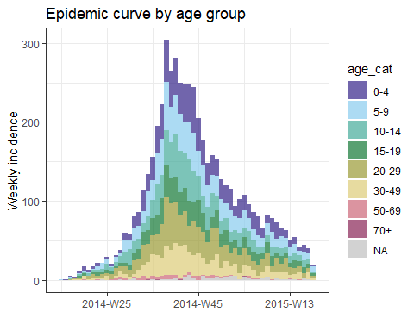
Epidemic curve by age

