Slide 1
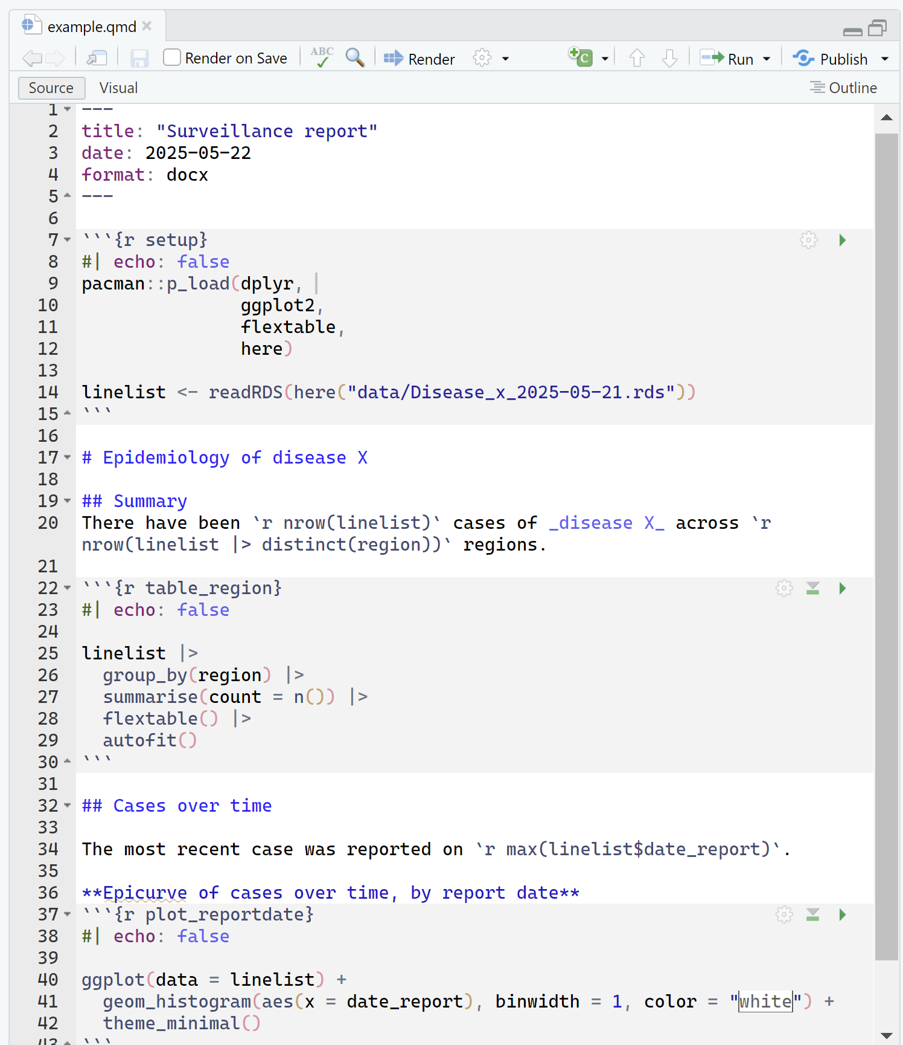
YAML
Specifies settings of the quarto file
Always located at the top
Written as key: value pairs
Settings include:
  Essential: File format (docx, pptx, html, pdf)
  Others: Title, Subtitle, Date, Author, table of contents, formatting.

Slide 2
Code chunks
Sections of R code
Code can be run as entire chunks (green arrows) or within chunks (highlight and run as usual).
Start with ```{r} and end with ```
Organisation tip: Each chunk should have a specific purpose, chunk names are encouraged
You can specify if chunk output shows the code or just the output, error messages, and warnings.
Notes:
How to deal with the chunk output options here?

Slide 3
Markdown text
Text to display in the final output
E.g. description of tables and figures, titles/subtitles
Uses basic Markdown formatting:
  **bold**
  _italics_
  `code`
  # Heading 1
  ## Heading 2 (etc…)
Can contain in-line code: `r code`

Slide 4
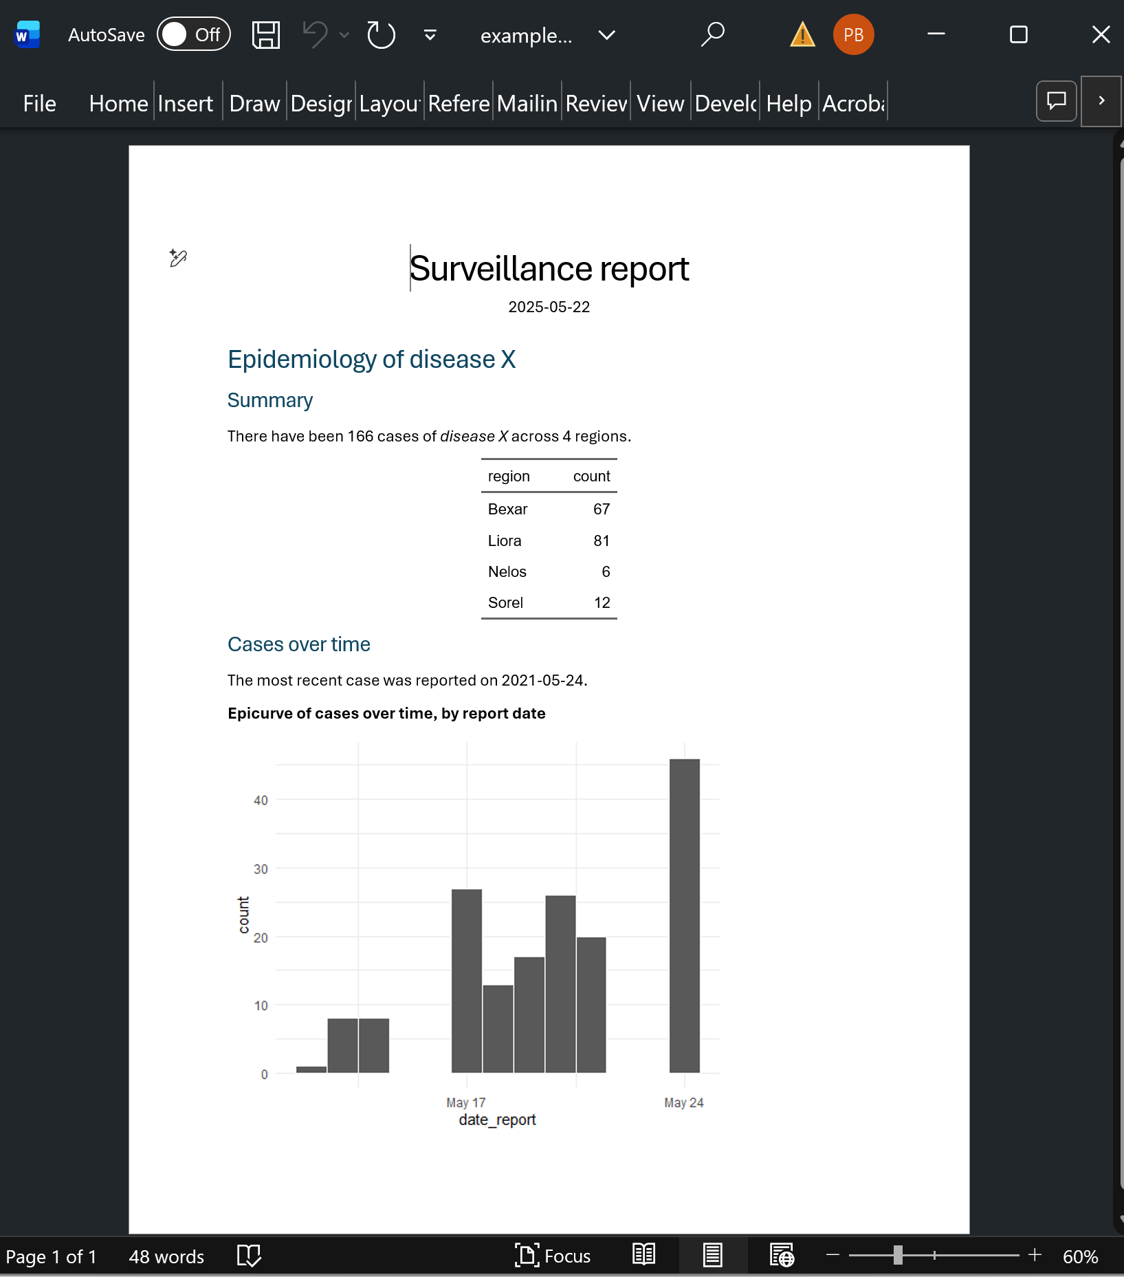

Slide 5
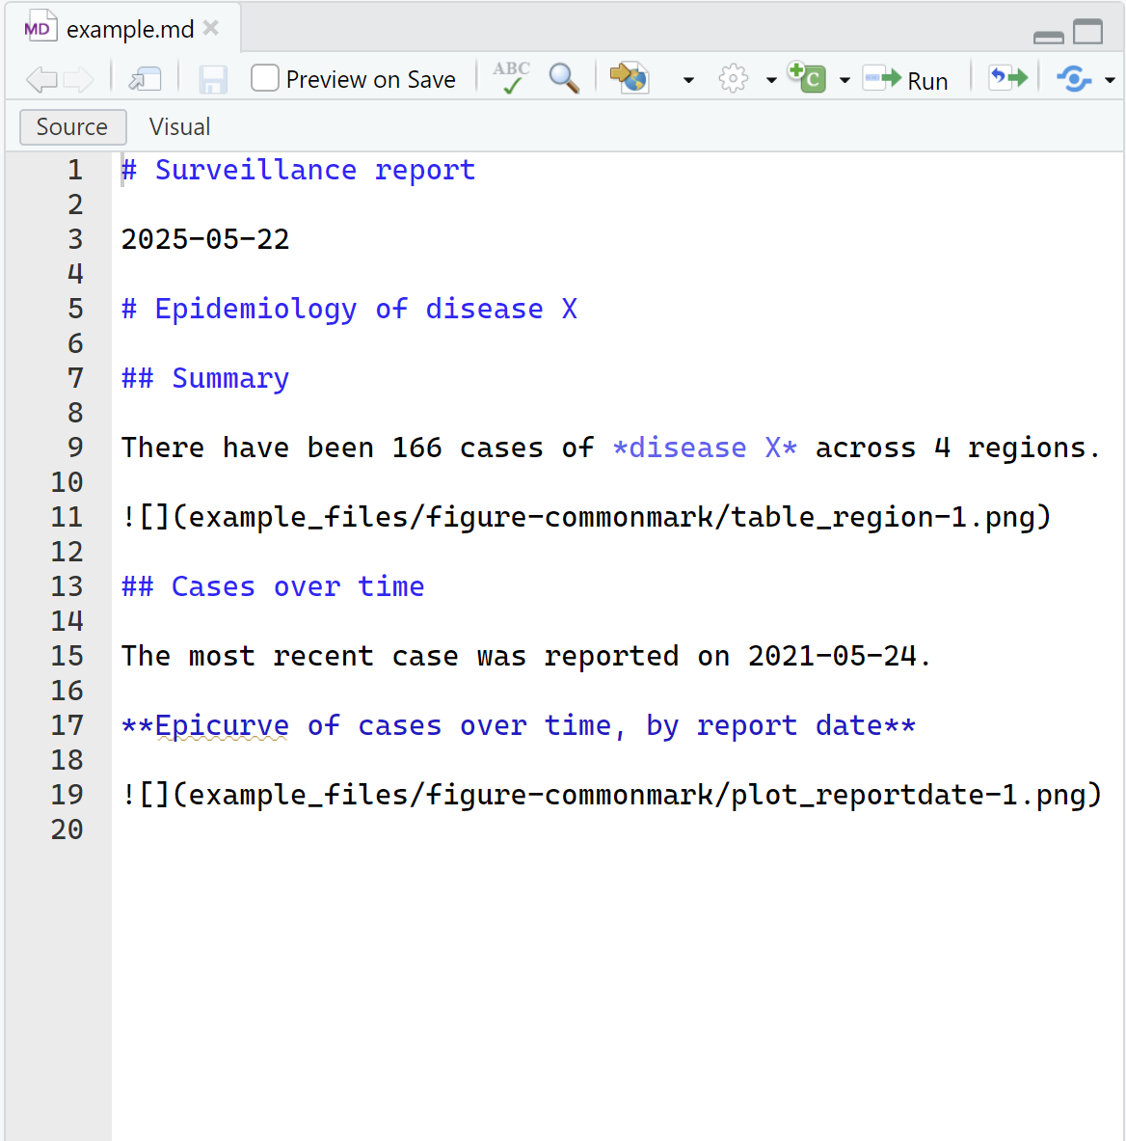

Slide 6
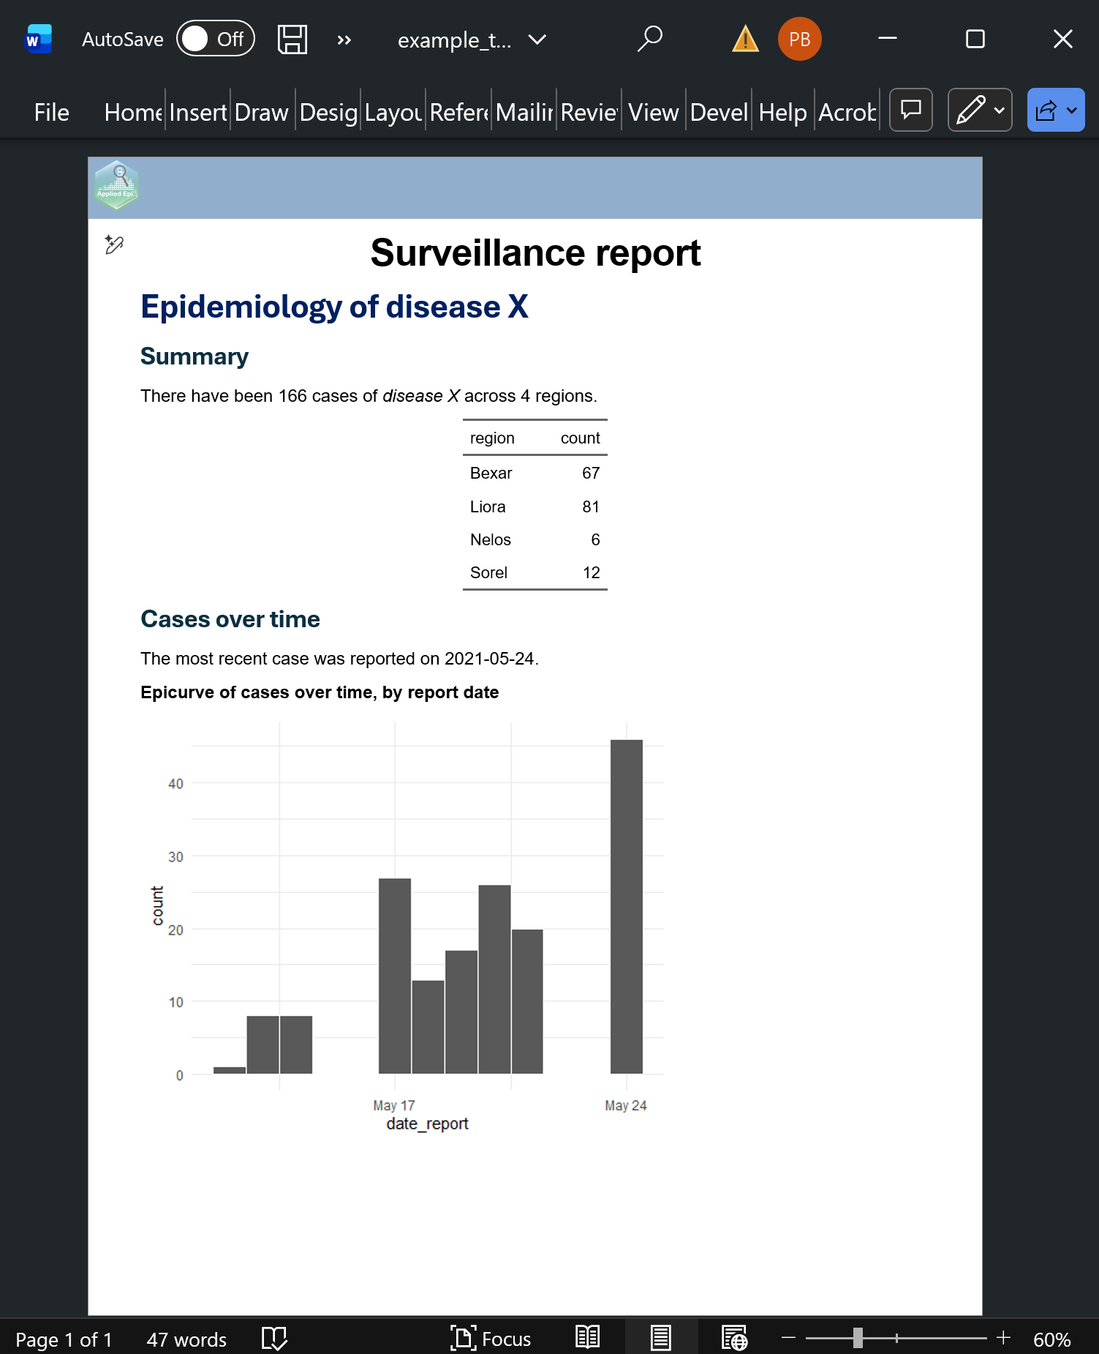
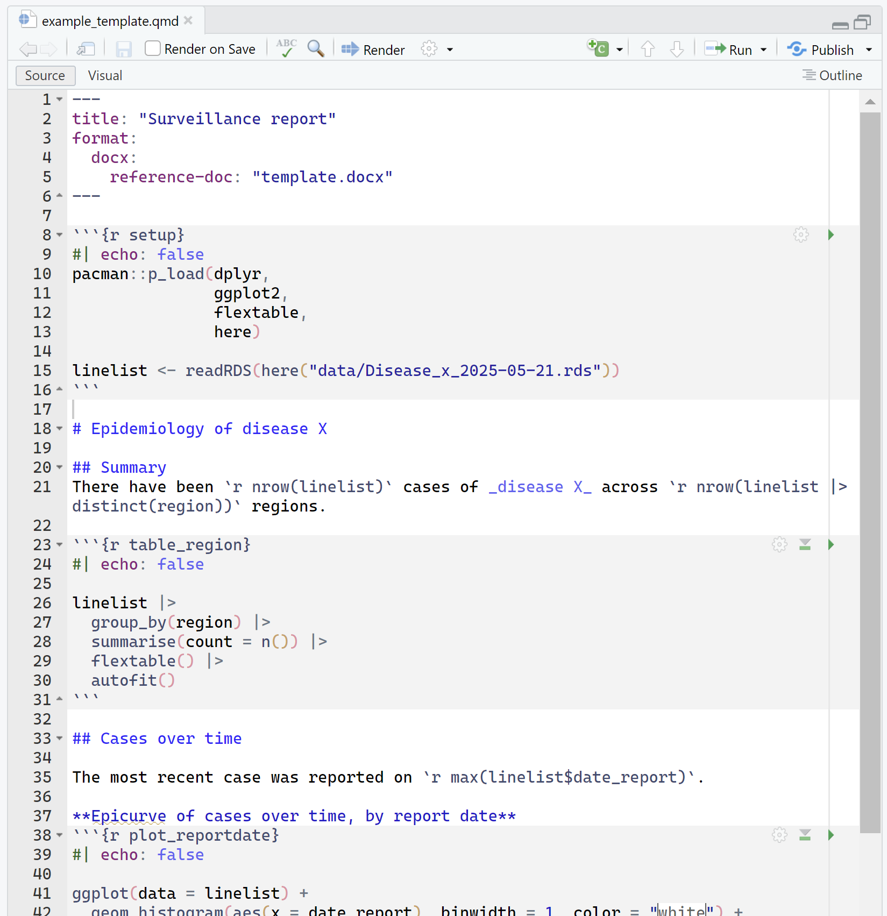

Slide 7
