Slide 1
Surveillance report

Slide 2
Epidemiology of disease X

Slide 3
Summary
There have been 166 cases of disease X across 4 regions.
region | count
Bexar | 67
Liora | 81
Nelos | 6
Sorel | 12

Slide 4
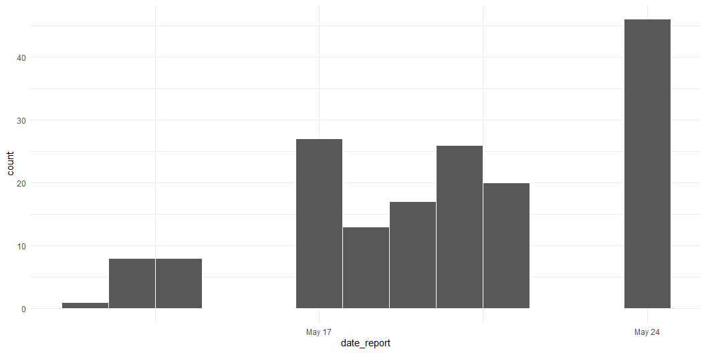
Cases over time
The most recent case was reported on 2021-05-24.
Epicurve of cases over time, by report date

