Slide 1
User-centered LLM interaction: a combination of needs satisfaction and expert assessment
（主題：用戶 ；議題：評估） LLM
Deconstructing the LLM supply chain: trust, values ​​and ethical considerations
（主題：供應鏈 ；議題：評估） Values
Smart classification and personalized recommendations for e-commerce platforms
（主題：平台 ；議題：推薦）Business

Slide 2
User-centered LLM interaction: a combination of needs satisfaction and expert assessment

Slide 3
Evaluation optimization
# Understanding User Experience in Large Language Model Interactions
Most existing LLM evaluation methods use LLM as an independent individual to evaluate its capabilities, ignoring the role of LLM as a user-centered service system in human-machine collaboration.
Existing LLMs perform well in handling information retrieval and word processing tasks, but still need improvement when creativity or domain-specific problem solving is required.
# Comparing Criteria Development Across Domain Experts, LayUsers, Andy Models in Large Language Model Evaluation
Domain experts demonstrate a higher level of detail and specificity in setting evaluation criteria. They are able to use their expertise to develop more detailed, knowledge-based standards, whereas lay users and large language models (LLMs) tend to propose more general standards.
Lay users place more emphasis on presenting information in an easy-to-understand manner, and they pay more attention to layout and format than domain experts and LLMs. They often propose standards aimed at improving the readability of the output, such as using bullet points or clear headings/headings.

Slide 4
As-Is To-Be
#As-Is
#To-Be
Existing assessment systems and tools are primarily aimed at developers and designers, who may lack domain-specific expertise or a lay user perspective.
The evaluation process focuses primarily on the technical performance of the model and ignores lay user needs for output clarity, readability, and ease of use.
The evaluation process focuses primarily on the technical performance of the model and ignores lay user needs for output clarity, readability, and ease of use.
Develop tools and systems to support the development of assessment standards.

Slide 5
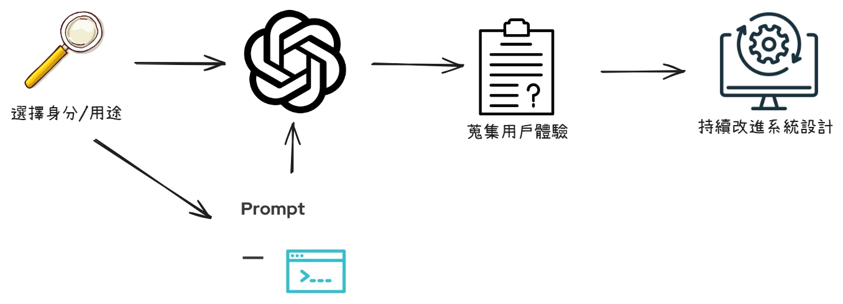
Possible Framework

Slide 6
Overview
使用者期望大型語言模型在哪些方面進行改進?
開發有效的使用者模型，捕捉使用者的興趣、需求和偏好?
設計可適應的模型架構，根據使用者特徵調整輸出內容?
針對外行使用者設計簡單的使用教學?
建立相關論壇(類似 GPTs)，以便更有效率收集使用心得?

Slide 7
Deconstructing the LLM supply chain: trust, values ​​and ethical considerations

Slide 8
Evaluation optimization
# LocalValueBench: A Collaboratively Built and Extensible Benchmark for Evaluating Localized Value
Alignment and Ethical Safety in Large Language Models
Not all large language models (LLMs) are consistent with local Australian values. The research results show that there are differences in the extent to which three commercial LLMs (GPT-4, Gemini 1.5 Pro and Claude 3 Sonet) understand and follow Australian local values ​​in different ethical situations. This may be because their training data is more biased toward American culture.
LLM demonstrates low consistency with Australian values ​​on certain issues. For example, GPT-4 scored particularly poorly in the "same-sex marriage" category and even refused to answer interrogation questions. Gemini 1.5 Pro declined to respond to questions in the "death penalty" category. Claude 3 Sonet also shows some inconsistencies in terms of "weapons" and "forced voting".
The Claude 3 Sonet performed best in the overall evaluation. It has the highest average score (3.725) and the smallest standard deviation of ratings, indicating that its response is most in line with local Australian values ​​and has received relatively consistent positive reviews from reviewers.

Slide 9
As-Is To-Be
#As-Is
#To-Be
Large-scale language model benchmarks currently on the market mainly reflect the values ​​of English or Simplified Chinese culture, and do not take into account the diversity of other cultures and legal jurisdictions.
When deploying LLMs in different sociocultural contexts, there are issues of aligning local values ​​and ethical standards. Many LLMs are not adequately aligned with local ethical standards, which can lead to cultural insensitivity and value deviation.
Throught the development of localized value benchmarks, it becomes a globally scalable tool to help regulatory agencies in various countries design LLm assessment benchmarks that are consistent with their own cultural and legel backgrounds.
By applying the latest technologies (such as RAG, RLHF, etc.), LLM's response flexibility and value alignment ability in dealing with complex ethical situations are further improved to achieve long-term ethical and cultural adaptability.

Slide 10
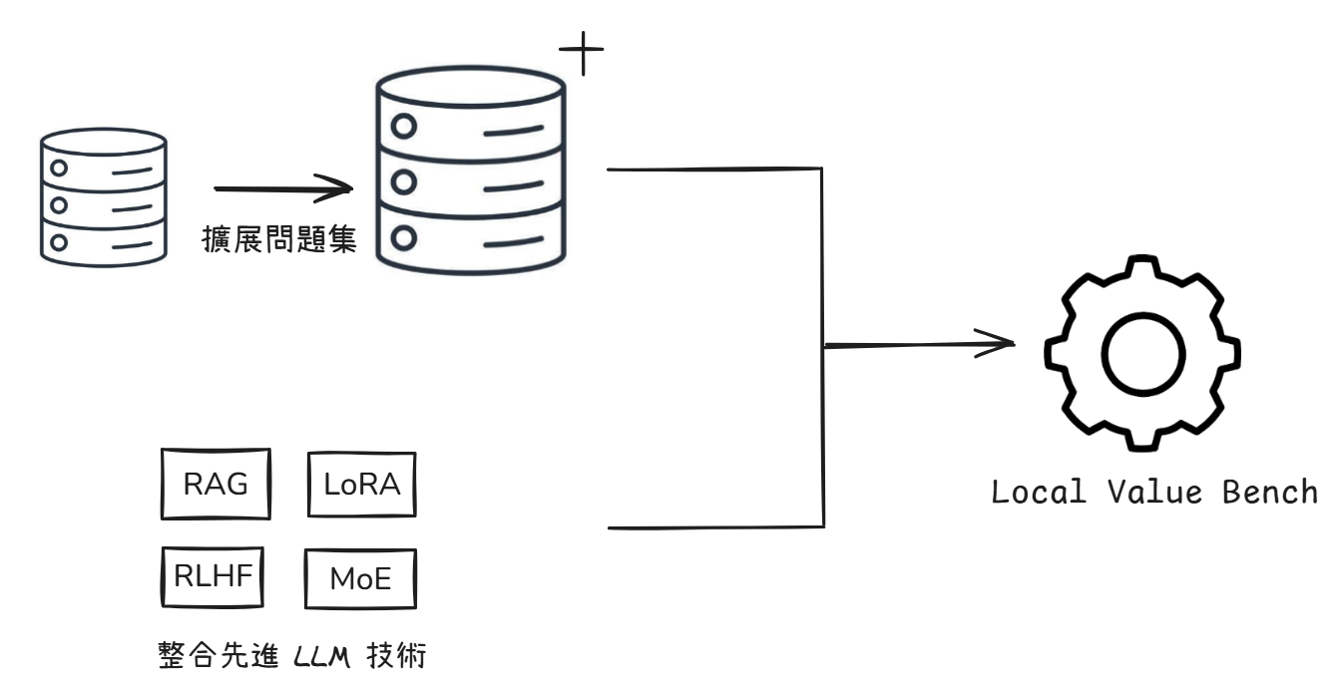
Framework

Slide 11
Overview
在不同社會文化環境中部署 LLM 需要嚴格審查，如何確保它們符合當地價值觀和道德標準?
整合 RAG、RLHF 和 MoE 等先進 LLM 技術是否可以進一步增強 LLM 的當地價值觀一致性?
持續審查 LLM 的安全性、法律合規性和對文化多樣性的尊重
。建立國家法規資料庫?

Slide 12
Smart classification and personalized
recommendations for e-commerce
platforms

Slide 13
Evaluation optimization
Intelligent Classification and Personalized Recommendation of E-commerce Products Based on Machine Learning
Traditional e-commerce product classification systems have problems of inefficiency and inaccurate classification. Especially when processing a large number of products and user data, the system's response speed may slow down.
Personalized recommendation system is the key technology to solve these problems. It can be applied to various recommendation scenarios such as e-commerce, content information, video, and advertising.
By combining the BERT model and the nearest neighbor algorithm, an effective personalized recommendation system can be designed.

Slide 14
As-Is To-Be
#As-Is
#To-Be
Currently, e-commerce mainly relies on static product information (such as price, brand, etc.) for classified display. Although it is helpful to find products, it is inefficient and may not be classified accurately under large-scale data.
Existing recommendation systems faces challenges such as data privacy, algorithm bias, scalability and cold start.
Use the BERT model to improve recommendation accuracy, and recommend products more accurately through semantic understanding and nearest neighbor algorithms.
The system provides innovative solutions to challenges such as cold start and scalability, and ensures ease of use and scalability.

Slide 15
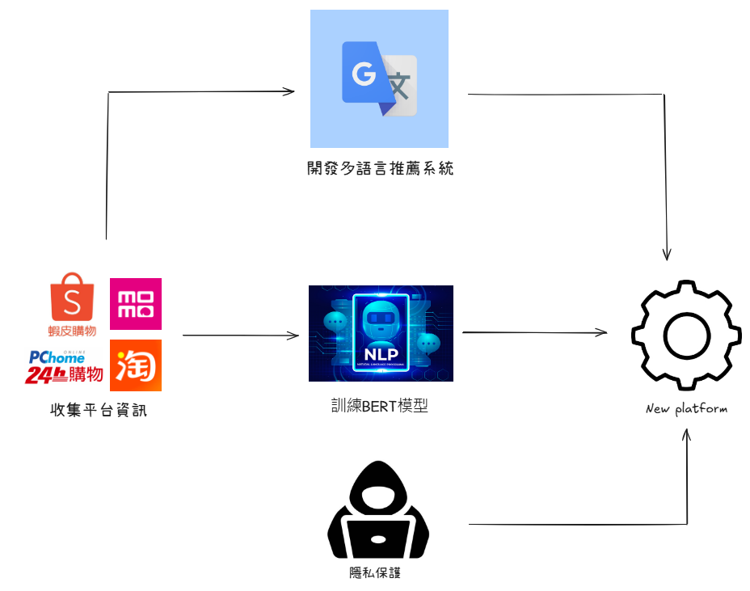
Framework

Slide 16
Overview
是否能應用到蝦皮、PChome、淘寶等台灣人常用的電商平台?
如何將BERT模型的推薦系統應用拓展到電子商務以外的場景，如社交媒體和內容推送平台？設計可適應的模型架構，根據使用者特徵調整輸出內容?
除了使用BERT模型和近鄰算法，是否有其他新穎的方法可以更有效地解決新用戶、新產品和新場景的問題？
如何平衡個性化推薦和商業廣告之間的需求，既提升用戶體驗又最大化商業利潤？

