Slide 1
Index Structures

Slide 2
Outline
Index structures in traditional databases
Disk structure
How data is stored
What is indexing
Multilevel indexing
B-trees
B⁺-trees

Slide 3
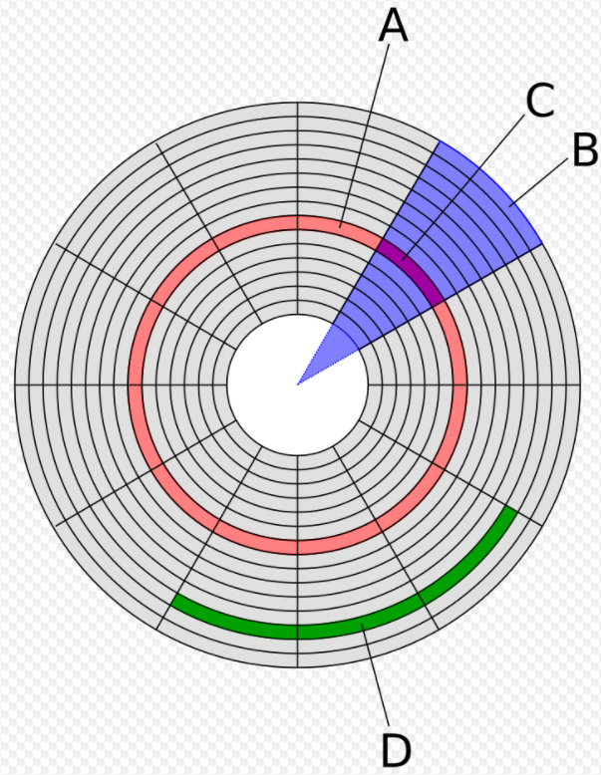
Disk structure (1)
track (磁軌)
Each track has a track number, t_no.
Each sector has a sector number, s_no.
Using t_no and s_no to locate a block.
s_no = 11
block (區塊)
sector (磁區)
t_no
(0, 1, 2,…)
A block whose size is 512 Bytes
s_no = 3
0
1
2
…
511
offset
s_no = 7
若區塊 C 所在位置 t_no = 8, s_no = 1, 可利用 (8, 1) 來定位區塊 C，再利用 offset 來存取區塊內特定資料

Slide 4
Disk structure (2)
Loading data from disk to main memory
512 Bytes
以 block為單位
CPU
Main memory (RAM)

Slide 5
How data is stored
Employee
Size of an Employee record
-------------------------------
Id = 10
Name = 50
Dept = 10
…
-------------------------------
Total size = 128 Bytes
Id | Name | Dept | …
1 | Aa | …
2 | Bb | …
3 | Cc
4 | Dd
5 | Ee
6 | Ff
7 | Gg
8 | Hh
9 | Ii
… | … | …
Block size = 512 Bytes
Need 25 blocks to store 100 records.
Number of records = 100

Slide 6
What is indexing (1)
Without indexing
Find the record for id = 100
Need to access 25 blocks
Records 1~4
Records 5~8
Records 97~100
25 blocks

Slide 7
What is indexing (2)
With indexing
Find the record for Id = 100
Need to access 4 + 1 = 5 blocks
Index data
Employee
Id | Ptr
1
2
3
…
100
Id | Name | Dept | …
1 | Aa | …
2 | Bb | …
3 | Cc
4 | Dd
5 | Ee
6 | Ff
7 | Gg
8 | Hh
9 | Ii
… | … | …
Size of an index record
---------------------------
Id = 10
Ptr = 6
---------------------------
Total size = 16 Bytes
32
Need 4 blocks to store index data.
Number of records = 100

Slide 8
Multilevel indexing
Index data
Employee
Id | Ptr
1
…
32
33
…
64
65
…
Id | Name | Dept | …
1 | Aa | …
2 | Bb | …
3 | Cc
4 | Dd
5 | Ee
6 | Ff
7 | Gg
8 | Hh
9 | Ii
… | … | …
Id | Ptr
1
33
65
…
993
Need 1 block to store index data.
Need 32 blocks to store index data.
Number of records = 1000

Slide 9
B-tree (1)
A B-tree of order m:
Each node has at most m children
Each non-leaf node has at least ceiling(m/2) child nodes
The root node has at least two children
All leaf nodes appear in the same level
Bottom-up construction

Slide 10
B-tree (2)
Example of a B-tree with m = 4:
 | 40
 | 15 |  |  | 30
 | 70
child ptr
5 |  | 10
20
35
50 |  | 60
80
record ptr
Employee
id
Name

Slide 11
B⁺-tree (1)
Commonly used in DBMS
Can be viewed as a B-tree
Each non-leaf node has child pointer
Each leaf node has record pointer
Leaf nodes are connected like a linked list

Slide 12
B⁺-tree (2)
Example of a B⁺-tree with m = 4:
 | 40
child ptr
 | 15 |  | 30
 | 70
5 |  | 10
15 |  | 20
30 |  | 35
40 |  | 50 |  | 60
70 |  | 80
record ptr
…
…
…
id
Name
Employee

Slide 13
B⁺-tree定義
階數 (m)
內部節點 (internal node) 最多有 m 個子樹，最少有 ⌈m/2⌉ 個子樹(根除外)
每個內部節點最多有 m−1 個鍵值 (keys)
葉節點 (leaf nodes)
所有資料皆儲存在葉節點
每個葉節點的資料數量介於 ⌈m/2⌉ 到 (m−1) 之間
葉節點之間鏈結，支援順序與範圍存取
插入規則 (insertion)
找到正確的葉節點，將新資料插入並保持排序
若葉節點溢位 → 分裂為兩個葉節點，並將右節點的第一個鍵值上推至父節點
內部節點溢位 → 分裂，並將中間鍵值上推 (若 m 為偶數，推右節點的第一個鍵值)
若根節點溢位 → 產生新根，樹高增加

Slide 14
B⁺-tree例子
輸入8個數字，依序為
12, 5, 18, 7, 3, 14, 9, 16
m = 3
leaf node容量 = 2

Slide 15
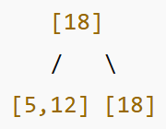
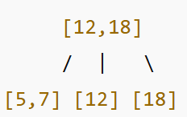
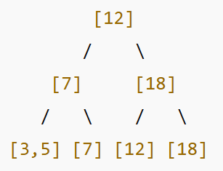
插入12
插入5
插入18，葉溢位，分裂
分成 [5, 12], [18]，右邊第一鍵18上推到父節點
[12]
[5, 12]
插入7，左葉溢位，分裂
左葉 [5, 7, 12] 分成 [5, 7], [12]，
上推12到父節點
插入3，左葉溢位，分裂
左葉 [3, 5, 7] 分成 [3, 5], [7]，上推7到父節點
父節點 [7, 12, 18]，內部分裂，取中間值12上推到父節點

Slide 16
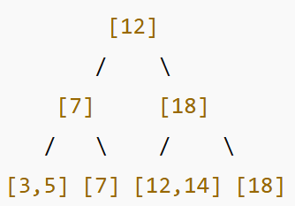
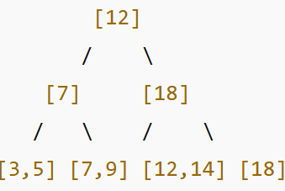
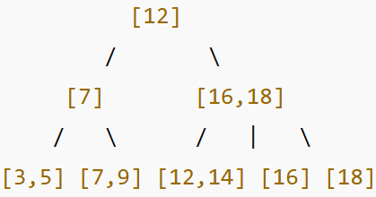
插入14，放到左葉 [12]
插入9，放到右葉 [7]
插入16，放到左葉 [12, 14, 16]，溢位分裂
分成 [12, 14], [16]，上推16到父節點

Slide 17
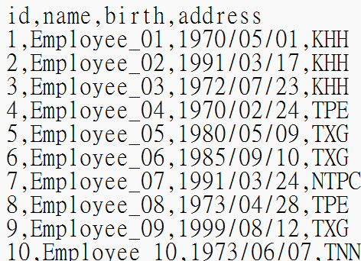
B⁺-tree建構 (1)
Data set: employee.txt
Number of tuples: 64
Attributes:
id: 1 ~ 64
name: Employee_01~64
birth: between 1970/01/01 and 2000/12/31
address: {TPE, NTPC, TXG, TNN, KHH}

Slide 18
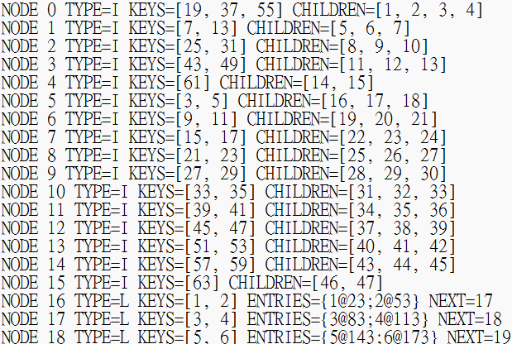
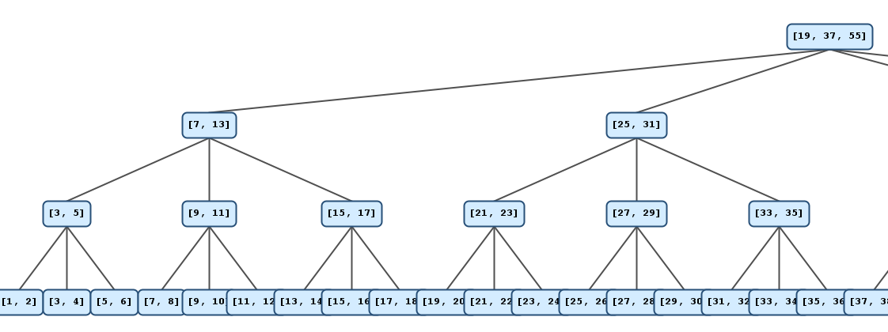
B⁺-tree建構 (2)
Input:
employee.txt
Output:
BPlusTree.txt
tree.png

Slide 19
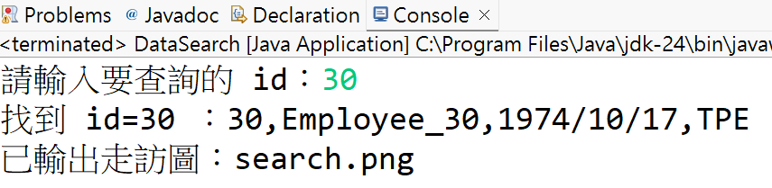
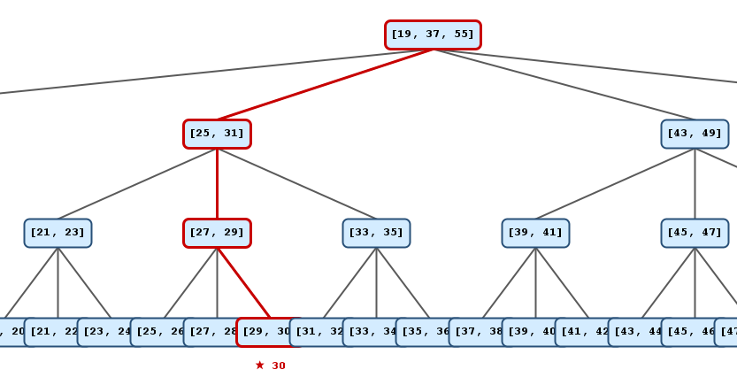
資料搜尋
Input:
employee.txt
BPlusTree.txt
id 值
Output:
符合的tuple
search.png

