Slide 1
Index Structures for Spatial Data

Slide 2
B⁺-tree
Focus on single key attribute:
E.g., primary key
 | 40
child ptr
 | 15 |  | 30
 | 70
5 |  | 10
15 |  | 20
30 |  | 35
40 |  | 50 |  | 60
70 |  | 80
record ptr
…
…
…
id
Name
Employee

Slide 3
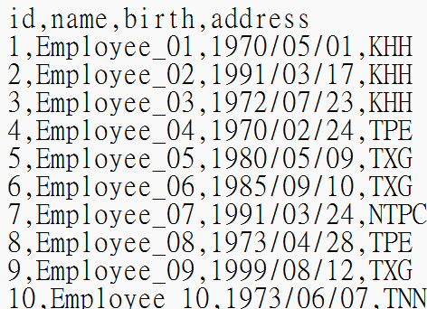
B⁺-tree建構 (1)
Data set: employee.txt
Number of tuples: 64
Attributes:
id: 1 ~ 64
name: Employee_01~64
birth: between 1970/01/01 and 2000/12/31
address: {TPE, NTPC, TXG, TNN, KHH}

Slide 4
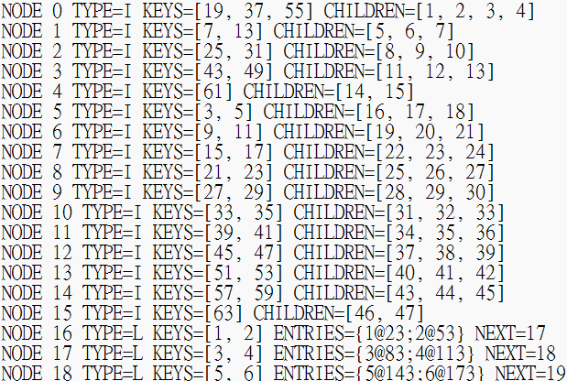
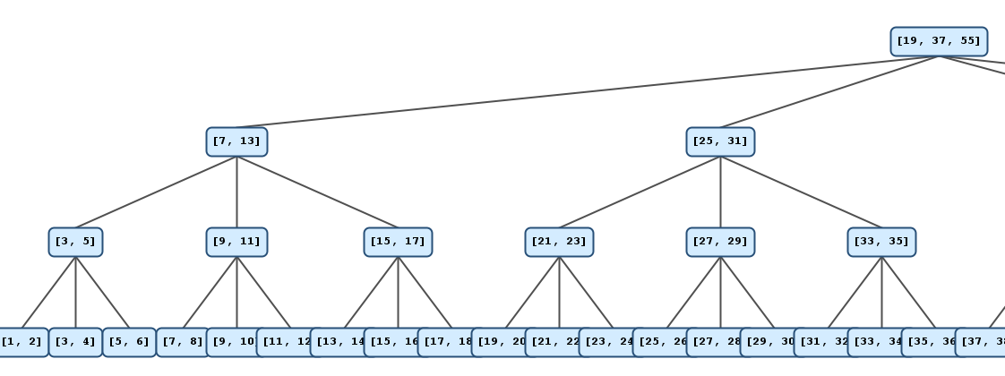
B⁺-tree建構 (2)
Input:
employee.txt
Output:
BPlusTree.txt
tree.png

Slide 5
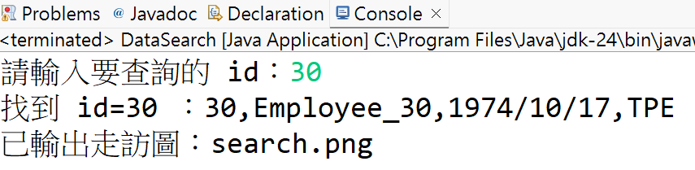
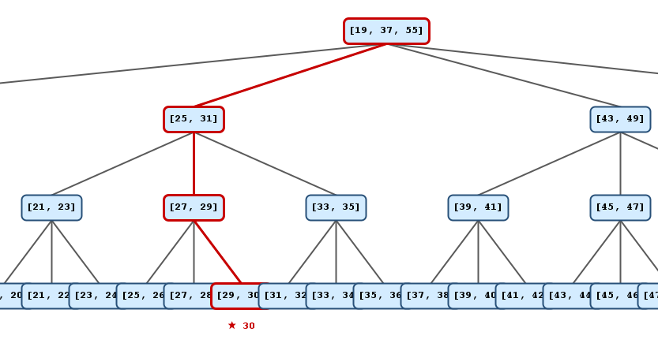
資料搜尋
Input:
employee.txt
BPlusTree.txt
id 值
Output:
符合的tuple
search.png

Slide 6
Spatial data
Contains basic attributes
Includes spatial coordinates
E.g., latitude, longitude
Supports spatial queries

Slide 7
Spatial queries
Point query:
Find the object located at a specific point.
Range query:
Retrieve objects within a given area or distance
Nearest neighbor query:
Find the closest object(s) to a given location.
Skyline query:
Retrieve objects that are not dominated by others in all dimensions.

Slide 8
Index structures
How to index spatial data using B⁺-tree
Supports spatial queries
 | 40
child ptr
?
 | 15 |  | 30
 | 70
5 |  | 10
15 |  | 20
30 |  | 35
40 |  | 50 |  | 60
70 |  | 80
record ptr
…
…
…
(x, y)
Name
Employee

Slide 9
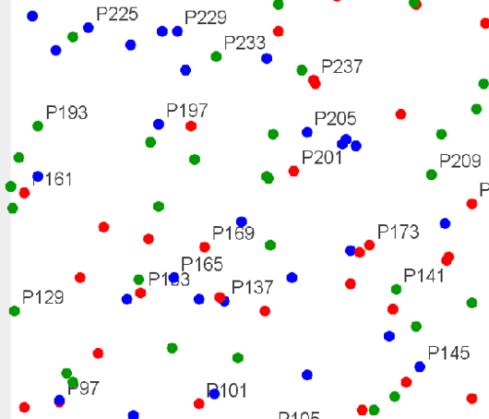
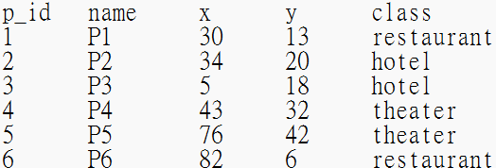
Spatial points
Points.png
Generating data set: Points.txt
Data Space: 400 × 400 (divide into 8 × 8 grids)
Number of points: 256
Attributes:
p_id: 1 ~ 256
name: P1 ~ P256
x, y: randomly generated coordinates inside each grid
class: {restaurant, hotel, theater}
Note: each grid contains 4 randomly generated points
P1~P4 => grid 1
P5~P8 => grid 2
…

Slide 10
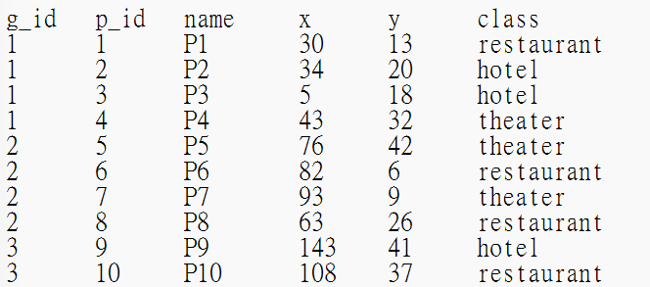
Index for spatial data
Mapping two-dimensional data onto a one-dimensional space: PointWithGrid.txt
Divide into 8 × 8 grids
Assign an ID to each grid (g_id 1 ~ 64)

Slide 11
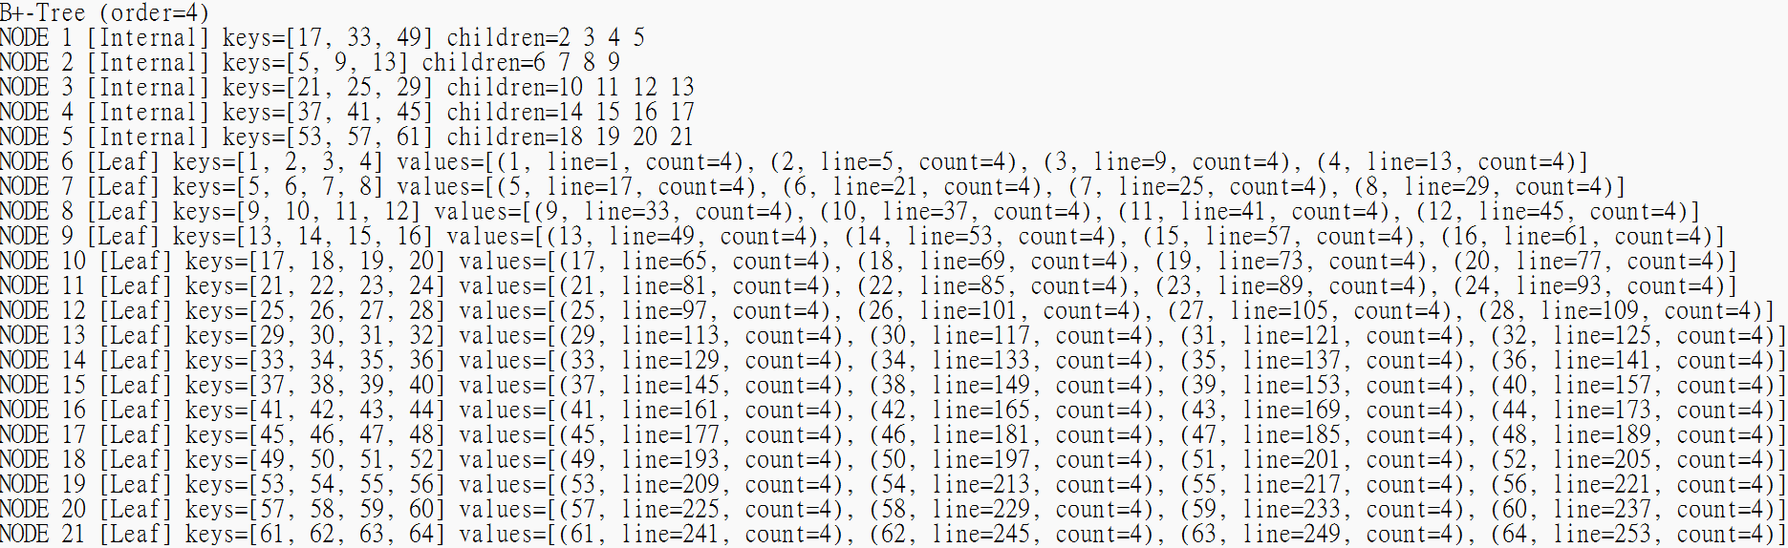
Building B⁺-tree
Loading PointWithGrid.txt and generating BTreeGrid.txt
BTreeGrid.txt
Example: g_id 64 在第254列 (列編號從0開始)，包含4個物體

Slide 12
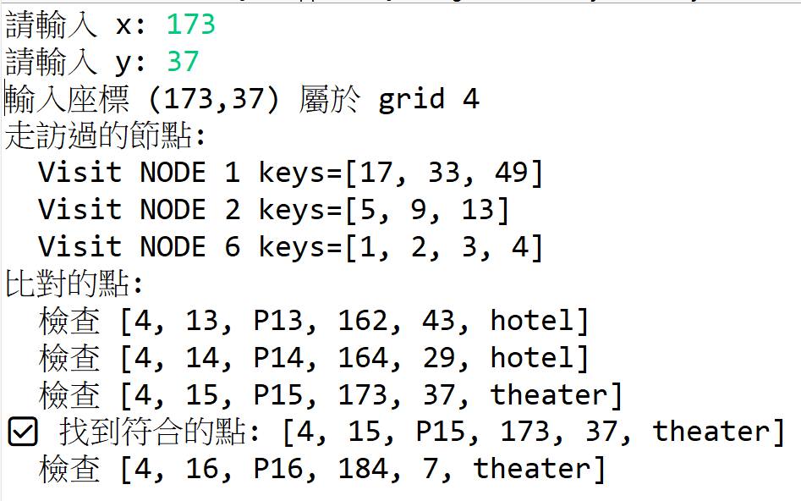
Point Search
Loading: BTreeGrid.txt and PointWithGrid.txt
Input
Output

Slide 13
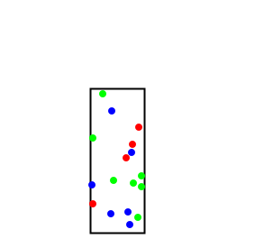
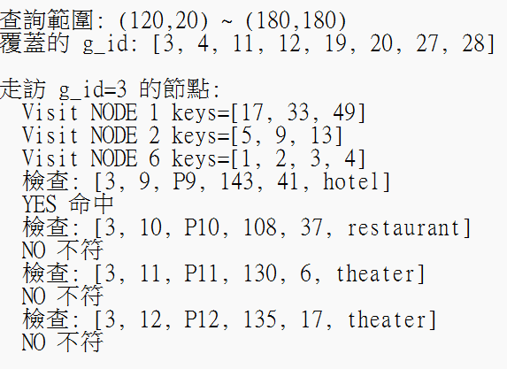
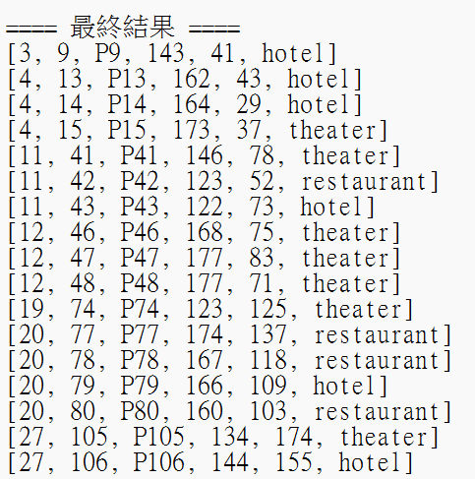
Range Search
search_process.png
Loading: BTreeGrid.txt and PointWithGrid.txt
Input: left, down, right, up
Output: search_process.txt, search_process.png
search_process.txt

