Slide 1

Tapping into community-lead
software projects
Master of Computing & Innovation Project-Team 5
Supervisor: Dr. Rebecca Vivian & Dr. Bradley Alexander
Team members：a1779388 Xuanji Li
a1776937 Menghan Li
a1788058 Yifei Xu
a1778478 Runtao Zhuge

Slide 2
Content
1 Introduction
2 Significance
3 Website functions

Slide 3
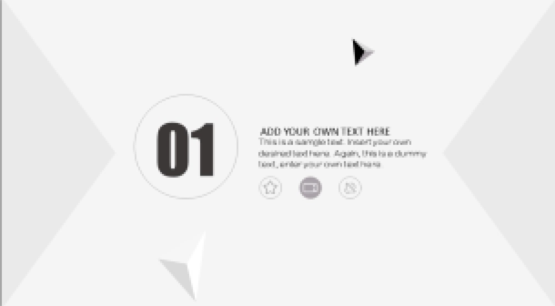
01
Introduction

Slide 4

Introduction
01
02
03
Background
The original intention of this project
What is it?
A web page that allows users to interact
Tools
Front-end
Back-end

Slide 5
Background & Purpose
Diverse projects from different fields can provide CS students with project-working experience
Number of CS students are increasing leads to difficulty of finding project effectively
A platform to school staff & CS students

Slide 6
02
Significance

Slide 7
Main customers
Staff
Post and share project proposals and requirements across the platform and get feedbacks according to their requests
Students
Looking for proper and relevant project proposals
Submit requests and communicate with staff.

Slide 8
For students
Significance and Importance
Customers can interact
students/clients/staff
(For students )Accumulating work experience
Familiar with teamwork
(Staff)Finding potential employees(or interns) and get the projects completed

Slide 9
03
Website Functions

Slide 10
Website main functions
1.Register and log in
2.sort projects proposals
01
02
Basic accounts information and profile set up
students make reasonable proposals to the new courses
3.Search and upload
3.comminication
03
04
Clients can search and upload resumes
Clients can commcate in website channels.

Slide 11
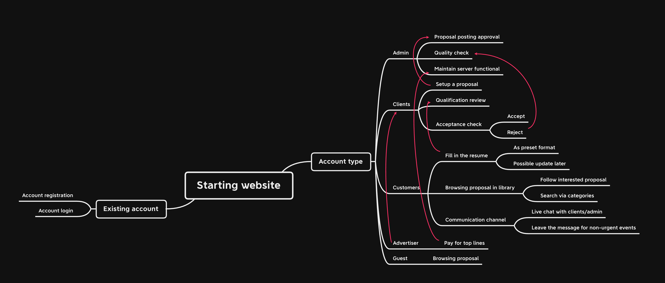
Website function--Flow chart

Slide 12

Tools
HTML5/CSS/Javascript --- Front-end
Potential Back-end:
ExpressJs
Django + reactjs
Springboot
Laravel
Etc.

Slide 13
单击添加标题
01
添加标题
单击此处添加副标题或详细文本描述
02
添加标题
单击此处添加副标题或详细文本描述
03
添加标题
单击此处添加副标题或详细文本描述
此处添加详细文本描述，建议与标题相关并符合整体语言风格
添加标题
04
单击此处添加副标题或详细文本描述
05
添加标题
单击此处添加副标题或详细文本描述

Slide 14
单击添加标题
01
02
03
04
架构
分析
完善
重建
此处添加详细文本描述，建议与标题相关并符合整体语言风格，语言描述尽量简洁生动。尽量将每页幻灯片的字数控制在200字以内，据统计每页幻灯片的最好控制在5分钟之内。此处添加详细文本描述，建议与标题相关并符合整体语言风格，语言描述尽量简洁生动。尽量将每页幻灯片的字数控制在200字以内，据统计每页幻灯片的最好控制在5分钟之内。

Slide 15
Acknowledgement
Acknowledge
Dr. Rebecca Vivian & Dr. Bradley Alexander for helping with the project and teamwork
Dr. Cruz Izu for setting up teams and guidelines
All the tutors for feedbacks and tutoring
University of Adelaide for resources and projects

Slide 16
Thanks for listening

