Slide 1

Tapping into community-lead
software projects
Master of Computing & Innovation Project-Team 5
Supervisor: Dr. Rebecca Vivian & Dr. Bradley Alexander
Team members：a1779388 Xuanji Li
a1776937 Menghan Li
a1788058 Yifei Xu
a1778478 Runtao Zhuge

Slide 2
Content
1 Introduction
2 Significance
3 Functionality
4 List of Extension
5 Summary

Slide 3
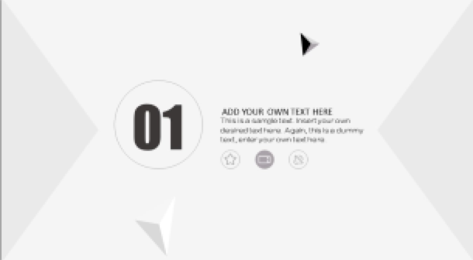
01
Introduction

Slide 4

Introduction
01
02
Background
What is it?

Slide 5


The original intention of this project
Background & Purpose
Diverse projects from different fields can provide CS students with project-working experience
Number of CS students are increasing leads to difficulty of finding project effectively

Slide 6
Current Problems
Background & Purpose
The internal(School of CS) projects are too limited and hard to find for students.
External (Non CS professional/Other schools) staff might not know the feasibility of the projects.
Communication via emails is tedious and inefficient.

Slide 7
Solutions
What is it?
A website for the university staff to share project proposals
A website for students to search or upload project proposals
Students of School of CS can participate
Administrative controls for feasibility
Online channels for communication(eg. chatbox)

Slide 8
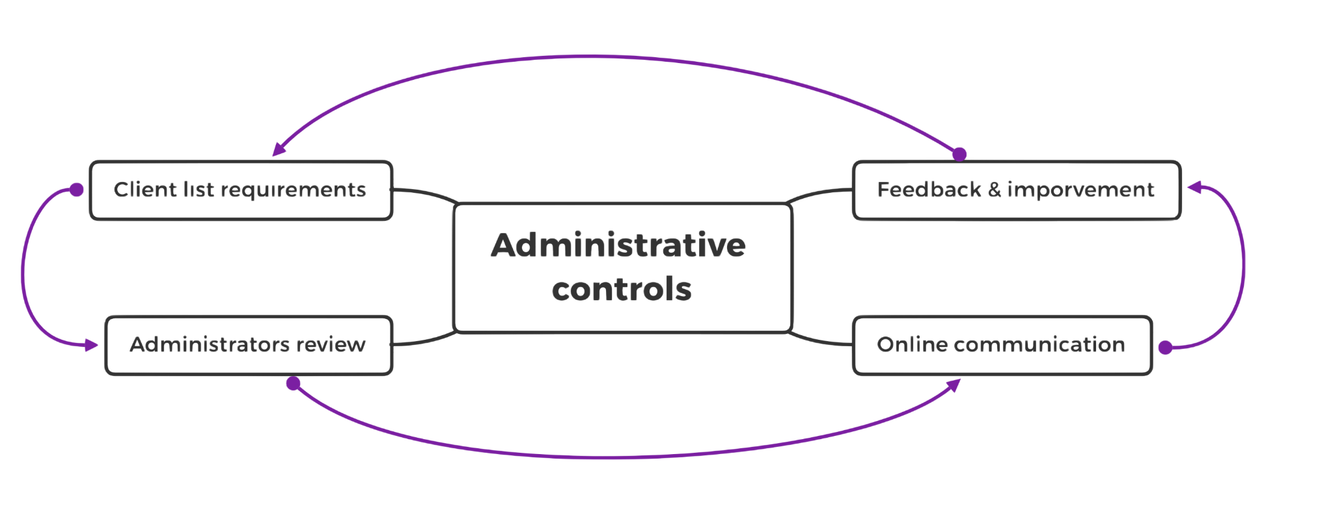
Administrative controls
(Guidelines to make project feasible)
Notes:
Project clients make requirements according to their project needs.
After the clients upload the projects, the administrators review these projects.
Students and clients communicate
The administrators and students give feedback and guidelines to make the projects feasible.

Slide 9
02
Significance

Slide 10


Main consumers
Project Clients
Students

Slide 11
Accumulating working experience
Familiarizing with teamwork
Finding potential employees

Slide 12
03
Functionality

Slide 13
Website main functions
1. Register and log in
2. Sort projects proposals
01
02
Rank choices and allocate projects
Basic accounts information and profile set up
Project clients
Course coordinators
Students
Project clients
Students
3. Search,upload
4. Communication
03
04
Project clients/course coordinator/students can communicate on the website
Project clients can search and upload project proposals
Project clients
Project clients
Course coordinators
Students

Slide 14
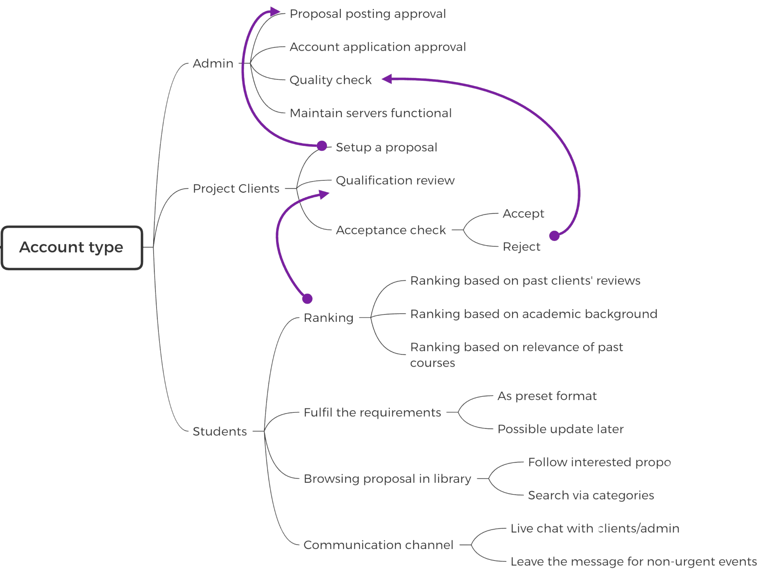
Website function--Flow chart

Slide 15

Tools
Front-end: HTML5/CSS/Javascript
Potential Back-end:
ExpressJs (NodeJS)
Django + reactjs(Python based)
SpringBoot (Java)
Laravel (PHP)
Etc.

Slide 16
04
List of Extensions

Slide 17
List of extensions
Due to the lack of resource and time limit, this website is limited to University of Adelaide
More functionalities can be added (if no time limit)
External universities
External companies
Multilingual
Chatbot

Slide 18
05
Conclusion

Slide 19
Conclusion
Purpose: A website for sharing project proposals
More diverse
More feasible (administrative controls)
More efficient
Main customers:
project clients (staff)
course coordinators
Students
Main functionalities:
Uploading
Sorting
Communication

Slide 20
Thanks for listening

