Slide 1

Tapping into community-lead
software projects
Team 5
Team members：a1779388 Xuanji Li
a1776937 Menghan Li
a1788058 Yifei Xu
a1778478 Runtao Zhuge

Slide 2
Content
1 Introduction
2 Significance of this project
3 Website function

Slide 3
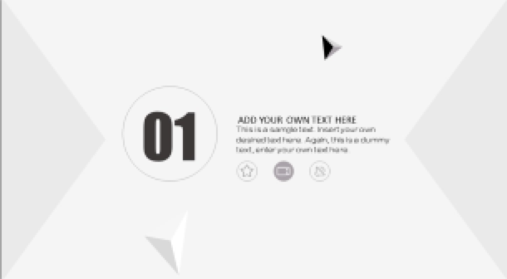
01
Introduction

Slide 4

Introduction
01
02
03
Background
The original intention of this project
What is it?
A web page that allows users to interact
Tools
???

Slide 5
02
Significance of the project

Slide 6
Significance and Importance
The practical significance of this project and why it is important.
customers can interact
students/clients/stuff
accumulate work experience
familiar with teamwork
find potential employees

Slide 7
03
Website function

Slide 8
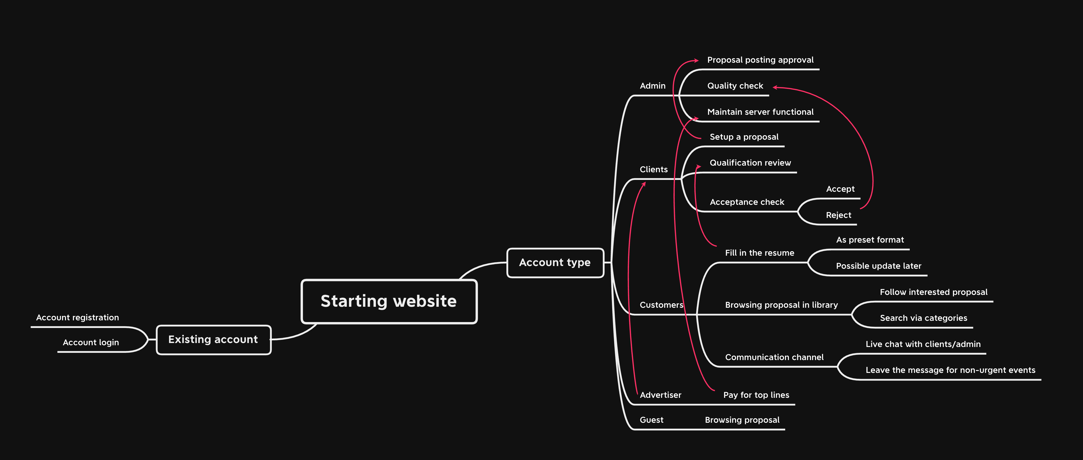
Website function--Flow chart

Slide 9
Website function
1.Register and log in
2.sort projects proposals
01
02
students make reasonable proposals to the new courses
3.Search and upload
3.comminication
03
04
Clients can search and upload resumes
Clients can commcate in website channels.

Slide 10
Website function
???
1.???
01
02
???
3.???
4.???
03
04
???
???

Slide 11
单击添加标题
01
添加标题
单击此处添加副标题或详细文本描述
02
添加标题
单击此处添加副标题或详细文本描述
03
添加标题
单击此处添加副标题或详细文本描述
此处添加详细文本描述，建议与标题相关并符合整体语言风格
添加标题
04
单击此处添加副标题或详细文本描述
05
添加标题
单击此处添加副标题或详细文本描述

Slide 12
单击添加标题
01
02
03
04
架构
分析
完善
重建
此处添加详细文本描述，建议与标题相关并符合整体语言风格，语言描述尽量简洁生动。尽量将每页幻灯片的字数控制在200字以内，据统计每页幻灯片的最好控制在5分钟之内。此处添加详细文本描述，建议与标题相关并符合整体语言风格，语言描述尽量简洁生动。尽量将每页幻灯片的字数控制在200字以内，据统计每页幻灯片的最好控制在5分钟之内。

Slide 13
Thanks for listening

