Slide 1

Towards Mining Comprehensive Android Sandboxes
Tien-Duy B. Le, Lingfeng Bao, David Lo, Debin Gao, and Li Li

Slide 2

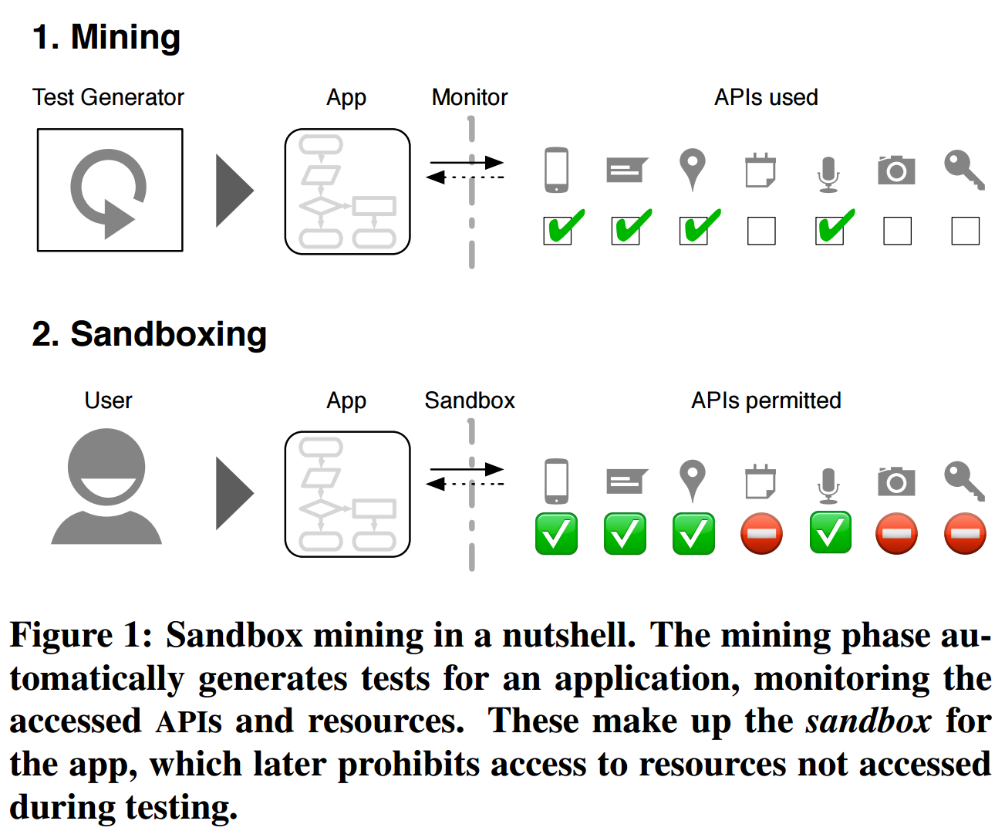
State-of-Research
Notes:
Background: an approach “Boxmate” proposed by Jamrozik et al. in ICSE 2016.
First, they use a test case generation tool to run Android apps automatically and explore behaviors of Android apps.
Duing its operation, Boxmate identifies sensitive Android APIs called during the execution of test cases and uses them to form a sandbox.
The sandbox will block calls to sensitive APIs unseen during testing. The set of sensitive APIs were quickly saturated by automated test generation. They also found that there were few false alarms by checking Boxmate against 18 use cases reflecting typical app usage

Slide 3
Motivation
The evaluation of Jamrozik et al.’s work
Only 12 benign apps
Goal
Effectiveness of mining sandboxes
in detecting malicious behaviors
Notes:
there is a need for additional studies to further demonstrate the applicability of mined sandboxes to detect and prevent malicious behaviors.

Slide 4
Motivation
The evaluation of Jamrozik et al.’s work
Only one test case generation tool
Goal
Effectiveness of multiple automated test
case generation tools to mine sandboxes
Notes:
there are many automated test case generation tools proposed in the literature,
More investigation is needed to assess: (1) which among these test case generation tools is more effective for building sandboxes, and (2) whether they can be used together to mine better sandboxes

Slide 5
Automated Test Case Generation Tool
Name | Strategy
Monkey | Random
GUIRipper | Model-based
PUMA | Model-based
Droidmate | Model-based
Droidbot | Model-based
Notes:
The primary goal of these tools is to detect existing faults in Android apps.
The test case generation tools could have different strategies to explore the behavior of an app under test, i.e., random, model-based, and systematic.
Monkey generates pseudo-random streams of user events such as clicks, touches, or gestures, as well as a number of system-level events. As Monkey has become a part of the Android developer toolkit, it is easy to install and use Monkey. GUIRipper builds a model of the app under test on the fly by collecting the information of the GUI of the app. It performs a depth-first search (DFS) procedure to generate input events from the model. PUMA is a generic framework that enables scalable and programmable UI automation. It supports the random exploration that is implemented by Monkey, as well as modelbased exploration by providing a finite state machine (FSM) representation of an app under test.
The key idea of Droidmate exploration strategy is to interact with views (GUI elements) randomly, but give precedence to views that have been interacted with the least amount of times so far.
Droidbot dynamically builds a GUI model of an app under test by collecting GUI information and running process information. Droidbot is lightweight, uses a simple DFS procedure to generate test cases

Slide 6


Experiment Setup
Benign
Malicious
Droidfax
Instrumentation
Format: caller -> callee
Test Generator
Sensitive APIs
Sensitive APIs
Sandbox
Malicious ?
Notes:
To validate the effectiveness of mining sandboxes, we run test case generation tools, construct sandboxes for benign apps based on sensitive APIs called in the execution of the generated test cases, and investigate the ability of those sandboxes to detect malicious behaviors in the malware that piggybacks the corresponding benign apps.
As both Droidmate and PUMA work on Android SDK version 19, we configure the emulator to run Android SDK version 19. An exception is made for running GUIRipper; it is not open source and the version that we have based on Choudhary et al.’s study [22] only works for Android SDK version 10.

Slide 7


App Selection
Piggybacked app dataset
Collected by Li et al. [1]
Instrumentation Failure
App Pairs
Installation Failure
1,497
Success
112
112 × 2 apps × 5 tools × 5 runs × 1 hour ≈ 233 days
Notes:
The malicious apps used in our study are piggybacked apps, which are built by unpacking benign apps and grafting some malicious code to them.
Previous studies shows most malware is piggybacked of benign apps, e.g., 80% of the malicious samples in the dataset MalGenome [18] are built through repackaging.
Each pair has one benign app and one malicious app, which is piggybacked on the benign app we fail to install a number of them on the emulator used in our study due to various compatibility issues with the SDK version and other settings of our emulators.
We configure each automated test case generation tool to run for each individual app for one hour and repeat this process 5 times.

Slide 8
Two Experiments
SmallE and LargeI
Index | Package | Category
P1 | com.google.android.diskusage | Tools
P2 | org.pyload.android.client | System
P3 | com.chinat2t10513zw.templte | Lifestyle
P4 | com.content.ugly.meter | Entertainment
P5 | andrei.brusentcov.lnguagepazzle.en | Education
P6 | com.northpark.beautycamera | Beauty
P7 | pl.netigen.bestbassguitarfree | Music & Audio
P8 | oms.wmessage | Communication
P9 | cz.romario.opensudoku | Puzzle
P10 | com.nesnet.android.cantonese | Book & Reference
Notes:
These 10 pairs of apps belong to different categories and have different functionalities. For example, both of P1 and P2 can access the storage of mobile devices since they need to manage files; P4 and P6 can take photos; P5 and P9 are game apps.

Slide 9
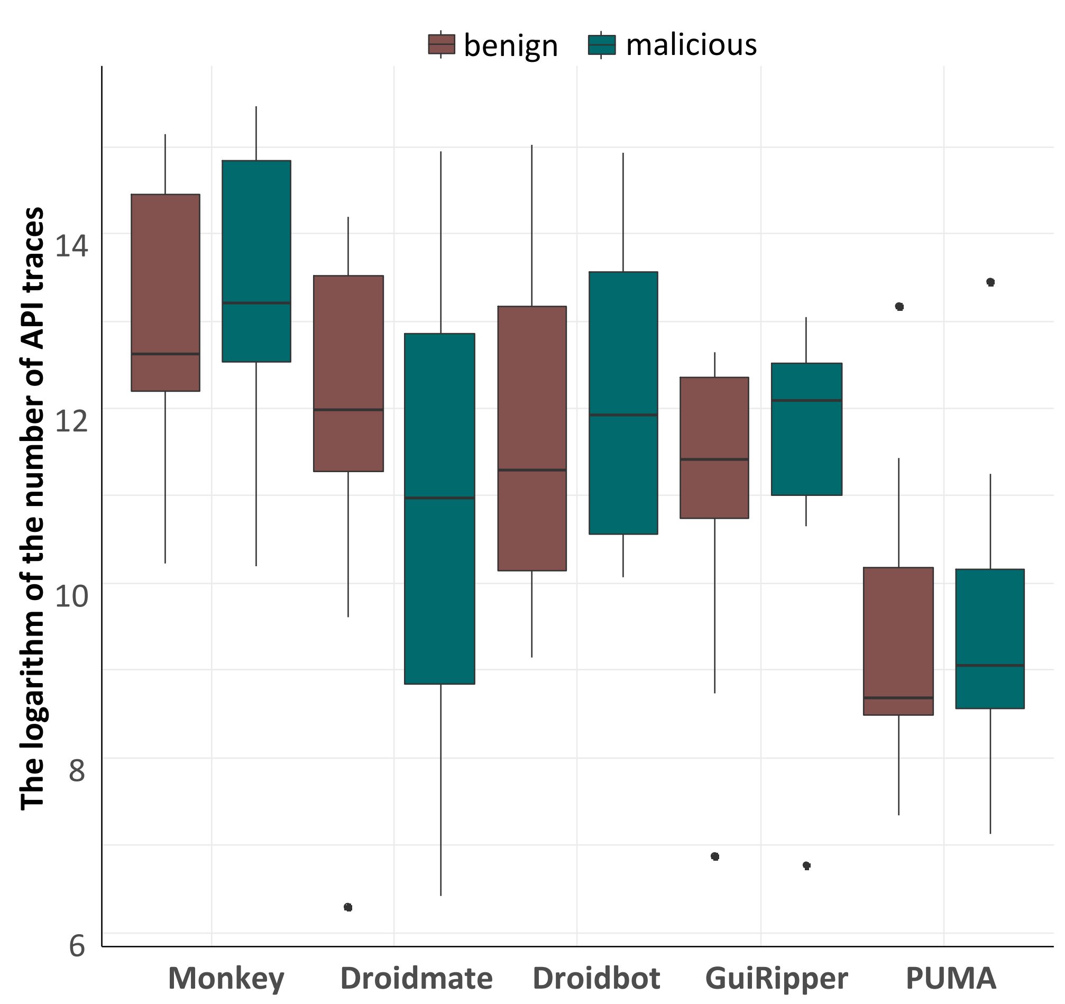
Experiment Results – SmallE
Statistics
The number of
API Traces
Notes:
Figure 3 shows the number of API traces across the 10 pairs of apps under test for each tool
The y-axis of this plot is the logarithm of the number of API traces as the range of the number of API traces is too large.
Monkey can generate the largest number of API traces in our experiment (i.e., more than one million API traces per run). This is because Monkey follows a random exploration strategy that might generate a large number of invalid inputs

Slide 10
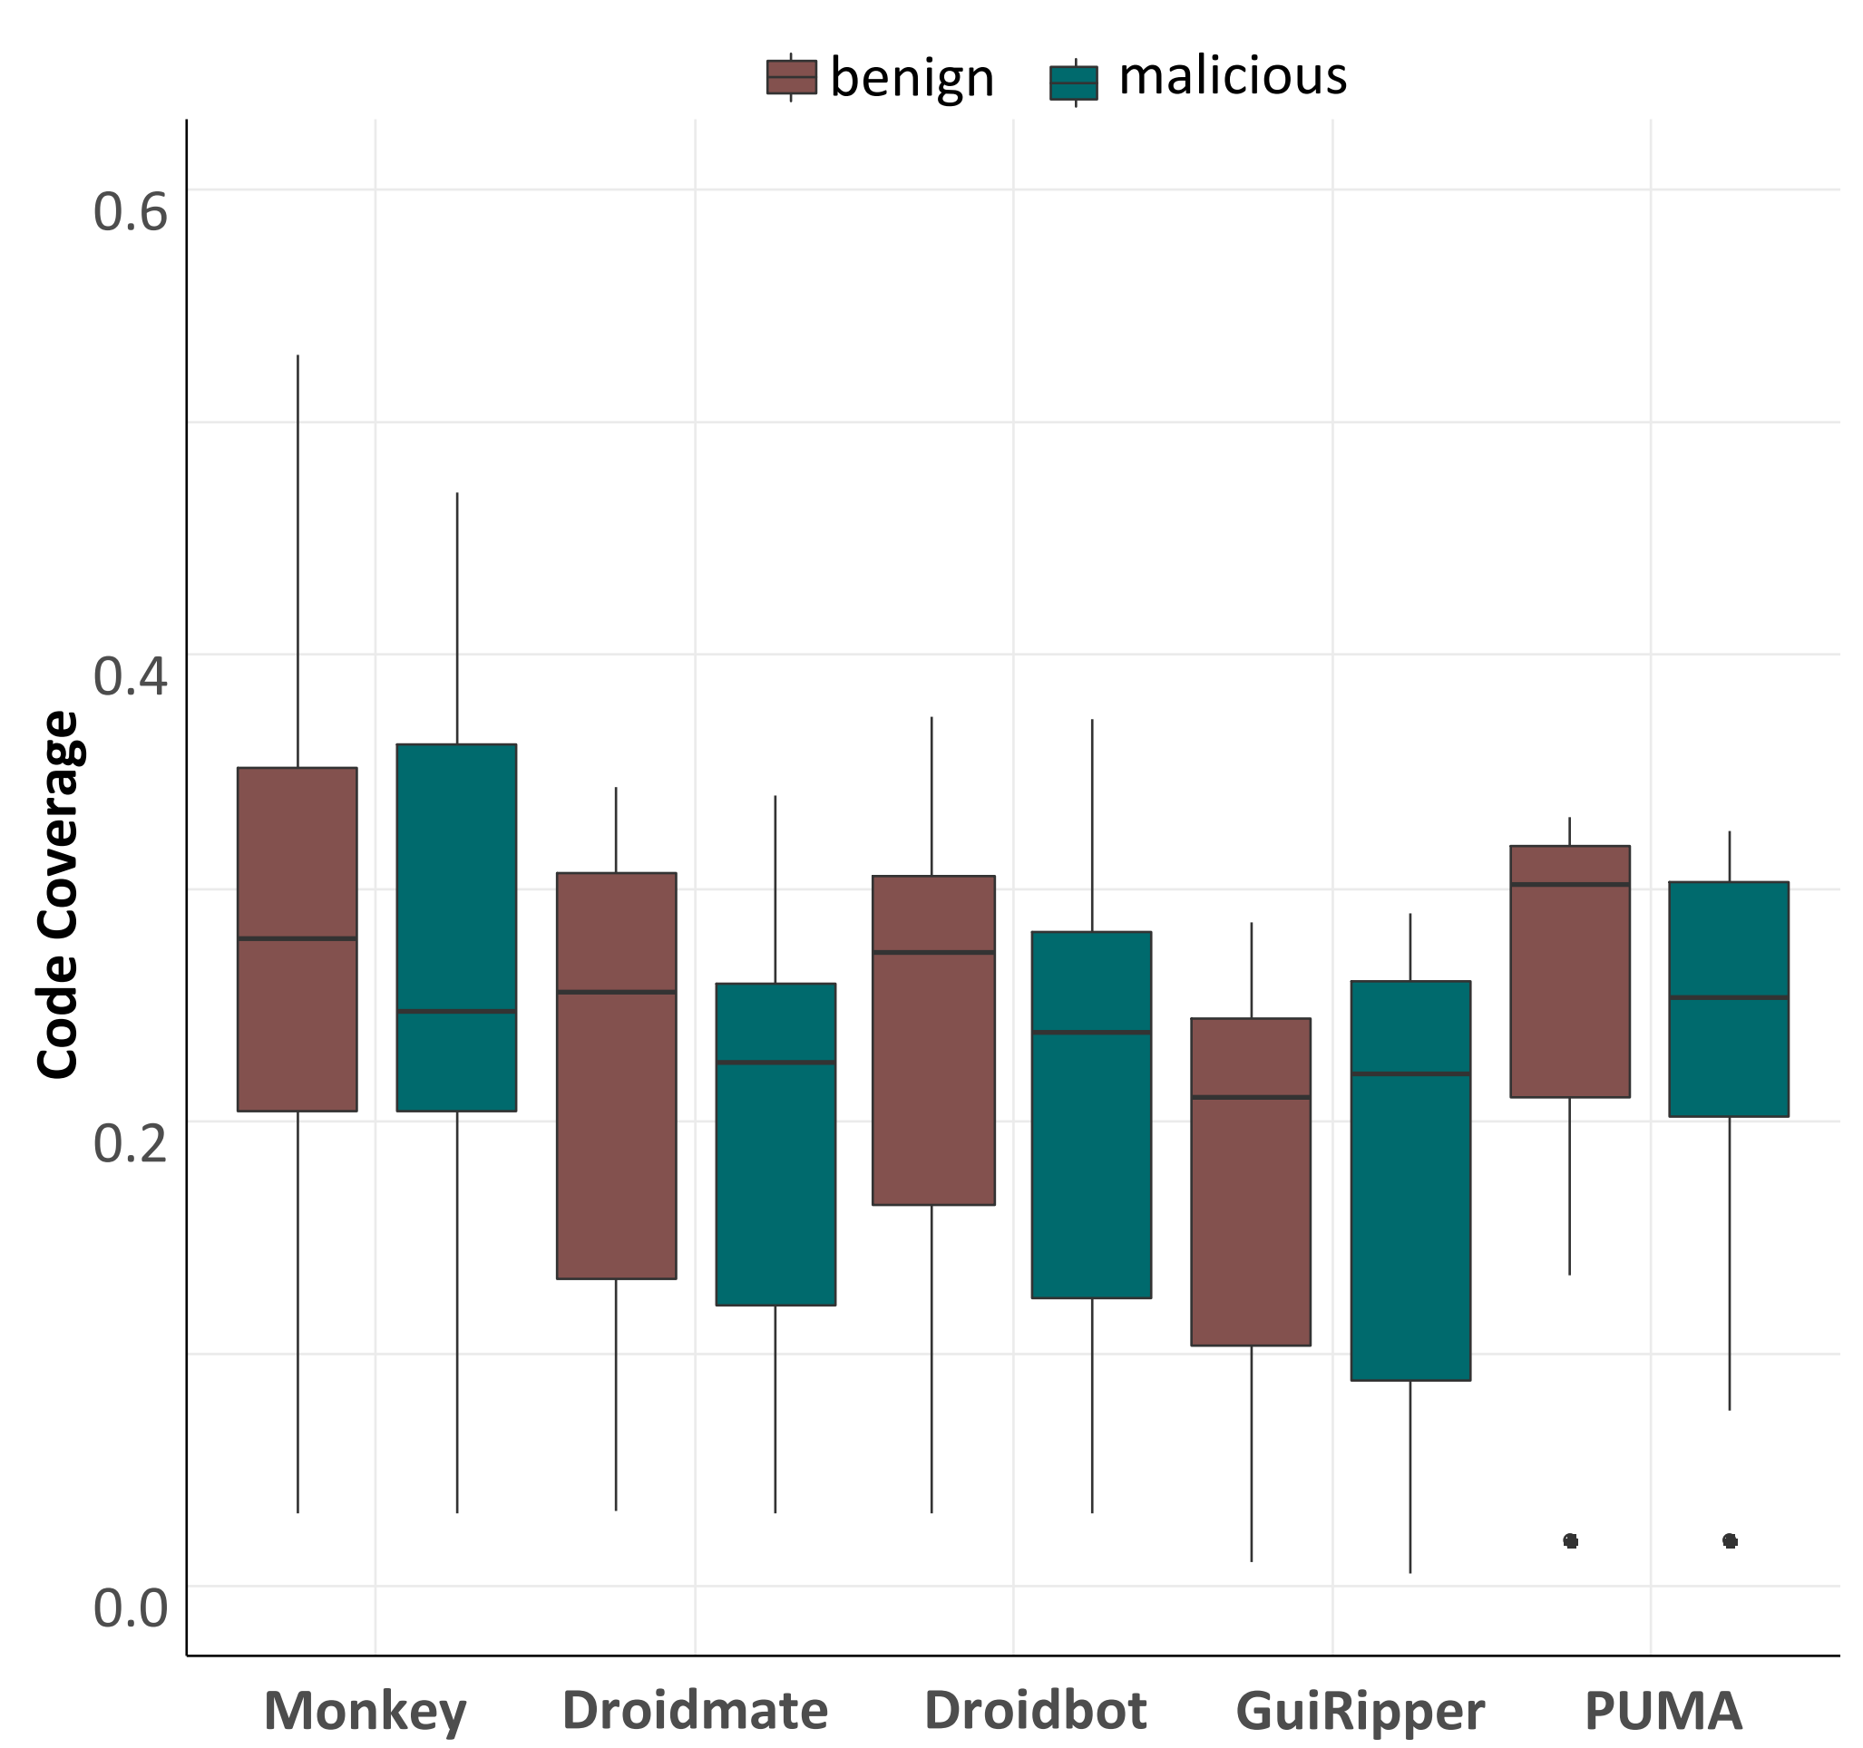
Experiment Results – SmallE
Statistics
Coverage
Notes:
Figure 4 presents the average code coverage of the five test case generation tools respectively. Although Monkey uses a simple random exploration strategy to explore the behavior of the app under test, it achieves the highest code coverage.
All the other tools have similar code coverage. One reason for the low code coverage might be that many of the unexecuted parts of the app are third party library code.

Slide 11
Experiment Results – SmallE
Effectiveness of Detecting Malicious Behavior
Benign API android.webkit.WebView.loadDataWithBaseURL(...)
Malicious APIs android.webkit.WebView.loadDataWithBaseURL(...) android.os.PowerManager$WakeLock.void acquire() android.telephony.TelephonyManager.getDeviceId() android.telephony.TelephonyManager.getSubscriberId()
Sample Detected Malicious Behavior
Notes:
Figure 5 presents an example of the sensitive API calls identified from the API traces generated for the benign and malicious apps of pair P8.
three additional sensitive APIs exist in the API traces of the malicious app, which shows that the malicious app tries to run background and steal the device and subscriber ID.

Slide 12


Experiment Results – SmallE
Effectiveness of Detecting Malicious Behavior
Pair | Monkey | Droidmate | Doridbot | GUIRipper | PUMA
P1
P2
P3
P4
P5
P6
P7
P8
P9
P10
Notes:
Table II presents the results on whether the sandboxes constructed by running different test case generation tools can identify the malicious apps.
All the sandboxes constructed by running these tools were able to identify the malicious behaviors for four pairs, i.e., P3, P4, P7, P9.
For pair P8 and P10, GUIRipper and PUMA failed to run the apps of pair P8 and P10, respectively.
Only Monkey found that the malicious app in pair P1, which invoked the sensitive API “android.webkit.WebView.loadDataWithBaseURL(...)”
we run all the tools for the malicious app and check if the sandbox could detect the malicious behavior. This sandbox can identify 8 out of 10 malicious apps except for the malicious apps in pair P2 and P6
Mining sandbox method can effectively identify 8 out of the 10 malicious apps as such

Slide 13
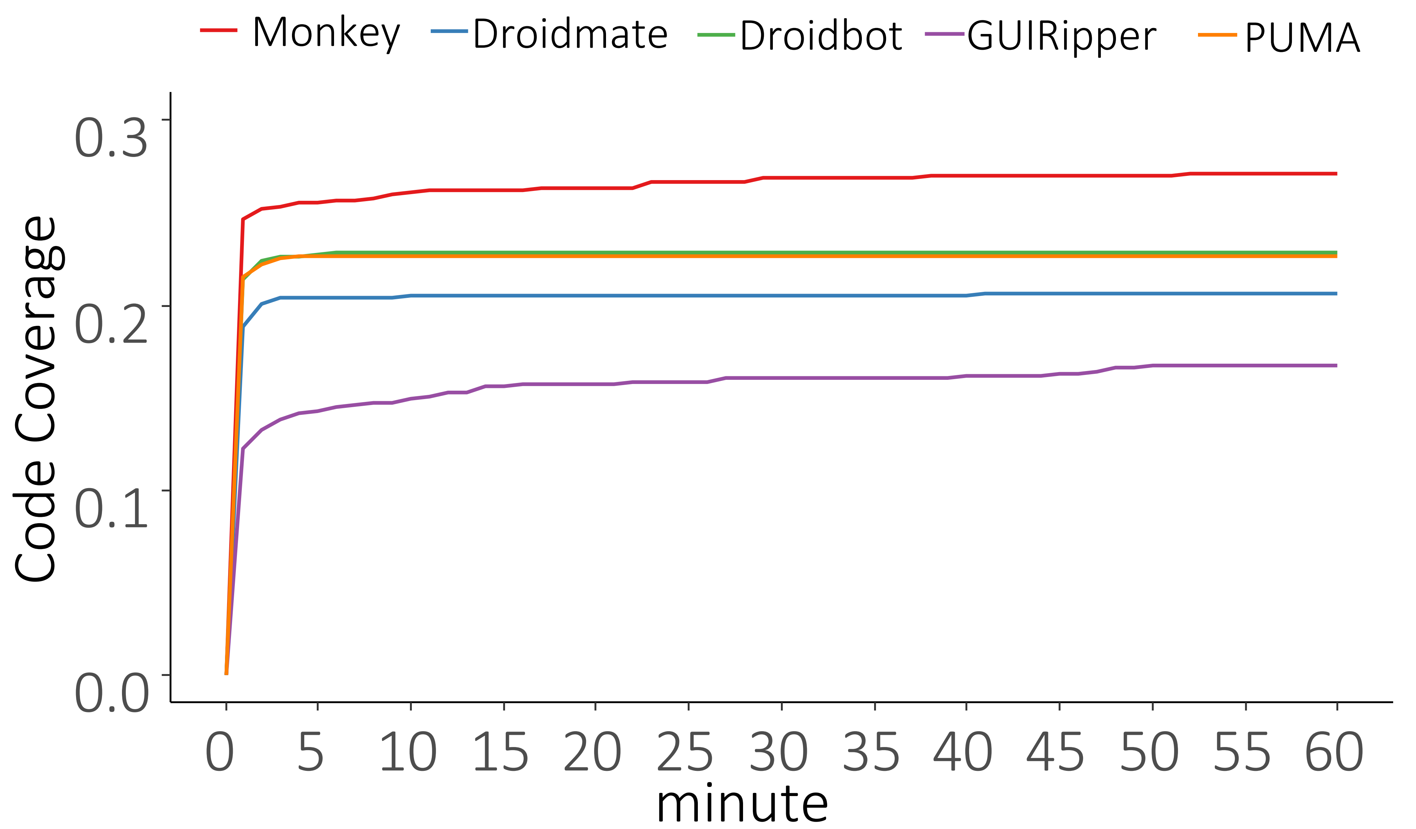
Experiment Results – SmallE
Efficiency of Detecting Malicious Behavior
Notes:
Figure 6 presents code coverage of these five test case generation tools over time.
All the tools achieve a coverage value that is close to the maximum value in one minute except GUIRipper. GUIRipper frequently restarts the exploration from the starting state. This operation needs time to restart the emulator

Slide 14
Experiment Results – SmallE
Efficiency of Detecting Malicious Behavior
Pair | Monkey | Droidmate | Doridbot | GUIRipper | PUMA
P1 | 3,412
P2
P3 | 1,642 | 8 | 9 | 35 | 23
P4 | 81 | 10 | 15 | 37 | 24
P5 |  |  |  | 13
P6
P7 | 44 | 13 | 24 | 368 | 26
P8 | 192 | 9 | 37 |  | 35
P9 | 352 | 56 | 10 | 33 | 22
P10 | 775 | 7 | 11 | 33
Mean | 928.3 | 17.2 | 17.7 | 86.5 | 26.0
Notes:
investigate the minimum amount of time the generated sandbox can identify malicious apps using test cases generated by the different test case generation tools.
Test cases generated using Monkey are the least efficient in detecting malicious apps.
The average time to detect malicious apps using all other tools (except Monkey) is less than two minutes.

Slide 15
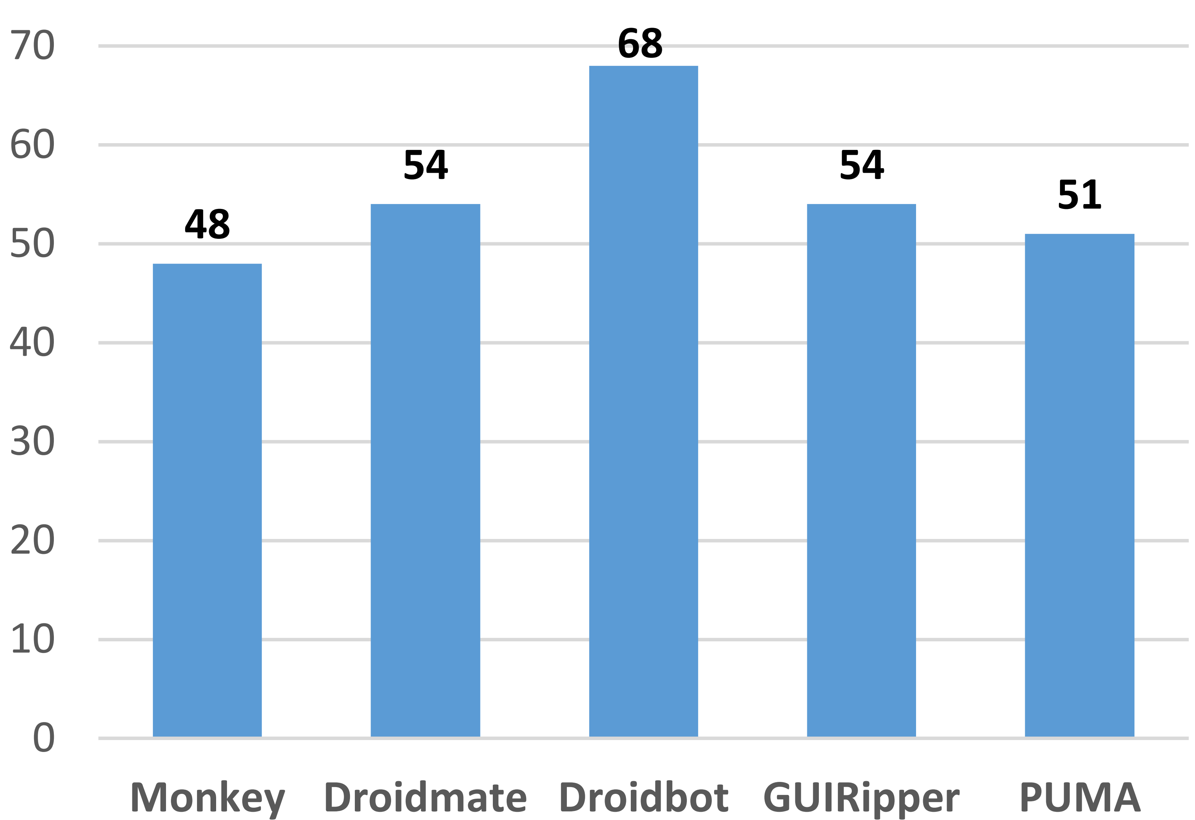
Experiment Results – LargeI
Monkey | Droidmate | GUIRipper | PUMA
73 | 74 | 77 | 71
Combined with Droidbot
Notes:
Sandboxes built by running Monkey, Droidmate, Droidbot, GUIRipper, and PUMA identified 48, 54, 68, 54, and 51 malicious apps among the 102 malicious apps, respectively.
The sandboxes built by running Droidbot identified the largest number of malicious apps.
we built sandboxes by combining Droidbot with each of the other four tools. We found that the number of identified malicious apps detected is increased to 73 (Droidbot+Monkey), 74 (Droidbot+Droidmate), 77 (Droidbot+GUIRipper), 71 (Droidbot+PUMA),
We also combined all the five tools together. For this setting, we found that 77 out of the 102 malicious apps were identified.

Slide 16
Conclusion & Future Work
Mining sandboxes can effectively detect malicious behaviors.
SmallE: 7, 6, 6, 6, 5
LargeI: 48, 54, 68, 54, 51
Multiple test case generation tools can be used to boost effectiveness of mined sandboxes.
SmallE: 8/10
LargeI: 77/102

Slide 17
Conclusion & Future Work
More work is needed to further improve the effectiveness of mining sandboxes.
To cover more behavior of an app under test.
Maintenance for automated test case generation tools
More complex sandboxes can capture additional constraints
Parameter values need to be considered

Slide 18
