Slide 1

Project Hyperkey
Introduction – Ming Chia, 17/03/26

Slide 2
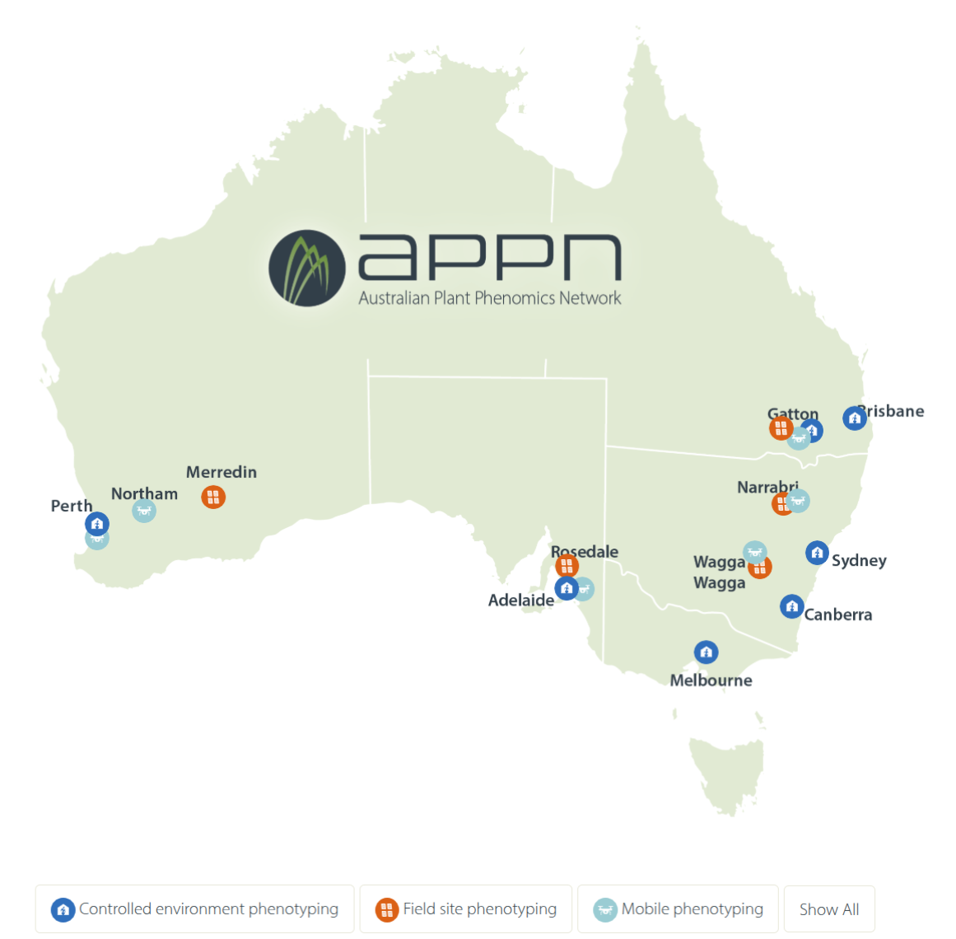
before the project ...
Acknowledgement of Country
About the APPN
Facility tour at some point?
Introductions

Slide 3
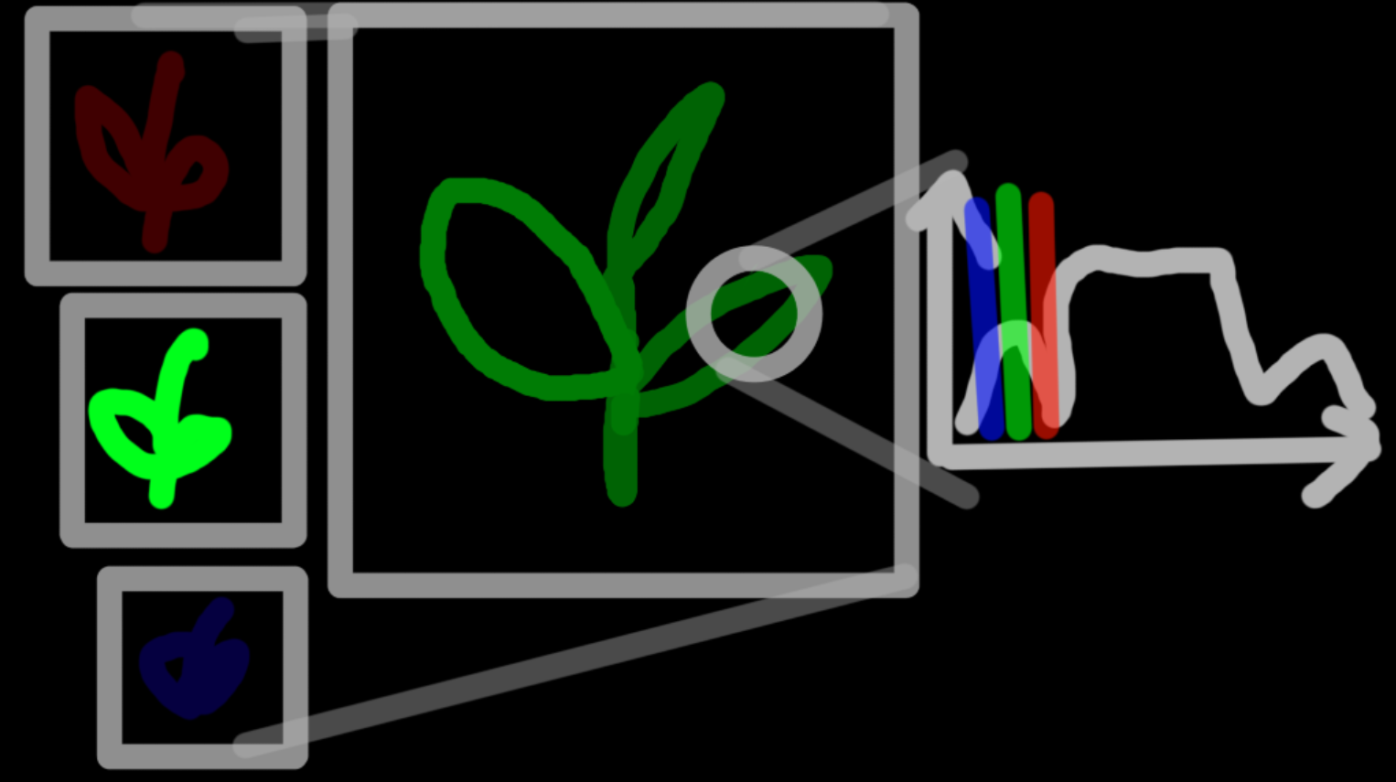
hyperspectral measurements
RGB
3 wavelengths (low spectral resolution)
Millions of pixels (high spectral resolution)
Hyperspec
700-2000 wavelengths (high spectral resolution)
1 "pixel" (no spectral resolution – unless with scanners)
Goes outside human vision (short wave infrared)

Slide 4
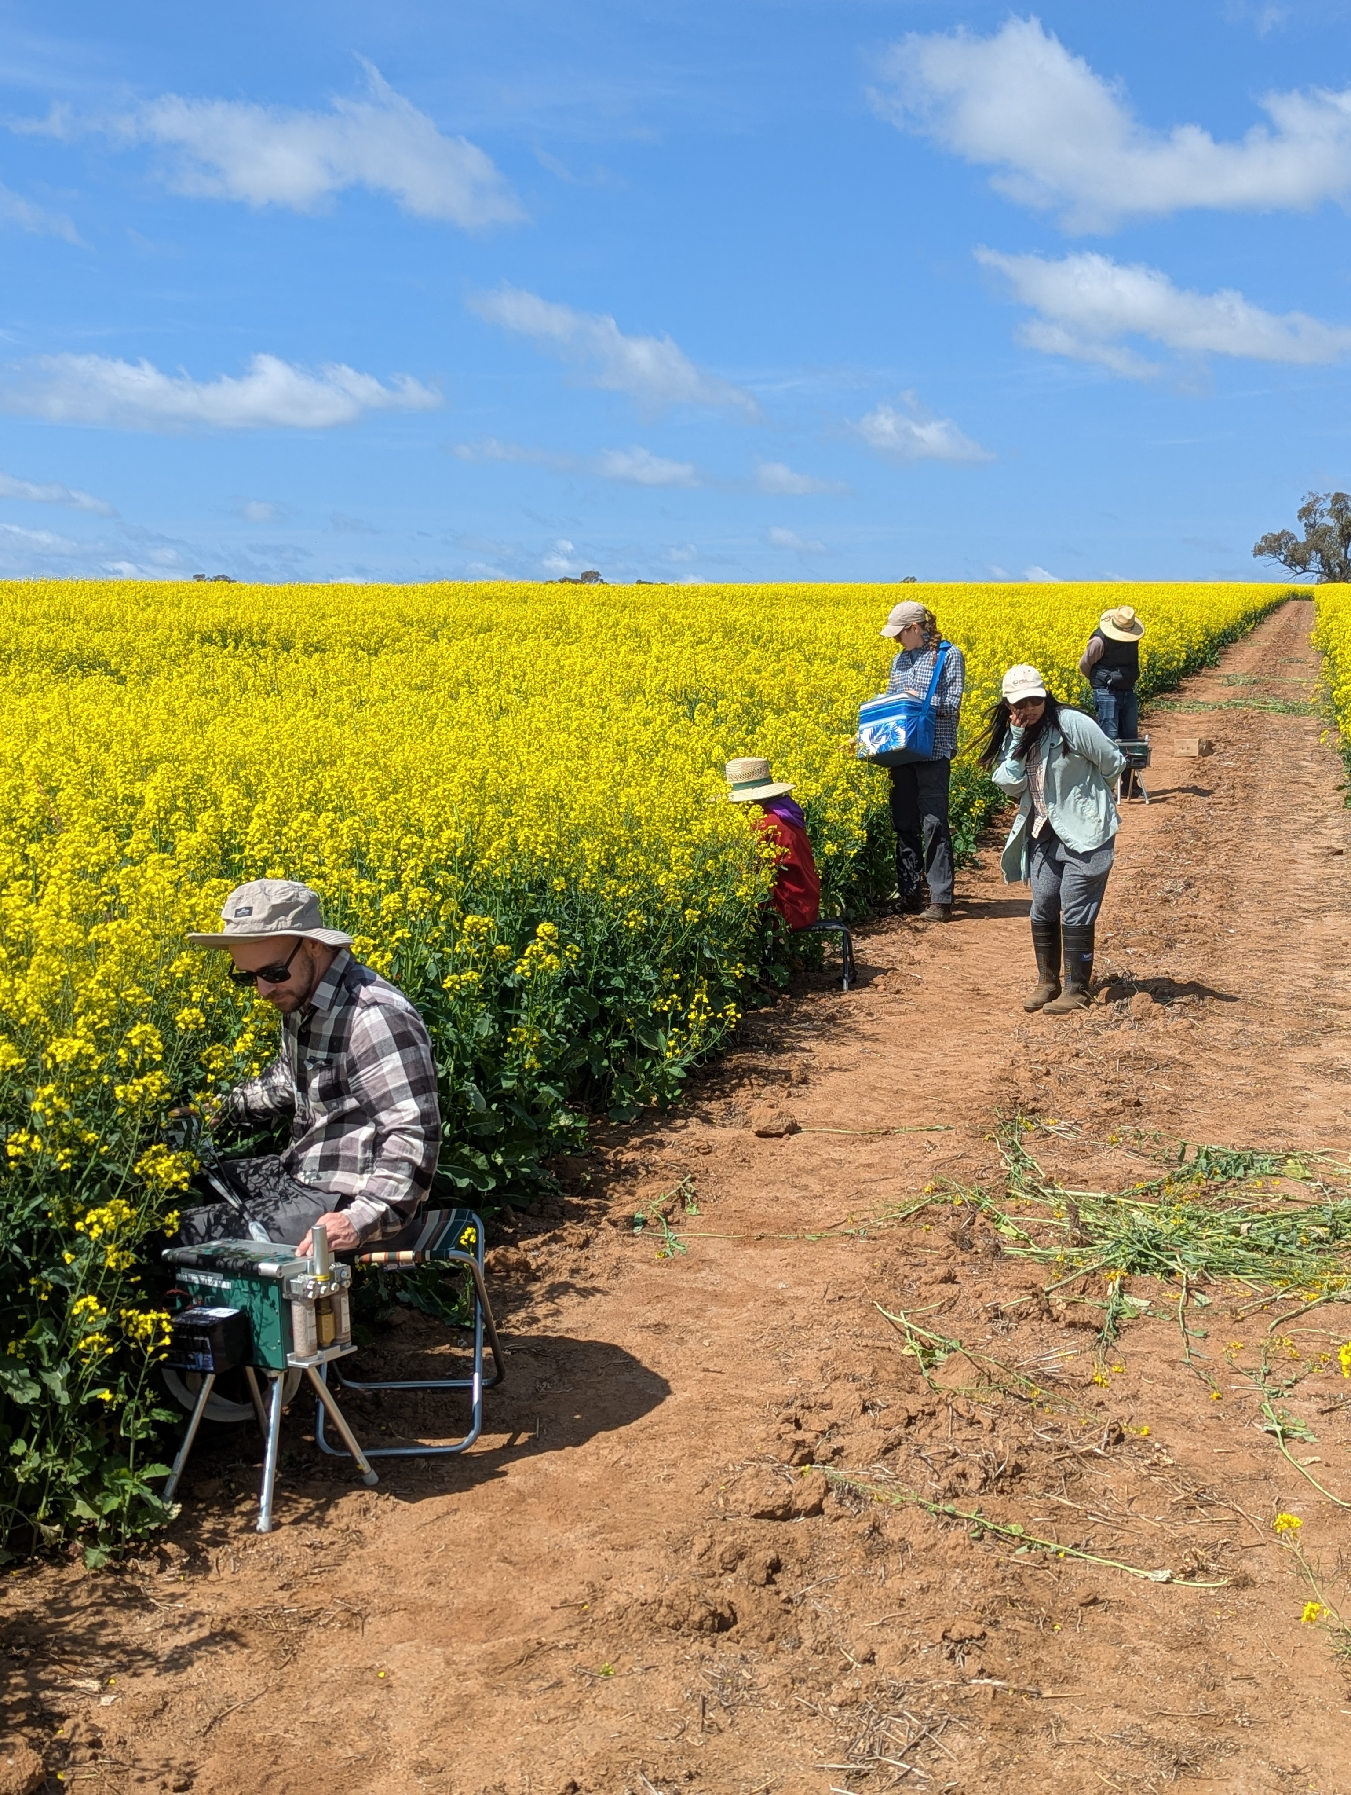
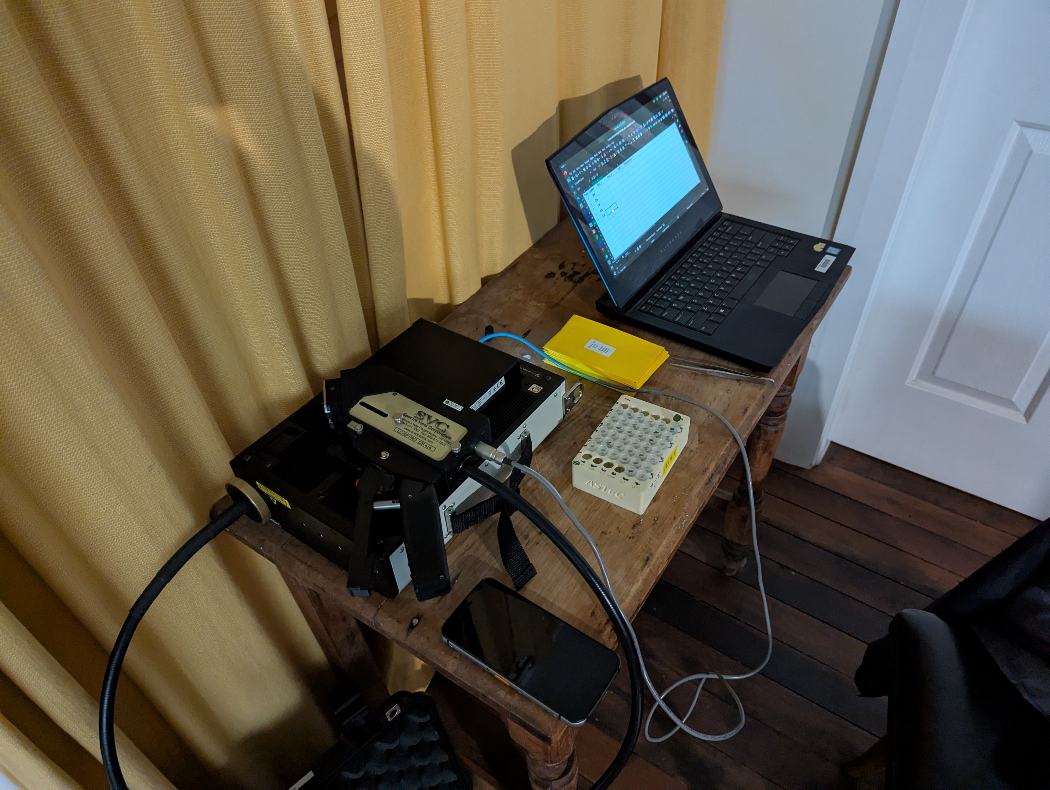
how do we get these measurements
Field vs. Lab measurements

Slide 5
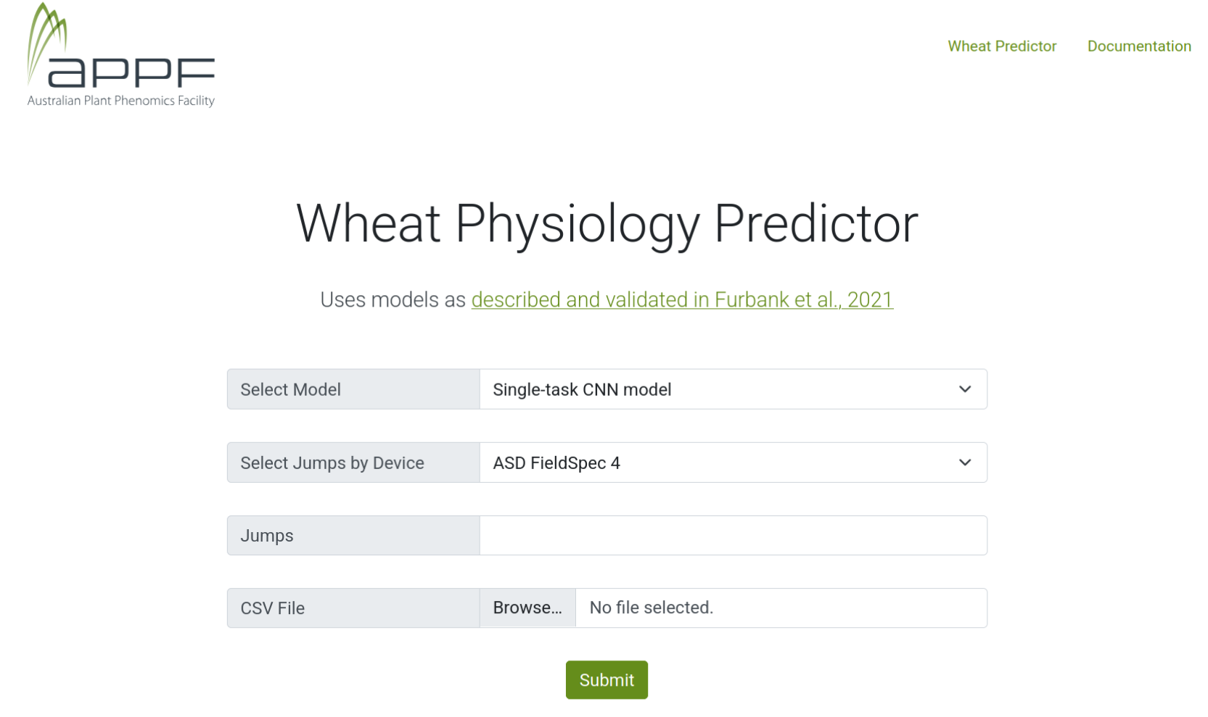

what happens to these measurements?
ML models with other measurements (the actual measurements plant scientists are interested in)
e.g. Wheat Predictor app

Slide 6
why do we use these measurements?
Working towards remote sensing
Faster
Non-destructive

Slide 7
measurement challenges
Operator error (e.g. insufficient leaf area)
Instrument error (instrument lamp off)
Environmental bias (plants sprayed, lots of dew)

Slide 8
core HyperKey layout
Unified data
Data files
+
Metadata spreadsheet(s)
Formatted visual report(s)
✨

Slide 9
core HyperKey layout
Data files + metadata spreadsheets
See sample data
Unified data + visual report
Metadata x reflectances on one spreadsheet
Check which metadata entries have valid data
Heatmap NDVI (for VNIR region) + index for SWIR1/SWIR2 (tbd)

Slide 10
HyperKey design principles
Interface
Have more options (with default values)
Document for both tech-oriented and agriculture/biology-oriented users
Immediate users: Biologists with some experience in CLI tools
Visual design
Old-school terminal type elements with more overall color
… while being large enough to share on mobile
Subject to change! Discuss

Slide 11
Overall deliverables
Command line interface program that takes in data/metadata, produces report
(Contributions) Summary promo website
(Optional) GUI wrapper to core program
This is phase 1 – phase 2/3 is a design constraint but getting a head start is likely out of scope

Slide 12
what do you need?
Sample data – 2x SVC files (more later)
SVC manual with file format documentation
Sample metadata sheet
Next week: 1x field metadata, 1x lab metadata, 1x lab metadata + positions

Slide 13
Goals this week
Rough plan for the year (6 sprints)
Keep in mind assessments!
Realistic goals for 1 day/week
Sprint 5/6 are in field season for us
Research and share anything you need more info on

