Slide 1
— PAWSEY ACACIA · RESEARCH DATA TRANSFER
Pawsey
Uploader
Move your research data into Pawsey object storage — safely, with progress, an audit trail, and a recycle bin. No command line required.
🖥
☁
YOUR PC
PAWSEY ACACIA
Version 1.4 · DPIRD · Demo & end-user guide
01 / 15

Slide 2
— WHY THIS TOOL
rclone's power, with guard rails
Raw command line
Pawsey Uploader
▪ One mistyped flag and sync deletes data on Pawsey
▪ No prompt, no progress bar, no undo
▪ Nothing records what you transferred or why
▪ A dropped connection means starting over
▪ Copy is the safe default — it never deletes
▪ Live progress, a recycle bin, and a delete safety cap
▪ Every transfer needs a note → permanent audit log
▪ Crash-resilient: resume any interrupted transfer
02 / 15

Slide 3
— ORIENTATION
Six tabs, one job each
TRANSFER
BUCKETS
STORAGE
Move data
Containers
File manager
Pick a folder, a destination, a mode, write a note, hit Start.
Create or delete the top-level buckets your data lives in.
Browse Pawsey, upload, download, rename / move, recycle bin.
HISTORY
SETTINGS
HELP
Audit log
Connection
In-app guide
Every transfer and action, with your notes and final status.
Your Pawsey keys, defaults, and performance tuning.
The full manual, always one click away inside the app.
03 / 15

Slide 4
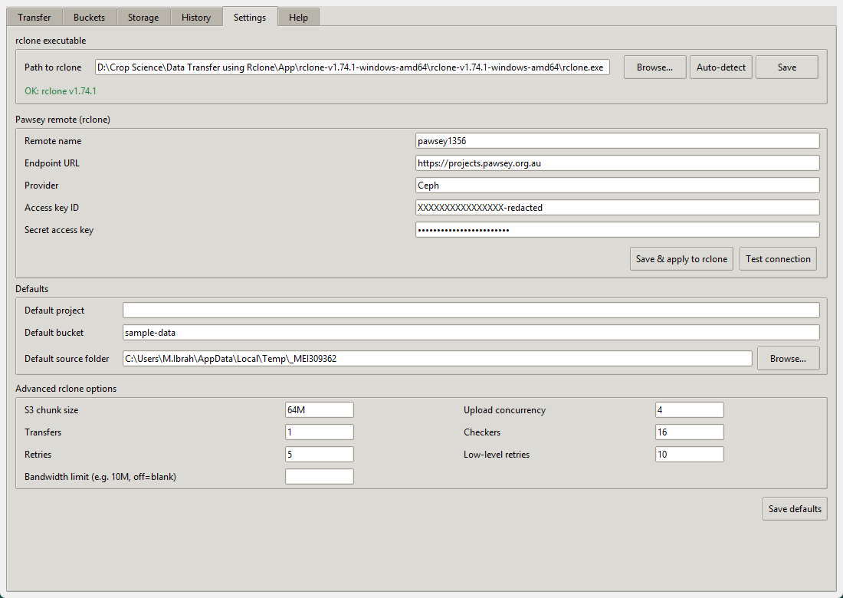
— ONE-TIME SETUP
Connect to Pawsey
DO THIS ONCE
▪ Paste your Access key ID and Secret access key
▪ Endpoint defaults to projects.pawsey.org.au — leave it
▪ Click Save & apply to rclone, then Test connection
▪ Set your usual default bucket & source folder
Keys disabled? A 403 UserSuspended means Pawsey turned your keys off — email help@pawsey.org.au. No app setting can fix that.
» Settings tab — credentials shown redacted
04 / 15

Slide 5
— THE KEY DECISION
Which mode should I use?
Mode | Direction | Deletes? | Use it when…
Copy | PC → Pawsey | Never | First upload, or adding new data to an archive. Safe default.
Mirror | PC → Pawsey | Yes, on Pawsey | You want Pawsey to be an exact copy of your folder right now.
Two-way sync | PC ⇄ Pawsey | Both sides | You work from more than one machine and want them kept identical, OneDrive-style.
Resume | continue | — | A previous transfer was interrupted and you want to finish it.
Rule of thumb: start with Copy. Only reach for Mirror or Two-way sync when you specifically need deletions to propagate — and keep the recycle bin on when you do.
05 / 15

Slide 6
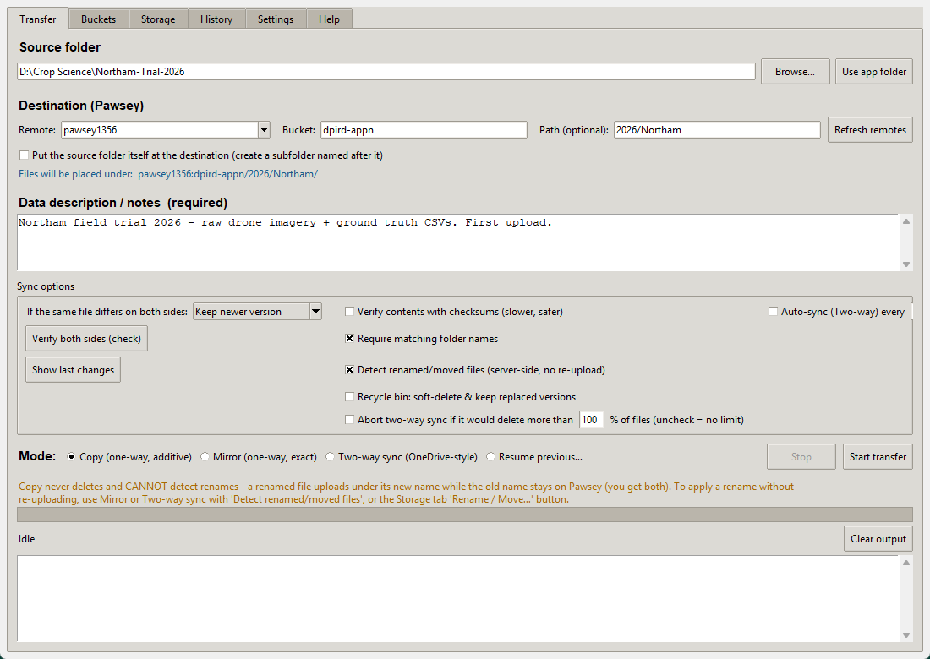
COPY · ONE-WAY, ADDITIVE
Scenario 1 — First upload & archiving
WHEN TO USE
You're sending data to Pawsey for the first time, or topping up an existing archive. Copy only ever adds and updates — it never removes anything on Pawsey, so you can't lose data with it.
BEFORE YOU CLICK START
✓ Source folder is correct
✓ The blue “Files will be placed under…” line points where you expect
✓ You've written a note (required)
» Transfer tab · Mode = Copy (one-way, additive)
Renamed a file? Copy can't tell — it uploads the new name and leaves the old one too. Use Mirror or Two-way for renames.
06 / 15

Slide 7
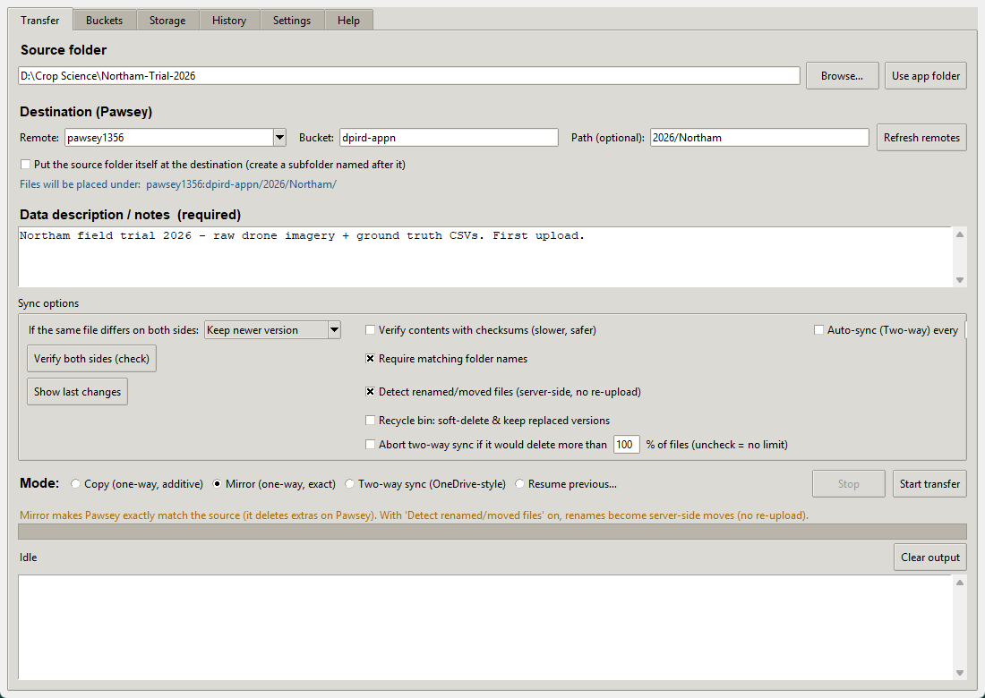
MIRROR · ONE-WAY, EXACT
Scenario 2 — Make Pawsey match exactly
WHEN TO USE
You want Pawsey to become an exact replica of your local folder — including removing files on Pawsey you've deleted locally. Good for publishing a cleaned-up, final dataset.
BEFORE YOU CLICK START
✓ Recycle bin ticked — deleted files move to _recycle_bin/
✓ Leave the delete safety cap on
✓ Detect renamed/moved files on → no re-upload of renames
» Transfer tab · Mode = Mirror (one-way, exact)
Mirror deletes anything on Pawsey not in your source. The app lists what will be removed and makes you confirm.
07 / 15

Slide 8
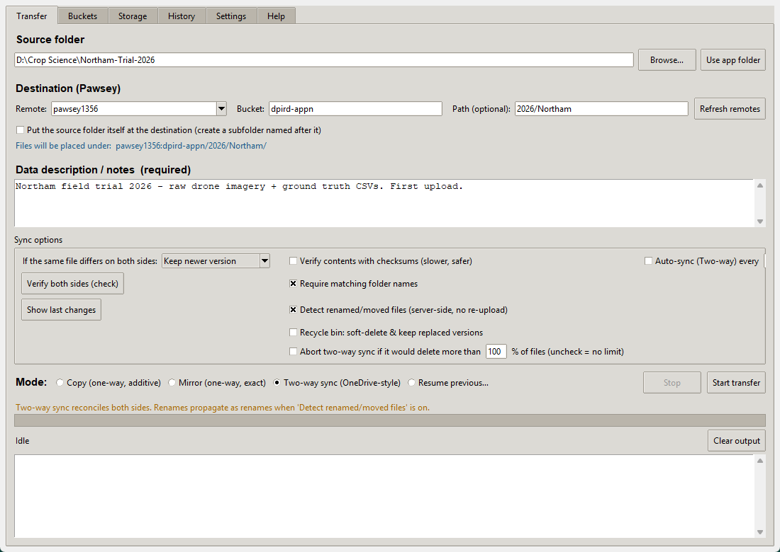
TWO-WAY SYNC · ONEDRIVE-STYLE
Scenario 3 — Keep both sides in sync
WHEN TO USE
You add, edit or delete files on either side — laptop, office PC, or Pawsey — and want every change to flow both ways automatically.
HOW IT WORKS
▪ The first run builds a baseline (local wins clashes); then both sides are equal
▪ Always use the same folder + same Pawsey path per project
▪ Tick Auto-sync every N min to keep it running OneDrive-style
▪ Set conflict resolution for files changed on both sides
» Transfer tab · Mode = Two-way sync (bisync)
08 / 15

Slide 9
RESUME PREVIOUS…
Scenario 4 — It got interrupted
What to do
It often resumes itself
▪ Reopen the app after a crash, reboot, or dropped link
▪ Transfer tab → choose Resume previous…
▪ Pick the transfer from the list (last 50 are remembered)
▪ Click Start — rclone skips files already uploaded
▪ Auto-restart on a network blip — up to 10 tries with backoff
▪ Stops cleanly on real errors (bad keys, missing bucket)
▪ Keeps your PC awake while a transfer runs
▪ A heartbeat file lets you check it's alive elsewhere
09 / 15

Slide 10
— SYNC OPTIONS
Your safety controls
If files differ
Recycle bin
Delete safety cap
Keep newer, keep both, or let local / Pawsey win when the same file changed on both sides.
Deleted & overwritten files move to _recycle_bin/ in the bucket — built-in version history.
Abort a two-way sync that would delete more than N% of files. Guards against accidental wipes.
Require matching names
Detect renamed files
Verify with checksums
Blocks a sync if the source name ≠ destination name. Stops the wrong project syncing to the wrong place.
Renames become server-side moves on Pawsey — no slow re-upload of huge folders.
Compares by MD5 hash instead of size + time. Slower, but catches silent corruption.
10 / 15

Slide 11
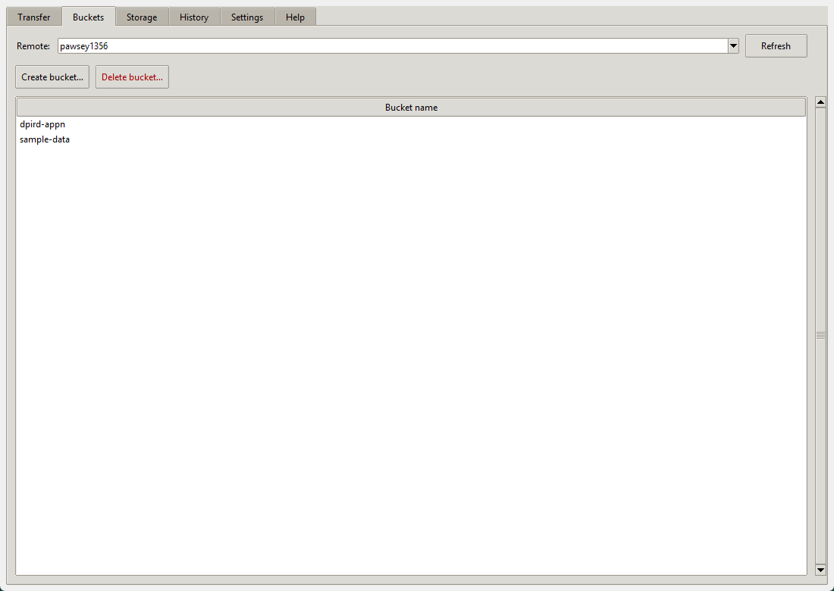
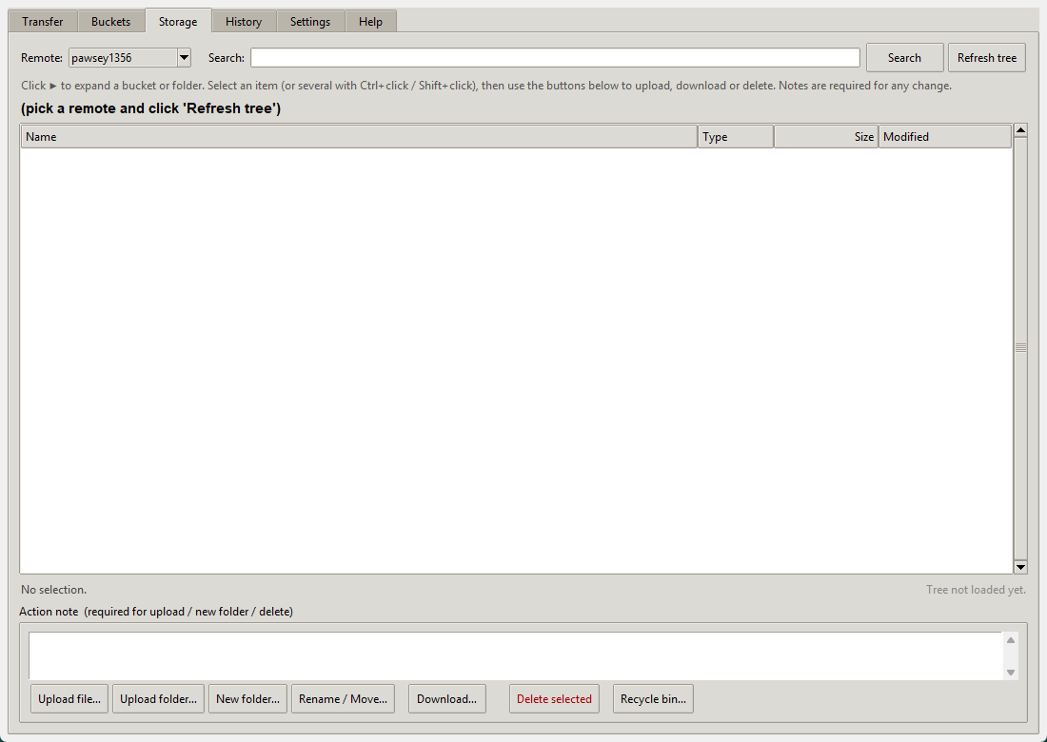
— MANAGE WHAT'S THERE
Buckets & Storage
BUCKETS — THE CONTAINERS
STORAGE — THE FILE MANAGER
» Create lowercase-hyphen names · delete needs typed confirm (no undo)
» Browse, upload, download · Rename / Move = TB-scale rename, no re-upload
11 / 15

Slide 12
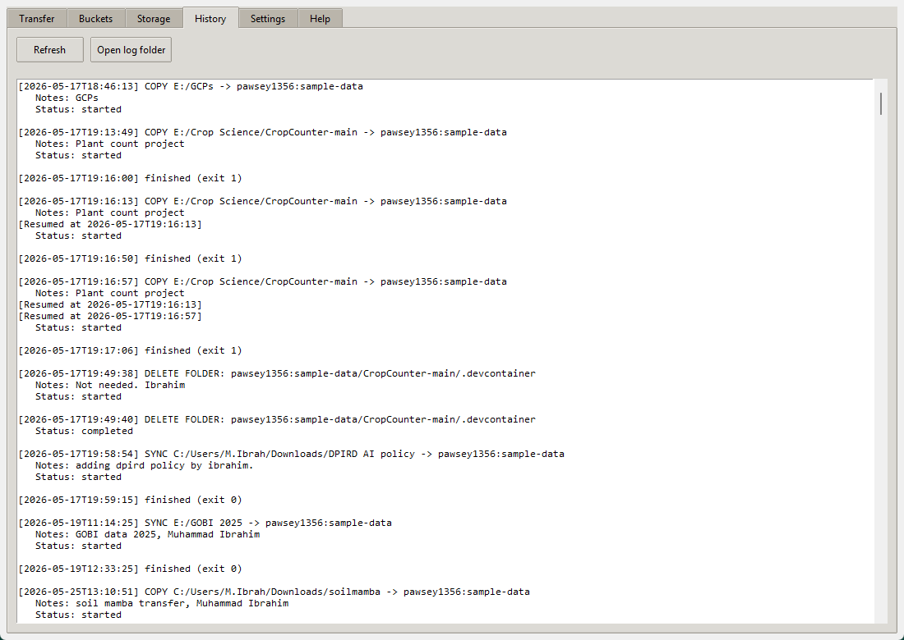
— AUDIT TRAIL
Nothing happens without a note
WHY IT MATTERS
Every transfer, delete, rename and upload is written to a permanent log with the note you wrote, the source, the destination, and the final status.
▪ The note is mandatory — no note, no transfer
▪ Answers “who put this here, and why?” months later
▪ Open log folder jumps straight to the raw files
» History tab — every transfer and storage action, permanently logged
12 / 15

Slide 13
— KEEP THESE IN MIND
Seven golden rules
▪ Copy is the safe default — it never deletes.
▪ Read the blue “Files will be placed under…” line every time.
▪ Mirror and Two-way can delete — keep the recycle bin on.
▪ Always write a real note — it's your future audit trail.
▪ For two-way sync, reuse the same folder & path per project.
▪ Renaming a big folder? Use Storage → Rename / Move.
▪ Empty the recycle bin now and then — it counts toward quota.
13 / 15

Slide 14
— IF SOMETHING LOOKS WRONG
Troubleshooting
rclone not found
403 UserSuspended
Point Settings → Path to rclone at the bundled rclone.exe, or install rclone and restart.
Your Pawsey keys are disabled. Email help@pawsey.org.au — no setting fixes this.
Transfer stopped halfway
Must run --resync
Reopen → Resume previous… → pick it → Start. Already-uploaded files are skipped.
A two-way baseline was lost. Run the pair again — the app rebuilds it without losing remote changes.
14 / 15

Slide 15
— SUGGESTED LIVE WALKTHROUGH
Let's see it in action
1 Settings → Test connection (green tick)
2 Transfer → Copy a small folder; watch progress + note
3 Storage → show it landed; Rename / Move it
4 Transfer → Two-way sync the pair; change a file; sync again
5 History → show both runs logged with notes
REMEMBER
Start with Copy. Write a note. Read the blue line.
Everything else — Mirror, Two-way, the recycle bin — builds on those three habits.
15 / 15

