Slide 1

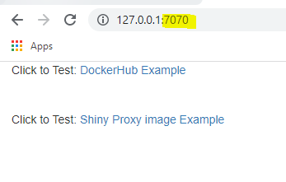
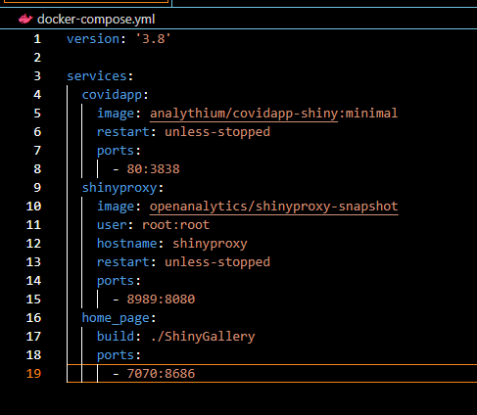
Home App
Covid App
(DockerHub Image)
Redirect
Port 80
Redirect
Shiny Proxy
(DockerHub Image)
Port 8989
Home Page
(Dockerfile Image)
Port 7070

