Slide 1

Expectation-Propagation performs smooth gradient descent Advances in Approximate Bayesian Inference 2016
Guillaume Dehaene
Notes:
I’d like to thank the organizers for inviting me.
I’m going to present some new work on expectation propagation, which shines a new light on this algorithm, by showing that it performs a smoothed gradient descent

Slide 2
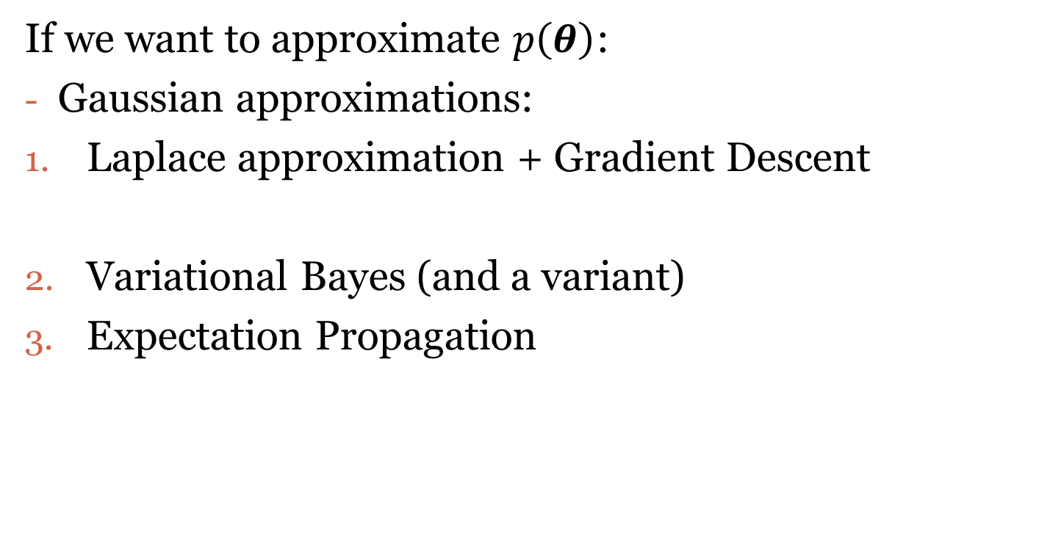
Computational troubles in Bayesia
If we want to approximate $p\left(θ\right)$:
Gaussian approximations:
Laplace approximation + Gradient Descent
Variational Bayes (and a variant)
Expectation Propagation
Notes:
The problem: Bayesian methods are susceptible to computational trouble
You should think of the first choice as conservative, and a bit boring, sort of like Jeb Bush
While the next two are the opposite of that, so maybe like 2007 Senator Barrack Obama
What I will show in this talk is that these three methods are closely linked.

Slide 3
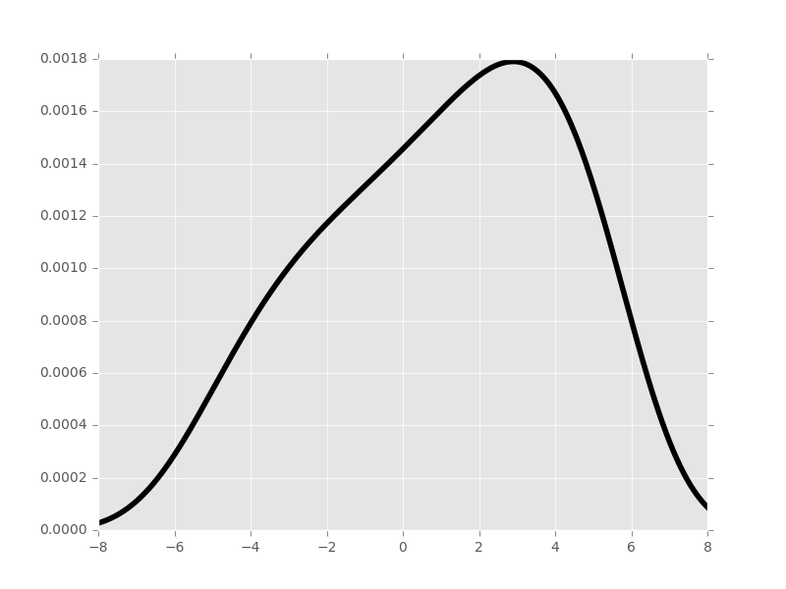
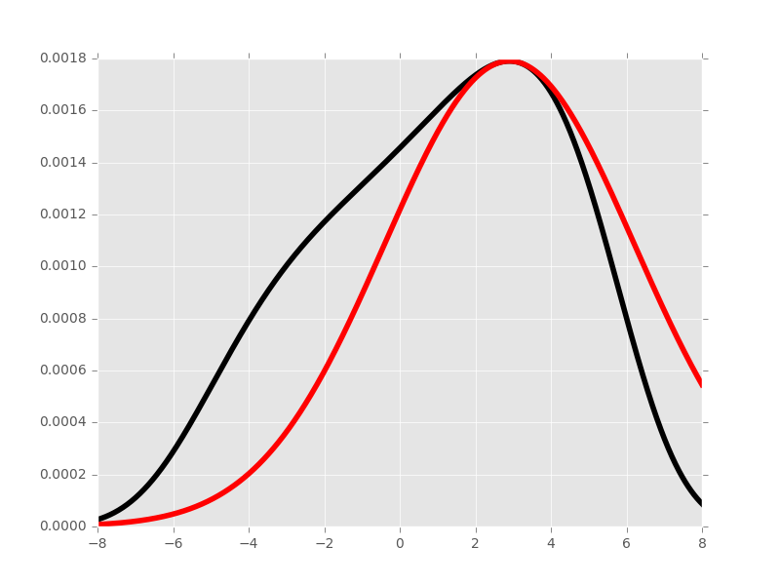


Laplace + Gradient Descent
Laplace = Gaussian approximation at the mode
Computed using Gradient Descent on $ψ=−\log{p}$
Probability
$$θ$$
Notes:
So here is one example of a posterior distribution
The laplace approximation consists in finding its maximum and fitting a purely local Gaussian approximation there

Slide 4
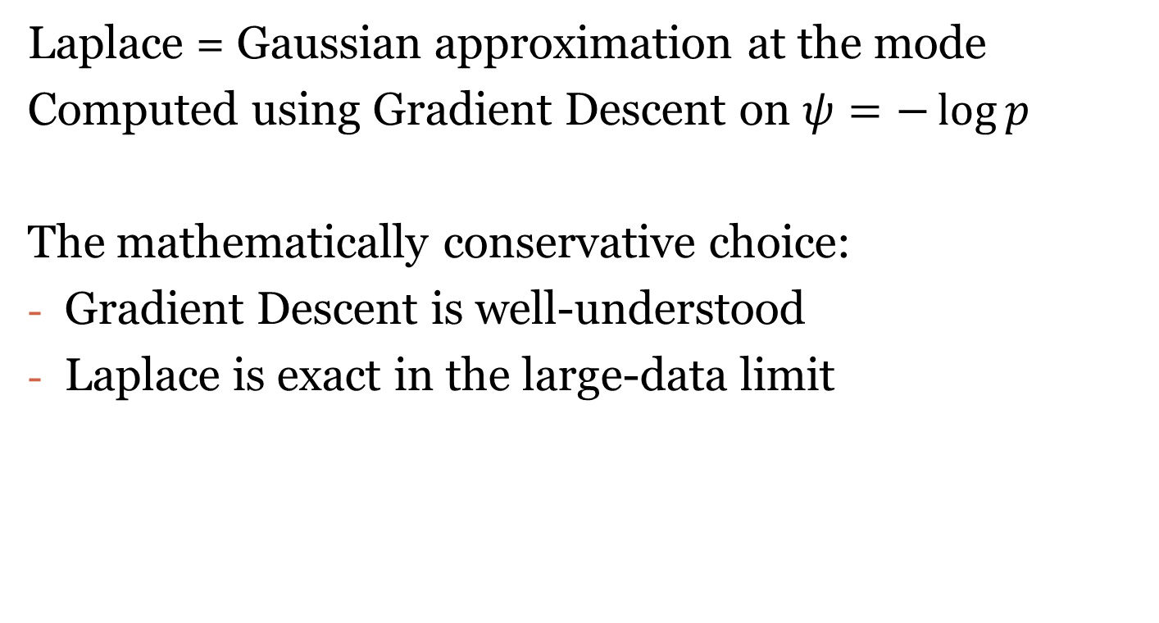
Laplace + Gradient Descent
Laplace = Gaussian approximation at the mode
Computed using Gradient Descent on $ψ=−\log{p}$
The mathematically conservative choice:
Gradient Descent is well-understood
Laplace is exact in the large-data limit

Slide 5
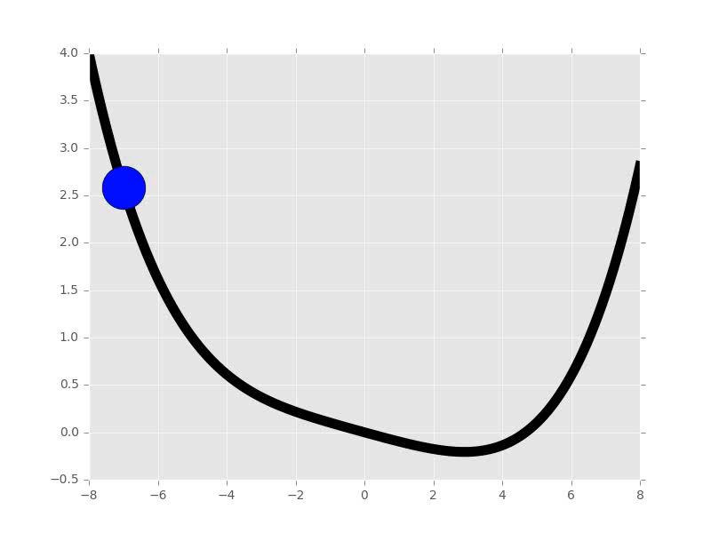
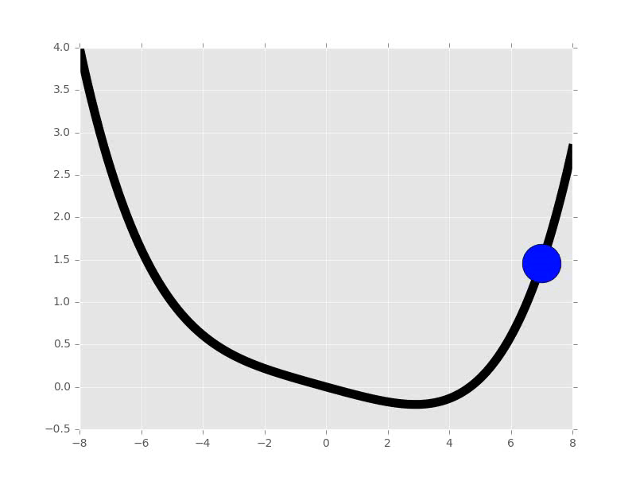

Physical intuitions
Gradient Descent $≈$ dynamics of a sliding object
- Log probability
- Log probability
Notes:
Final great feature: Gradient descent appeals to our physical intuitions because it matches the dynamics of an object sliding down a slope

Slide 6
Linking GD, VB and EP
VB and EP iterate Gaussian approximations
We can define an algorithm that:
Iterates Gaussian
Computes the Laplace
Does Gradient Descent

Slide 7
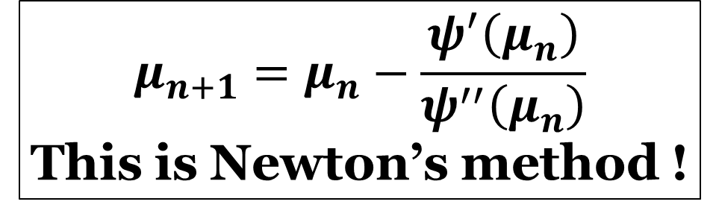
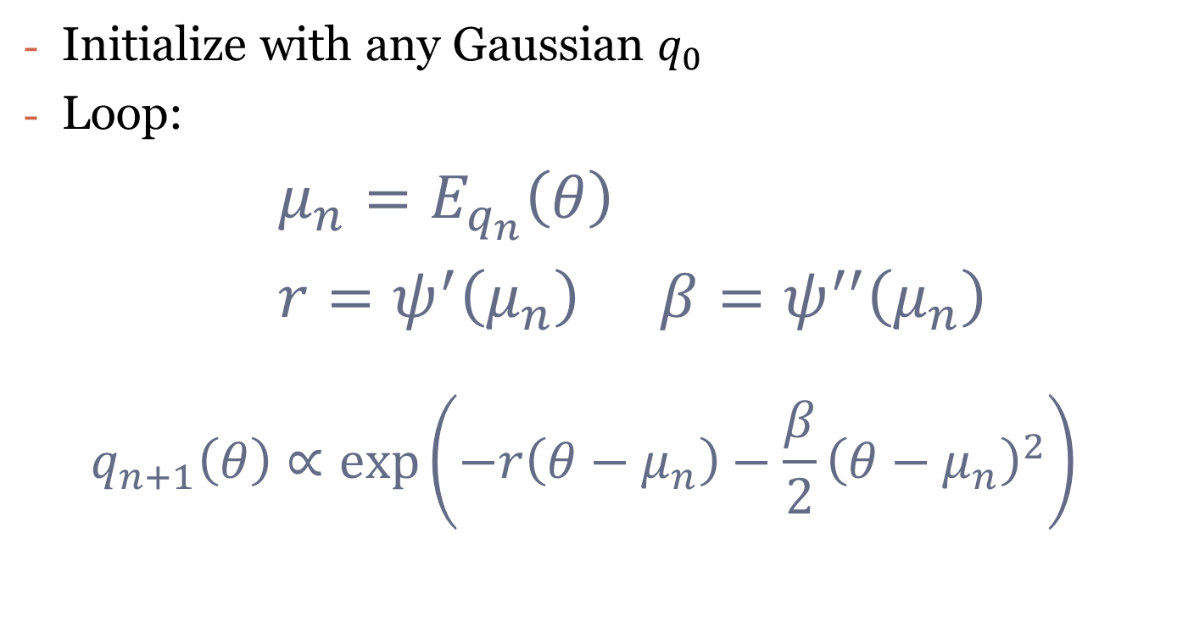
Algorithm 1: disguised gradient descent
Initialize with any Gaussian $q_{0}$
Loop:
$μ_{n}=E_{q_{n}}\left(θ\right)$
$r=ψ^{′}\left(μ_{n}\right)$ $β=ψ^{′′}\left(μ_{n}\right)$
$$q_{n+1}\left(θ\right)∝\exp\left(−r\left(θ−μ_{n}\right)−\frac{β}{2}{\left(θ−μ_{n}\right)}^{2}\right)$$
$$μ_{n+1}=μ_{n}−\frac{ψ^{′}\left(μ_{n}\right)}{ψ^{′′}\left(μ_{n}\right)}$$
This is Newton’s method !

Slide 8
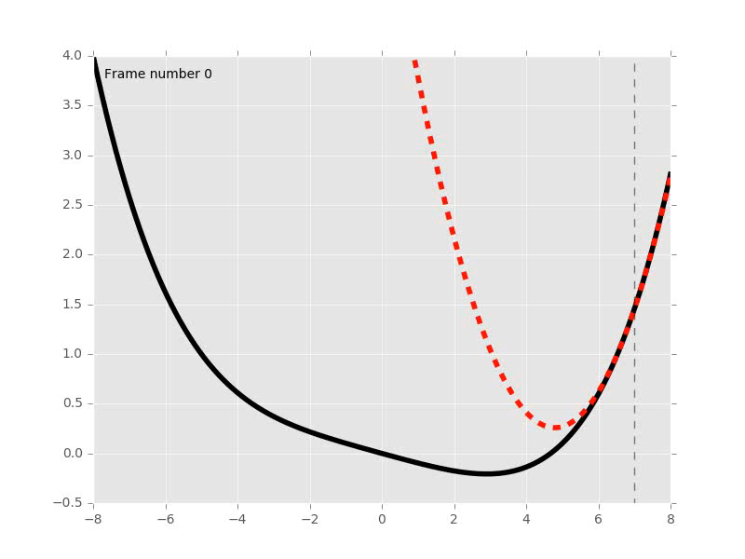
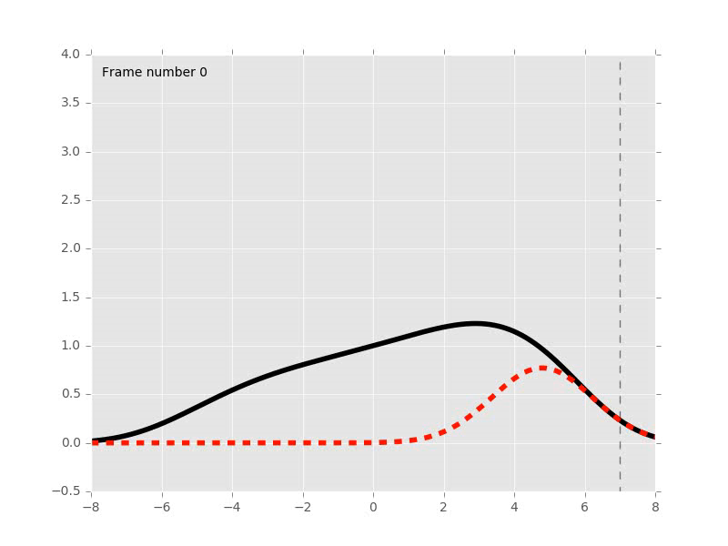

Algorithm 1: disguised gradient descent
Newton’s method DGD
$ψ≈quadratic$ $p≈\exp\left(−quadratic\right)$
$p≈Gaussian$

Slide 9
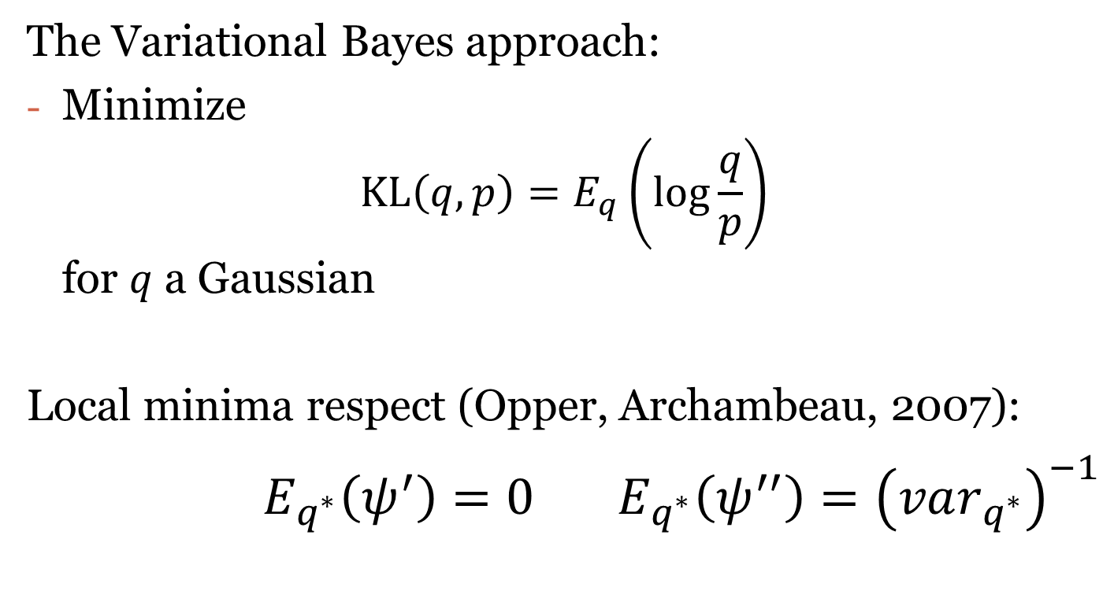
Variational Bayes Gaussian approximation
The Variational Bayes approach:
Minimize $KL\left(q,p\right)=E_{q}\left(\log{\frac{q}{p}}\right)$ for $q$ a Gaussian
Local minima respect (Opper, Archambeau, 2007):
$E_{q^{∗}}\left(ψ^{′}\right)=0$ $E_{q^{∗}}\left(ψ^{′′}\right)={\left(var_{q^{∗}}\right)}^{−1}$

Slide 10

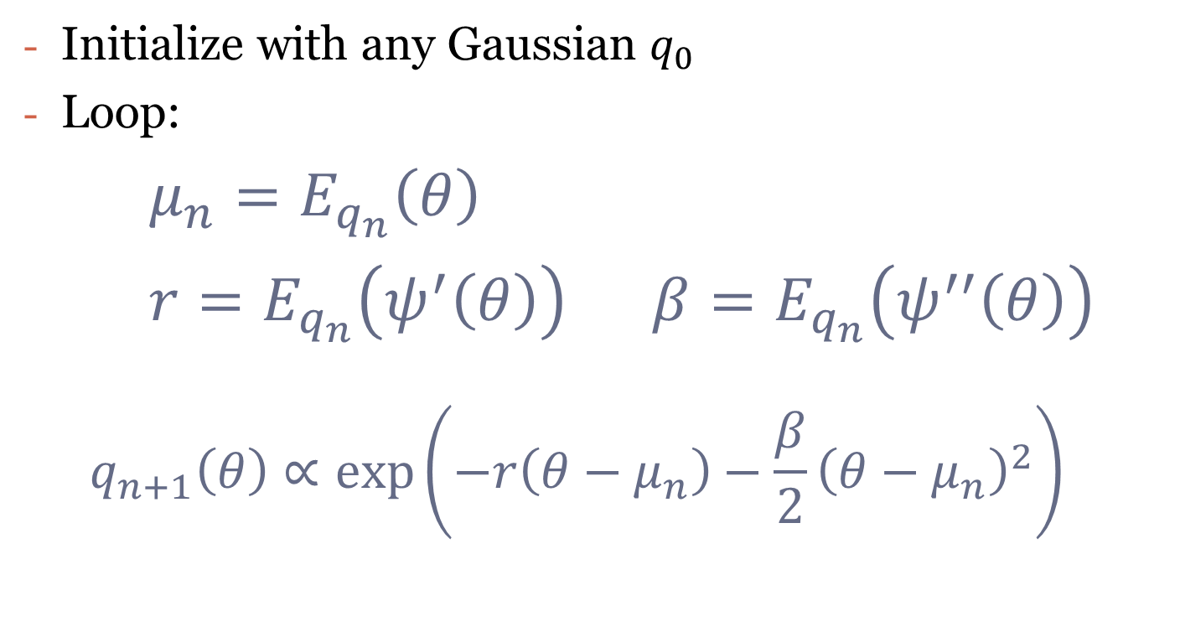

Algorithm 2: smoothed gradient descent
Initialize with any Gaussian $q_{0}$
Loop:
$μ_{n}=E_{q_{n}}\left(θ\right)$
$r=E_{q_{n}}\left(ψ^{′}\left(θ\right)\right)$ $β=E_{q_{n}}\left(ψ^{′′}\left(θ\right)\right)$
$$q_{n+1}\left(θ\right)∝\exp\left(−r\left(θ−μ_{n}\right)−\frac{β}{2}{\left(θ−μ_{n}\right)}^{2}\right)$$
$$≈ψ^{′}(μ_{n})$$
$$≈ψ^{′′}(μ_{n})$$

Slide 11
Algorithm 2: smoothed gradient descent

Slide 12
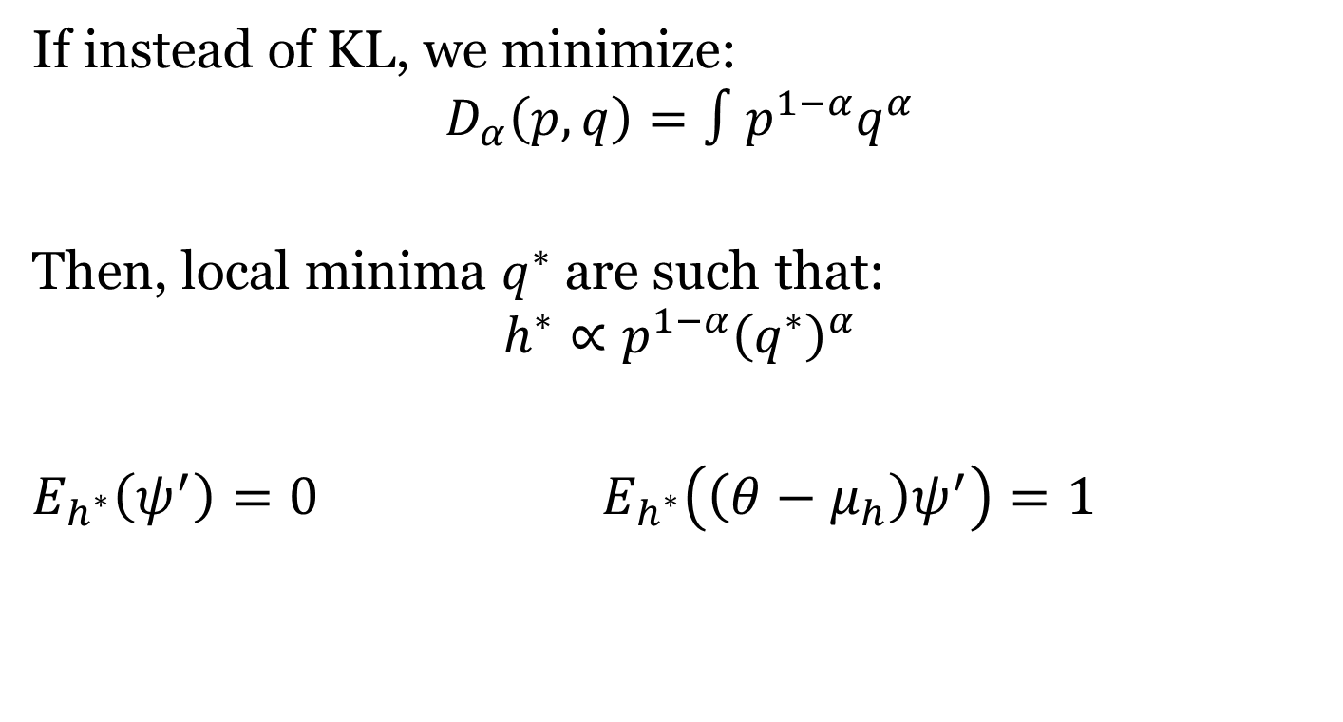

$α$-Divergence minimization
If instead of KL, we minimize:
$$D_{α}\left(p,q\right)=∫p^{1−α}q^{α}$$
Then, local minima $q^{∗}$ are such that:
$$h^{∗}∝p^{1−α}{\left(q^{∗}\right)}^{α}$$
$E_{h^{∗}}\left(ψ^{′}\right)=0$ $E_{h^{∗}}\left(\left(θ−μ_{h}\right)ψ^{′}\right)=1$

Slide 13

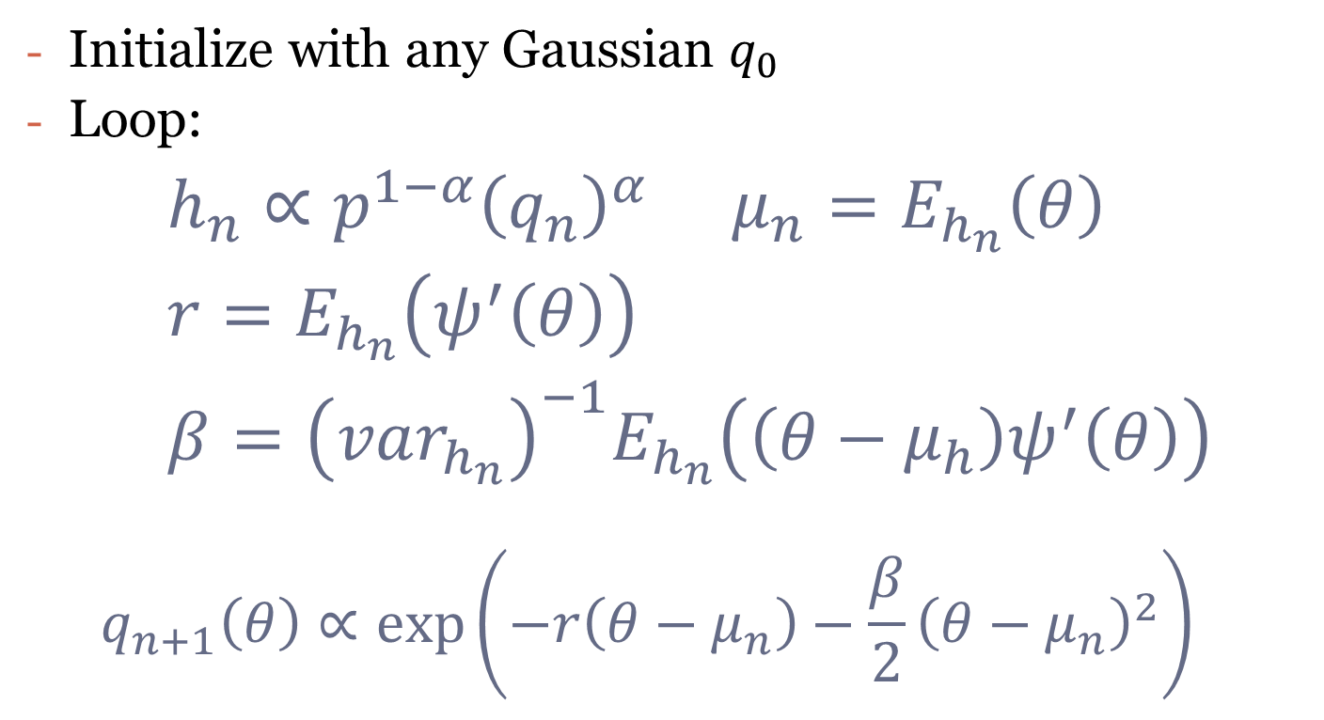
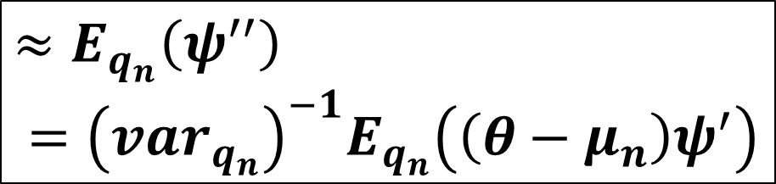

Algorithm 3: hybrid smoothing GD
Initialize with any Gaussian $q_{0}$
Loop:
$h_{n}∝p^{1−α}{\left(q_{n}\right)}^{α}$ $μ_{n}=E_{h_{n}}\left(θ\right)$
$r=E_{h_{n}}\left(ψ^{′}\left(θ\right)\right)$
$β={\left(var_{h_{n}}\right)}^{−1}E_{h_{n}}\left(\left(θ−μ_{h}\right)ψ^{′}\left(θ\right)\right)$
$$q_{n+1}\left(θ\right)∝\exp\left(−r\left(θ−μ_{n}\right)−\frac{β}{2}{\left(θ−μ_{n}\right)}^{2}\right)$$
$$≈ψ^{′}(μ_{n})$$
$≈E_{q_{n}}\left(ψ^{′′}\right)$
$={\left(var_{q_{n}}\right)}^{−1}E_{q_{n}}\left(\left(θ−μ_{n}\right)ψ^{′}\right)$
$$≈ψ^{′′}(μ_{n})$$

Slide 14
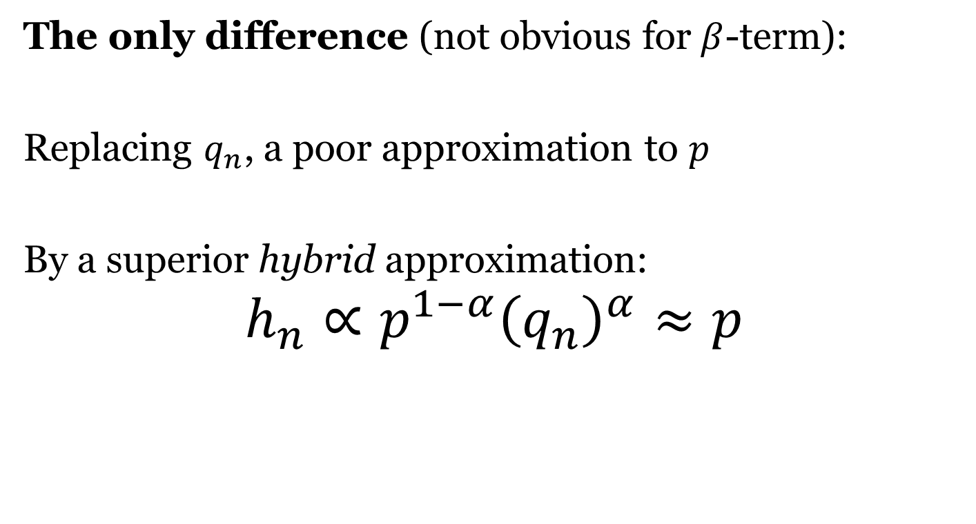
Interpreting algorithm 3
The only difference (not obvious for $β$-term):
Replacing $q_{n}$, a poor approximation to $p$
By a superior hybrid approximation:
$$h_{n}∝p^{1−α}{\left(q_{n}\right)}^{α}≈p$$

Slide 15
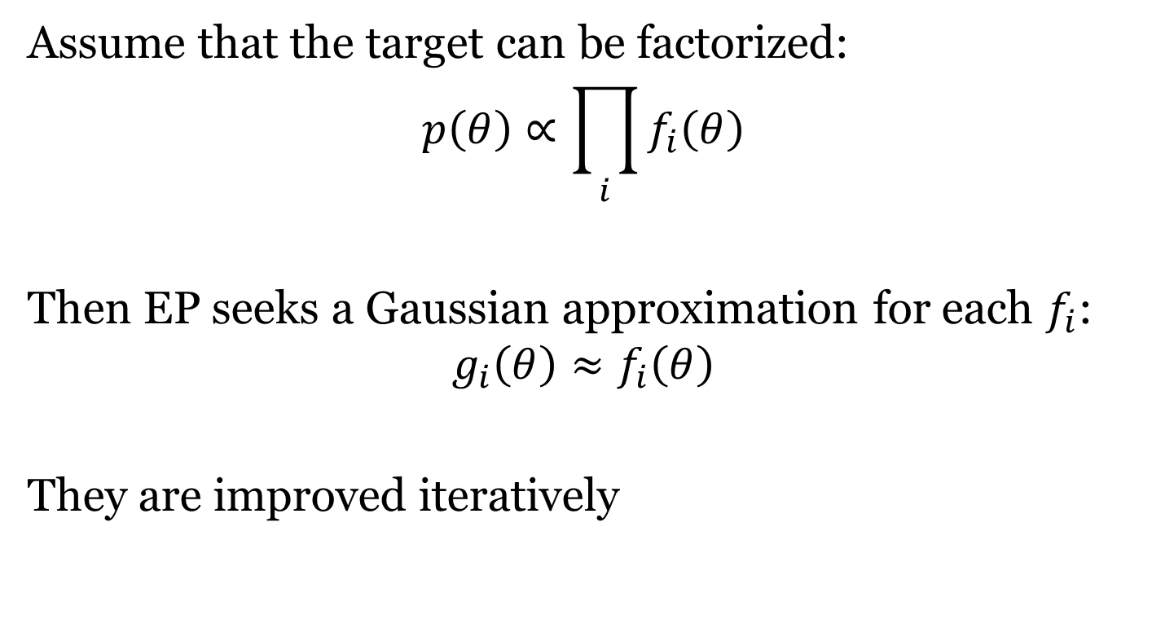
Expectation Propagation
Assume that the target can be factorized:
$$p\left(θ\right)∝\prod_{i}{f_{i}\left(θ\right)}$$
Then EP seeks a Gaussian approximation for each $f_{i}$:
$$g_{i}\left(θ\right)≈f_{i}\left(θ\right)$$
They are improved iteratively

Slide 16

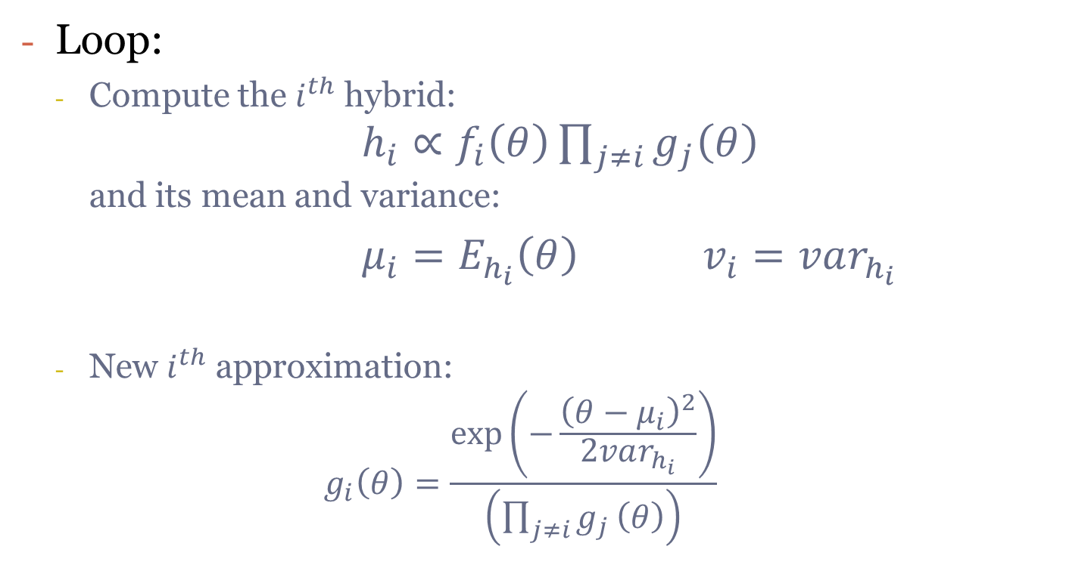

Algorithm 4: classic Expectation Propagation
Loop:
Compute the $i^{th}$ hybrid: $h_{i}∝f_{i}\left(θ\right)\prod_{j≠i}{g_{j}\left(θ\right)}$ and its mean and variance:
$μ_{i}=E_{h_{i}}\left(θ\right)$ $v_{i}=var_{h_{i}}$
New $i^{th}$ approximation: $g_{i}\left(θ\right)=\frac{\exp\left(−\frac{{\left(θ−μ_{i}\right)}^{2}}{2var_{h_{i}}}\right)}{\left(\prod_{j≠i}{g_{j}}\left(θ\right)\right)}$
$$≈p$$
$$≈f_{i}∏g_{j}$$

Slide 17
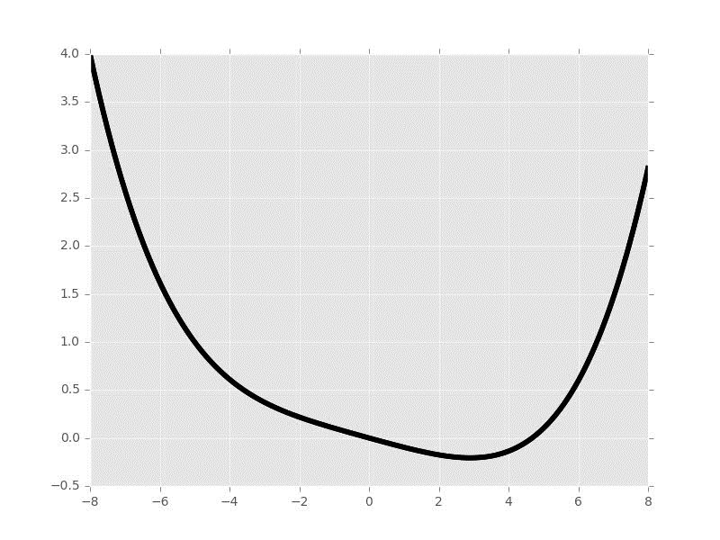
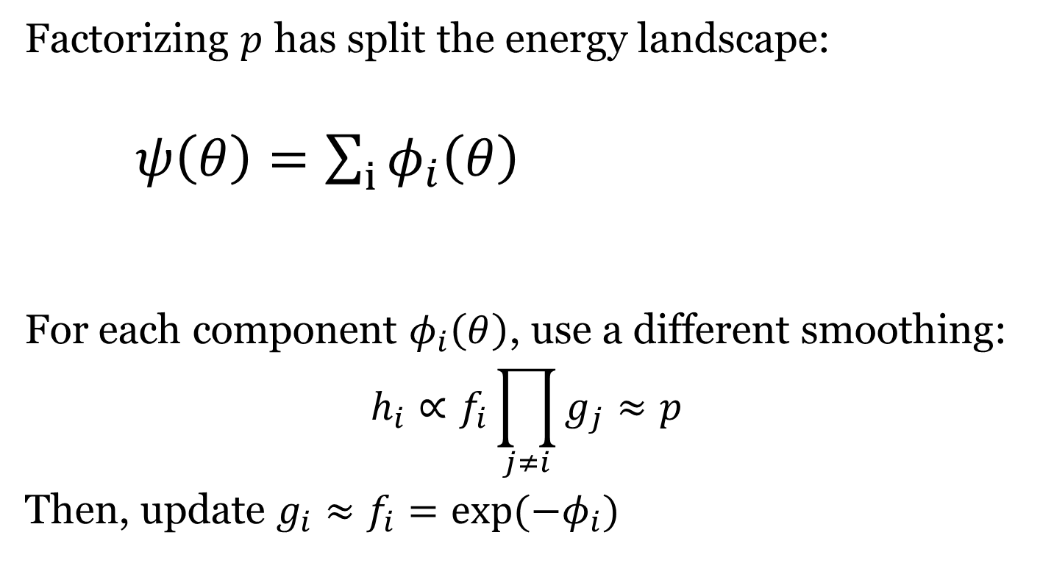
Algorithm 5: smooth EP
Factorizing $p$ has split the energy landscape:
$ψ\left(θ\right)=\sum_{i}{φ_{i}\left(θ\right)}$
For each component $φ_{i}\left(θ\right)$, use a different smoothing:
$$h_{i}∝f_{i}\prod_{j≠i}{g_{j}}≈p$$
Then, update $g_{i}≈f_{i}=\exp{(−φ_{i})}$

Slide 18
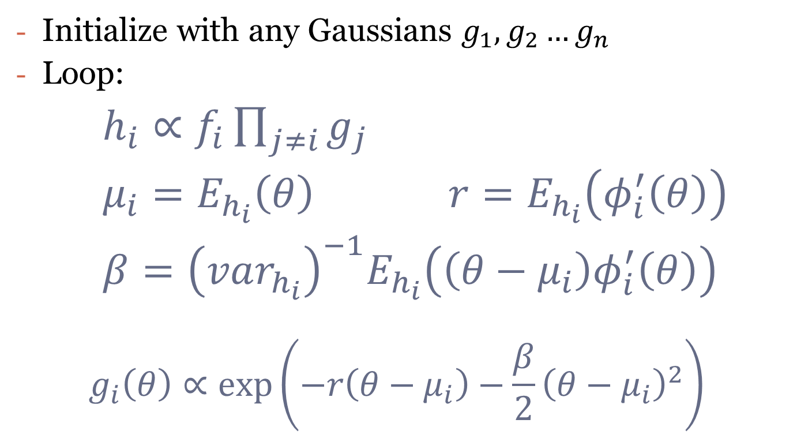
Algorithm 5: smooth EP
Initialize with any Gaussians $g_{1},g_{2}…g_{n}$
Loop:
$h_{i}∝f_{i}\prod_{j≠i}{g_{j}}$
$μ_{i}=E_{h_{i}}\left(θ\right)$ $r=E_{h_{i}}\left(φ_{i}^{′}\left(θ\right)\right)$
$β={\left(var_{h_{i}}\right)}^{−1}E_{h_{i}}\left(\left(θ−μ_{i}\right)φ_{i}^{′}\left(θ\right)\right)$
$$g_{i}\left(θ\right)∝\exp\left(−r\left(θ−μ_{i}\right)−\frac{β}{2}{\left(θ−μ_{i}\right)}^{2}\right)$$

Slide 19

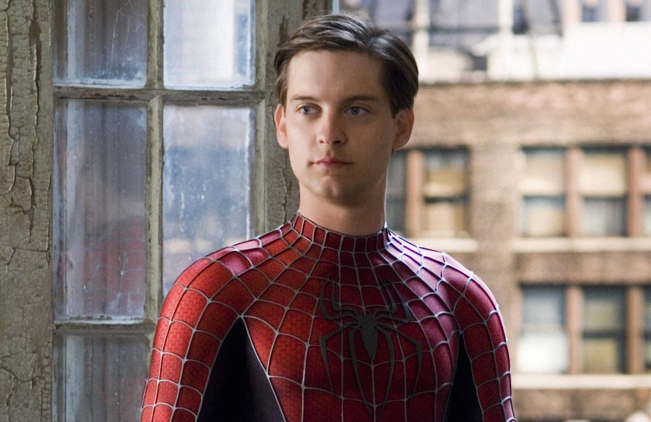
Classic vs Smooth EP
Algorithm 4:
Computationally efficient
Completely unintuitive
Algorithm 5:
Intuitive: linked to Newton’s method
Tractable to analysis
Which should we choose?

Slide 20
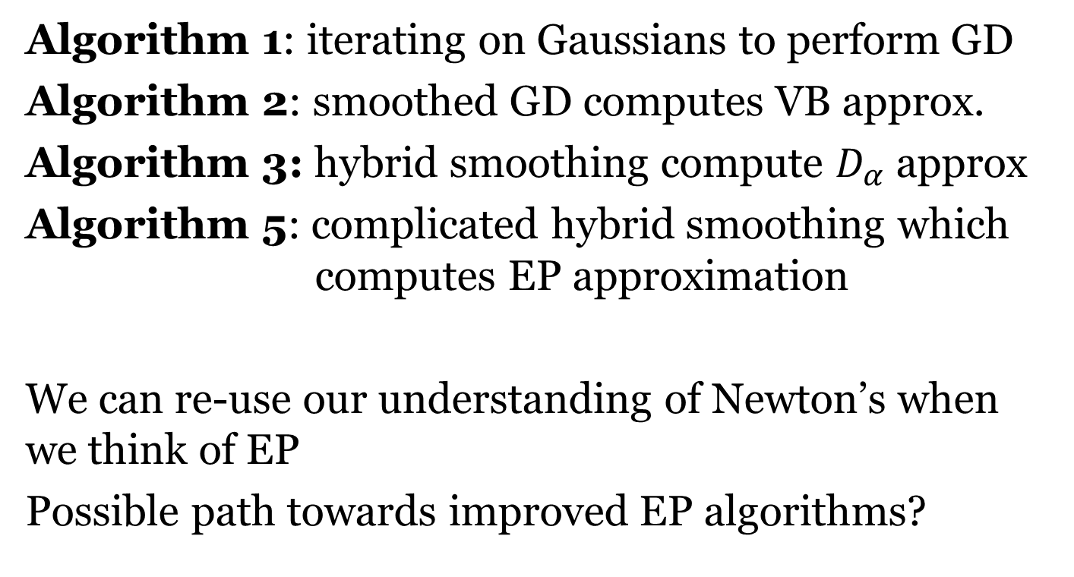
Conclusion
Algorithm 1: iterating on Gaussians to perform GD
Algorithm 2: smoothed GD computes VB approx.
Algorithm 3: hybrid smoothing compute $D_{α}$ approx
Algorithm 5: complicated hybrid smoothing which computes EP approximation
We can re-use our understanding of Newton’s when we think of EP
Possible path towards improved EP algorithms?

Slide 21
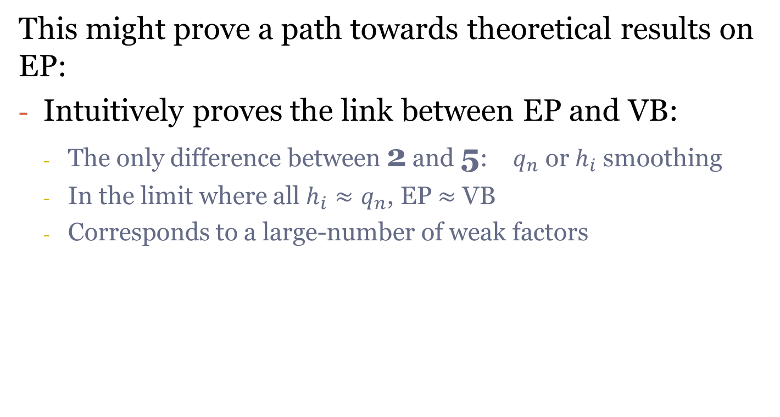
Conclusion
This might prove a path towards theoretical results on EP:
Intuitively proves the link between EP and VB:
The only difference between 2 and 5: $q_{n}$ or $h_{i}$ smoothing
In the limit where all $h_{i}≈q_{n}$, EP $≈$ VB
Corresponds to a large-number of weak factors
Notes:
I hope that this can help you understand EP better and apply it on your own problems. Thank you very much for your attention.

