Slide 1
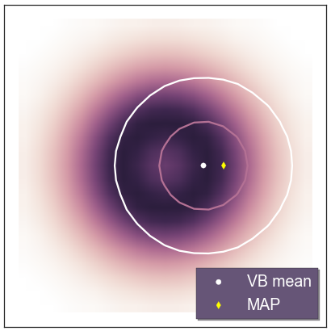
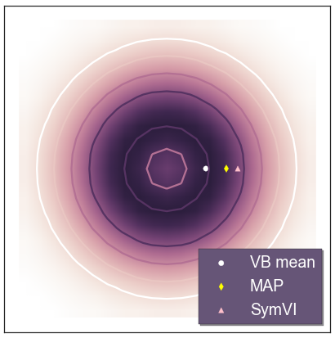
Symmetrized Variational Inference
Dave Moore, UC Berkeley
Advances in Approximate Bayesian Inference, NIPS 2016

Slide 2
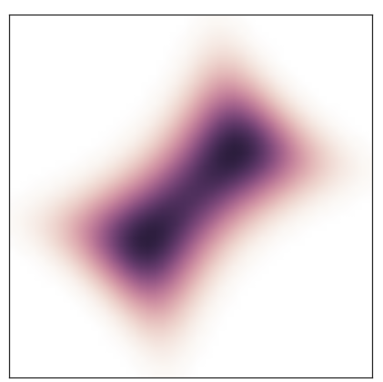
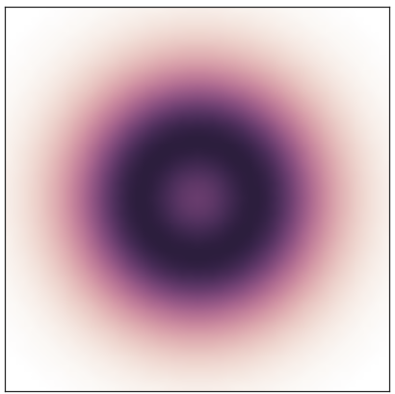
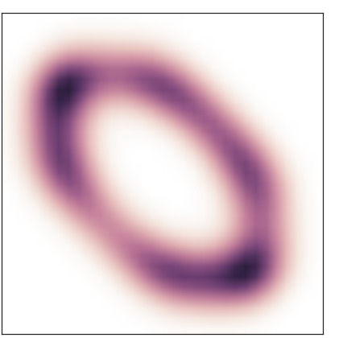
Parameter Symmetries
Posterior invariant under action of group G:
Signflip
Model | Symmetry
Matrix factorization | Orthogonal transforms
Variational autoencoders | Orthogonal transforms
Discrete mixtures (GMMs, HMMs, DPMMs, …) | Permutation (”label switching”)
Topic models | Permutation
Bayesian neural nets | Orthogonal (/invertible) transforms
Softmax classifiers | Translation
many others… (Nishihara et al., 2013) | Signflip, scaling, …
Rotation (orthogonal transform)
Permutation
Notes:
Hi, I'm Dave Moore from UC Berkeley. I’m interested in models with symmetries, where the posterior is invariant to some class of transformations, like signflips, rotations, permutations, etc. This is common whenever we learn a latent represention, which is often not identifiable. Posteriors in these models are highly multimodal but very structured.

Slide 3
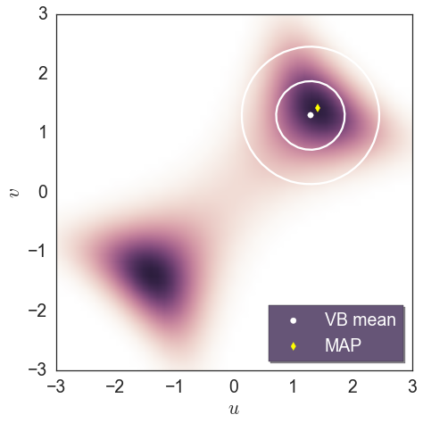
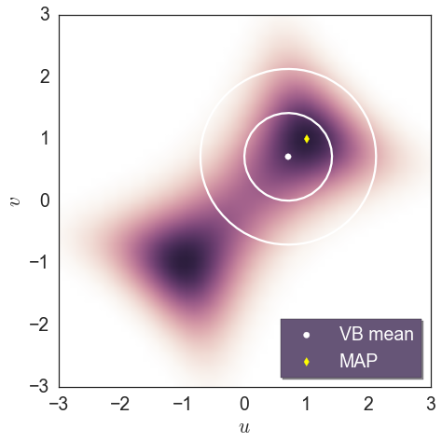
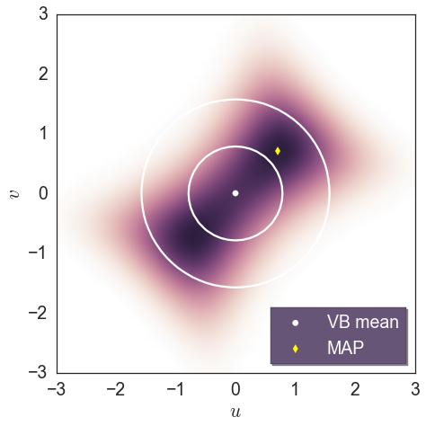
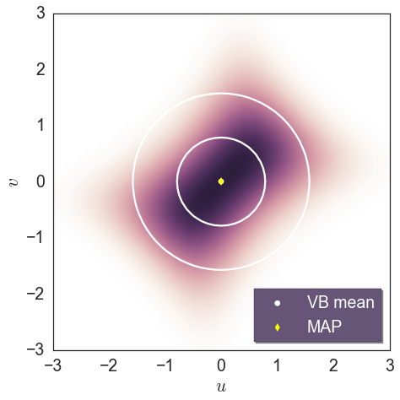
Do Symmetries Matter?
observed r = 3
Symmetric modes are identical, KL[ q | p] is “mode-seeking”,
so we’re fine?
Modes are not always isolated!
In practice, variational posteriors (even MAP estimates) find degenerate solutions straddling multiple modes.
Yields poor predictions, biases model selection.
observed r = 1
observed r = 2
observed r = 1.5
Bayesian scalar factorization:
r = uv + ε
u, v, ε ~ N(0,1)
Notes:
Most people assume symmetries don’t matter because they have the picture that KL[q|p] finds a single mode and they’re all equivalent. But modes aren’t necessarily these isolated things, whenever they’re close together you can get degenerate solutions where your Q distribution straddles multiple modes instead of modeling the structure of a single mode.

Slide 4
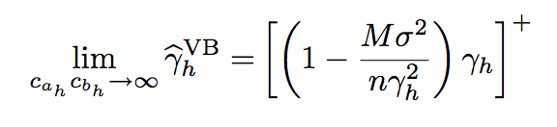
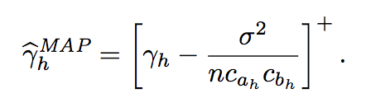
Degenerate posteriors
Theory (Nakajima et al., JMLR 2013): in Bayesian matrix factorization, VB shrinks small singular values to zero.
“Implicit regularization” not present in true posterior.
Similar effect observed with component collapse in variational autoencoders (Dinh & Dumoulin, 2014).
Can we build approximations that let models use their full capacity?
Notes:
There’s actually rheory analyzing this, in Bayesian matrix factorization the VB solution shrinks the small singular values to zero so no matter how much capacity you add the model won’t learn a representation above a particular rank. And they call this effect implicit regularization because it’s actually an artifact of approximate inference, the true posterior does not have this effect. So it seems like an interesting question to say, can we build approximations so that our models actually use their full capacity?

Slide 5
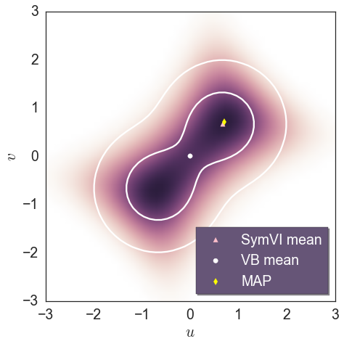
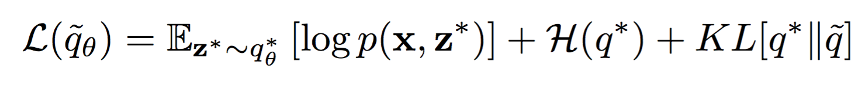
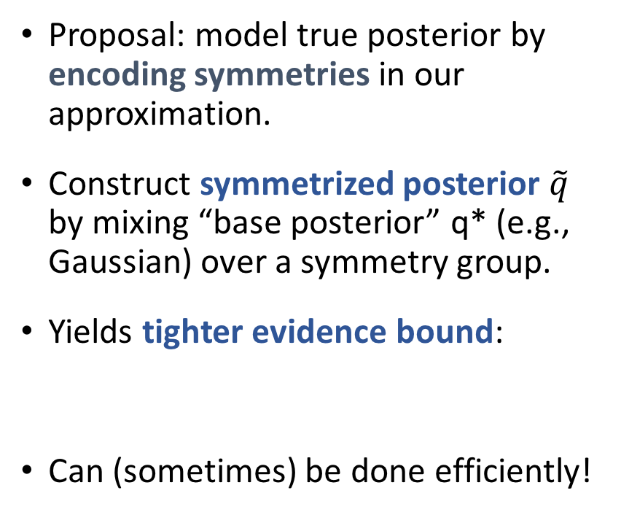
Symmetrized Variational Inference
Proposal: model true posterior by encoding symmetries in our approximation.
Construct symmetrized posterior $\tilde{q}$ by mixing “base posterior” q* (e.g., Gaussian) over a symmetry group.
Yields tighter evidence bound:
Can (sometimes) be done efficiently!
Notes:
If we know our posterior has symmetries, we should model them explicit in our Q distribution. One way is to start with something simple like a Gaussian and construct the explicit mixture over a symmetry group. When you do this is turns out you get the original ELBO plus an extra KL term that’s always nonnegative, so this is a tighter bound, and you can think of the extra term as encouraging non-degenerate solutions that model individual modes. And you’d think mixtures are intractable but sometimes we can actually do this efficiently.

Slide 6
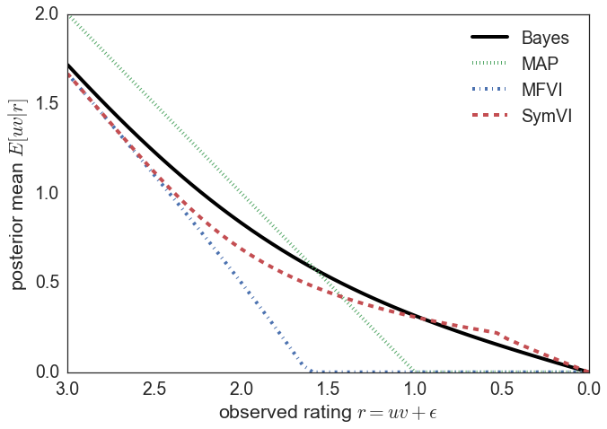
Symmetrization avoids implicit regularization
Toy scalar factorization model (predictive means)
Notes:
In simple cases we can see that using a symmetrized posterior avoids implicit regularization and much more closely tracks the true Bayes predictions.

Slide 7
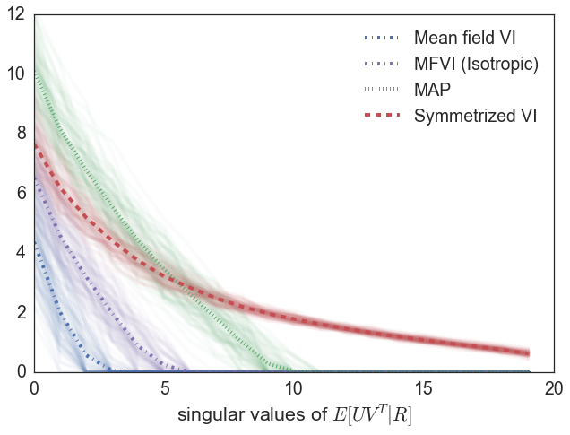
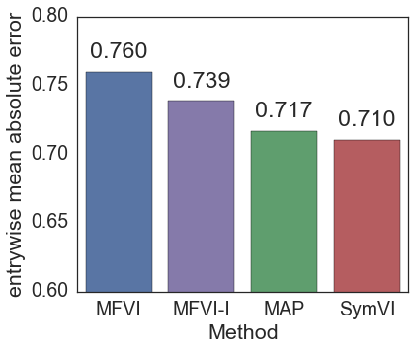
Symmetrized matrix factorization
Can efficiently approximate (isotropic) Gaussian mixture over orthogonal group O(k).
Symmetrized VI uses full model capacity
(no implicit regularization)
Improves predictions!
Notes:
In matrix factorization, for some cases we can efficiently compute the Gaussian mixture over the orthogonal group and it turns out this avoids implicit regularization, lets us use the full model capacity and that yields better predictions.

Slide 8
Questions
Efficient mixtures over common symmetries?
(non-isotropic) orthogonal transforms
Permutations
Scaling / translation / compositions of symmetries
General recipe: frame as hierarchical variational model (Ranganath et al., 2015)?
Can we symmetrize more “interesting” posteriors? (normalizing flows, GPs, particle/sample-based)
When is symmetrization helpful?
prediction? ARD? model comparison/selection?
Enables inclusive divergences (non-mode-seeking)?
Notes:
So this is all still very preliminary, there’s a ton of interesting questions, would love to discuss it more at the poster. Thanks!

