Slide 1
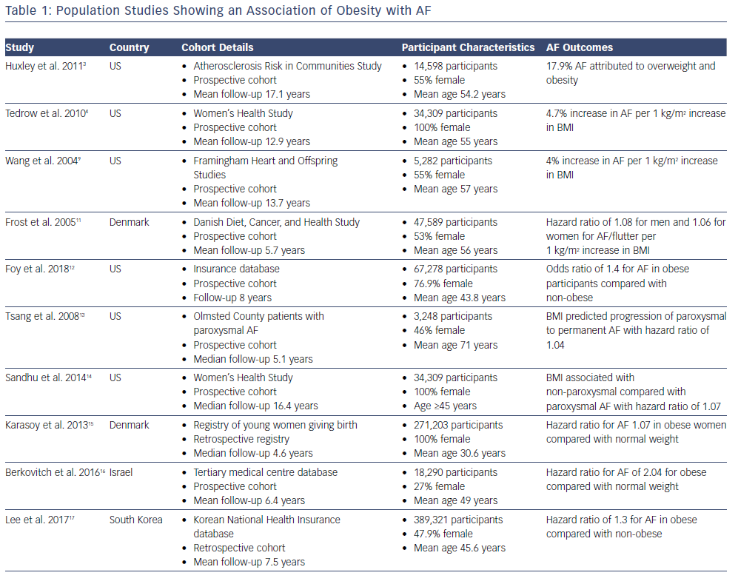

Arrhythmia & Electrophysiology Review 2019;8(1):28–36.

