Slide 1

AI, Machine Learning, and Data Mining – Why should we care?
Jörgen Blomberg

Slide 2
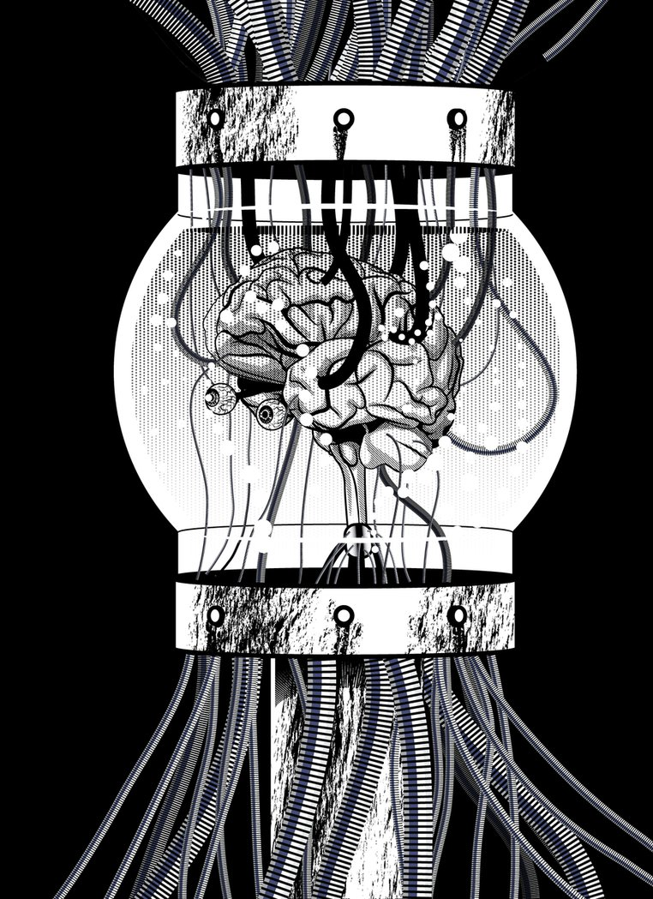
Artificial intelligence

Slide 3
Artificial Intelligence
Been around since…
… 1955
What it isn’t:
”Making a computer ’think’ like a human.”
What it is:
Computers making conclusions from unstructured input…
…and finding the most effective way to reach a specific goal, based on the input.
It is not everything we call ”intelligence” but rather ”problem solving”

Slide 4

Difference from ”normal” programming
Imperative programming – You tell the computer what to expect, what to do with it, and how.
If the input isn’t what we expect, the program will not execute properly.

Slide 5





Difference from ”normal” programming
AI ”programming” – You define the goals, and train the system by feeding it data, optimizing by giving feedback until you efficiently reach the goals.
Input | Output | Feedback
 | ”P”? | No, ”B”
 | ”O”? | No, ”A”
 | ”U”? | No, ”V”
 | ”W”? | Yes.
 | ”V”? | Yes

Slide 6
Artificial Neural Networks
A common implementation of AI
(Loosely) modelled on neurons and synapses in the brain

Slide 7
Artificial Neural Networks
Neurons (circles) add all incoming connections…
… and if the sum exceeds the neuron’s threshold…
… the neuron “fires”…
… and sends a value to all outgoing connections.
0.1
0.3 < 0.5
0
0.1
0.1
7

Slide 8
Artificial Neural Networks
Neurons (circles) add all incoming connections…
… and if the sum exceeds the neuron’s threshold…
… the neuron “fires”…
… and sends a value to all outgoing connections.
0.1
0.6 > 0.5
1
0.2
0.3
8

Slide 9
Artificial Neural Networks

Slide 10
Artificial Neural Networks

Slide 11
Artificial Neural Networks
Each connection has a weight (a multiplier on the outgoing data).
When training the network:
Positive results: reinforce the weights and/or thresholds for the firing neurons (Back propagation)
Negative results: do the opposite (decrease weights and increase thresholds for firing neurons)

Slide 12
OCR again
Input | Output | Feedback
 | ”P”? | No, ”B”
 | ”O”? | No, ”A”
 | ”U”? | No, ”V”
 | ”W”? | Yes.
 | ”V”? | Yes

Slide 13
OCR – a poorly written ”g” (or is it a ”9”?)

Slide 14
OCR – bounding box

Slide 15
OCR - grid

Slide 16
OCR – find cells with more than 50% black

Slide 17
OCR – what?

Slide 18
OCR – how it’s actually done

Slide 19
Why AI is still hard
Neural networks are generic and easy to build.
Finding good ways to input data is hard.

Slide 20
NN in practice
Pre-processing
NN
Post-processing
Unstructured data
”prepared” input
NN output
Sound processing:
(Noise removal, Sampling, Transients, Slicing, etc.)
NN
Sequence of ”tokens”
Mapping tokens to apps, search terms, contacts etc.
Sound data from mic
”phoneme” sound vector

Slide 21
What can an AI do (well)?
Classification
Character recognition, automated synopsis, medical diagnostics
Regression
Numerical analysis
Clustering
Data optimization, customer behavior analysis
Dimensionality reduction
Eliminating irrelevant data to simplify analysis

Slide 22

Machine Learning

Slide 23
Machine Learning
Been around since…
… 1959
What it is:
Self-modifying (AI) systems, optimizing for defined goals

Slide 24
Supervised learning
Someone, the “trainer”, tells the system when the goals are reached and when not (right or wrong)
Like in the OCR example
Both input and output are structured or “labeled”.
The trainer supplies a mapping from input to output.
Can be used to optimize the cost of reaching goals…
… but not find anything “new”

Slide 25
Unsupervised learning
The input, and sometimes the output, is unstructured (no labels) and only the goals are defined
Reaching any goal is a “positive”
Can be used to find “hidden patterns”
Examples:
Customer behavior analysis - clustering
Automated testing

Slide 26
Reinforced learning
”Gamified” version of supervised or unsupervised learning.
A ruleset of ”rewards” and ”punishments” is used to give feedback.
Examples:
Game AI: Chess, Go, RTS
Self-driving cars
Financial analysis

Slide 27
Genetic algorithms
Start with set of instances with randomized parameters.
Let all instances try to reach the goals a number of times.
Keep those who perform best in reaching the goals. Discard the rest.
Create a new set with the best from 2. and the rest being slightly modified (”mutated”) versions of those.
Repeat step 2-4 until one or more instances perform well enough.

Slide 28
Deploying ML systems
Deploy as-is (Keep learning)
Works for supervised systems
Can potentially deteriorate and need resetting
Deploy fully trained system (Stop learning)
Works for retail apps or embedded systems
Keeps performing as expected.
You don’t want your self-driving car to suddenly “invent” a faster way to get across town…

Slide 29

Data mining

Slide 30
Data mining
Been around since…
… 1968
What it is: Processing large amounts of data to find patterns or trends.
Used for:
Quantitative (financial) analysis
Customer behavior analysis
Trend forecasting
And many more applications
Can give misleading results if the analysts using the data don’t have a clear picture of the underlying data
AI and unsupervised learning work well for finding new patterns. (With the above in mind…)

Slide 31
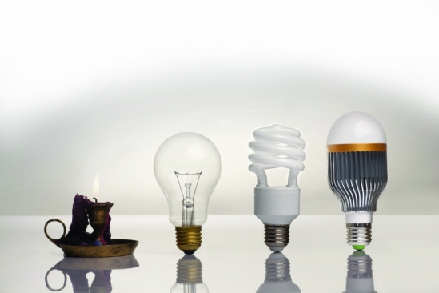
So, what IS new?

Slide 32
What is new?
More data available to analyze.
Combinations of AI/ML/Data Mining.
Better algorithms and understanding of the math behind the algorithms.
New applications for AI.
Better hardware.

Slide 33
“Big Data” & The Cloud
Internet + smartphones + IoT =
a lot more data captured.
Big data – allows storage of huge amounts of unstructured data.
Cloud storage – allows reuse and sharing of data across systems and applications.

Slide 34
Deep learning
“Deep” in this case refers to the depth of a neural network, i.e. the number of hidden layers.
Specialized hardware can support several more hidden layers and handle the exponential growth in complexity better then other architectures.
Can find multiple localized “sub-goals” very quickly and the aggregate the results.
Example: Google’s AlphaGo

Slide 35
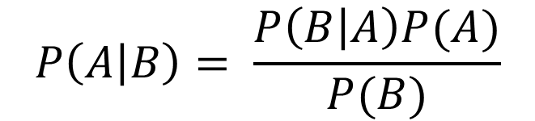
?
$$P\left(A | B\right)= \frac{P\left(B | A\right)P(A)}{P(B)}$$

Slide 36
Bayes’ Theorem
$$P\left(A | B\right)= \frac{P\left(B | A\right)P(A)}{P(B)}$$
The basis for Bayesian statistics

Slide 37
Bayesian statistics
Bayes’ theorem and it’s applications leads to better ways of analyzing data.
Bayesian networks can be used to model probabilities in a way that works well for AI.
Bayesian programming – a way to construct solutions for problems with less data than necessary.

Slide 38
State of the industry
Behavior analysis
Machine/Human interaction
Automation

