Slide 1
Apache MINA
High-performance network applications

Slide 2
Multipurpose
Infrastructure
Networked
Application
http://mina.apache.org

Slide 3
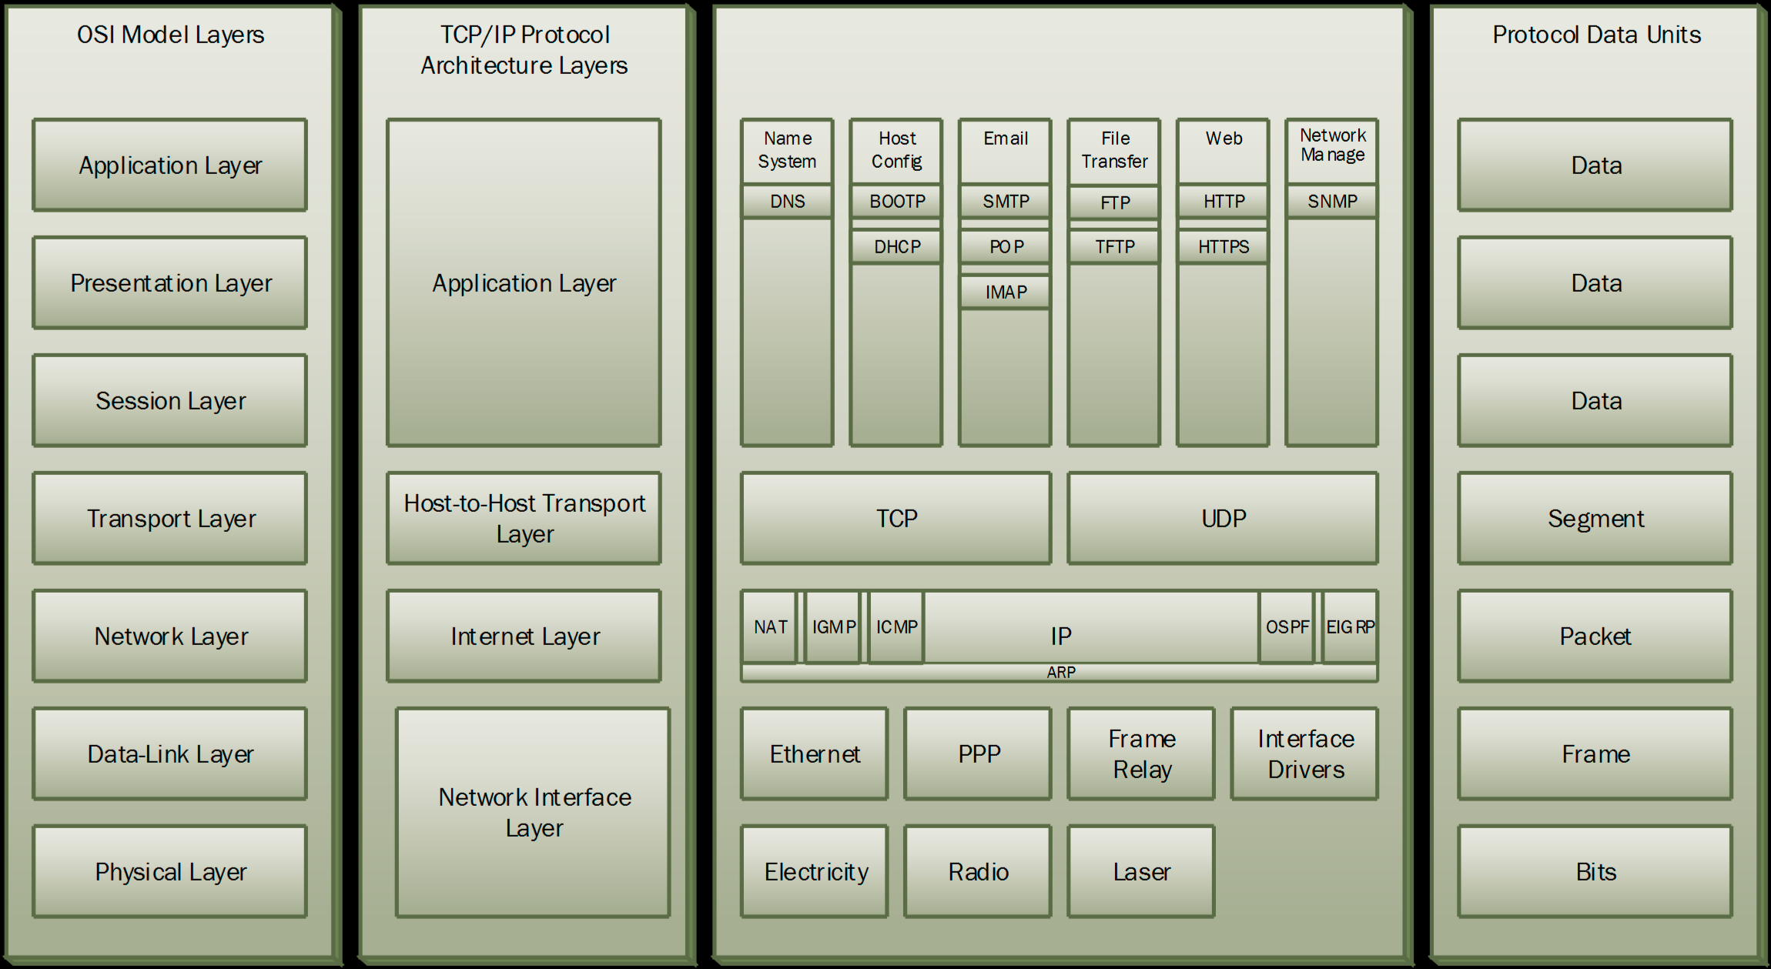

Where?
frontend
full stack
- developer

Slide 4
Design
“Smart”
Inversion of control pattern (good for Spring)
Bad scalability
ver. 2.0 since 2012

Slide 5

Strengths
Maturity ( 2006 -> v.1.0, v.1.1, …, v.2.x -> 2016)
API simplification
Performance boost (almost like C/C++)
Low latency
v.2.0 decreased connection latency
Queueing sessions
Delegated to Executor (i.e. java.util.concurrent.ThreadPoolExecutor)

Slide 6
Who is using it?
Apache (LDAPv3, NTP, DNS, DHCP, Kerberos)
Tigris (SMTP)
Openfire (Jabber/XMPP)
…

Slide 7
Engine 1/3
NIO
Non Blocking
Async
Event-Driven
Agnostic Framework
ByteBuffer (very powerfull, v2 Heap only, no Stack and no Pooling)
Future (unlike java5)
Blocking functions avail
Callbacks on completion
Single thread for new connections

Slide 8
Engine 2/3
public Server() throws IOException {
// Create a TCP acceptor
IoAcceptor acceptor = new NioSocketAcceptor();
// Associate the acceptor to an IoHandler instance (your application)
acceptor.setHandler(…);
// Bind : this will start the server...
acceptor.bind(new InetSocketAddress(PORT));
}
acceptor.getFilterChain().addLast( "logger", new LoggingFilter() ); acceptor.getFilterChain().addLast( "codec",
new ProtocolCodecFilter(
new TextLineCodecFactory( Charset.forName( "UTF-8" ))));
public class MyHandler extends IoHandlerAdapter {
@Override
public void exceptionCaught(IoSession session, Throwable cause) throws Exception {…}
@Override
public void messageReceived(IoSession session, Object message ) throws Exception {…}
@Override
public void sessionIdle(IoSession session, IdleStatus status ) throws Exception {…}
}
App. Logic
Service
Connector
Processor
Filter
Filter
Filter
Handler
public Server() throws Throwable {
// Create a TCP connector
NioSocketConnector connector = new NioSocketConnector();
connector.setHandler(…);
// Bind : this will connect to server...
IoSession session;
try {
ConnectFuture future = connector.connect(new InetSocketAddress(HOSTNAME, PORT));
future.awaitUninterruptibly();
session = future.getSession();
} …
}
Service
Acceptor
Processor
Filter
Filter
Filter
Handler
connector.getFilterChain().addLast("codec",
new ProtocolCodecFilter(
new SumUpProtocolCodecFactory(false)));

Slide 9
Engine 3/3
App. Logic
Write
Service
Connector
Processor
Filter
Filter
Filter
Handler
Service
Acceptor
Processor
Filter
Filter
Filter
Handler
Read
Reusability
Hot Deployment
All events

Slide 10
Pre-set features
All famous network protocols as application (FTP, HTTP/s, Proxy, Firewall, Traffic Shaper, DNS, NTP, …)
Many codecs on IoBuffer (aka ByteBuffer)
Blacklists, Logging, SSL/TLS, Compression
DI & Spring Framework

Slide 11



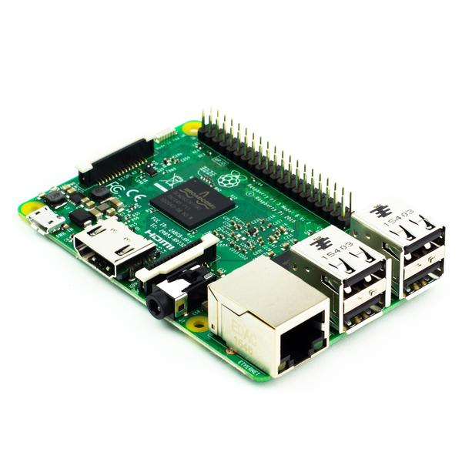
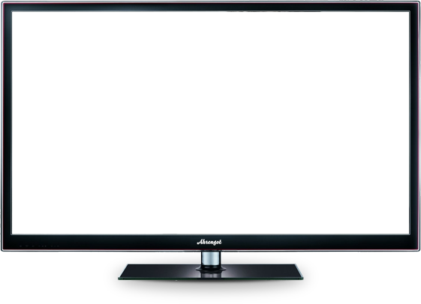
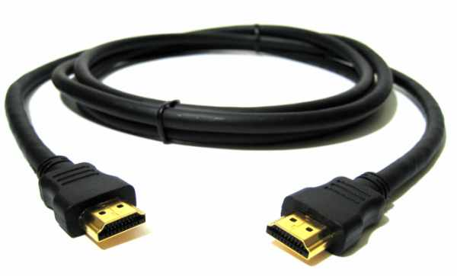
Clone Desktop to TV via Wifi
Screen Recorder 30fps
MINA compressing media
MINA@Pi3 de-compressing media
pics
pics

Slide 12

Converting chat from TCP to UDP
Chat Server
Jabber/XMPP
(TCP)
TCP
TCP
Chat Proxy (MINA)
NAT w UDP-2-TCP conversion
High-bandwidth internet
UDP
UDP
Low-bandwidth internet

Slide 13

Q?
Branislav Bajlovski,
VP/CTO @ Sourcico

