Slide 1
--How Reactive do we need to be
Javaskop 2017, Skopje
Jana Karcheska - Netcetera

Slide 2
--What is my background?
Big web applications primarily for the desktop with frontend built in Javascript
Enthusiasm for functional programming
Notes:
My background is in working on big enterprise apps with JavaScript frontend. On the other hand I love functional programming and JavaScript is a functional programming language.
My last project was an International train scheduling tool - rich web application for desktops. Lots of complex data shown to the user at once, complicated searches and results, data change comparisons, interface that leads the user through the complicated process of creating train timetables.

Slide 3
--intro
--how long will your app live?
--how big, how good, how flexible is your team?
--how complex is the business?
--who are your users?
--how bullet-proof your UI/UX needs to be?
Notes:
Next generation projects in Netcetera are built usually with Angular 2 or React. Existing big apps done in AngularJs are being migrated.
My goal is to talk about the pain points when building large JavaScript apps, in the scale of hundreds of thousands of lines of code, and examine the concepts that are in play today in the most popular frameworks.
There are many things to be considered when building an enterprise application. It needs to live long in terms of decades sometimes, it is big and needs to grow in a sustainable manner, and your business case is probably fairly complex. There are more and more demanding needs about user experience - people expect these apps to be as fancy as other software they use in their daily life. And we need to meet all these requirements.
There was quite some friction for the enterprise to accept JavaScript as a viable technology, or to learn to tolerate it. And yes it is hard so we need good frameworks to the rescue.

Slide 4
--Reactive, Immutable, Stateless
What is Reactive programming …and what it is not
Notes:
The question is now how well we can cope with new (or more precisely recycled) concepts like Reactive programming? Reactive programming promises to solve the interaction with the real world. It simplifies our abstraction of asynchronous user interaction which is problematic in traditional approaches. Back in the days when we were building UI’s with Java we had one glorified dispatcher thread for handling user interaction in Swing. It was a nightmare. You’ve probably heard the term “the hell of handling callback” when developing with JQuery.
But do not be fooled by promises of reactive and immutable everywhere and don’t look for it where it isn’t. Map-reduce in rendering your UI has nothing to do with reactive programming, which language you use has nothing to do with it either. And moreover it is not “The solution” to everything. Yes, in the end we still need to deal with keeping state and if everything is immutable then there will be no user interaction in your app.
So what do we use today to build UI’s... yes in a way I will put React and Angular code side to side, but only to examine the different (or similar) concepts they propose.
Both libraries have no direct connection to reactive programming. Apps built with React or Agular could be completely statefull and most that I’ve seen are. But it is also not true that you cannot do reactive programming with these tools.

Slide 5
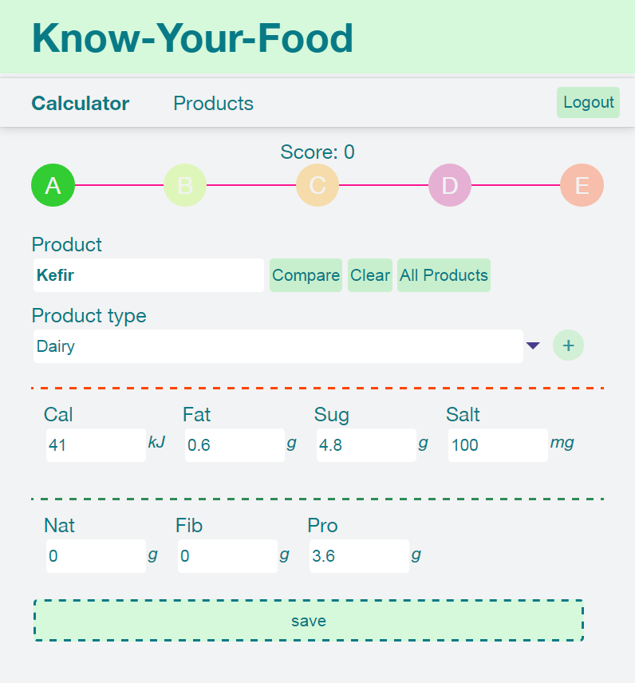
github.com/janakkar
Notes:
In preparation for this presentation, I found couple of enthusiasts and we recreated the same app once with Angular and once with React. We held lengthy discussions and changed our minds quite too often.
The app is fairly simple but it contains key features that are important in large applications.
The app gives a label on how healthy a given product is, based on couple of ingredients in it, that the user should provide. It can authenticate a user, store his products, search them, compare them, show details etc.

Slide 6
--Project kick-off
Language features--
class IngredientThreshold {
grade: number;
threshold: number;
upperLimit?: boolean = false;
constructor(grade: number, threshold: number, upperLimit: boolean) {
this.grade = grade;
this.threshold = threshold;
this.upperLimit = upperLimit;
}
checkThreshold(ingredient: Ingredient) {
return this.upperLimit ? this.threshold >= ingredient.amount : this.threshold < ingredient.amount;
}
}
class IngredientThreshold {
constructor(grade, threshold, upperLimit) {
this.grade = grade;
this.threshold =
threshold;
this.upperLimit = upperLimit;
}
checkThreshold(ingredient) {
return this.upperLimit ?
this.threshold >= ingredient.amount :
this.threshold < ingredient.amount;
}
}
Notes:
The first question that arises when kicking off a new project probably is what language to use. What do we feel comfortable working with? Can we live without types? Should we choose plain JavaScript, ES6 or not? Should we maybe use Typescript?
If I didn’t have to consider anything else but what I would really enjoy working with most, I would definitely choose ES6. But wait, what about those hundreds of thousands of lines of code we were going to write and what about those 10+ developers in the team? Well I fought with it a little but finally I think that Typescript might be worth looking into.

Slide 7
class IngredientThreshold {
grade: number;
threshold: number;
upperLimit?: boolean = false;
constructor(grade: number, threshold: number, upperLimit: boolean) {
this.grade = grade;
this.threshold = threshold;
this.upperLimit = upperLimit;
}
checkThreshold(ingredient: Ingredient) {
return this.upperLimit ?
this.threshold >= ingredient.amount :
this.threshold < ingredient.amount;
}
}
Notes:
Here is the base class that models the ingredient quality thresholds that my algorithm uses. It is immediately easy to spot the type of information I will use to create them and helps me get an idea of the structure of the data I will need. A threshold value defined as an upper or lower limit that will indicate a certain quality grade.

Slide 8
class IngredientThreshold {
constructor(grade, threshold, upperLimit) {
this.grade = grade;
this.threshold = threshold;
this.upperLimit = upperLimit;
}
checkThreshold(ingredient) {
return this.upperLimit ?
this.threshold >= ingredient.amount :
this.threshold < ingredient.amount;
}
}
Notes:
Pretty similar structure in ES 6 - close enough so far.

Slide 9
type ThresholdDictionary = {[id: number]: IngredientThreshold[]};
const initThresholds = function(thresholdInput: number[][], ingredients: string[]): thresholdDictionary {
const thresholds: ThresholdDictionary = {};
ingredients.forEach(o => thresholds[o] = []);
thresholdInput.forEach((v, i) => {
ingredients.forEach((type,k) => {
thresholds[type].push(new IngredientThreshold(i, v[k], i === 0));
});
});
return thresholds;
};
const badThresholds: ThresholdDictionary = initThresholds(bad, Object.keys(BadIngredient));
const goodThresholds: ThresholdDictionary = initThresholds(good, Object.keys(GoodIngredient));
Notes:
Now here is how a data loaded as a matrix of numeric values turns into my desired data structure. Here Typescript ugliness comes to light. I have to define this weird structure - a dictionary, because guess what in Typescript I can’t have a map (not yet at least) or an object with an arbitrary properties like the traditional JavaScript object. The code consequentially is quite unreadable too and quite bulky.

Slide 10
const initThresholds = (ingredients, thresholds) => {
return Object.keys(ingredients).map(type => ingredients[type])
.map(i => thresholds.map((row, j) => new IngredientThreshold(j, row[i], j === 0)));
};
const badIngredients = initThresholds(BAD, bad);
const goodIngredients = initThresholds(GOOD, good);
What does it return?
Notes:
ES6 code on the other hand elegantly maps my data in a single line and the code is much shorter and much prettier. Maybe it is slightly mind boggling what exactly this code returns :). It will return a “map” - an object with ingredient types as properties and as values arrays of respective ingredient thresholds.
I personally love writing such code and love just working with JavaScript objects to map stuff. But the question, in the context of the problem that I proposed at the beginning of this presentation, is what is more practical in the end. Remember those 10+ developers at one point refactoring the code. Without type safety it could get messy.
Additionally Typescript allows you to write Decorators (like Annotations in Java). This could be really helpful in handling a huge code base. Of course I am just scratching the surface here, there’s much more to this discussion but let’s move on to how are we going to deal with the DOM and HTML.

Slide 11
--Templating
export default class AmountInput extends Component {
render() {
return (
<div className="row ">
<label htmlFor={createId(this.props.controlName)}>
{this.props.controlLabel}
</label>
<div className="amount">
<input type="number" step="0.1"
id={createId(this.props.controlName)}
value={this.props.amount}
onChange={this.props.onAmountChange}/>
<span className="measure">{this.props.measure}</span>
</div>
</div>
);
}
}
AmountInput.propTypes = {
controlLabel: React.PropTypes.string,
controlName: React.PropTypes.string,
measure: React.PropTypes.string,
amount: React.PropTypes.number
};
<label for="field{{controlName}}">{{controlLabel}}</label>
<div class="amount">
<input type="number" step="0.1"
id="field{{controlName}}" [ngModel]="amount"
(ngModelChange)="onChange($event)">
<span class="measure">{{measure}}</span>
</div>
Notes:
Angular on the left, React on the right.
React mixes JavaScript and HTML, though I thought I would hate it, it really gets addictive and it’s messing up your habits when searching for something in the code for a while. Mixing the code requires getting used to some other tweaks like className instead of class, htmlFor instead of for, closing slash for inputs etc.
Otherwise, the concept of binding html props and events with staff in your JavaScript code for both libraries is similar. Angular works with expressions, React works with function handles. This distinction might be pointing to the biggest difference between the two. In React everything is a function and the accent is really on turning everything into a function - it has its beauty and elegance but also some drawbacks - a lot of things in this cleaner approach are left to you to take care of, like for example the fact that your function handle is not bound to anything (your component class in this case would be desirable). This means you have to take care of it each time.
And wait what is that? React uses types? Well only for input props not in general but it helps a lot. On the other hand Angular does this all over the code with Typescript.
Angular code looks shorter so far but we are missing the JavaScript code here.

Slide 12
@Component({
selector: '[kyf-input]',
templateUrl: './input.component.html',
styleUrls: ['./input.component.css'],
providers: [{
provide: NG_VALUE_ACCESSOR,
useExisting: forwardRef(() => InputComponent),
multi: true}]
})
export class InputComponent implements OnInit, ControlValueAccessor {
private amount: number;
@Input()
private controlLabel: string;
@Input()
private measure: string;
@Input()
private controlName: string;
private propagateChange = (_: any) => {};
ngOnInit() {}
onChange(newValue) {
this.amount = newValue;
this.propagateChange(this.amount);
}
writeValue(obj: any): void {
this.amount = obj;
}
registerOnChange(fn: any): void {
this.propagateChange = fn;
}
registerOnTouched(fn: any): void {}
setDisabledState(isDisabled: boolean): void {}
}
Notes:
You need all this boilerplate to make you custom made small component work with a parent form which I will come back to later. Of course here we have types for the fields defined with Typescript.

Slide 13
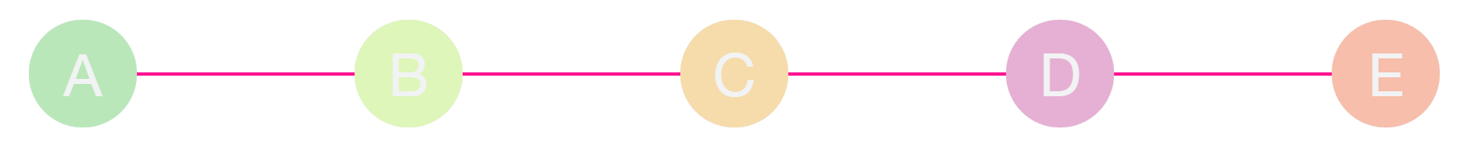
<div class="container">
<template ngFor let-grade [ngForOf]="grades"
let-i="index">
<div kyf-badge [label]="grade"
[isActive]="isActive(grade)"></div>
<div *ngIf="i < grades.length - 1"
class="line"></div>
</template>
</div>
renderGradePanel() {
return this.grades.map((grade, i) =>
<GradeBadge key={grade} label={grade}
showLine={i < this.grades.length - 1}/>
);
}
<div className="h-container">
{this.renderGradePanel()}
</div>
Notes:
Simple and similar so far. Let’s see how we will render a list of stuff. Here the list of badges representing the possible grades that a product can get (A - most healthy, E - least healthy)
The code on the left in Angular uses some bulky template tag to introduce for-loop to render a list of elements.
React code is elegant and seductive with its JSX JavaScript dialect. You can elegantly map your list to elements. This style of writing out your app looks very enjoyable and appealing.
In React every component has a render function and we always have to return a component function to compose our components (remember everything is a function). This means we can never return list of things. We will always have to wrap the elements representing the data in our list in one parent element. While in ng I can put the badge and line one under the other in the template loop, in react I have to combine them in a parent component - can’t just leave the div that draws a line hanging out there. I can tell you this is much more important than you might think because for sure it will spoil your reputation with your designers who will have to handle all those extra divs, especially ruins it for flexbox.

Slide 14
--Forms
<form class="container" [formGroup]="productForm"
(ngSubmit)="onSave()">
<div class="row">
<label for="productName">Product</label>
<div class="h-container">
<input type="text" id="productName" formControlName="name">
</div>
</div>
<div class="row">
<label for="productType">Product type</label>
<kyf-dropdown id="productType"
[listItems]="productTypes"
formControlName="productType"></kyf-dropdown>
</div>
...
<div class="row">
<input type="submit" value="{{actionName}}"
[disabled]="!productForm.valid">
</div>
</form>
<form className="container">
<div className="row">
<label htmlFor="productName">Product</label>
<div className="h-container">
<input type="text" id="productName"/>
</div>
</div>
<div className="row">
<label htmlFor="productType">Product type</label>
<Dropdown listItems={this.productTypes}
onSelectItem={this.onProductTypeSelected}
selectedItem={this.state
.product.get('productType')}/>
</div>
...
<div className="row">
<input type="submit" value="Add" onClick={this.onSave}/>
</div>
</form>
Notes:
Next step is to create a form. So far we’ve been seduced by React’s beauty and thankful for Angular thinking about our designers.
Here’s how our forms will look like - pretty similar but there is some funny business going on in the react part - referencing state!
But let’s see first how Angular manages our form data before we clarify React’s state. Notice first how form elements are annotated with names.

Slide 15
this.productForm = this.formBuilder.group({
name: ['', Validators.required],
productType: 'Dairy',
badIngredients: this.formBuilder.array(this.getBadIngredients().map(createIngredientFormControl)),
goodIngredients:this.formBuilder.array(this.getGoodIngredients().map(createIngredientFormControl))
});
this.productForm.valueChanges.subscribe((value) => {
if (value && value.goodIngredients && value.badIngredients) {
this.calculate({value, valid: true});
}
});
Notes:
Angular offers reactive forms. You annotate your fields with form names, bind the form names to form controls.
Assign each form control a validator. And subscribe to the changes that you are interested in.
The form object does all the work and when done gives you an object without mutating your initial data - hence no state and no state handling. It offers interfaces that allow you to hook up your custom component directly in your form.

Slide 16
const createIngredientFormControl = (key) => {
return formBuilder.group({
type: key,
amount: [0, createAmountValidator(key)]
}
);
};
Notes:
Here’s how we create a group of controls to reflect the input for the custom component for amount entry.

Slide 17
const createAmountValidator = (key) => {
const maxValue = this.ingredientService.getIngredientMaxValue(key);
return (c: FormControl) => {
return c.value <= maxValue ? null : {
validateAmount: {
valid: false
}
};
};
};
Notes:
… and define a custom validator for it which depends on some input parameters.

Slide 18
constructor(props) {
super(props);
this.onAmountChange = this.onAmountChange.bind(this);
this.onProductTypeSelected = this.onProductTypeSelected.bind(this);
this.onSave = this.onSave.bind(this);
const product = ProductService.createProductTemplate();
const badIngredients = {};
product.get('badIngredients')
.forEach(ingredient => {badIngredients[ingredient.get('type')] = false});
const goodIngredients = {};
product.get('goodIngredients')
.forEach(ingredient => {goodIngredients[ingredient.get('type')] = false});
this.state = {
product: product,
calculation: undefined,
errors: {
badIngredients: badIngredients,
goodIngredients: goodIngredients
}
};
}
Notes:
React has no concept for handling forms, you have to deal with everything on your own. And without any help of additional libraries like redux you will soon manage state all over the place. React does two way binding yes, because you cannot handle a form without data flowing to and from the user back to your app. The tricky thing is to propagate the change backwards all the way to the parent component that in the end knows what to do with the change.

Slide 19
validate(value) {
return value < 0 || value > 1000;
}
onAmountChange(type, subtype, index, value) {
if (value) {
const changedProduct = this.state.product.setIn([type, index, 'amount'], value);
let currentErrors = this.state.errors;
currentErrors[type][subtype] = this.validate(value);
this.setState({
product: changedProduct,
errors: currentErrors
});
}
}
createOnAmountChangeHandler(type, subtype, index) {
return (event) => {
this.onAmountChange(type, subtype, index, event.target.valueAsNumber);
}
}
onProductTypeSelected(item) {
let changedProduct = this.state.product.set('productType', item);
this.setState({product: changedProduct});
}
Notes:
So for everything you delegate for rendering to child components you will have to provide “handle change” functions that will know how to update the parent state. And at the same time deal with validating it.
Forms need mutation, no hiding from it. But you can build a reactive app around them if the framework abstracts away nicely the mutability for you.

Slide 20
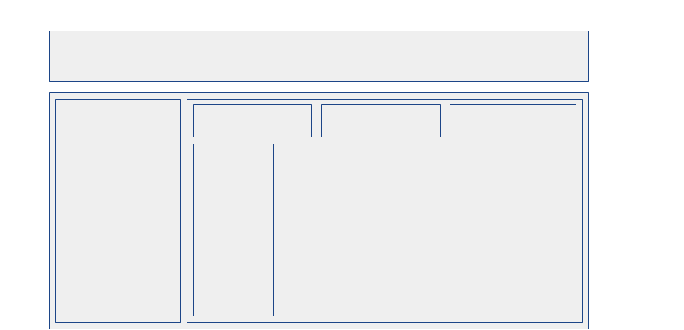


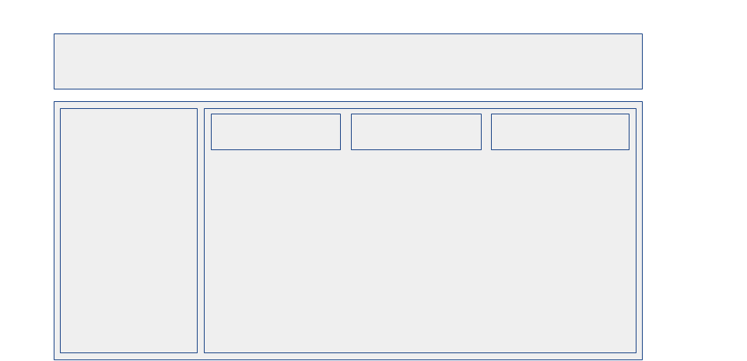
--Routing
/home
/items
/item/1
/edit
Notes:
Client side routing is indispensable in large frontend apps today. We do not want to go back to the server each time the users wants to navigate.
Here is how we go deeper into the UI as the route gets built and more detailed and deeply nested components come to life.

Slide 21
const APP_ROUTES: Routes = [
{path: 'login', component: LoginComponent},
{path: 'home', component: CalculatorComponent,
canActivate: [CanActivateIfAuthenticatedGuard]},
{
path: 'products', component: ProductsComponent,
canActivate: [CanActivateIfAuthenticatedGuard],
children: [{path: ':id', component: ProductDetailComponent}]
},
{path: '', redirectTo: '/login', pathMatch: 'full'},
{path: '**', redirectTo: '/home', pathMatch: 'full'}
];
Notes:
Angular wants you to provide a declarative configuration for your routes. And this is the correct way to do it. Resilient to change, abstracted from component functions.
It is easy to define nested routes as children.
And you can also modularize your routes and have them being lazy loaded all out of the box.

Slide 22
<div class="kyf-root">
<h1 class="kyf-header">
Know-Your-Food
</h1>
<kyf-navigation></kyf-navigation>
<div class="kyf-content">
<router-outlet></router-outlet>
</div>
</div>
Notes:
In your component’s template you need to state where nested route content will go.

Slide 23
<Router history={hashHistory}>
<Route path='/' component={App}>
<IndexRedirect to="/home"/>
<Route path='login' component={Login}/>
<Route path='home' component={CalculatorComponent}
onEnter={this.requireAuth}/>
<Route path='products' component={ProductList}
onEnter={this.requireAuth}>
<Route path='product/:id' component={ProductDetail} />
</Route>
<Route path='*' onEnter={this.avoidPageNotFound} />
</Route>
</Router>
Notes:
In React routes are actually trying to be components. And it is here that the whole concept falls apart, you can’t simply add here other components either built in html elements or your own intermixed with the routes which means they are not in the end just components. The routing concept for React changes so often and it is so different each time but it never really succeeds to hit the target. This is a no go for large apps. It is not so straightforward to split it up in separate components. There is no one best approach on how to implement authentication guards either. Most likely Redux will come again to the rescue, but that’s one opinionated approach that is out of scope for me today.

Slide 24
class App extends Component {
render() {
return (
<div className="container">
<div className="kyf-root">
<h1 className="kyf-header">
Know-Your-Food
</h1>
{this.props.children}
</div>
</div>
);
}
}
Notes:
Yep, that’s the weird way to render nested route content.

Slide 25
--React vs. Angular2 ?!
React method count ~tens
Angular method count ~hundreds
React dependencies: ~750
Angular 2 with CLI: ~780
React fails on routing and forms, wins on code style
Angular fails on boilerplate, wins on completeness
Neither has anything to do with Reactive programming :)
Notes:
Both libraries have advantages and disadvantages and though it seems I’ve made no conclusions and I’m completely undecided, the point is in fact that the process of choosing what tools to use when you build your app depends exactly on what you are trying to achieve. No tool fits all purpose, you have to choose which one is better for you.
But to avoid being completely vague, my conclusion is that if you go for big enterprise apps with lots of forms and your team is big and diverse in experience and competencies you should probably go for Angular. If performance on various devices is of essence, if you’re building mobile first or you have a well-adjusted very strong team than you could consider React also for bigger projects. Experts on the library also have decided after a while some of their ideas were leading to overly complex solutions with React (using mixins).
Disclaimer: I am not an expert in either, but I am in ng1 and I thought that my process of scrutinizing of the intro to both might be interesting to share.

Slide 26



--Big Thanks to my contributors!
Hristijan
Emilija
Valerija

