Slide 1
Java 9
Project Jigsaw / JSR 376: JavaTM Platform Module System

Slide 2

Who is speaking
Java developer in SEAVUS
Oracle Certified Professional, Java SE 8 Programmer
Over 8 years in this ever advancing industry
Mother of two boys / beasts

Slide 3
Content of this presentation
Why modularity ?
Jigsaw In a nutshell
Modularity basic concepts
Example
Migration of existing code to Java 9

Slide 4

Why Modularity ?

Slide 5

Jigsaw in a nutshell
Create Modular System
Key values of the project:
strong encapsulation
reliable configuration

Slide 6
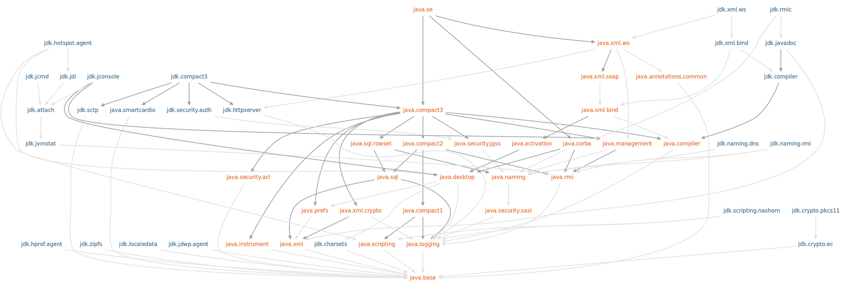
Jigsaw in a nutshell
module graph of the platform
Notes:
80 platform modules
java -listmods

Slide 7
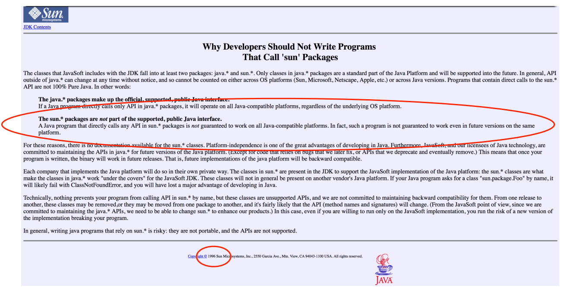
What it means for the platform ? - Security

Slide 8
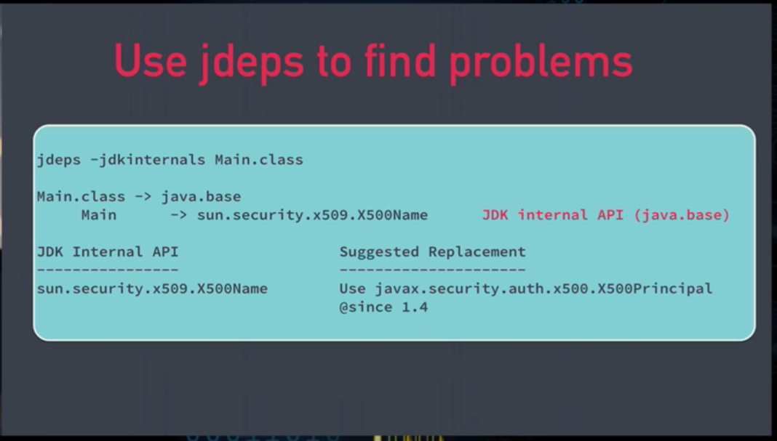
What module means for the platform ? - Security
Notes:
--add-exports java.base/sun.security.provider=ALL-UNNAMED
Add-Exports: java.base/sun.security.provider

Slide 9
What module means for the platform ? - Scalability
jlink custom modular run-time image
your app modules + only the required subset of JRE modules = modular run-time image

Slide 10
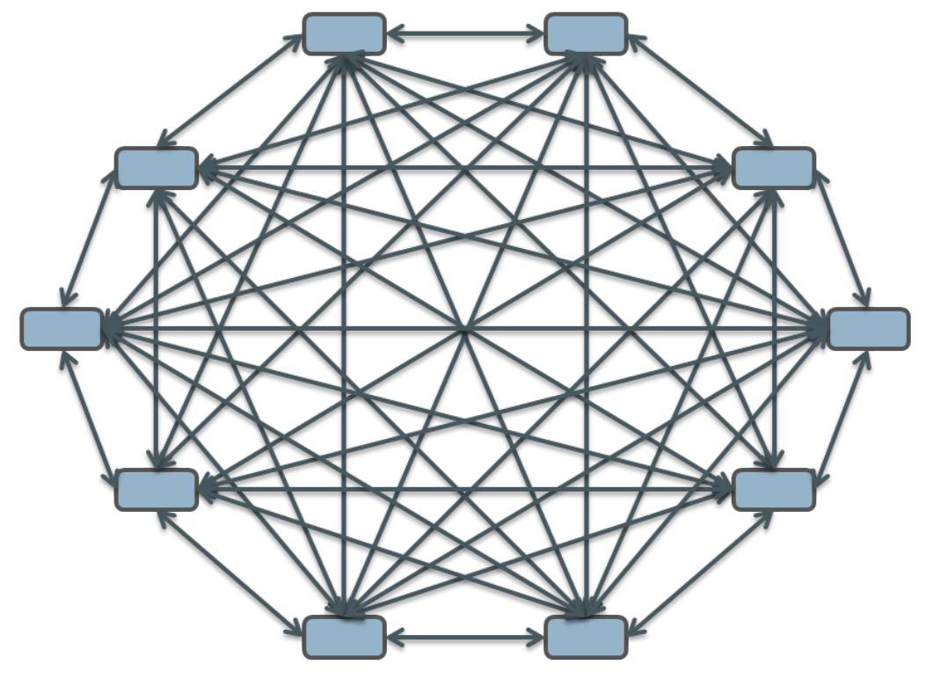
What problems is it truing to solve ?
Whatever you know for the structure of your system it erases and connects everything to everything else.
Problems:
duplicate classes,
missing classes
slow sequential lookup
The problem with the classpath

Slide 11
Modularity Basic Concepts
What is module ?
01
How does this impact on readability and accessibility?
02
What is Unnamed module ?
03
What is Automatic module ?
04

Slide 12
What is Module

Slide 13
Define Module
Module is a named self describing collection of code and data.
Unit of software that declares the answers to three questions about itself in a file named module-info.java:
What is its name?
What does it require?
What does it export?
module name
exports
requires

Slide 14
Define Module
1. What is its name?
module com.foo.bar { }
3. What does it export?
module com.foo.bar {
requires org.baz.qux;
exports com.foo.bar.alpha;
exports com.foo.bar.beta;
}
2. What does it require?
module com.foo.bar {
requires org.baz.qux;
}

Slide 15
Define Module
module-info.java source file content:
module com.foo.bar {
requires org.baz.qux;
exports com.foo.bar.alpha;
exports com.foo.bar.beta;
}

Slide 16
Define Module
Modular jar- regular jar with module-info.class in the top level directory
Module path - the folders where modules reside it is different than class path.

Slide 17
Readability And Accessibility

Slide 18
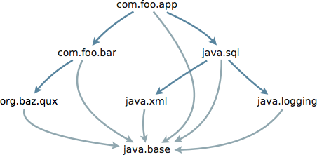
Readability - Direct Readability
module com.foo.app {
requires com.foo.bar;
requires java.sql;
}
module com.foo.bar {
requires org.baz.qux;
exports com.foo.bar.alpha;
exports com.foo.bar.beta;
}
module java.sql {
requires java.logging;
requires java.xml;
exports java.sql;
exports javax.sql;
exports javax.transaction.xa;
}

Slide 19
Readability - Implied Readability
String url = ...;
Properties props = ...;
Driver d = DriverManager.getDriver(url);
Connection c = d.connect(url, props);
d.getParentLogger().info("Connection acquired");
module java.sql {
requires transitive java.logging;
requires transitive java.xml;
exports java.sql;
exports javax.sql;
exports javax.transaction.xa;
}
Refactor the module -> without breaking it’s consumers.

Slide 20
Accessibility
Accessibility is created of two constrains:
The readability relationship
The exports declaration.
Module X
reads
Module Y
class A.B
accesses
class Q.D
exports
module X{
requires Y;
}
module Y{
exports Q;
}

Slide 21
Accessibility
Accessibility (JDK 9 –)
public to everyone
public but only to specific modules
public only within a module
protected
<package>
private

Slide 22
Unnamed And Automatic Modules

Slide 23

Unnamed Module
There are situations in which you will need to load a package that is not put in any module yet and it is still on the classpath. In this scenario if the package is found and loaded it is considered as if it belongs to an “unnamed module”.
The unnamed module reads code in any other module
The unnamed module exports all of its packages.

Slide 24

Automatic Module
An automatic module is created when we take code from the class path and we put it in the module path. If we take jar from the class pat and put it in the module path this implicitly becomes named module. It’s name is derived from the jar name, and it is not real module because it does not have explicit module-info declaration.
The automatic module reads every other named module.
The automatic module exports all of its packages. It guarantees direct and implied readability to all other modules.

Slide 25
Example

Slide 26
EXAMPLE
com.coffeeshop.app
com.coffeeshop.cup
com.coffeeshop.factories
com.coffeeshop.ingredients
java.base

Slide 27
Services
Loose coupling with services
One module requires implementation of interface and other module provides implementation
There can be more than one provider implementation, ServiceLoader is used and the preferred type is chosen at runtime.
//provider module
module java.some.provider{
provides java.provider with java.providerimplementation
}
//consumer module
module java.user{
requires java.xyz;
exports java.abc
uses java.provider ->> service type
}

Slide 28
Open Modules
Some kinds of framework, libraries require reflective access to members of the non-exported types of other modules -> solution is open modules.
open module foo.bar {
exports com.foo.bar;
requires hibernate.core;
requires hibernate.entitymanager;
}
module foo.bar {
exports com.foo.bar;
opens com.foo.bar.model;
requires hibernate.core;
requires hibernate.entitymanager;
}
Notes:
Java EE, Hibernate, Spring
All elements of all packages are available for deep reflection at run time, but only the public and protected types of com.foo.bar are accessible at compile time
Here only com.foo.bar is accessible at compile time.

Slide 29
Migrating to Java 9

Slide 30
Migrating to Java 9
Top Down
App Migration
Your app
myapp.jar
mylib.jar
Libraries and
Third party apps
lib1.jar
otherapp.jar
lib2.jar
JDK
module
java.base
module
java.sql
module
java.logging
module
java.xml
Bottom Up
Library Migration
Notes:
gradual migration path to modularization.

Slide 31
Migrating to Java 9
Top down would be migrating your application and using not migrated libraries that are still residing on the classpath.
Bottom up would be migrating the libraries first and using migrated modularized libraries while your app is still on the class path.

Slide 32
Migrating to Java 9
module
myapp
module
mylib
Top Down
App Migration
Your app
Libraries and
Third party apps
AUTOMATIC MODULE
lib1.jar
otherapp.jar
lib2.jar
JDK
module
java.base
module
java.sql
module
java.logging
module
java.xml

Slide 33
Migrating to Java 9
Your app
myapp.jar
UNNAMED MODULE
mylib.jar
Libraries and
Third party apps
module
lib1
module
otherapp
module
lib2
JDK
Bottom Up
Library Migration
module
java.base
module
java.sql
module
java.logging
module
java.xml
Notes:
This is a crucial escape hatch in
case some problem prevents a migration

Slide 34
Questions?

Slide 35
Prizes
Hard Disc:
Martin Spasovski @moondowner
Java t-shirts:
Thunder God @LordRaydenMK
Gjorgji Noveski @kacibe_ti
MolYDolY @molYCS
Ilievski Martin @martinmaxs

Slide 36
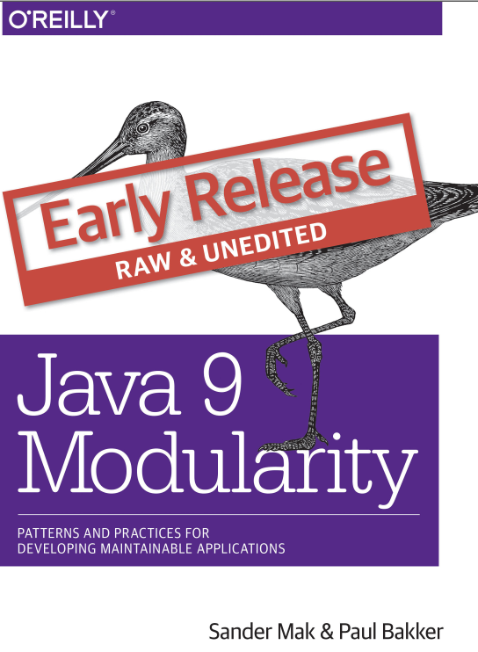
References
Project Jigsaw - http://openjdk.java.net/projects/jigsaw/
Project Jigsaw: Talks - http://openjdk.java.net/projects/jigsaw/talks/#j1-2016
Follow @mreinhold https://twitter.com/mreinhold
In Seavus Library you can find: Java 9 Modularity

