Slide 1


Flux your app via Redux
Quick introduction of state management in JavaScript apps using Redux

Slide 2
Petar Blazhevski
Front-end developer at Polar Cape
@PetarBlazevski

Slide 3
History
Facebook UI transition to components (React)

Slide 4
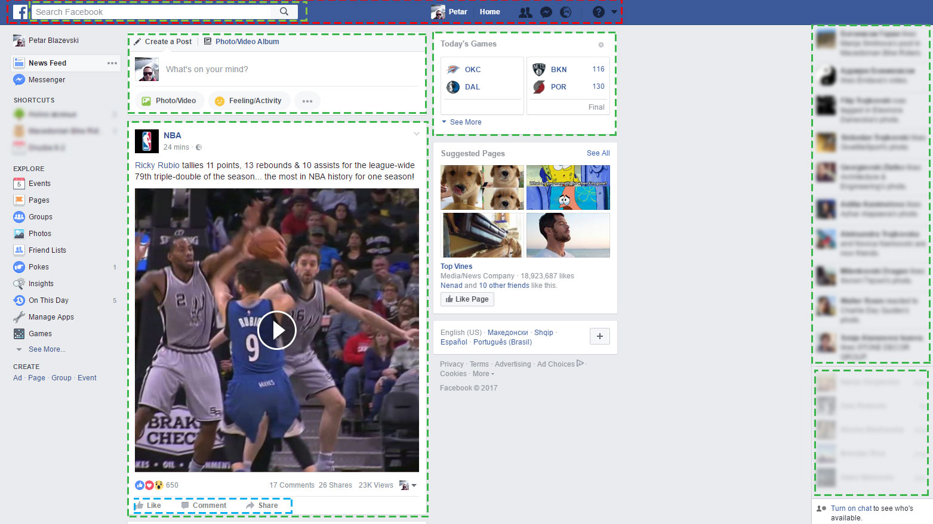

Slide 5
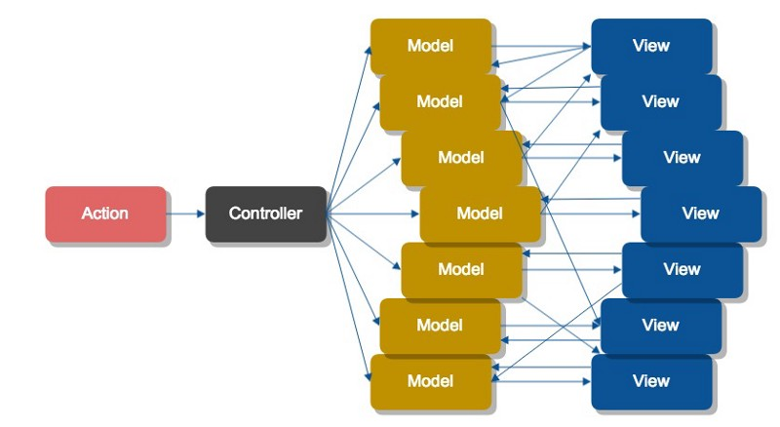
The problem: Data Flow
MVC – Bidirectional data flow. One change can affect the state of the app in many places

Slide 6
Introduction of Flux

Slide 7

What is Flux?
Application architecture, or
Pattern for managing data flow in an application
Designed by Facebook
Unidirectional data flow
Flux

Slide 8
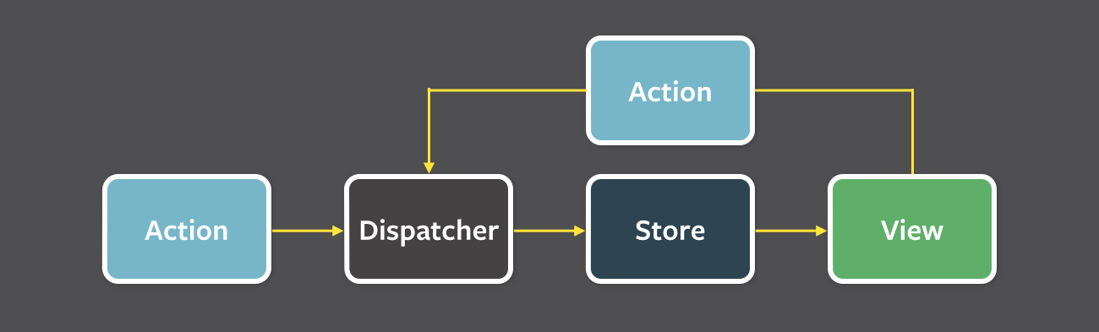
The 4 parts of Flux
View – Displays the data, and enables user interactions with the app
Action – Single object that contains the payload. Must contain the “type” field
Dispatch – Receives actions and dispatches them to the store
Store – Stores the data. We can have multiple stores in an application

Slide 9
Redux

Slide 10

What is Redux?
Inspired by Flux
Avoids it’s complexity
Doesn’t have a real dispatcher
Should contain only one immutable store
Has the ability to be implemented in logging, hot reload, time travel, etc.

Slide 11
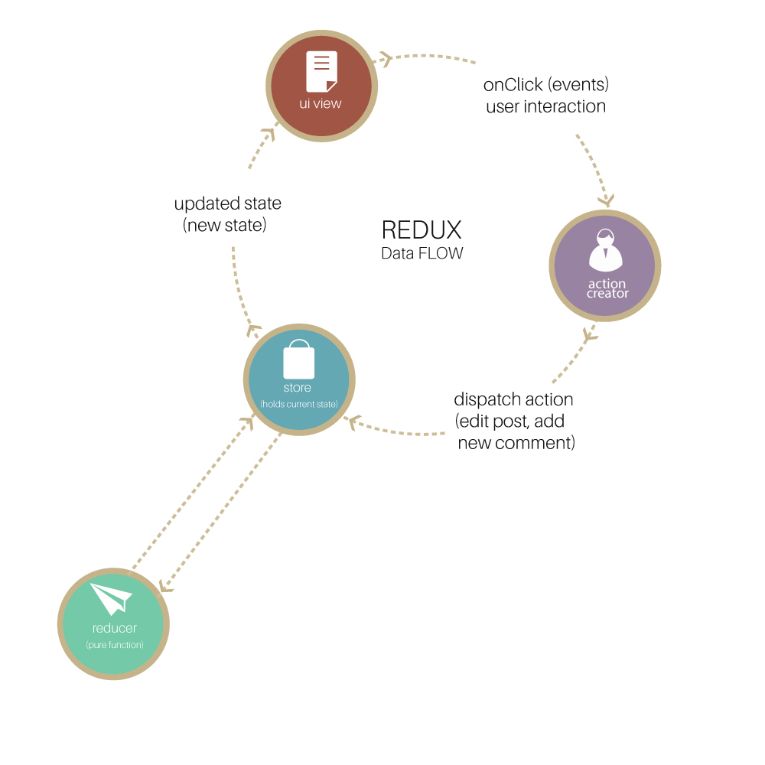
The 3 parts of redux
Actions – Similar to Flux Actions
Store
Stores the application state
Immutable object
Only one store in application
Reducers – Takes the current state, performs simple actions, and returns new state

Slide 12
Q&A

Slide 13
Thank you all

