Slide 1


Michael Drost Tricode Team Lead Quality Assurance WHY THE TESTER IS YOUR BEST FRIEND IN SCRUM
JAVASKOP`17
Date: 11-03-2017

Slide 2
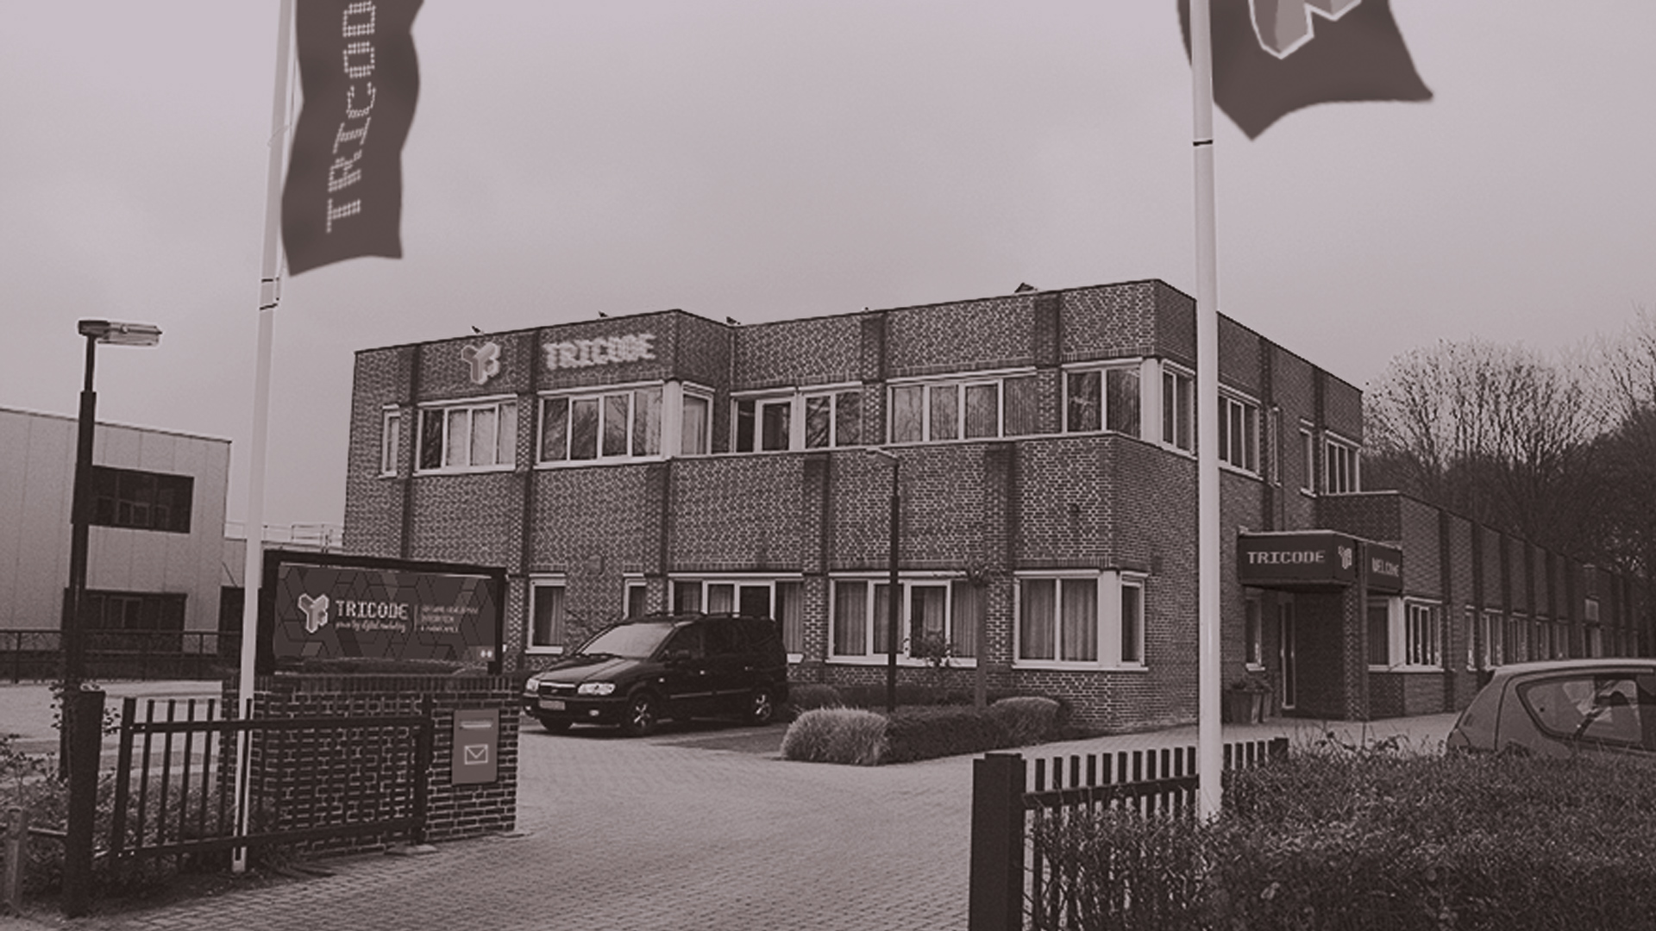












A B O U T T R I C O D E |
Offices in Veenendaal (the Netherlands) and Skopje (Macedonia)
02

Slide 3


I N T R O D U C T I ON |

Slide 4

What do you know?
What do you enjoy?
What do you LOVE?
04

Slide 5
Product Owners and Functionality, Scrum Masters and Burn Down rates
Technical Debt, incomplete Architecture, assumed knowledge of Customer Culture
Solution Thinking instead of asking more questions
05

Slide 6

FIRED UP! READY TO GO!

Slide 7
IDEA
Do what we do best
Work as a team
Cover the gaps between skillsets
07

Slide 8
TRICODE METHOD
Tester in from the start
Use flows scripted in Gerhkin
Use Business Language
08

Slide 9
BENEFITS
Refined scope
User Documentation
Language and Structure
09

Slide 10
GUIDELINES
Keep User Stories simple
One actor/role per flow
Review by Product Owner
010

Slide 11
CONCLUSION
Let the Tester ask the questions
Let the Developer fix the problem
Let the scripts do the talking
011

Slide 12

Any questions?

Slide 13
Follow us
facebook.com/tricode
linkedin.com/company/tricode
slideshare.net/tricode
twitter.com/tricode
www.tricode.nl

