Slide 1

Face feature detection using Java and OpenCV

Slide 2
Content
What is OpenCV?
What is face detection and haar cascade classifiers?
How to make face detection in Java using OpenCV
Live Demo
Problems in face detection process
How to improve face detection

Slide 3
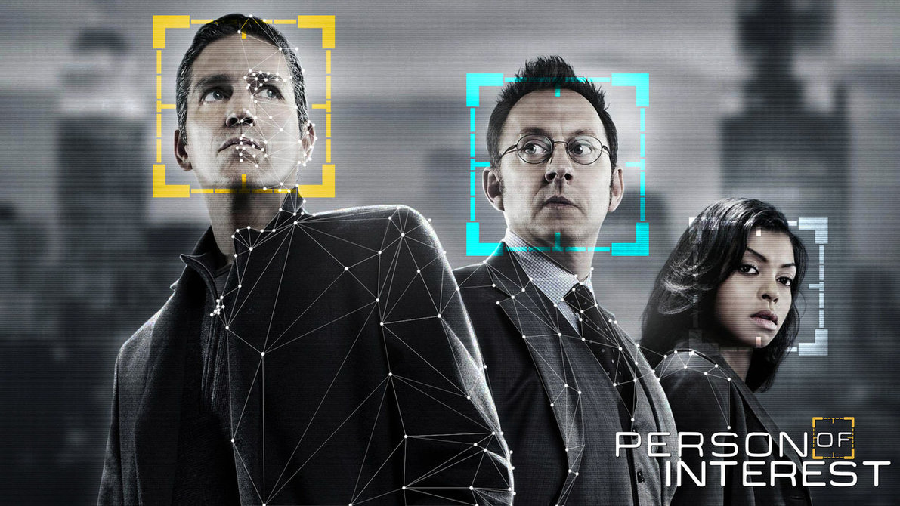
What is OpenCV ?
OpenCV (Open Source Computer Vision Library)
is an open source computer vision
and machine learning software library.
The library has more than 2500 optimized algorithms used for:
Recognize faces
Identify objects
Image matching
Track camera movements
Track moving objects
Tracking eyes movements
Recognize scenery

Slide 4
What is OpenCV ?
Very large community and millions of downloads
OpenCV supports Java, C++, C, Python and Matlab
OpenCV runs on different platform
(Windows,Linux,Android,iOS,Blackberry …)
It is used by big companies such as
Google, Microsoft, Intel, IBM, Sony, Toyota, nVidia, Honda …
Easy to use and install

Slide 5
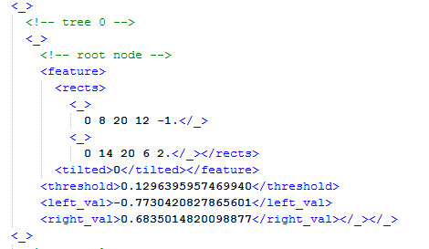
Face detection and Haar Cascade Classifiers
What is face detection?
What are Haar Feature – based Cascade Classifiers?
You can train your own files

Slide 6
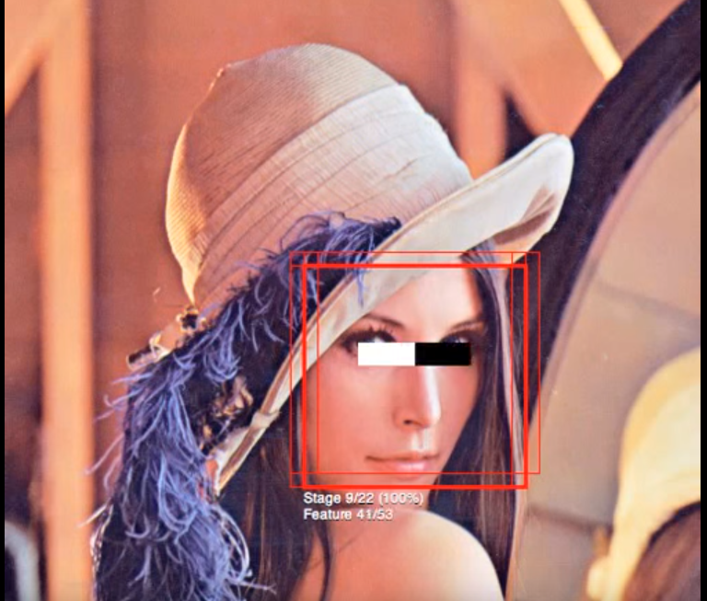
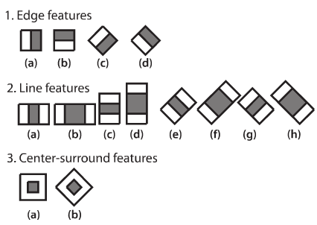
Face detection and Haar Cascade Classifiers
Dramatically increases the speed of the detector by focusing attention on promising regions of the image
OpenCV's algorithm is currently using the following Haar-like features which are the input to the basic classifiers:

Slide 7
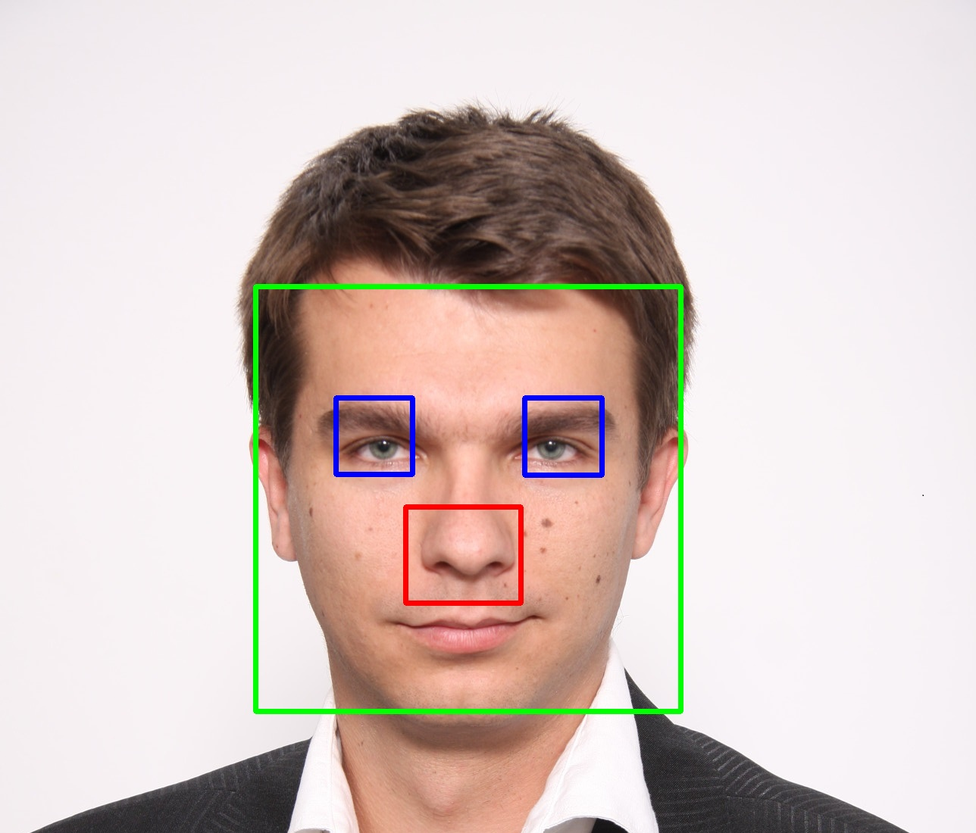
Face detection and Haar Cascade Classifiers
OpenCV already contains many pre-trained classifiers for:
Eyes
Nose
Mouth
Face
Smile
Body
Profile face
Frontal face
…...

Slide 8
Make face detection using Java and OpenCV
Load OpenCV driver
System.load(‘path-to-the-driver/driver-name’);
Load haar cascade classifier
CascadeClassifier classifier = new CascadeClassifier(‘path-to-the-classifier’);
Detect face feature and return position of the detected feature in the original image
MatOfRect detections = new MatOfRect();
classifier.detectMultiScale(source, detections);

Slide 9

Live Demo

Slide 10
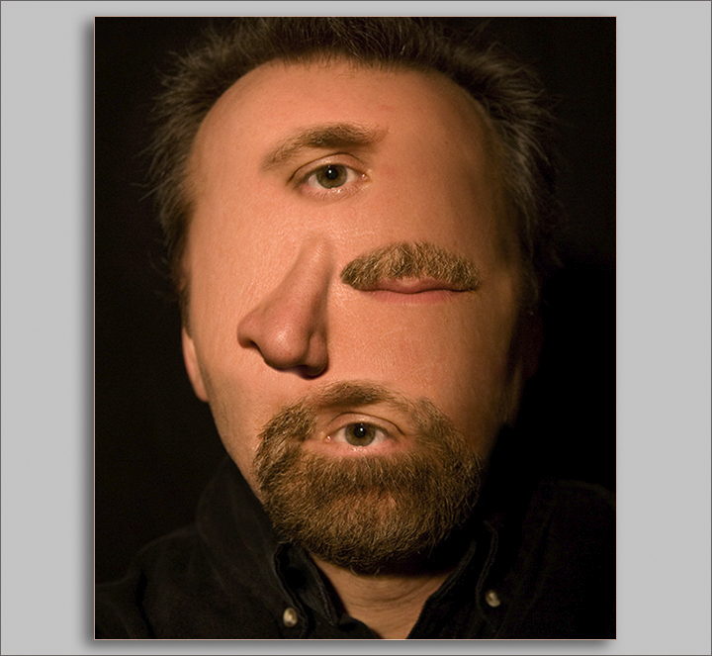
Problems with detection
Bad lightening
Bad image quality
Sometimes can detect more than two eyes or noses
Sometimes can detect two eyes on one eye
Face features detection on wrong places

Slide 11
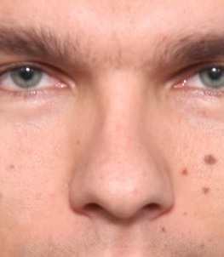
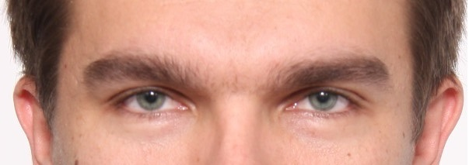
How to improve face feature detection
Convert the image in black and white format
Use regions of interest on the face
Example: If you want to detect eyes, cut the image around the eyes and then run eyes detection
Try different trained haar cascade xml files
Add common logic in iterating detected arrays

Slide 12
Conclusion
It is free to use for both personal and business proposes,
only several algorithms are patented, but they are marked as non free.
It is easy to use in Java, just a few lines of code
Can be implemented in various applications
because it offers a lot of functionalities and algorithms.

Slide 13

QUESTIONS

Slide 14

Thanks to all employees in Polar Cape Macedonia that were included in researching and investigating OpenCV
dragan.miladinoski@gmail.com

