Slide 1
Spring Cloud Netflix
Sinisha Mihajlovski

Slide 2
About me
Software engineer at Endava
I like engineering in general
“Throwing, catching and handling exceptions does not make you an exceptional person”

Slide 3
About the presentation
Spring Boot
Spring Cloud Netflix
Demo

Slide 4
Spring Boot
Easy to get started - Spring Initializr
Embedded servlet container
Easy configuration - no XML
Easy extension - to change the default behavior
Easy running and deploying of applications
This makes it perfect for developing microservices

Slide 5
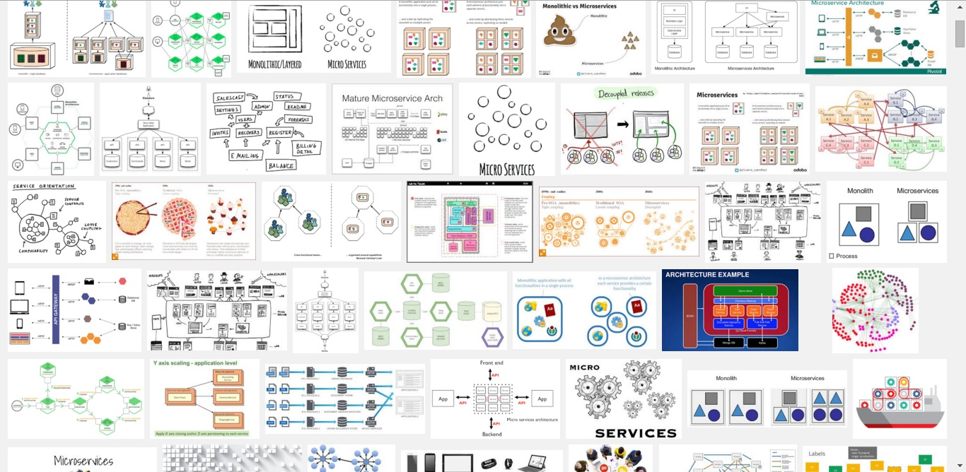
Architecture

Slide 6
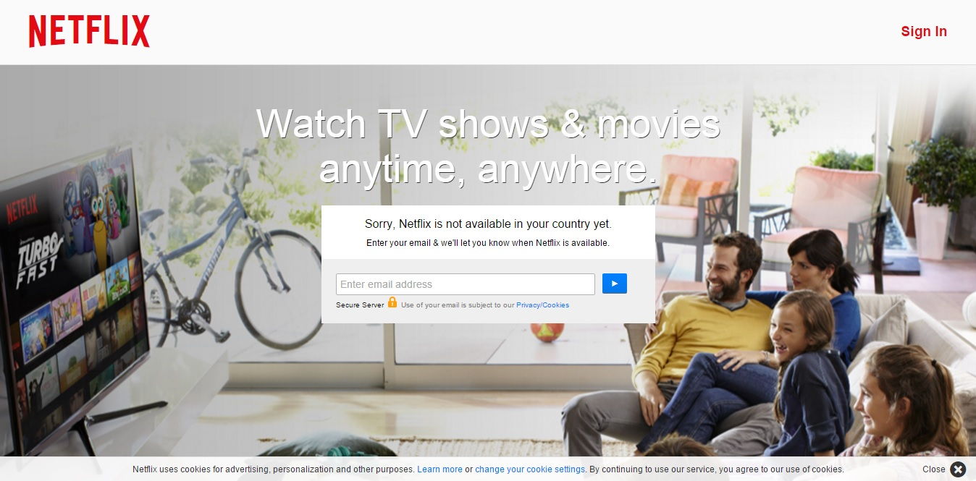

Slide 7
Netflix
Service Discovery: Eureka Clients
Service Discovery: Eureka Server
Circuit Breaker: Hystrix Clients
Circuit Breaker: Hystrix Dashboard
Client Side Load Balancer: Ribbon
Declarative REST Client: Feign
Router and Filter: Zuul
External Configuration: Archaius

Slide 8
Eureka Client
@Configuration @ComponentScan @EnableAutoConfiguration @EnableEurekaClient @RestController public class Application { @RequestMapping("/") public String home() { return "Hello world"; } public static void main(String[] args) { new SpringApplicationBuilder(Application.class).web(true).run(args); } }
application.properties:
server.port=8811
spring.application.name=SERVICE-1
eureka.client.registerWithEureka=true
eureka.client.serviceUrl.defaultZone=${vcap.services.eureka-service.credentials.uri:http://127.0.0.1:8761}/eureka/

Slide 9
Eureka Server
application.properties:
server.port=8761
eureka.client.registerWithEureka=false
eureka.client.fetchRegistry=false
eureka.client.serviceUrl.defaultZone=http://localhost:${server.port}/eureka/
@SpringBootApplication @EnableEurekaServer public class Application { public static void main(String[] args) { new SpringApplicationBuilder(Application.class)
.web(true).run(args); } }

Slide 10
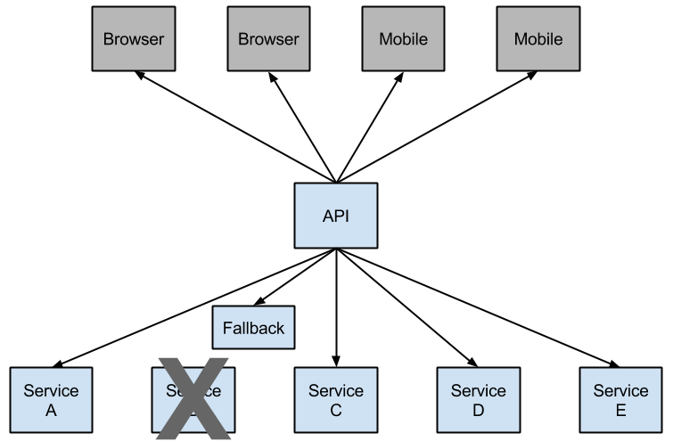
Hystrix Clients
Netflix has created a library called Hystrix that implements the circuit breaker pattern. In a microservice architecture it is common to have multiple layers of service calls.

Slide 11
Hystrix Clients
@SpringBootApplication @EnableCircuitBreaker public class Application { public static void main(String[] args) { new SpringApplicationBuilder(Application.class).web(true).run(args); } }

Slide 12
Hystrix Clients
@Component public class StoreIntegration { @HystrixCommand(fallbackMethod = "defaultStores") public Object getStores(Map<String, Object> parameters) { //do stuff that might fail } public Object defaultStores(Map<String, Object> parameters) { return /* something useful */; } }

Slide 13
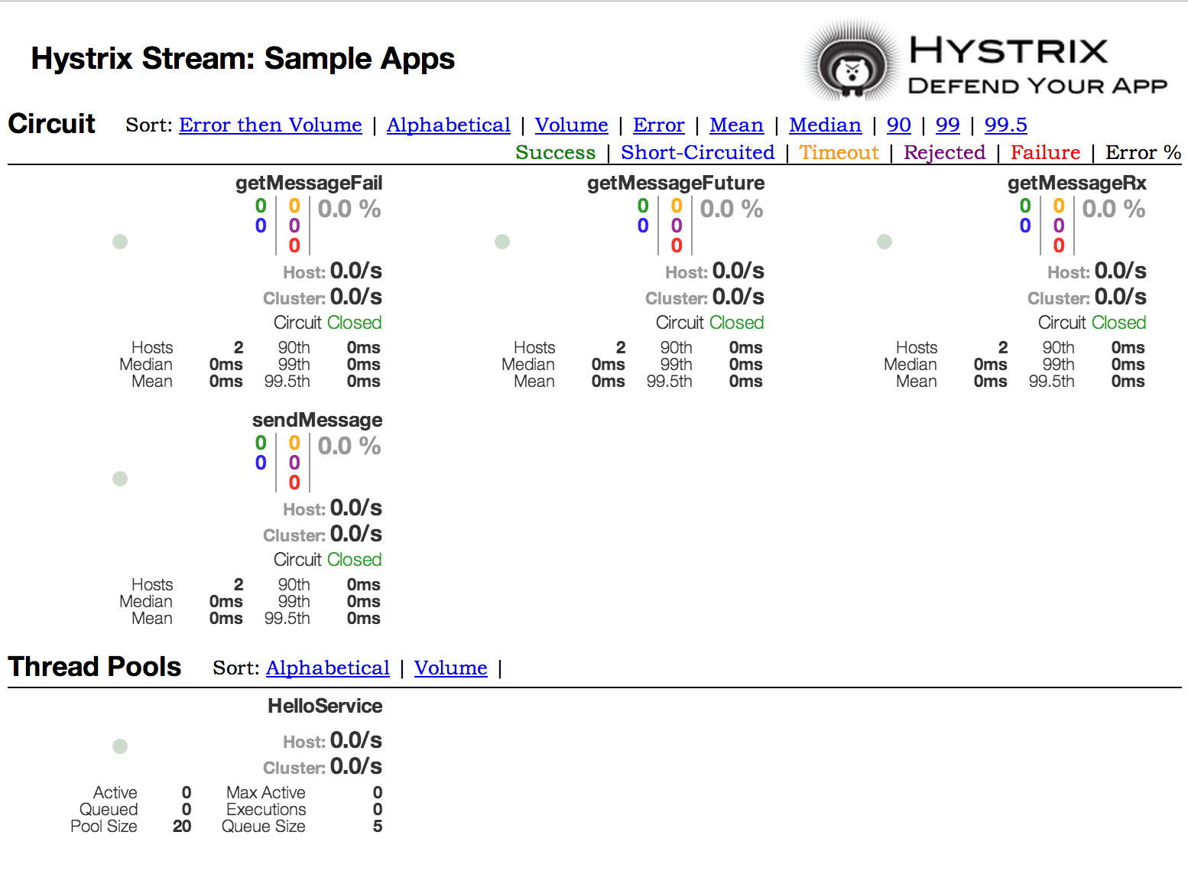
Hystrix Dashboard

Slide 14
Ribbon
Ribbon is a client side load balancer which gives you a lot of control over the behaviour of HTTP and TCP clients.
IClientConfig ribbonClientConfig: DefaultClientConfigImpl
IRule ribbonRule: ZoneAvoidanceRule
IPing ribbonPing: NoOpPing
ServerList<Server> ribbonServerList: ConfigurationBasedServerList
ServerListFilter<Server> ribbonServerListFilter: ZonePreferenceServerListFilter
ILoadBalancer ribbonLoadBalancer: ZoneAwareLoadBalancer

Slide 15
Ribbon
@Configuration @RibbonClient(name = "foo", configuration = FooConfiguration.class) public class TestConfiguration { }
@Configuration public class FooConfiguration { @Bean public IPing ribbonPing(IClientConfig config) { return new PingUrl(); } }

Slide 16
Declarative REST Client: Feign
@Configuration @ComponentScan @EnableAutoConfiguration @EnableEurekaClient @EnableFeignClients public class Application { public static void main(String[] args) { SpringApplication.run(Application.class, args); } }

Slide 17
Declarative REST Client: Feign
@FeignClient("SERVICE-2") public interface StoreClient { @RequestMapping(method = RequestMethod.GET, value = "/stores") List<Store> getStores(); @RequestMapping(method = RequestMethod.POST, value = "/stores/{storeId}", consumes = "application/json") Store update(@PathVariable("storeId") Long storeId, Store store); }

Slide 18
Router and Filter: Zuul
Routing in an integral part of a microservice architecture. For example, / may be mapped to your web application, /api/users is mapped to the user service and /api/shop is mapped to the shop service. Zuul is a JVM based router and server side load balancer by Netflix.

Slide 19
Router and Filter: Zuul
application.properties:
zuul.routes.users.path=/myusers/**
zuul.routes.users.serviceId=users_service

Slide 20
Demo

Slide 21
Source and references
https://github.com/sinisa229/springCloudNetflixShowcase
http://cloud.spring.io/spring-cloud-netflix/spring-cloud-netflix.html
http://techblog.netflix.com/2013/08/deploying-netflix-api.html
https://github.com/joshlong/service-registration-and-discovery
https://spring.io/blog/2015/01/20/microservice-registration-and-discovery-with-spring-cloud-and-netflix-s-eureka
https://spring.io/blog/2015/07/14/microservices-with-spring
https://github.com/paulc4/microservices-demo

Slide 22
Thanks

