Slide 1
Spring RabbitMQ
Martin Toshev

Slide 2

Who am I
Software consultant (self-employed)
BG JUG board member (http://jug.bg)

Slide 3
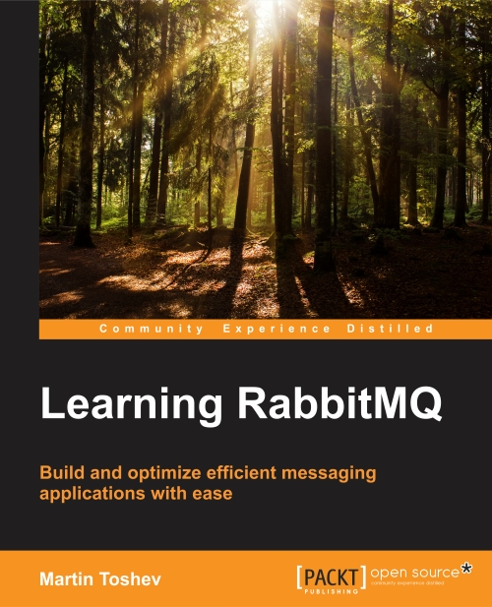
Who am I
Just finished a book on RabbitMQ …

Slide 4
Agenda
Messaging Basics
RabbitMQ Overview
Spring RabbitMQ

Slide 5
Messaging Basics

Slide 6
Messaging Basics
Messaging provides a mechanism for loosely-coupled integration of systems
The central unit of processing in a message is a message which typically contains a body and a header

Slide 7
Messaging Basics
Use cases include:
Log aggregation between systems
Event propagation between systems
Offloading long-running tasks to worker nodes

Slide 8
Messaging Basics
Messaging solutions implement different protocols for transferring of messages such as AMQP, XMPP, MQTT and many others
The variety of protocols implies vendor lock-in when using a particular messaging solution (also called a messaging broker)

Slide 9






Messaging Basics
A variety of messaging brokers can be a choice for applications …

Slide 10
Messaging Basics
Messaging solutions provide means for:
securing message transfer, authenticating and authorizing messaging endpoints
routing messages between endpoints
subscribing to the broker

Slide 11
RabbitMQ Overview

Slide 12
RabbitMQ Overview
An open source message broker written in Erlang
Implements the AMQP Protocol (Advanced Message Queueing Protocol)
Has a pluggable architecture and provides extensions for other protocols such as HTTP, STOMP and MQTT

Slide 13
RabbitMQ Overview
The AMQP protocol defines:
exchanges – the message broker endpoints that receive messages
queues – the message broker endpoints that store messages from exchanges and are used by subscribers for retrieval of messages
bindings – rules that bind exchanges and queues
The AMQP protocol is programmable – which means that the above entities can be created/modified/deleted by applications

Slide 14
RabbitMQ Overview
The AMQP protocol defines multiple connection channels inside a single TCP connection in order to remove the overhead of opening a large number of TCP connections to the message broker

Slide 15
RabbitMQ Overview
Subscriber
Publisher
binding
queue
exchange
binding
Subscriber
queue
Publisher
exchange
queue
binding
Subscriber

Slide 16
RabbitMQ Overview
Subscriber
exchange=“xyz”
routing key=“abc” payload=“bcd”
Publisher
binding
queue
exchange
Subscriber
queue
Publisher
exchange
binding
queue
binding
Subscriber

Slide 17
RabbitMQ Overview
Each message can be published with a routing key
Each binding between an exchange and a queue has a binding key
Routing of messages is determined based on matching between the routing and binding keys

Slide 18
RabbitMQ Overview
Different types of messaging patterns are implemented by means of different types of exchanges
RabbitMQ provides the following types of exchanges:
direct/default
fanout
topic
headers

Slide 19
RabbitMQ Overview
A default exchange has the empty string as a name and routes messages to a queue if the routing key of the message matches the queue name (no binding needs to be declared between a default exchange and a queue)
Default exchanges are suitable for point-to-point communication between endpoints

Slide 20
RabbitMQ Overview
Subscriber
exchange=“”
key=“general” payload=“XYZ”
Publisher
(AMQP default)
general
Subscriber
chat
error
Publisher
log
warning
binding
Subscriber
(AMQP default) is a system exchange

Slide 21
RabbitMQ Overview
A direct exchange routes messages to a queue if the routing key of the message matches the binding key between the direct exchange and the queue
Direct exchanges are suitable for point-to-point communication between endpoints

Slide 22
RabbitMQ Overview
Subscriber
exchange=“chat”
key=“b_general” payload=“XYZ”
Publisher
b_general
(AMQP default)
general
Subscriber
chat
error
Publisher
log
warning
Subscriber
chat is defined as a direct exchange upon creation

Slide 23
RabbitMQ Overview
A fanout exchange routes (broadcasts) messages to all queues that are bound to it (the binding key is not used)
Fanout exchanges are suitable for publish-subscribe communication between endpoints

Slide 24
RabbitMQ Overview
Subscriber
exchange=“log”
key=“” payload=“XYZ”
Publisher
(AMQP default)
general
Subscriber
chat
error
Publisher
log
warning
Subscriber
log is defined as a fanout exchange upon creation

Slide 25
RabbitMQ Overview
A topic exchange routes (multicasts) messages to all queues that have a binding key (can be a pattern) that matches the routing key of the message
Topic exchanges are suitable for routing messages to different queues based on the type of message

Slide 26
RabbitMQ Overview
Subscriber
exchange=“log”
key=“warning.#” payload=“XYZ”
Publisher
(AMQP default)
general
error
Subscriber
chat
Publisher
warning.server
warn.server
log
warning.client
warn.client
Subscriber
log is defined as a topic exchange upon creation

Slide 27
RabbitMQ Overview
A headers exchange routes messages based on a custom message header
Header exchanges are suitable for routing messages to different queues based on more than one attribute

Slide 28
RabbitMQ Overview
Apart from queues, exchanges and bindings we can also manage the following types of components:
vhosts – for logical separation of broker components
users
parameters (e.g. for defining upstream links to another brokers)
policies (e.g. for queue mirroring)

Slide 29
RabbitMQ Overview
Administration of а single instance or an entire cluster can be performed in several ways:
using the management Web interface
using the management HTTP API
using the rabbitmq-admin.py script
using the rabbitmqctl utility

Slide 30
RabbitMQ Overview
RabbitMQ provides clustering support that allows new RabbitMQ nodes to be added on the fly
Clustering by default does not guarantee that message loss may not occur

Slide 31
RabbitMQ Overview
Default clustering mechanism provides scalability in terms of queues rather than high availability
Mirrored queues are an extension to the default clustering mechanism that can be used to establish high availability at the broker level

Slide 32
RabbitMQ Overview
(demo)

Slide 33
Spring RabbitMQ

Slide 34
Spring RabbitMQ
The Spring Framework provides support for RabbitMQ by means of:
The Spring AMQP framework
The Spring Integration framework
The Spring XD framework

Slide 35
Spring RabbitMQ
The Spring AMQP framework provides:
RabbitAdmin class for automatically declaring queues, exchanges and bindings
Listener container for asynchronous processing of inbound messages
RabbitTemplate class for sending and receiving messages

Slide 36
Spring RabbitMQ
Utilities of the Spring AMQP framework can be used either directly in Java or preconfigured in the Spring configuration
The Spring Integration framework provides adapters for the AMQP protocol

Slide 37
Spring RabbitMQ
The following Maven dependency can be used to provide the Spring AMQP framework to the application:
<dependencies>
<dependency>
<groupId>org.springframework.amqp</groupId>
<artifactId>spring-rabbit</artifactId>
<version>1.4.5.RELEASE</version>
</dependency>
</dependencies>

Slide 38
Spring RabbitMQ
RabbitAdmin (plain Java):
CachingConnectionFactory factory = new CachingConnectionFactory("localhost");
RabbitAdmin admin = new RabbitAdmin(factory);
Queue queue = new Queue("sample-queue");
admin.declareQueue(queue);
TopicExchange exchange = new TopicExchange("sample-topic- exchange");
admin.declareExchange(exchange);
admin.declareBinding(BindingBuilder.bind(queue).to(exchange)
.with("sample-key"));
factory.destroy();

Slide 39
Spring RabbitMQ
Container listener (plain Java):
CachingConnectionFactory factory =
new CachingConnectionFactory(
"localhost");
SimpleMessageListenerContainer container = new SimpleMessageListenerContainer(
factory);
Object listener = new Object() {
public void handleMessage(String message) {
System.out.println("Message received: " + message);
}};
MessageListenerAdapter adapter = new MessageListenerAdapter(listener);
container.setMessageListener(adapter);
container.setQueueNames("sample-queue");
container.start();

Slide 40
Spring RabbitMQ
RabbitTemplate (plain Java):
CachingConnectionFactory factory =
new CachingConnectionFactory("localhost");
RabbitTemplate template = new RabbitTemplate(factory);
template.convertAndSend("", "sample-queue", "sample-queue test message!");

Slide 41
Spring RabbitMQ
All of the above examples can be configured using Spring configuration
Cleaner and decouples RabbitMQ configuration from the business logic

Slide 42
Spring RabbitMQ
The following Maven dependency can be used to provide the Spring Integration AMQP framework to the application:
<dependency>
<groupId>org.springframework.integration</groupId>
<artifactId>spring-integration-amqp</artifactId>
<version>4.0.4.RELEASE</version>
</dependency>

Slide 43
Spring RabbitMQ
The Spring Integration Framework provides:
Inbound-channel-adapter for reading messages from a queue
outbound-channel-adapter for sending messages to an exchange

Slide 44
Spring RabbitMQ
(demo)

Slide 45
Thank you !
Q&A

