Slide 1
REST API

Slide 2
What is Rest API?
Representational State Transfer (REST) is an architectural style that defines a set of constraints to be used for creating web services.
REST API is a way of accessing web services in a simple and flexible way without having any processing.
REST uses less bandwidth, simple and flexible making it more suitable for internet usage.
It’s used to fetch or give some information from a web service.
All communication done via REST API uses only HTTP request.

Slide 3
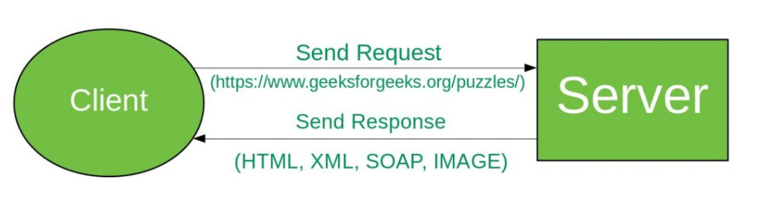
Working
A request is sent from client to server in the form of a web URL as HTTP GET or POST or PUT or DELETE request. After that, a response comes back from the server in the form of a resource which can be anything like HTML, XML, Image, or JSON. But now JSON is the most popular format being used in Web Services.

Slide 4
In HTTP there are five methods that are commonly used in a REST-based Architecture i.e., POST, GET, PUT, PATCH, and DELETE.
These correspond to create, read, update, and delete (or CRUD) operations respectively. There are other methods which are less frequently used like OPTIONS and HEAD.
GET: The HTTP GET method is used to read (or retrieve) a representation of a resource. In the safe path, GET returns a representation in XML or JSON and an HTTP response code of 200 (OK). In an error case, it most often returns a 404 (NOT FOUND) or 400 (BAD REQUEST).
Eg: GET:/api/students
POST: The POST verb is most often utilized to create new resources. On successful creation, return HTTP status 201, returning a Location header with a link to the newly-created resource with the 201 HTTP status.
Eg: POST:/api/students
{“name”:”Raj”}

Slide 5
PUT: It is used for updating the capabilities. On successful update, return 200 (or 204 if not returning any content in the body) from a PUT. If using PUT for create, return HTTP status 201 on successful creation. PUT is not safe operation but it’s idempotent.
Eg: PUT or PATCH:/api/students/1
{“name”:”Raj”}
DELETE: It is used to delete a resource identified by a URI. On successful deletion, return HTTP status 200 (OK) along with a response body.
Eg: DELETE:/api/students/1

Slide 6
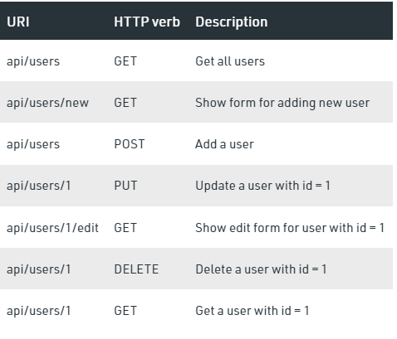
Rules
Always use plurals in URL to keep an API URI consistent throughout the application.

Slide 7
Send a proper HTTP code to indicate a success or error status.
HTTP verbs are used to identify the action. Some of the HTTP verbs are – GET, PUT, POST, DELETE, GET, PATCH.
A web application should be organized into resources like users and then uses HTTP verbs like – GET, PUT, POST, DELETE to modify those resources. And as a developer it should be clear that what needs to be done just by looking at the endpoint and HTTP method used.

