Slide 1

RANI CHANNAMMA UNIVERSITY, BELAGAVI
School of Mathematics and Computing Sciences
DEPARTMENT OF COMPUTER SCIENCE
Presentation On
“SAMPLE HOTEL SITE”
Submitted by
Mr. Lakkappa H Bhajantri.
MSc Ist Semester
December -2018

Slide 2
Description
Sample Hotel Site
Develop a project using HTML,JAVASCRIPT & CSS. Here, customer can check the facilities provided by the Hotel. There is Gallery section to check the images of perticular places of the Hotel. Staff’s Detail information are also provided on Website. And it’s easy to contact hotel from the site for online reservations. Responsive slides are also included in this project .This responsive site project is simple and easy to operate by the users.

Slide 3
Problem Definition
Niyaz Hotel offers accommodation, meals, additional facilities and other services. Accomodation services are offered as followes
ITEM | COST
KAJU KURMA | 205.00
CHICKEN DRUM STICK | 250.00
DAL FRY | 120.00
BIRIYANI | 120`00

Slide 4
Objectives
Access anywhere: The online hotel reservation project can be reached at any time and anywhere from the world with great efficiency.
Easy booking: The rooms in the particular hotel can be reserved easily through this site with great expertise.
Room availability: The rooms that are open in the particular hotel must be refreshed in real time.

Slide 5
Category: The hotels can be classified based on the appropriate region of your preference.
Price: The price or rent of the appropriate rooms in the appropriate hotel in the chosen section will also be updated.
Payment options: The clients will be having the option of paying the rent of the hotels through the online mode without any difficulty.

Slide 6

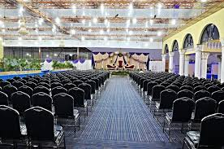
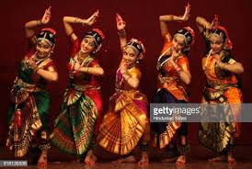
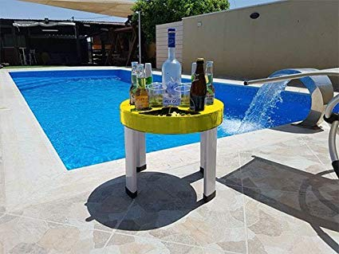
Our Niyaz Hotel Services
CULTURE SHOW
SWIMMING POOL
RESTAURANT
CONFERENCE HALL
GARDEN
POOLSIDE BAR

Slide 7
Languages
HTML(Hyper Text Markup Language)
JAVA SCRIPT
CSS(Cascading Style Sheet)

Slide 8
REQUIRMENTS
Software
Windows 10 OS
Intel pentium processor
Notepad++
MySQL(DATA BASE)
CSS
HTML
JAVA SCRIPT
Hardware
Hard Disk:- 15GB
RAM:- 1GB

Slide 9
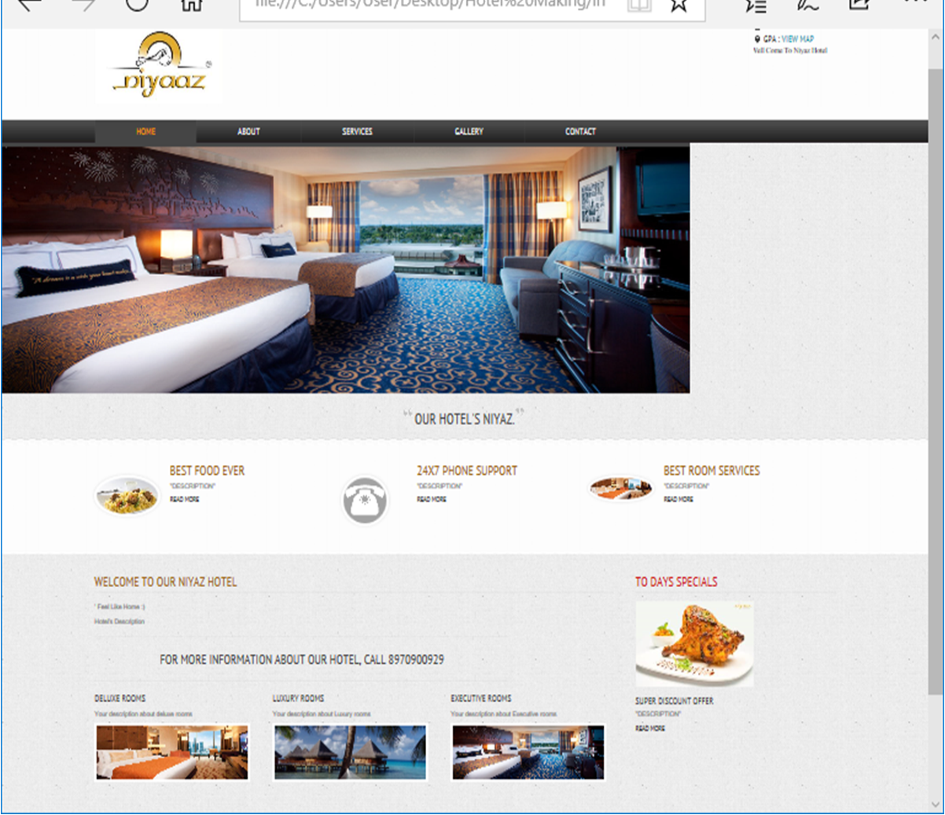
Screenshots
HOME

Slide 10
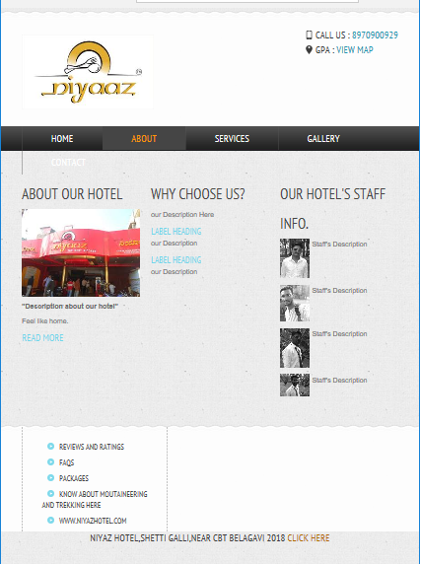
ABOUT

Slide 11
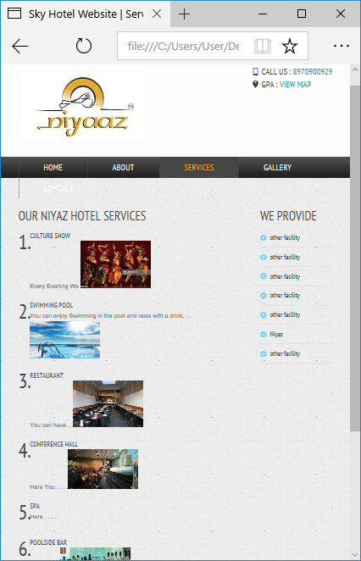
SERVICES

Slide 12
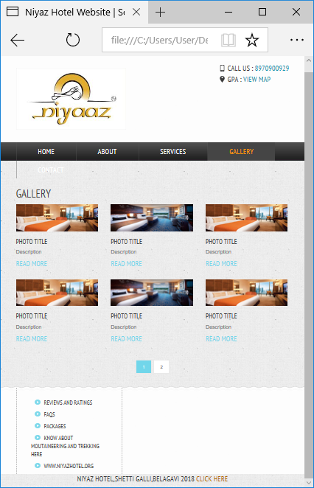
GALLERY

Slide 13
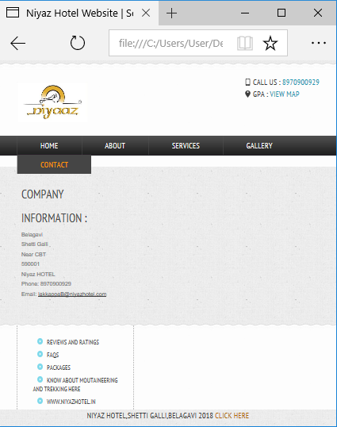
CONTACT

Slide 14
Thank You

