Slide 1
JAVA OOPs Constructor

Slide 2
Constructor
It is special type of method which will be same name as class name with no return type .
Purpose: Constructor are mainly used to initialization of instance variable of class.
Syntax: access-modifiers className()
{
}

Slide 3
Types of Constructor
* Default Constructor
* parameterized constructor
Default Constructor:
Constructor with ‘0’ parameter it is considered as default constructor.

Slide 4
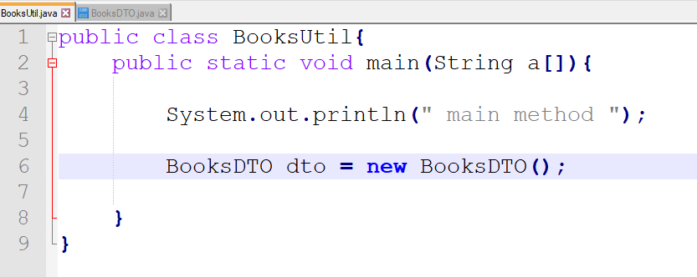
Example: ScreenShoots-1

Slide 5
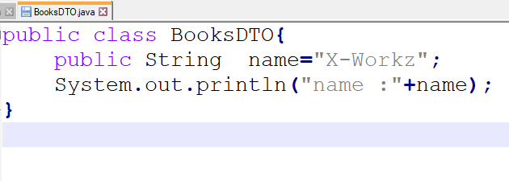
ScreenShoots-2
ScreenShoots-1

Slide 6
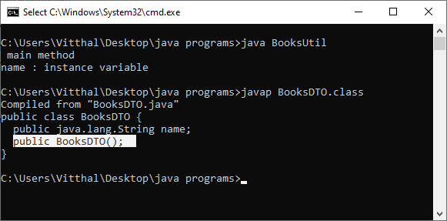
De compilation

Slide 7
Parameterized constructor
Defining constructor with parameter is know as parameterized constructor .
Or
Constructor defining programmers is know as
User defined constructor

Slide 8
Example
Example:
Public a(int a , int b){
System.out.print(a+” , ”+b);
}

Slide 9
Constructor Overloading
In class defining more than one constructor with different parameter list is know as constructor overloading.

Slide 10
Example:
public a(int a)
{
// code
}
Public a(int a , int b){
{
//code
}

Slide 11
Thank You

