Slide 1
Why Program?
Chapter 1
Notes:
Note from Chuck. If you are using these materials, you can remove the UM logo and replace it with your own, but please retain the CC-BY logo on the first page as well as retain the acknowledgements page(s).

Slide 2

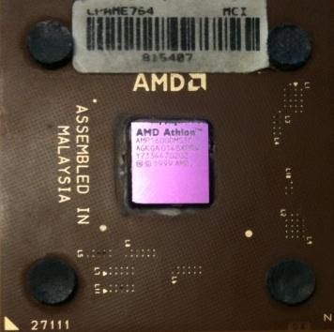
Computers Want to be Helpful...
Computers are built for one purpose - to do things for us
But we need to speak their language to describe what we want done
Users have it easy - someone already put many different programs (instructions) into the computer and users just pick the ones they want to use
What
Next?
What
Next?
What
Next?
What
Next?
What
Next?
What
Next?
What
Next?

Slide 3
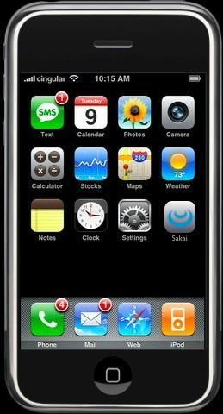
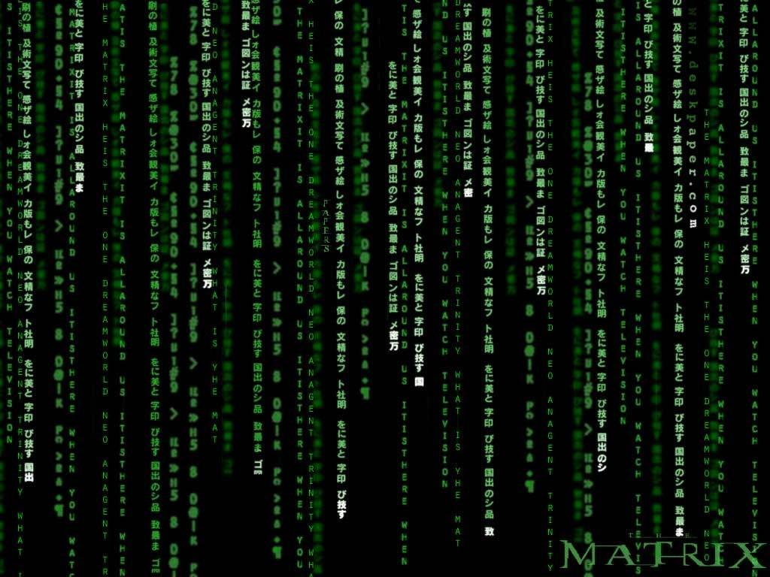
Programmers Anticipate Needs
iPhone applications are a market
iPhone applications have over 3 billion downloads
Programmers have left their jobs to be full-time iPhone developers
Programmers know the ways of the program
Pick
Me!
Pick
Me!
Pick
Me!
Pick
Me!
Pick
Me!
Pay
Me!

Slide 4
Users vs. Programmers
Users see computers as a set of tools - word processor, spreadsheet, map, to-do list, etc.
Programmers learn the computer “ways” and the computer language
Programmers have some tools that allow them to build new tools
Programmers sometimes write tools for lots of users and sometimes programmers write little “helpers” for themselves to automate a task

Slide 5
Why be a Programmer?
To get some task done - we are the user and programmer
- Clean up survey data
To produce something for others to use - a programming job
- Fix a performance problem in the Sakai software
- Add a guestbook to a web site

Slide 6
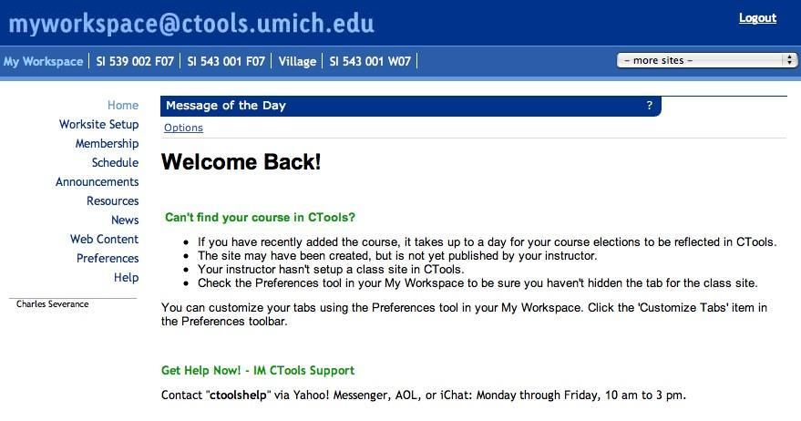

User
Computer
Hardware + Software
Programmer
Data
Information
Networks
....
From a software creator’s point of view, we build the software. The end users (stakeholders/actors) are our masters - who we want to please - often they pay us money when they are pleased. But the data, information, and networks are our problem to solve on their behalf. The hardware and software are our friends and allies in this quest.

Slide 7
What is Code? Software? A Program?
A sequence of stored instructions
- It is a little piece of our intelligence in the computer
- We figure something out and then we encode it and then give it to someone else to save them the time and energy of figuring it out
A piece of creative art - particularly when we do a good job on user experience

Slide 8
What
Next?
Generic
Computer
Software
Input
and Output
Devices
Central
Processing
Unit
Secondary
Memory
Main
Memory

Slide 9
Definitions
Central Processing Unit: Runs the Program - The CPU is always wondering “what to do next”. Not the brains exactly - very dumb but very very fast
Input Devices: Keyboard, Mouse, Touch Screen
Output Devices: Screen, Speakers, Printer, DVD Burner
Main Memory: Fast small temporary storage - lost on reboot - aka RAM
Secondary Memory: Slower large permanent storage - lasts until deleted - disk drive / memory stick
What
Next?

Slide 10
What
Next?
Generic
Computer
Software
Input
and Output
Devices
Central
Processing
Unit
Secondary
Memory
if x< 3: print
Main
Memory

Slide 11
What
Next?
Generic
Computer
Software
Input
and Output
Devices
Central
Processing
Unit
Secondary
Memory
01001001
00111001
Main
Memory
Machine
Language

Slide 12
Python as a Language

Slide 13
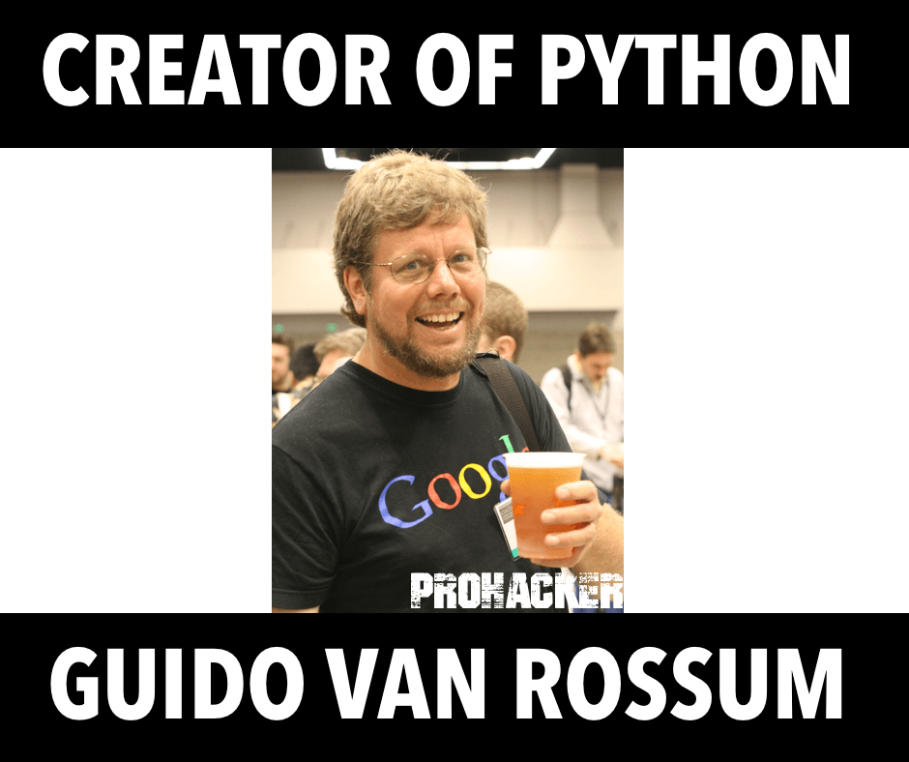
When he began implementing Python, Guido van Rossum was also reading the published scripts from “Monty Python's Flying Circus”, a BBC comedy series from the 1970s. Van Rossum thought he needed a name that was short, unique, and slightly mysterious, so he decided to call the language Python.

Slide 14
Reserved Words
You cannot use reserved words as variable names / identifiers
False class return is finally
None if for lambda continue
True def from while nonlocal
and del global not with
as elif try or yield
assert else import pass
break except in raise

Slide 15
Conversing with Python
Python Installation
Cmd prompt: python
>>> : Interpreter waiting command to be executed
Errors for improper syntax
Print function
Quit function

Slide 16
Interpreter and Compiler
Interpreter
Compiler

Slide 17
Interactive versus Script
Interactive
- You type directly to Python one line at a time and it responds
Script
- You enter a sequence of statements (lines) into a file using a text editor and tell Python to execute the statements in the file

Slide 18
Python Scripts
Interactive Python is good for experiments and programs of 3-4 lines long.
Most programs are much longer, so we type them into a file and tell Python to run the commands in the file.
In a sense, we are “giving Python a script”.
As a convention, we add “.py” as the suffix on the end of these files to indicate they contain Python.

Slide 19
Python Script
Creating file in script
.py extension
Execution through script or cmd prompt.

Slide 20
Elements of Python
Vocabulary / Words - Variables and Reserved words (Chapter 2)
Sentence structure - valid syntax patterns (Chapters 3-5)
Story structure - constructing a program for a purpose

Slide 21
Building blocks of programs
Input
Output
Sequencial Execution
Conditional Execution
Repeated Execution
Reuse

Slide 22
Types of Errors
Syntax Error
Logic Error
Semantic Error

