Slide 1
Strings
Chapter 6
Notes:
Note from Chuck. If you are using these materials, you can remove the UM logo and replace it with your own, but please retain the CC-BY logo on the first page as well as retain the acknowledgement page(s) at the end.

Slide 2
String Data Type
>>> str1 = "Hello"
>>> str2 = 'there'
>>> bob = str1 + str2
>>> print(bob)
Hellothere
>>> str3 = '123'
>>> str3 = str3 + 1
Traceback (most recent call last): File "<stdin>", line 1, in <module>
TypeError: cannot concatenate 'str' and 'int' objects
>>> x = int(str3) + 1
>>> print(x)
124
>>>
A string is a sequence of characters
A string literal uses quotes 'Hello' or "Hello"
For strings, + means “concatenate”
When a string contains numbers, it is still a string
We can convert numbers in a string into a number using int()

Slide 3
Reading and Converting
>>> name = input('Enter:')
Enter:Chuck
>>> print(name)
Chuck
>>> apple = input('Enter:')
Enter:100
>>> x = apple – 10
Traceback (most recent call last): File "<stdin>", line 1, in <module>
TypeError: unsupported operand type(s) for -: 'str' and 'int'
>>> x = int(apple) – 10
>>> print(x)
90
We prefer to read data in using strings and then parse and convert the data as we need
This gives us more control over error situations and/or bad user input
Input numbers must be converted from strings

Slide 4
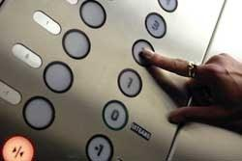
Looking Inside Strings
We can get at any single character in a string using an index specified in square brackets
The index value must be an integer and starts at zero
The index value can be an expression that is computed
b
a
n
a
n
a
0
1
2
3
4
5
>>> fruit = 'banana'
>>> letter = fruit[1]
>>> print(letter)
a
>>> x = 3
>>> w = fruit[x - 1]
>>> print(w)
n

Slide 5
A Character Too Far
You will get a python error if you attempt to index beyond the end of a string
So be careful when constructing index values and slices
>>> zot = 'abc'
>>> print(zot[5])
Traceback (most recent call last): File "<stdin>", line 1, in <module>
IndexError: string index out of range
>>>

Slide 6
Strings Have Length
The built-in function len gives us the length of a string
b
a
n
a
n
a
0
1
2
3
4
5
>>> fruit = 'banana'
>>> print(len(fruit))
6

Slide 7
len Function
>>> fruit = 'banana'
>>> x = len(fruit)
>>> print(x)
6
A function is some stored code that we use. A function takes some input and produces an output.
len()
function
'banana'
(a string)
6
(a number)

Slide 8
len Function
A function is some stored code that we use. A function takes some input and produces an output.
>>> fruit = 'banana'
>>> x = len(fruit)
>>> print(x)
6
>>>last = fruit[len-1]
Negative indexing for values from end
Alternatively: fruit[-1],fruit[-2]

Slide 9
Write a program to read string and print all characters of string with index value using while loop.
Write a program to print reverse of a string

Slide 10
Looping Through Strings
Using a while statement, an iteration variable, and the len function, we can construct a loop to look at each of the letters in a string individually
fruit = 'banana'
index = 0
while index < len(fruit):
letter = fruit[index]
print(index, letter)
index = index + 1
0 b
1 a
2 n
3 a
4 n
5 a

Slide 11
Looping Through Strings
A definite loop using a for statement is much more elegant
The iteration variable is completely taken care of by the for loop
b
a
n
a
n
a
fruit = 'banana'
for letter in fruit:
print(letter)

Slide 12
Write a program to count the number of times the loop encounters the 'a' character in the word banana

Slide 13
Looping and Counting
This is a simple loop that loops through each letter in a string and counts the number of times the loop encounters the 'a' character
word = 'banana'
count = 0
for letter in word :
if letter == 'a' :
count = count + 1
print(count)

Slide 14
More String Operations

Slide 15
Slicing Strings
M
o
n
t
y
P
y
t
h
o
n
0
1
2
3
4
5
6
7
8
9
10
11
We can also look at any continuous section of a string using a colon operator
String_var[n:m]
The second number is one beyond the end of the slice - “up to but not including”
>>> s = 'Monty Python'
>>> print(s[0:4])
Mont
>>> print(s[6:7])
P
>>> print(s[6:20])
Python

Slide 16
Slicing Strings
M
o
n
t
y
P
y
t
h
o
n
0
1
2
3
4
5
6
7
8
9
10
11
If we leave off the first number or the last number of the slice, it is assumed to be the beginning or end of the string respectively
>>> s = 'Monty Python'
>>> print(s[:2])
Mo
>>> print(s[8:])
thon
>>> print(s[:])
Monty Python

Slide 17
String Concatenation
When the + operator is applied to strings, it means “concatenation”
>>> a = 'Hello'
>>> b = a + 'There'
>>> print(b)
HelloThere
>>> c = a + ' ' + 'There'
>>> print(c)
Hello There
>>>

Slide 18
Strings are immutable
>>> greeting = 'Hello, world!'
>>> greeting[0] = 'J'
TypeError: 'str' object does not support item assignment

Slide 19
Using in as a Logical Operator
>>> fruit = 'banana'
>>> 'n' in fruit
True
>>> 'm' in fruit
False
>>> 'nan' in fruit
True
>>> if 'a' in fruit :
... print('Found it!')
...
Found it!
>>>
The in keyword can also be used to check to see if one string is “in” another string
The in expression is a logical expression that returns True or False and can be used in an if statement

Slide 20
String Comparison
if word == 'banana':
print('All right, bananas.')
if word < 'banana':
print('Your word,' + word + ', comes before banana.')
elif word > 'banana':
print('Your word,' + word + ', comes after banana.')
else:
print('All right, bananas.')

Slide 21
String Library
Python has a number of string functions which are in the string library
These functions are already built into every string - we invoke them by appending the function to the string variable
These functions do not modify the original string, instead they return a new string that has been altered
>>> greet = 'Hello Bob'
>>> zap = greet.lower()
>>> print(zap)
hello bob
>>> print(greet)
Hello Bob
>>> print('Hi There'.lower())
hi there
>>>

Slide 22
>>> stuff = 'Hello world'
>>> type(stuff)
<class 'str'>
>>> dir(stuff)
['capitalize', 'casefold', 'center', 'count', 'encode', 'endswith', 'expandtabs', 'find', 'format', 'format_map', 'index', 'isalnum', 'isalpha', 'isdecimal', 'isdigit', 'isidentifier', 'islower', 'isnumeric', 'isprintable', 'isspace', 'istitle', 'isupper', 'join', 'ljust', 'lower', 'lstrip', 'maketrans', 'partition', 'replace', 'rfind', 'rindex', 'rjust', 'rpartition', 'rsplit', 'rstrip', 'split', 'splitlines', 'startswith', 'strip', 'swapcase', 'title', 'translate', 'upper', 'zfill']
>>>help(str.capitalize)
https://docs.python.org/3/library/stdtypes.html#string-methods

Slide 23
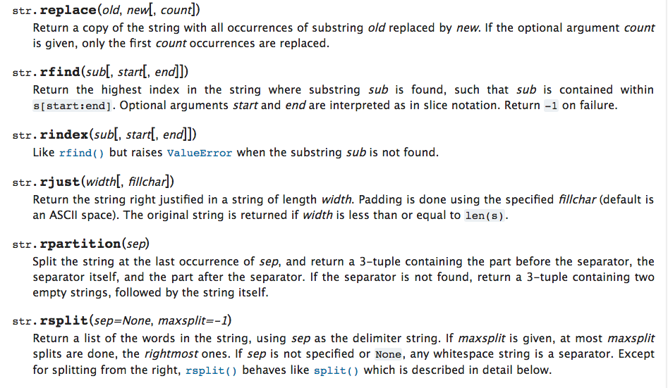

Slide 24
Searching a String
b
a
n
a
n
a
We use the find() function to search for a substring within another string
find() finds the first occurrence of the substring
If the substring is not found, find() returns -1
Remember that string position starts at zero
0
1
2
3
4
5
>>> fruit = 'banana'
>>> pos = fruit.find('na')
>>> print(pos)
2
>>> aa = fruit.find('z')
>>> print(aa)
-1

Slide 25
Making everything UPPER CASE
You can make a copy of a string in lower case or upper case
Often when we are searching for a string using find() we first convert the string to lower case so we can search a string regardless of case
>>> greet = 'Hello Bob'
>>> nnn = greet.upper()
>>> print(nnn)
HELLO BOB
>>> www = greet.lower()
>>> print(www)
hello bob
>>>

Slide 26
Search and Replace
The replace() function is like a “search and replace” operation in a word processor
It replaces all occurrences of the search string with the replacement string
>>> greet = 'Hello Bob'
>>> nstr = greet.replace('Bob','Jane')
>>> print(nstr)
Hello Jane
>>> nstr = greet.replace('o','X')
>>> print(nstr)
HellX BXb
>>>

Slide 27
Stripping Whitespace
Sometimes we want to take a string and remove whitespace at the beginning and/or end
lstrip() and rstrip() remove whitespace at the left or right
strip() removes both beginning and ending whitespace
>>> greet = ' Hello Bob '
>>> greet.lstrip()
'Hello Bob '
>>> greet.rstrip()
' Hello Bob'
>>> greet.strip()
'Hello Bob'
>>>

Slide 28
Prefixes
>>> line = 'Please have a nice day'
>>> line.startswith('Please')
True
>>> line.startswith('p')
False

Slide 29
Parsing and Extracting
21
31
From stephen.marquard@uct.ac.za Sat Jan 5 09:14:16 2008
>>> data = 'From stephen.marquard@uct.ac.za Sat Jan 5 09:14:16 2008'
>>> atpos = data.find('@')
>>> print(atpos)
21
>>> sppos = data.find(' ',atpos)
>>> print(sppos)
31
>>> host = data[atpos+1 : sppos]
>>> print(host)
uct.ac.za

Slide 30
Format operator
The format operator, % allows us to construct strings, replacing parts of the strings with the data stored in variables
When applied to integers, % is the modulus operator. But when the first operand is a string, % is the format operator.
The first operand is the format string, which contains one or more format sequencesthat specify how the second operand is formatted. The result is a string.

Slide 31
Ex 1: >>> camels = 42
>>> '%d' % camels
'42‘
Ex 2: >>> camels = 42
>>> 'I have spotted %d camels.' % camels
‘I have spotted 42 camels.'

Slide 32
>>> 'In %d years I have spotted %g %s.' % (3, 0.1, 'camels')
'In 3 years I have spotted 0.1 camels.'

Slide 33
Summary
String type
Read/Convert
Indexing strings []
Slicing strings [2:4]
Looping through strings with for and while
Concatenating strings with +
String operations
String library
String comparisons
Searching in strings
Replacing text
Stripping white space

Slide 34


Acknowledgements / Contributions
These slides are Copyright 2010- Charles R. Severance (www.dr-chuck.com) of the University of Michigan School of Information and open.umich.edu and made available under a Creative Commons Attribution 4.0 License. Please maintain this last slide in all copies of the document to comply with the attribution requirements of the license. If you make a change, feel free to add your name and organization to the list of contributors on this page as you republish the materials.
Initial Development: Charles Severance, University of Michigan School of Information
… Insert new Contributors and Translators here
...

