Slide 1
Python Dictionaries
Chapter 9
Notes:
Note from Chuck. If you are using these materials, you can remove the UM logo and replace it with your own, but please retain the CC-BY logo on the first page as well as retain the entire last page.

Slide 2
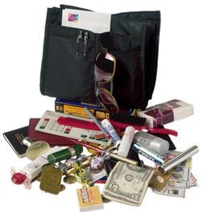
Dictionaries
Dictionaries are Python’s most powerful data collection
Dictionaries allow us to do fast database-like operations in Python
Dictionaries have different names in different languages
- Associative Arrays - Perl / PHP
- Properties or Map or HashMap - Java
- Property Bag - C# / .Net

Slide 3
Dictionaries
>>> purse = dict()
>>> purse['money'] = 12
>>> purse['candy'] = 3
>>> purse['tissues'] = 75
>>> print(purse)
{'money': 12, 'tissues': 75, 'candy': 3}
>>> print(purse['candy'])
3
>>> purse['candy'] = purse['candy'] + 2
>>> print(purse)
{'money': 12, 'tissues': 75, 'candy': 5}
Lists index their entries based on the position in the list
Dictionaries are like bags - no order
So we index the things we put in the dictionary with a “lookup tag”

Slide 4
Comparing Lists and Dictionaries
Dictionaries are like lists except that they use keys instead of numbers to look up values
>>> ddd = dict()
>>> ddd['age'] = 21
>>> ddd['course'] = 182
>>> print(ddd)
{'course': 182, 'age': 21}
>>> ddd['age'] = 23
>>> print(ddd)
{'course': 182, 'age': 23}
>>> lst = list()
>>> lst.append(21)
>>> lst.append(183)
>>> print(lst)
[21, 183]
>>> lst[0] = 23
>>> print(lst)
[23, 183]

Slide 5
>>> lst = list()
>>> lst.append(21)
>>> lst.append(183)
>>> print(lst)
[21, 183]
>>> lst[0] = 23
>>> print(lst)
[23, 183]
List
Key
Value
[0]
21
lst
[1]
183
>>> ddd = dict()
>>> ddd['age'] = 21
>>> ddd['course'] = 182
>>> print(ddd)
{'course': 182, 'age': 21}
>>> ddd['age'] = 23
>>> print(ddd)
{'course': 182, 'age': 23}
Dictionary
Key
Value
['course']
182
ddd
['age']
21

Slide 6
Dictionary Literals (Constants)
Dictionary literals use curly braces and have a list of key : value pairs
You can make an empty dictionary using empty curly braces
>>> jjj = { 'chuck' : 1 , 'fred' : 42, 'jan': 100}
>>> print(jjj)
{'jan': 100, 'chuck': 1, 'fred': 42}
>>> ooo = { }
>>> print(ooo)
{}
>>>

Slide 7
>>> jjj = { 'chuck' : 1 , 'fred' : 42, 'jan': 100}
>>>len(jjj)
>>>3
in : checks key in dictionary
>>>’chuck’ in jjj
>>>True

Slide 8
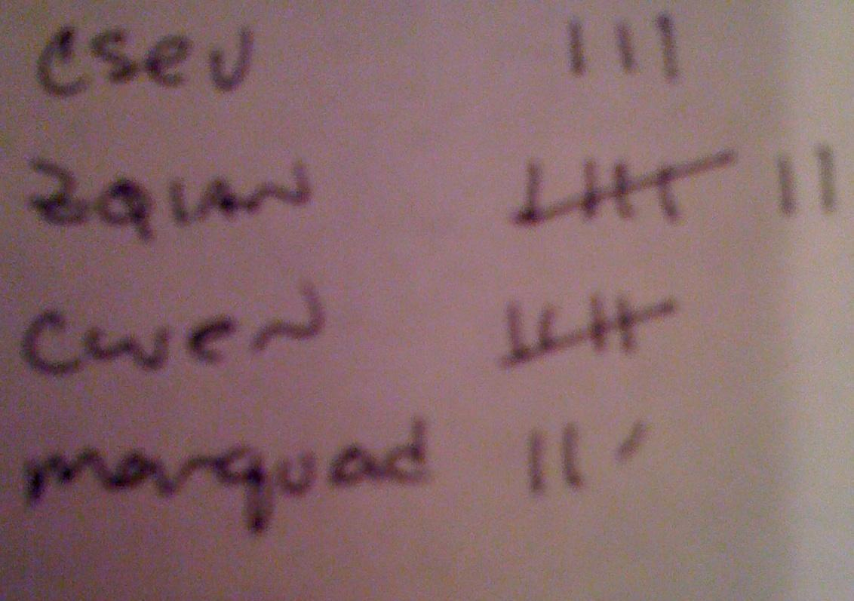
Many Counters with a Dictionary
One common use of dictionaries is counting how often we “see” something
Key
Value
>>> ccc = dict()
>>> ccc['csev'] = 1
>>> ccc['cwen'] = 1
>>> print(ccc)
{'csev': 1, 'cwen': 1}
>>> ccc['cwen'] = ccc['cwen'] + 1
>>> print(ccc)
{'csev': 1, 'cwen': 2}

Slide 9
Dictionary Tracebacks
It is an error to reference a key which is not in the dictionary
We can use the in operator to see if a key is in the dictionary
>>> ccc = dict()
>>> print(ccc['csev'])
Traceback (most recent call last):
File "<stdin>", line 1, in <module>
KeyError: 'csev'
>>> 'csev' in ccc
False

Slide 10
When We See a New Name
When we encounter a new name, we need to add a new entry in the dictionary and if this the second or later time we have seen the name, we simply add one to the count in the dictionary under that name
counts = dict()
names = ['csev', 'cwen', 'csev', 'zqian', 'cwen']
for x in names :
if x not in counts:
counts[x] = 1
else :
counts[x] = counts[x] + 1
print(counts)
{'csev': 2, 'zqian': 1, 'cwen': 2}

Slide 11
The get Method for Dictionaries
The pattern of checking to see if a key is already in a dictionary and assuming a default value if the key is not there is so common that there is a method called get() that does this for us
x = counts.get(name, 0)
Default value if key does not exist (and no Traceback).
{'csev': 2, 'zqian': 1, 'cwen': 2}

Slide 12
Simplified Counting with get()
We can use get() and provide a default value of zero when the key is not yet in the dictionary - and then just add one
counts = dict()
names = ['csev', 'cwen', 'csev', 'zqian', 'cwen']
for name in names :
counts[name] = counts.get(name, 0) + 1
print(counts)
{'csev': 2, 'zqian': 1, 'cwen': 2}

Slide 13
Counting Words in Text

Slide 14
Writing programs (or programming) is a very creative and rewarding activity. You can write programs for many reasons ranging from making your living to solving a difficult data analysis problem to having fun to helping someone else solve a problem. This book assumes that everyone needs to know how to program and that once you know how to program, you will figure out what you want to do with your newfound skills.
We are surrounded in our daily lives with computers ranging from laptops to cell phones. We can think of these computers as our “personal assistants” who can take care of many things on our behalf. The hardware in our current-day computers is essentially built to continuously ask us the question, “What would you like me to do next?”
Our computers are fast and have vast amounts of memory and could be very helpful to us if we only knew the language to speak to explain to the computer what we would like it to do next. If we knew this language we could tell the computer to do tasks on our behalf that were repetitive. Interestingly, the kinds of things computers can do best are often the kinds of things that we humans find boring and mind-numbing.

Slide 15
Counting Pattern
counts = dict()
print('Enter a line of text:')
line = input('')
words = line.split()
print('Words:', words)
print('Counting...')
for word in words:
counts[word] = counts.get(word,0) + 1
print('Counts', counts)
The general pattern to count the words in a line of text is to split the line into words, then loop through the words and use a dictionary to track the count of each word independently.

Slide 16
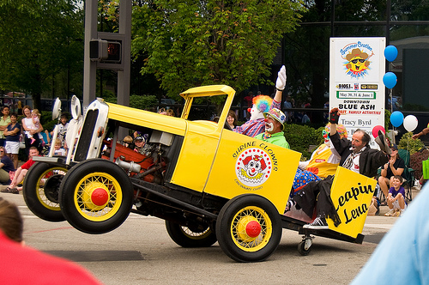
python wordcount.py
Enter a line of text:
the clown ran after the car and the car ran into the tent and the tent fell down on the clown and the car
Words: ['the', 'clown', 'ran', 'after', 'the', 'car', 'and', 'the', 'car', 'ran', 'into', 'the', 'tent', 'and', 'the', 'tent', 'fell', 'down', 'on', 'the', 'clown', 'and', 'the', 'car']
Counting…
Counts {'and': 3, 'on': 1, 'ran': 2, 'car': 3, 'into': 1, 'after': 1, 'clown': 2, 'down': 1, 'fell': 1, 'the': 7, 'tent': 2}
http://www.flickr.com/photos/71502646@N00/2526007974/

Slide 17
python wordcount.py
Enter a line of text:
the clown ran after the car and the car ran into the tent and the tent fell down on the clown and the car
Words: ['the', 'clown', 'ran', 'after', 'the', 'car', 'and', 'the', 'car', 'ran', 'into', 'the', 'tent', 'and', 'the', 'tent', 'fell', 'down', 'on', 'the', 'clown', 'and', 'the', 'car']
Counting...
Counts {'and': 3, 'on': 1, 'ran': 2, 'car': 3, 'into': 1, 'after': 1, 'clown': 2, 'down': 1, 'fell': 1, 'the': 7, 'tent': 2}
counts = dict()
line = input('Enter a line of text:')
words = line.split()
print('Words:', words)
print('Counting...’)
for word in words:
counts[word] = counts.get(word,0) + 1
print('Counts', counts)

Slide 18
Definite Loops and Dictionaries
If you use a dictionary as the sequence in a for statement, it traverses the keys of the dictionary
so we must use the index operator to retrieve the corresponding value for each key.
>>> counts = { 'chuck' : 1 , 'fred' : 42, 'jan': 100}
>>> for key in counts:
... print(key, counts[key])
...
jan 100
chuck 1
fred 42
>>>

Slide 19
Find all the entries in a dictionary with a value above ten

Slide 20
counts = { 'chuck' : 1 , 'annie' : 42, 'jan': 100}
for key in counts:
if counts[key] > 10 :
print(key, counts[key])

Slide 21
Key Method
Key method retrieves keys from dictionary.
Syntax: dictionary_variable.keys()
Ex:to print the keys in alphabetical order, you first make a list of the keys in the dictionary using the keys method available in dictionary objects.
counts = { 'chuck' : 1 , 'annie' : 42, 'jan': 100}
lst = list(counts.keys())
print(lst)
lst.sort()
for key in lst:
print(key, counts[key])
['jan', 'chuck', 'annie']
annie 42
chuck 1
jan 100

Slide 22
Two Iteration Variables!
We loop through the key-value pairs in a dictionary using *two* iteration variables
Each iteration, the first variable is the key and the second variable is the corresponding value for the key
d1 = { 'chuck' : 1 , 'fred' : 42, 'jan': 100}
for x,y in d1.items() :
print(x,y)
jan 100
chuck 1
fred 42
x
y
[jan]
100
[chuck]
1
[fred]
42

Slide 23
Files
fname = input('Enter the file name: ')
try:
fhand = open(fname)
except:
print('File cannot be opened:', fname)
exit()
counts = dict()
for line in fhand:
words = line.split()
for word in words:
if word not in counts:
counts[word] = 1
else:
counts[word] += 1
print(counts)

Slide 24
Files with punctuations
Files consists of text with punctuations,lowercase and upper case letters.
These problems can be solved by using the string methods lower, punctuation,and translate.
line.translate(str.maketrans(fromstr, tostr, deletestr))
>>> import string
>>> string.punctuation
'!"#$%&\'()*+,-./:;<=>?@[\\]^_`{|}~'

Slide 25
import string
fname = input('Enter the file name: ')
try:
fhand = open(fname)
except:
print('File cannot be opened:', fname)
exit()
counts = dict()
for line in fhand:
line = line.rstrip()
line = line.translate(line.maketrans('', '', string.punctuation))
line = line.lower()
words = line.split()
for word in words:
if word not in counts:
counts[word] = 1
else:
counts[word] += 1
print(counts)

Slide 26

Summary

