Slide 1
AgriSea:Each Grain Matters
Team:KAAYA

Slide 2
What is AgriSea?
AgriSea, is a decentralized marketplace for farmers and consumers which will create a diversified environment between the farmers and consumers.

Slide 3
The marketplace basically is a two way communication channel between the producers and consumers.
The farmer are going to put out the information about the crop and on that the users put a bid and finally the farmers are going to get a premium price for their produce.
The marketplace increases the connectivity of the farmers.
The trust between the organization is achieved by agreeing to the smart contract conditions

Slide 4
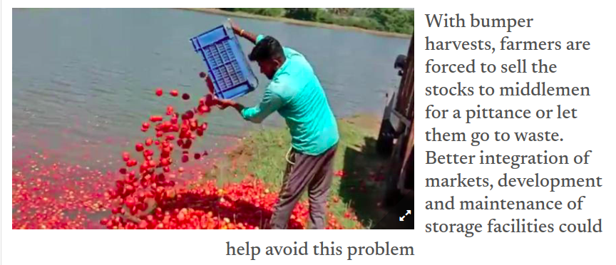

Slide 5
The reason why farmers resort to dumping their produce is because from the moment farmer harvests their crop the farmers have no clue on how the prices will get fluctuated.
Usually, they are on bitter end of this and all the work that they did for the crop cycle is wasted.
This just proves the genesis long problem of market friction between farmers and end customers.
There are 3 major pain points which we have observed with respect to the farmers present on the network.
1. delay in payment for the farmer
2. price fluctuation
3. collusion between supply chain entities.

Slide 6
How AgriSea is resolving these problems?
The entire process flow of AgriSea is designed in such a way that the all touch points in the supply chain are abstracted and monitored.

Slide 7
The entire process flow for AgriSea is as follows:
The first step is onboarding verified farmers and consumers.
For Farmers, then the next step is where a Field Officer will physically verify the land whose details the farmer provides in the initial stage of registration ie the registration phase.
After this there is a dedup check which is to check whether the farmer is already present in the system, each farmer has a unique UID associated with them.
After the dedup check results are negative the create prospect function is invoked which adds the details of the farmers into a block on the blockchain.
After this process the farmer adds crop details like lot ID, crop ID , crop Name and a few other details which is absolutely necessary.
Similar to farmers the consumers also have a dedup check and create prospect step. After this step the consumers will have an option to check out all the crops which they can bid onto.

Slide 8
The entire idea of making this supply chain decentralized is so that the farmer and consumer can get the best out of their money.
The process which we are following in order function the transfer of asset is an auction process where each potential buyer will be asked to put the buy-in amount of the auction into an escrow account for assurance purposes.
As the produce moves ahead in the supply chain the different components of the chain receive their payments based on the proof of stake consensus algorithm.
This reduces the collusion amongst the different parties as it makes the system completely transparent, the price fluctuation is also taken care as the entire price of the asset is pre-determined during the auction phase.

Slide 9
Futures

Slide 10
Check all the illegal components of supply chain like hoarding, black marketting, collusion etc.
Completely transparent supply chain right from the farmer sowing the seeds to food present on the plate, every step of the supply chain should be transparent to the end-user
Bring all the components of agriculture on the blockchain to analyze where the efficiency can be achieved.

Slide 11
Tech Stack

Slide 12
Hyper Ledger Fabric
Golang
Nodejs
HTML, CSS and JS

Slide 13
Impact Created on End User

Slide 14
The impacts which it will create in farmer and end user will be discussed.

