Slide 1
VISIBLE DATA COMMUNICATION ( Li-Fi) BASED DATA TRANSMISSION
Mini Project
APPU RATHOD 1NH23EC015
DARSHAN 1NH23EC028
Guided By:
Dr. Lipsa Dash
Senior Associate Professor
Department of ECE
New Horizon College of Engineering , Bengaluru

Slide 2
Contents
Introduction
Literature Review
Existing System
Problem Statement & Objectives
Proposed System
Feature Engineering
Block Diagram
Results

Slide 3
Introduction
What is Li-Fi ?
Li-Fi is a wireless communication technology that uses visible light to transmit data. Unlike Wi-Fi, which uses radio waves, Li-Fi transfers information through light signals generated by LED sources or mobile flashlights.
It is an alternative to traditional Wi-Fi communication.
Mobile flashlight acts as the transmitter.
LDR sensor acts as the receiver.
Arduino UNO processes the received signal.
Received message is displayed on the LCD.

Slide 4
Literature Review
Sytem / Paper | Key Methodology | Strengths | Limitations Identified in Literature | Comparison to Proposed System
Harald Haas (2011) – Li-Fi Data Transmission through Visible Light | Used LED light modulation for data transmission | Introduced Li-Fi technology and high-speed communication | Requires direct line-of-sight communication | Our system uses a mobile flashlight and LDR sensor for simple text transmission
S. Rajagopal et al. (2014) – Design and Implementation of Li-Fi System | Used LED and photodiode for audio and data transmission | Practical implementation of Li-Fi communication | Affected by external light sources | Our system focuses on text transmission using Arduino UNO and LCD display
IEEE Researchers (2015) – Visible Light Communication | Used LED transmitters and photodetector receivers | Secure indoor communication with high data rates | Limited coverage and blocked by obstacles | Our project uses low-cost components and is easier to implement

Slide 5
Existing System
1. Wi-Fi Based Communication
Method: Uses radio frequency (RF) signals for wireless data transmission.
Limitations: RF spectrum congestion, signal interference, security issues, and reduced performance in crowded networks.
2. Conventional Li-Fi Systems
Method: Uses LED transmitters and photodiode receivers for visible light communication.
Limitations: Requires direct line-of-sight communication, affected by ambient light, and limited communication range.

Slide 6
Problem Statement & Objectives
Problem Statement:
Core Challenge: Traditional wireless communication systems face signal interference, Security concerns, Limited RF spectrum availability.
Objectives
To transmit text data using visible light communication.
Receive light signals using an LDR sensor.
Process received data using Arduino UNO.
Display the received message on a 16×2 LCD.
Demonstrate a simple and low-cost Li-Fi communication system.
.

Slide 7
Proposed System
Core Concept: Li-Fi based wireless data transmission using visible light communication.
Objective: Transmit text data through mobile flashlight and receive it using an LDR sensor.
Proposed Approach:
Li-Fi Mobile App: Converts text into light signals using the mobile flashlight.
LDR Sensor: Detects the transmitted light variations.
Arduino UNO: Processes and decodes the received signal.
LCD Display: Displays the received text message.

Slide 8
Feature Engineering
System Workflow
Input Features:
Transmission : Mobile flashlight converts text into visible light signals.
Receiver Input : LDR sensor detects light intensity variations.
Signal Processing : Arduino UNO reads and processes the received signals.
Output : Decoded message displayed on 16×2 LCD display.

Slide 9
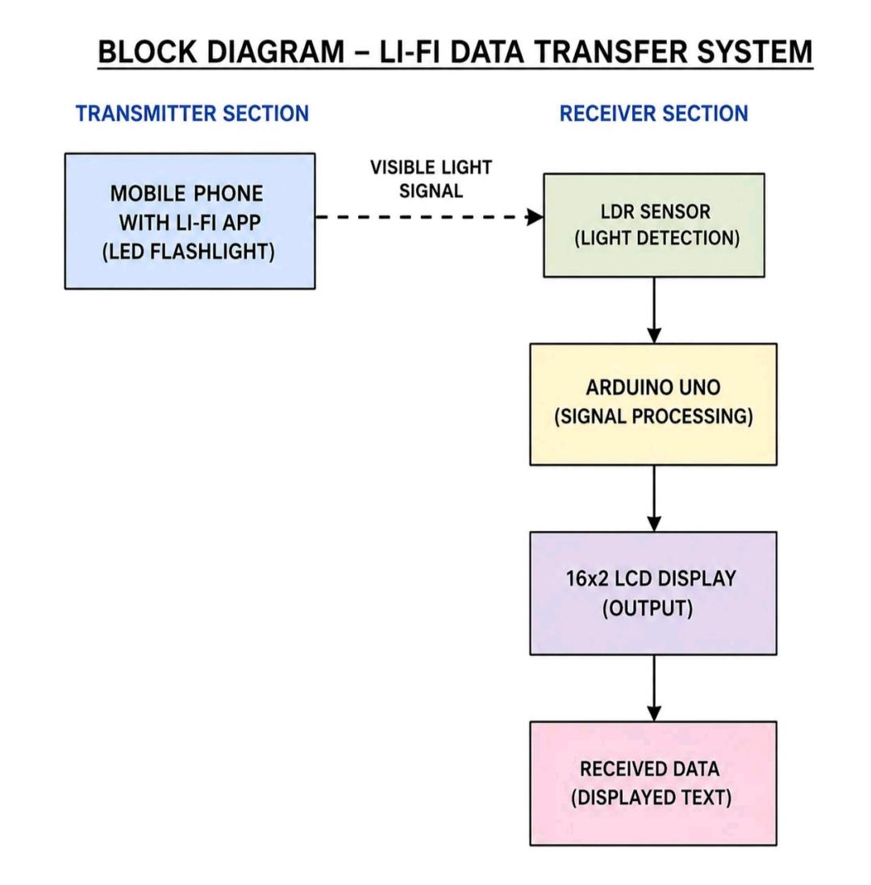
BLOCK DIAGRAM

Slide 10
RESULTS
• Text data was successfully transmitted using mobile flashlight.
• LDR sensor accurately detected the light signals.
• Arduino UNO processed the received data correctly.
• Message was displayed on the LCD display.
• The project successfully demonstrated Li-Fi based data communication.
5.1.8After tapping the

Slide 11
Thank You

