Slide 1

Medical Advisory System
PROJECT PHASE-ONE OF REVIEW-2
Under the Guidance Dr.Jayalaxmi
Submitted by Appuraj

Slide 2
Structure of Presentation
Problem Statement
Introduction
Objectives
Low level design
High level design
System Design
Requirement analysis
References

Slide 3
Introduction
Finding disease in infants is difficult task for doctors in that we are focusing on physically challenged child
We are creating system that identifies the disease by make use of the foot pressure of the child
Doctors can able to see the pressure values graph and according to that they can analyse and suggest the treatment

Slide 4
Problem Statement
HAEGL automatic posture and movement tracking of infants for physically disabled people

Slide 5
Objectives
To design and develop Foot Track Device for children with Cerebral Palsy which is capable of mapping at each level of foot through which we can locate whether the problem is in fore foot
Mid foot, hind foot, medial foot and lateral foot.
Design and develop an application which is capable of storing the Institution Doctors and Patient Details

Slide 6
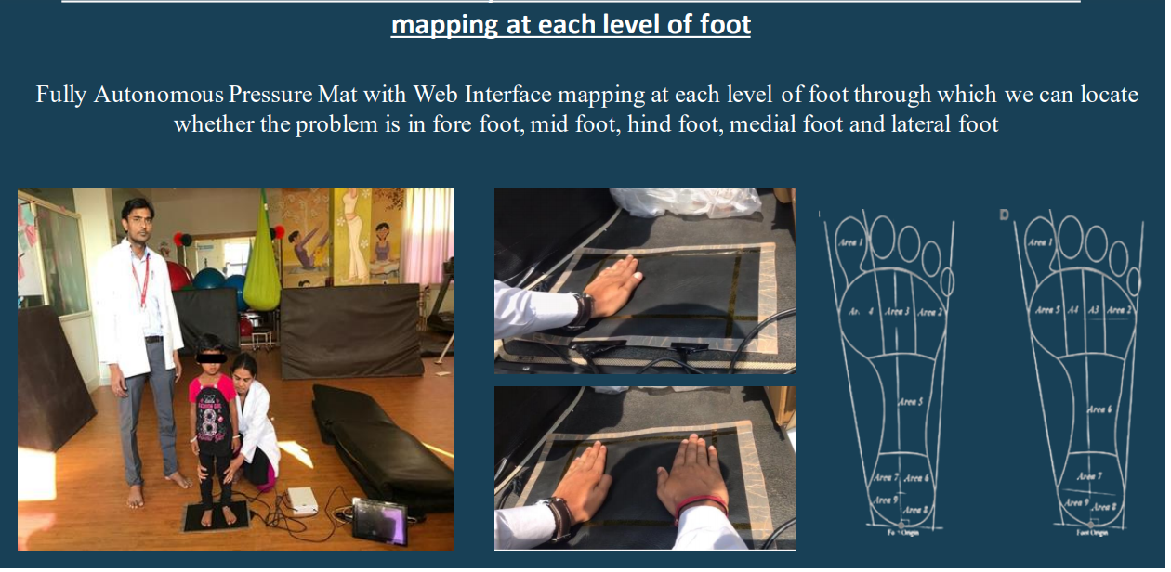
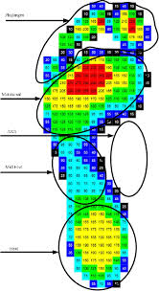
System Design

Slide 7
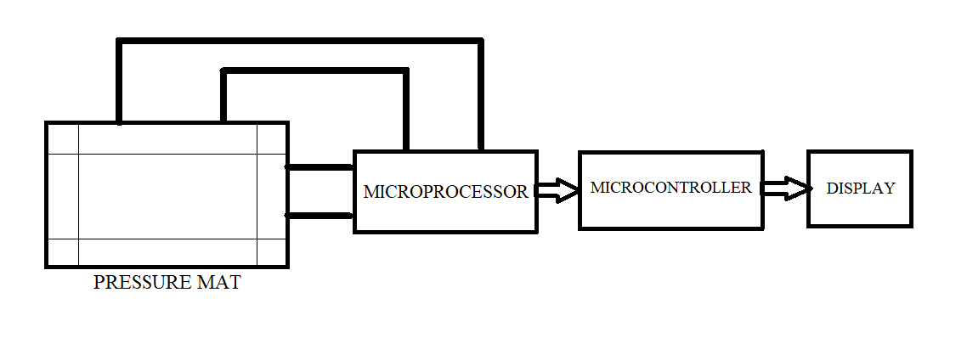
High level design

Slide 8
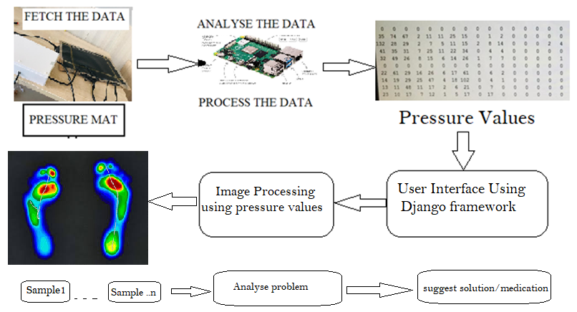
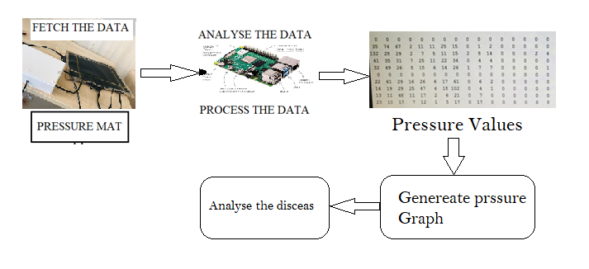
Low Level Design

Slide 9
Requirement analysis
Django framework for front end design
Pressure Mat
Arduino for interfacing with pressure mat
Open Cv library for processing the images
Numpy for processing the pressure values
Respberry-pi to run Django server
MYSQL for database

Slide 10
Conclusion
The foot pressure analyser can measure the amount of foot pressure applied
This system indicates the problem of the feet much better than what objectively the doctors are doing.
Mapping at each level of foot through which we can locate whether the problem is in forefoot, mid foot, hind foot, medial foot and lateral foot.

Slide 11
References
Rosenberg, S. A., Zhang, D. & Robinson, C. C. Prevalence of developmental delays and participation in early intervention services for young children. Pediatrics 121, 1503–1509, https://doi.org/10.1542/peds.2007-1680 (2008).
Novak, I. et al. Early, Accurate Diagnosis and Early Intervention in Cerebral Palsy: Advances in Diagnosis and TreatmentEarly, Accurate Diagnosis and Early Intervention in Cerebral PalsyEarly, Accurate Diagnosis and Early Intervention in Cerebral Palsy. JAMA Pediatr. 171, 897–907, https://doi.org/10.1001/jamapediatrics.2017.1689 (2017).
Lobo, M. A. et al. Wearables for Pediatric Rehabilitation: How to Optimally Design and Use Products to Meet the Needs of Users. Phys. Ter. 99, 647–657, https://doi.org/10.1093/ptj/pzz024 (2019).
Nazneen, N. et al. A novel system for supporting autism diagnosis using home videos: Iterative development and evaluation of system design. JMIR mHealth uHealth 3, e68, https://doi.org/10.2196/mhealth.4393 (2015).
Rihar, A., Mihelj, M., Pašič, J., Kolar, J. & Munih, M. Infant trunk posture and arm movement assessment using pressure mattress, inertial and magnetic measurement units (IMUs). J. NeuroEngineering Rehabil. 11, https://doi.org/10.1186/1743-0003-11-133 (2014).
Venek, V., Kremser, W. & Schneider, C. Towards an IMU Evaluation Framework for Human Body Tracking, vol. Volume 248: Health Informatics Meets eHealth of Studies in Health Technology and Informatics, 156–163 (IOS Press, 2018).
Einspieler, C., Marschik, P. & Prechtl, F. R. H. Human motor behavior: Prenatal origin and early postnatal development. J. Psychol. 216, 147–153, https://doi.org/10.1027/0044-3409.216.3.147 (2008).

Slide 12
Thank you

