Slide 1
ISS Course Project:
IDS Design & Evaluation
Group 8:
Appurv Jain
Sameera Desai
Sagar Parab

Slide 2
Design & Evaluation Aspects
Design Aspects
First Phase
Statistical methods used: SVM
Used J48 & Weka for benchmarking performance
Second Phase
Used NN
8-10 neurons in hidden layer
Evaluation Aspects
Accuracy
False positives
False negatives

Slide 3
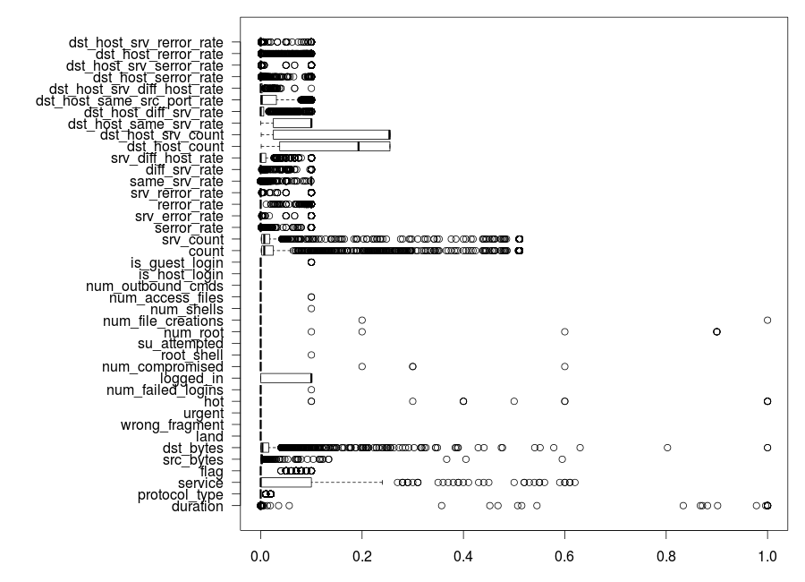
Data Plot - Misuse

Slide 4
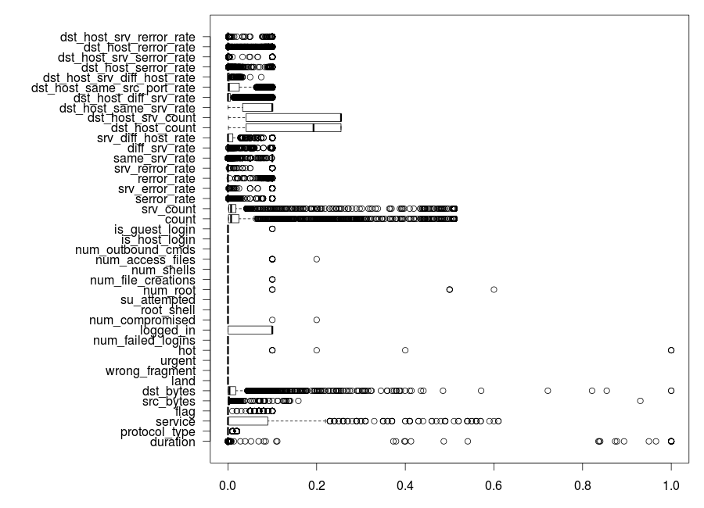
Data Plot - Anomaly

Slide 5
Important Aspects
SVM
Neural Networks
Confusion Matrix

Slide 6
Comparison
Project 1
J48 & SVM
All attributes
Accuracy = 95%
Project 2
Neural Networks
Shredded attributes
Accuracy = 98%
Preference:
Neural Networks

Slide 7
Novel Idea
Shredding the data
Removing attributes which contribute least to results
Using R
Allowed fine tuning the algorithms by passing appropriate parameters

Slide 8
Problems Identified, not solved
Better GUI
The tool needs to incorporated into a network analyser like Snort or Wireshark
This will enable real - time detection of threats using the models built

Slide 9
Design Approach
Eliminating redundant attributes helped the training speed and space efficiency of the model
Approach justified by high test accuracy and low false positives and false negatives

Slide 10
Why R was picked over other tools?
R provides great flexibility for data preprocessing and manipulation
Data structures are designed with big data processing in mind
Scalability - Automated scripts make the final IDS highly scalable

Slide 11
Limitations of design
No mechanism for continuously incorporating newly discovered attack types
No continuous training mechanism
Trained only on a small subset of overall data, so my not fully represent
the true scenario

Slide 12
Important results
Learning based technique has outperformed statistical techniques
Also leaves room for learned protection which may be better at classifying
than traditional methods

Slide 13
Questions

