Slide 1
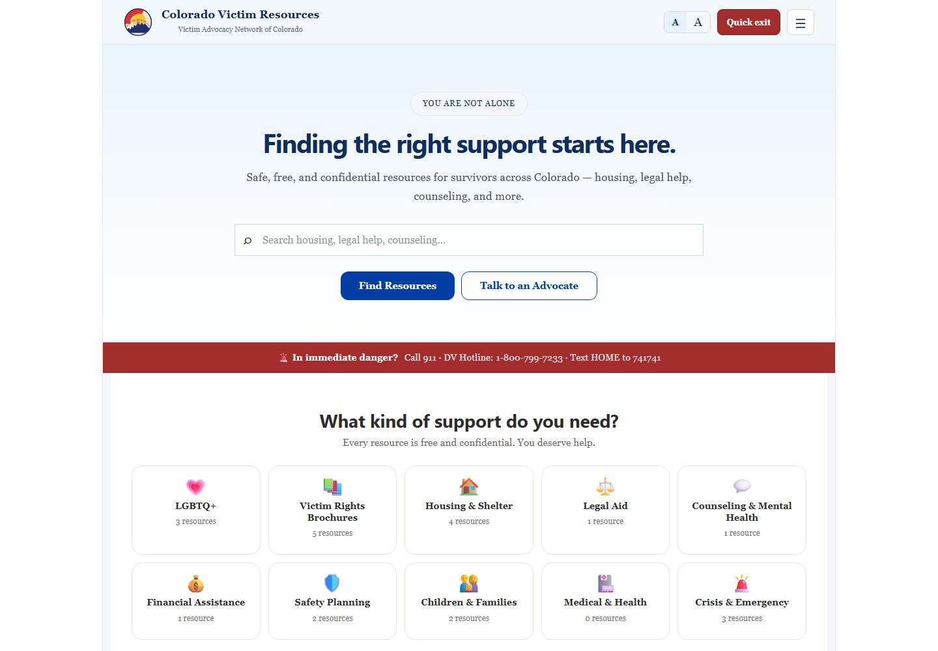
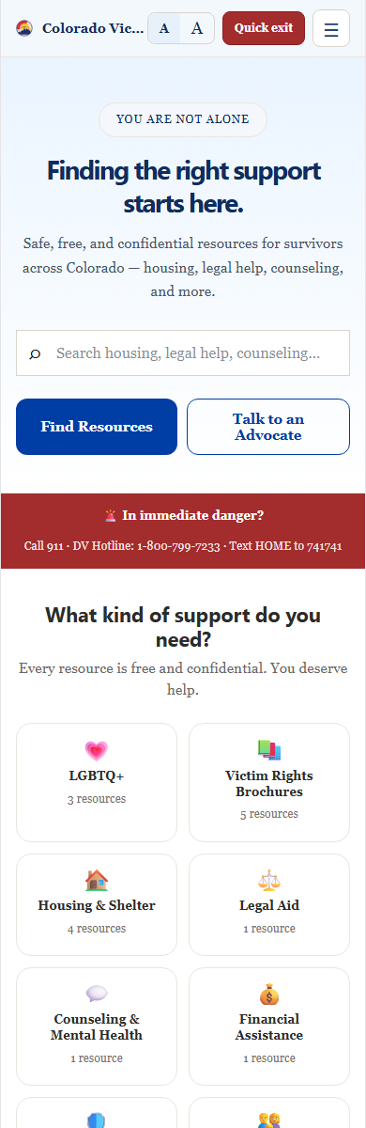
Colorado Victim Resources
Public resource site + admin portal overview
Deployed site: https://erievictimsadvocate.netlify.app/
Admin portal: https://erievictimsadvocate.netlify.app/admin
Helps volunteer advocates and community members find victim-support resources quickly.
Provides a maintainable admin portal for brochures, categories, field guide content, admin invites, and team updates.
Designed for mobile use, accessibility, quick resource sharing, and safe exit behavior.

Slide 2
Public Site: Searchable Resource Library
The public site is the front door for finding and sharing support resources.
Search by title, description, or tag from the home page or menu.
Browse resource categories when the user is not sure what to search for.
Featured resources help surface common or high-priority information.
Clickable phone numbers support tap-to-call behavior on mobile devices.
Public
Mobile friendly

Slide 3
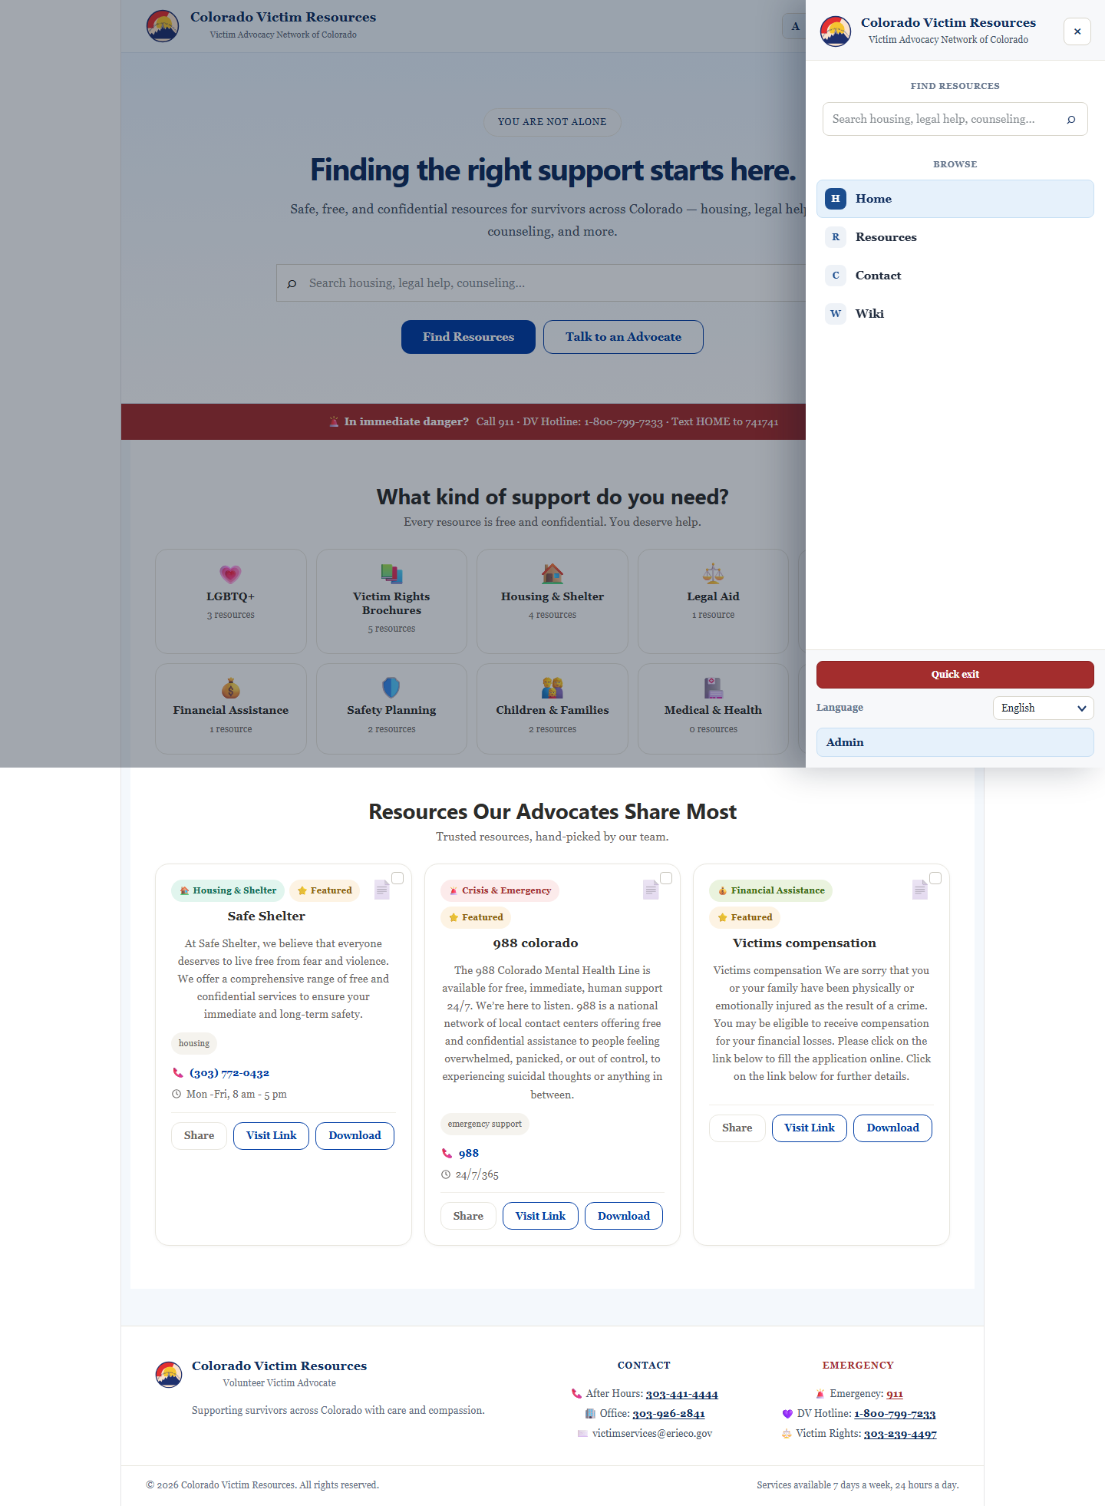
Mobile Navigation and Accessibility
The hamburger menu prioritizes search first, then navigation and safety actions.
Search is first in the menu so users can act quickly.
Text size control is available in the header.
Language selector is compact and available in the drawer.
Quick Exit gives users a fast way to leave the site.

Slide 4
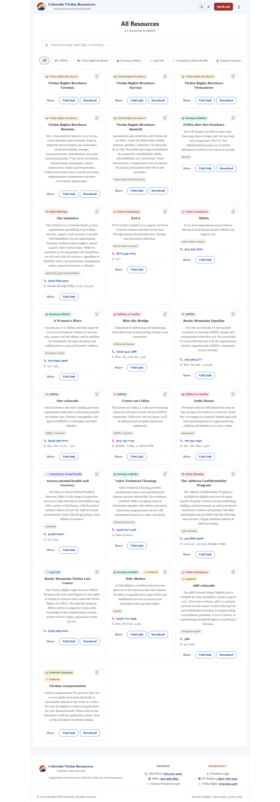
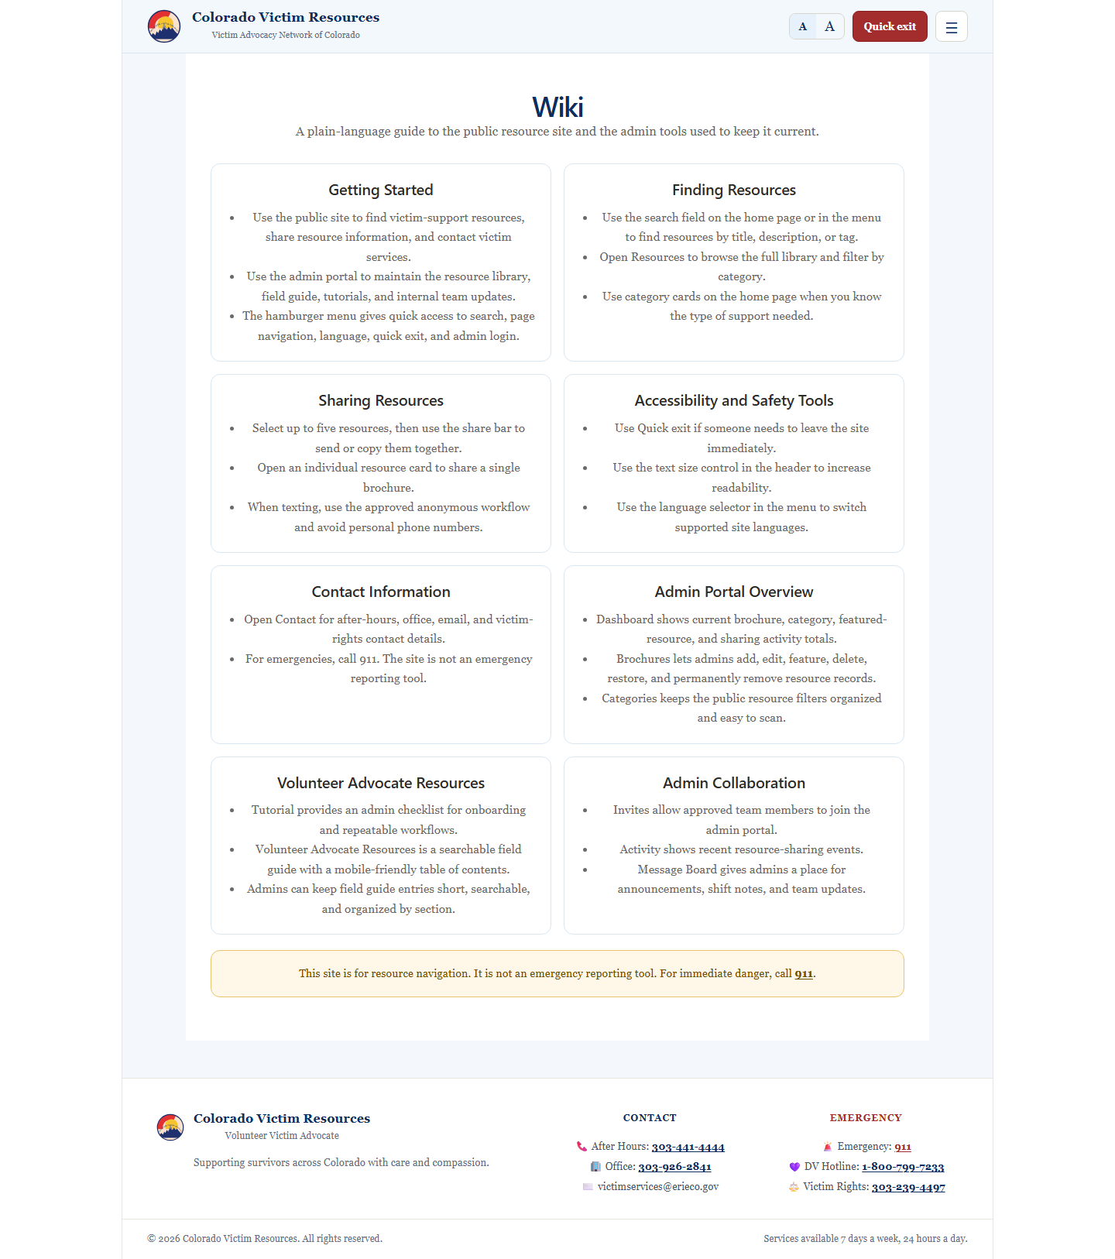
Resources and Wiki
Resources support public browsing; Wiki explains how the site and admin tools work.
Resources page: category filtering, searching, resource cards, and multi-select sharing.
Wiki page: plain-language explanation of public and admin functionality without internal implementation details.

Slide 5
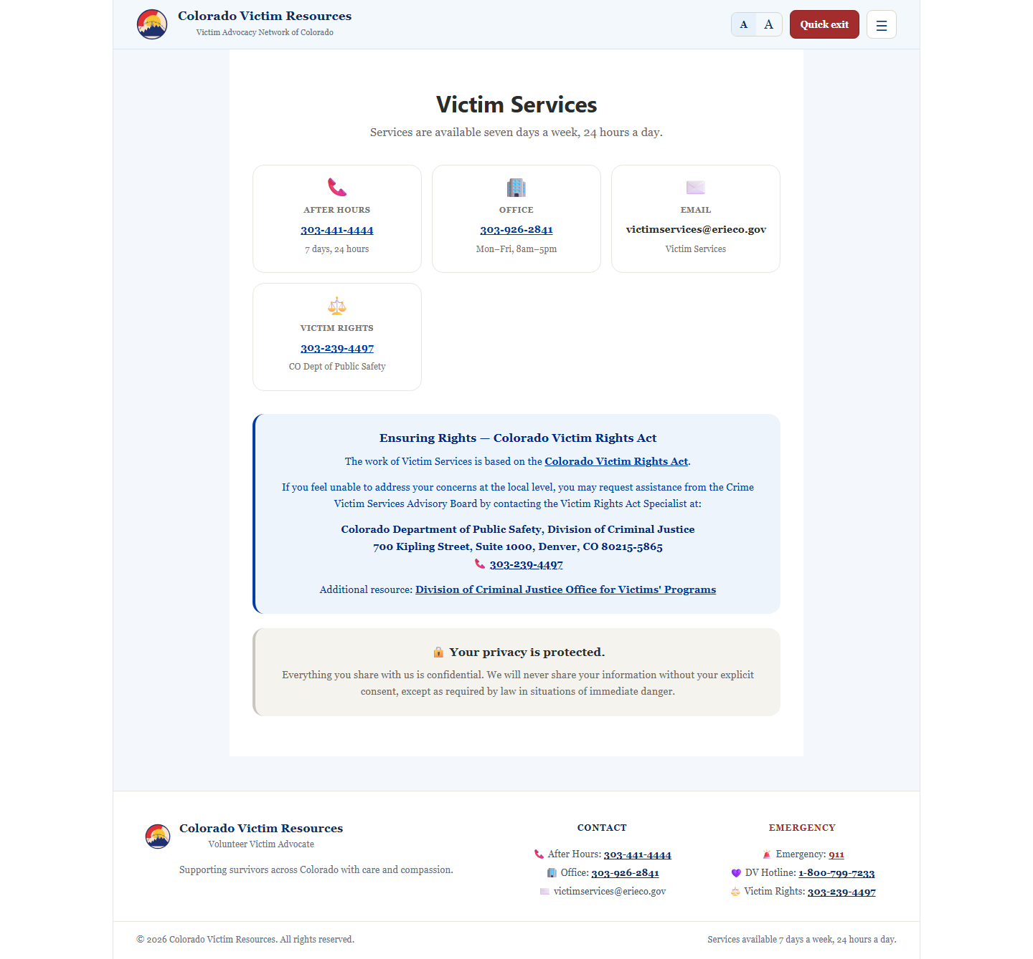
Contact and Safety Information
Contact information is visible, readable, and actionable from the public site.
After-hours, office, victim-rights, hotline, and emergency numbers are clickable telephone links.
Contact cards make core numbers easy to scan on desktop and mobile.
Emergency messaging clearly states that the site is not an emergency reporting tool.
Victim Rights Act information links to the official Colorado resource.

Slide 6
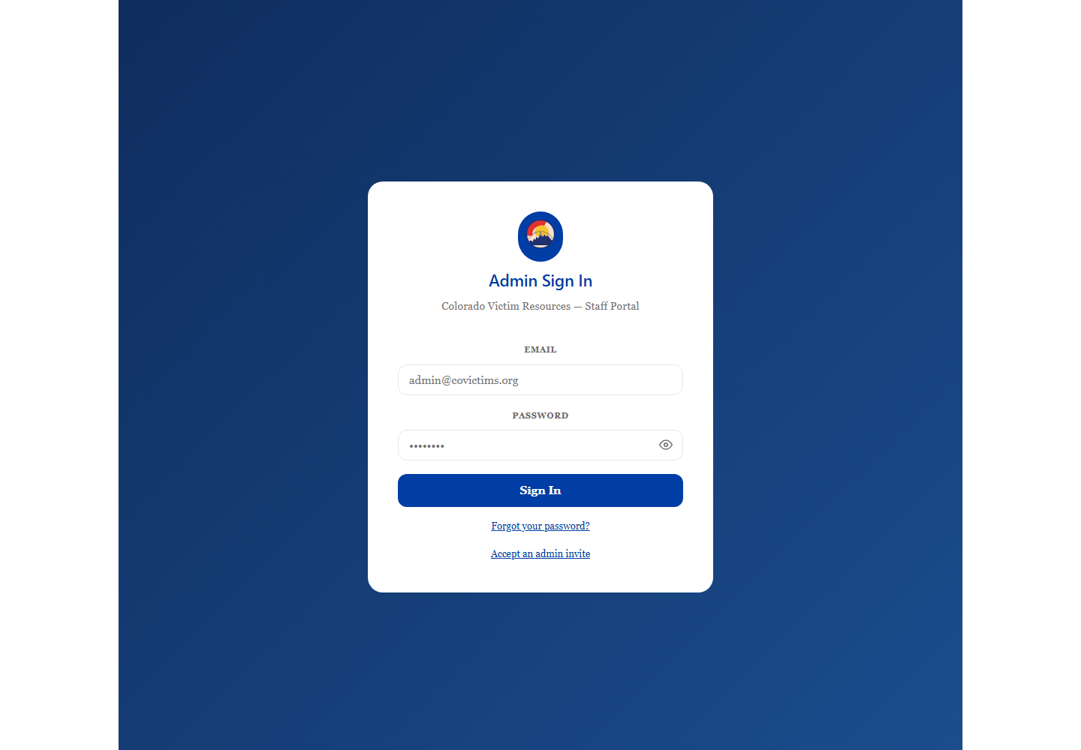
Admin Portal: Controlled Maintenance Area
Approved admins maintain the resource system behind the public experience.
Dashboard: totals, recent uploads, and quick edit/share actions.
Brochures: add, edit, feature, delete, restore, and permanently remove resources.
Categories: maintain public resource filters and visual symbols.
Invites: invite-only admin registration and admin user management.
Admin portal

Slide 7
Volunteer Advocate Field Guide and Message Board
Admin tools support the operational side of volunteer advocate work.
Tutorial: onboarding checklist and repeatable admin/advocate workflows.
Volunteer Advocate Resources: searchable field guide with mobile-friendly table of contents and section submenus.
Message Board: internal team announcements, shift notes, and resource updates.
Help: admin-facing guide for how to use the portal and maintain content.
Admin Workflow
Upload resource
Organize category
Update field guide
Invite admins
Share team message

Slide 8
Deployment and Test Coverage
The project is deployed through GitHub-based version control and Netlify hosting.
Built with React and Vite for the frontend experience.
Uses Supabase for authentication, data, storage, and serverless email/invite functions.
Deployed at https://erievictimsadvocate.netlify.app/.
Admin portal is available at https://erievictimsadvocate.netlify.app/admin.
Validated with production builds and API/integration tests for upload/edit, invite validation, field guide management, message board access, and email workflows.
Testing Used
npm run build
Integration tests
Supabase API workflows
Email function test
Admin message board test

Slide 9
Project Goal
Make resource access faster for advocates and easier to maintain for the team.
Public users can search, browse, call, share, and understand the site from mobile or desktop.
Admins can keep resources, field guide content, and team information current.
The product reduces scattered documents and gives the volunteer advocate program one maintained digital hub.
Links
Public: https://erievictimsadvocate.netlify.app/
Admin: https://erievictimsadvocate.netlify.app/admin

