Slide 1
Last update: 2018 By Drs Clara Tong & Jacklyn Yek Abey Mathews, Ong Yee Yian, Chong Shin Yuet
CRISIS MANAGEMENT MANUAL

Slide 2
Content Page
1
1
2
3
4
5
6
7
8
9
10
11
12
13
14
Anaphylaxis | 2
Asystole/Pulseless Electrical Activity | 3
Bradycardia | 4
Difficult Airway: Needle Cricothyroidotomy | 5
Difficult Airway: Surgical Cricothyroidotomy | 6
Fire | 7
Local Anaesthetic Toxicity | 8
Malignant Hyperthermia | 9
Massive Hemorrhage | 10
Ventricular Fibrillation/Pulseless Ventricular Tachycardia (VF/VT) | 11
Important Numbers and Drug Dilutions | 12
Code Algorithms | 13
Debriefing after a Crisis | 14

Slide 3
Anaphylaxis
2
1
2
3
4
5
6
7
8
9
10
11
12
13
14
Refractory hypotension, acute altered mental status, shock, ischemic chest discomfort or acute heart failure
STOP and remove all potential causative agents Including chlorhexidine impregnanted catheters, colloids, latex
Call for help and E-trolley; Note the time Ask: “Who will be the crisis manager?”
Maintain and secure airway; Use 100% Oxygen
Intubate if airway oedema or potential respiratory compromise
Give IV Crystalloids fast (20 ml/kg); repeat as required
Give IV Adrenaline; repeat as required
Consider IV Adrenaline infusion if repeated boluses required (i.e. severe hypotension or bronchospasm)
Refractory hypotension: Continue Adrenaline and IV fluid bolus 50ml/kg
Consider insertion of IA/CVP lines; Consider TTE to assess filling
Obtain labelled blood samples Mast cell tryptase, FBC, coagulation screen, electrolytes, +/- ABG
Post crisis management
Consider adjunctive therapy when haemodynamically stable
Monitor closely for 6 hours, up to 24H ICU/HD if mod-severe (up to 20% incidence of biphasic reaction)
Reprint AIMS chart on expanded time scale
Refer Allergist (using template in Anaphylaxis Guidelines)
Update Citrix of suspected allergen.
Refer Anaphylaxis Management Guidelines on ANA dept website
DRUG DOSES and treatments
Adrenaline | Adult: 50 mcg (0.5 ml of 1:10 000 solution) Child: 1.0 μg.kg-1 (0.1 ml.kg-1 1:100 000 solution) IV Infusion: 2 – 10 mcg/kg/min
Dopamine | 2 – 10 mcg/kg/min
Salbutamol | MDI: 6-8 puffs repeated as necessary Refractory bronchospasm: IV 100 - 200 mcg slow bolus +/- infusion of 5 – 25 mcg/min. Consider neb Salbutamol: NS 2:2
Adjunctive therapy
Hydrocortisone |  | Adult: 200 mg IV Child: 6 – 12 years – 100 mg IV 6 months – 6 years – 50 mg IV <6 months – 25 mg IV
Consider oral 2nd generation antihistamines when patient able to take orally
Mast cell tryptase
Blood samples for mast cell tryptase to be taken during resuscitation, 2 hours and >24 hours At least 5mls of blood into plain tube labelled with patient’s sticker and time of collection Use “Immunology Form” and write “Note: Sample to TTSH, spin and separate” , indicate ‘serum tryptase test’ under ‘other tests’, Indicate Department’s fax number 62241792 No need to send sample in ice, regardless of time of sample collection Use pneumatic tube system, send to ‘901’

Slide 4
Asystole/Pulseless Electrical Activity (PEA)
3
1
2
3
4
5
6
7
8
9
10
11
12
13
14
Non-shockable pulseless cardiac arrest
Call for help and E-trolley
Ask: “Who will be the crisis manager?”
Say: “The top priority is high-quality CPR”
Commence CPR (100 compressions/min)
Secure Airway. Turn Fi O₂ to 100% Turn off volatile anaesthetics. 10 - 12 breaths/minute. Do not overventilate
Give IV Adrenaline 1mg in 10ml bolus Repeat adrenaline every 2 minutes
Assess every 2 minutes Change CPR compression provider as and when necessary Consider reversible causes. Read aloud Hs and Ts Check rhythm, if rhythm organised, check pulse
IF VF/VT: Resume CPR; Go to ALGORITHM 11
If asystole/PEA continues: Resume CPR.
Check EtCO2
If < 10mmHg, evaluate CPR technique
If sudden increase to > 40mmHg, may indicate return of spontaneous circulation
DRUG DOSES and treatments
Adrenaline | 1 mg in 10ml (1:10,000) IV, repeat every 2 minutes
Dopamine | 5 – 20 mcg/kg/min IV
HYPERKALAEMIA treatments
Calcium gluconate - or - Calcium chloride |  | 0.3 ml/kg IV 0.1 ml/kg IV
Insulin |  | 10 units regular IV with 1 – 2 amps D50W as needed
Sodium bicarbonate 8.4% |  | 1 – 1.5 mEq/kg IV slow push for hyperkalaemia, antidepressant overdose – NOT prolonged resuscitation
Potentially reversible causes (Hs & Ts)
Hydrogen ion (acidosis) Hyperkalaemia Hypothermia Hypovolemia Hypoxia | Tamponade (Cardiac) Tension pneumothorax Thrombosis (coronary/pulmonary)
During CPR
Airway | Adequate ventilation
Circulation | Confirm adequate IV or IO access
Assign roles | Chest compressions, Airway, Vascular access, Documentation, Crash trolley, Time keeping

Slide 5
Bradycardia - Unstable
4
1
2
3
4
5
6
7
8
9
10
11
12
13
14
HR < 50bpm with hypotension, acute altered mental status, shock, ischemic chest discomfort or acute heart failure
Call for help and E-trolley
Ask: “Who will be the crisis manager?”
Turn Fi O₂ to 100%
Verify oxygenation/ventilation adequate
Give atropine
Stop surgical stimulation (if laparoscopy, desufflate)
If atropine ineffective:
Start adrenaline or dopamine infusion - or –
Start transcutaneous pacing
Consider…
Turning off volatile anaesthetics if patient remains unstable
Calling for expert consultation e.g. Electrophysiologist
Assessing for drug induced causes e.g. beta blockers, calcium channel blockers, digoxin
Cardiology consultation if myocardial infarction suspected e.g. ECG changes
DRUG DOSES and treatments
Atropine | 0.6 mg IV, may repeat up to 2.4 mg total
Adrenaline | 2 – 10 mcg/min IV
Dopamine | 5 – 20 mcg/kg/min IV
OVERDOSE treatments
B-blocker | Glucagon 2 – 4 mg IV push (Consult Pharmacy for availability)
CCB | Calcium chloride 1g IV
TRANSCUTANEOUS PACING instructions
Place pacing electrodes front and back. Connect 3-lead ECG from pacing defibrillator to patient Turn monitor/defibrillator to PACER mode Set PACER RATE (ppm) to 80/min (adjust based on clinical response once pacing is established) Start to 60mA of PACER OUTPUT and increase until electrical capture (pacer spikes aligned with QRS complexes) Set final milliamperes 10mA above initial capture level Confirm effective capture - Electrically: Assess ECG tracing - Mechanically: Palpate femoral pulse (carotid pulse unreliable)

Slide 6
Difficult Airway: Needle Cricothyroidotomy
5
1
2
3
4
5
6
7
8
9
10
11
12
13
14
Rescue technique for “can’t intubate, can’t ventilate” situation to buy time before definite airway
Call for expert anaesthesiology and/or ENT specialist, E-trolley & Difficult Airway Cart
Ask: “Who will be the crisis manager?”
Identify cricothyroid membrane
If anatomy not palpable, consider surgical cricothyroidotomy with blunt dissection using scalpel-bougie-tube technique (ALGORITHM 6)
Use Insyte 14G or Ravussin needle-catheter connected to 5ml syringe with normal saline
Stab over midpoint of cricothyroid membrane, at an angle 45-60° to the skin, in a caudad direction
On aspiration of air into 5ml syringe, advance 2mm and confirm aspiration of air again before advancing catheter over needle
Connect Rapid O₂ to auxiliary oxygen source on anaesthetic machine at 15L/min, and connect luer-lock end to catheter
Equipment
Note: All equipment available in 2nd drawer of AU machine BD Insyte 14G cannula or VBM Ravussin catheter 5ml syringe with normal saline Rapid O₂ set
Use of Rapid O₂ (Jet oxygenation)
Note: This device can deliver 15L/min but at the expense of high airway pressure and risk of barotrauma Initial jet: Deliver 4 second oxygen jet by occluding thumb Y-piece - While administering 1) Look for chest rise 2) Ensure no excessive back pressure on thumb Wait for response: Release occlusion and wait 20 seconds for SpO₂ to rise DO NOT jet again unless 1) No initial rise in SpO₂ or 2) Drop in SpO₂ by 5% from maximum previously achieved from initial successful jet Subsequent jet: 2 seconds duration Wait for response for 20 seconds a) No SpO₂ response: 2 seconds jet b) SpO₂ response: Repeat from STEP 3
In all cases, once there has been successful oxygenation, early conversion to a definitive airway is required.

Slide 7
Difficult Airway: Surgical Cricothyroidotomy
6
1
2
3
4
5
6
7
8
9
10
11
12
13
14
Rescue technique for “can’t intubate, can’t ventilate” situation or failure of needle cricothyroidotomy
Call for expert anaesthesiology and/or ENT specialist, E-trolley & Difficult Airway Cart
Ask: “Who will be the crisis manager?”
Identify cricothyroid membrane
Transverse stab incision through skin and membrane
Rotate scalpel blade 90° with sharp edge of blade pointing caudally, while maintaining traction towards the operator
Insert bougie into airway
Switch hands so that dominant hand now holds bougie, and non dominant hand maintains traction on blade
Use scalpel blade to guide insertion of bougie
Advance ETT via bougie using rotational 360° technique
- Inflate cuff and withdraw ETT till resistance is felt from inflated cuff abutting airway wall
Ventilate with low-pressure source
Verify tube position and pulmonary ventilation with EtCO₂
Equipment
1) Scalpel – short and rounded (Size 10) 2) Small (e.g. 6 or 7mm) cuffed tracheal tube or Tracheostomy tube 3) Bougie
If anatomy not palpable
Make a 6 to 8cm midline vertical neck incision With blunt finger dissection, separate the strap muscles to expose the trachea Cannula cricothyroidotomy can then be achieved under vision.
In all cases, once there has been successful oxygenation, early conversion to a definitive airway is required.

Slide 8
Fire
7
1
2
3
4
5
6
7
8
9
10
11
12
13
14
Evidence of fire (smoke, odour, flash) on patient, drapes or in patient’s airway
Call for help, and activate fire alarm
Ask: “Who will be the crisis manager?”
Delegate: Get the fire extinguisher (Located along corridors)
Extinguish fire
Remove drapes/flammable or smouldering material
If non-electrical: Extinguish with saline or saline-soaked gauze
If electrical equipment burning, use only CO₂ fire extinguisher (safe in wounds)
DO NOT USE - Alcohol-based solutions - Any liquid on or in energised equipment (laser, anaesthesia/diathermy machine)
EOT Registrar-on-call to take charge of EOT evacuation
Inform Consultant-on-call and HOD
Announcement via PA system to confirm fire, location and order to evacuate
If PA system not working, EOT Reg to deploy available MOs to inform staff in other OTs
OT Anaesthesiologist will take charge of their own OT
Patient can be evacuated
Advise surgeons to close wound ASAP
Prepare (1) Drug tray (2) Ambu bag (induction room) (3) Portable monitor (induction room/recovery area); (4) Torchlight (Anaesthesia machine drawer)
Inform Circulating Nurse to turn of all medical gases supply to OT and induction room
Transfer patient onto trolley and evacuate patient to Assembly area accompanied by Scrub Nurse
Patient cannot be evacuated
Cover patient in ‘fire blanket’ (R2 exit lobby/M5 prep room)
Ensure patient ventilated and anaesthetised
Take torchlight (In anaesthesia machine drawer)
Close OR door upon exit
All visitors/medical students evacuate with OT team as a group
RACES (When you see fire)
R | Rescue personnel from fire site
A | Alert other staff, activate alarm
C | Call FRC at 4000, report fire details, notify SNM I/C
E | Extinguish fire (Use CO₂ extinguisher)
S | Shut OR door and medical gas panel
Operate Fire Extinguisher (CO₂)
P | Pull safety device
A | Aim nozzle at base of fire, stand 1-1.5m away
P | Press trigger to discharge
Airway Fire
1. Call for help and inform your immediate theatre team
2. Surgeon to switch off laser and flood operation site with water/saline; Remove all flammable and burning materials from the airway
3. Disconnect anaesthesia machine and stop flow of respiratory gases
4. Remove all flammable materials and ETT; if difficult airway: railroad new ETT through bougie
5. Ventilate patient with bag-valve-mask circuit If necessary, continue anaesthesia with TIVA Avoid supplemental O₂ & nitrous oxide, if possible
6. Surgeon to inspect airway with rigid bronchoscope to assess damage and remove remaining fragments
7. Refer to ICU for post crisis management

Slide 9
Local Anaesthetic Toxicity
8
1
2
3
4
5
6
7
8
9
10
11
12
13
14
CNS: Sudden alteration in mental status, agitation or loss of consciousness with or without tonic-clonic seizures CVS: Cardiovascular collapse – hypotension, brady-arrhythmias including conduction blocks, ventricular tachy-arrhythmias or asystole
Stop injecting the LA
Call for help, E-trolley and Intralipid 20%
Ask: “Who will be the crisis manager?”
Intralipid is kept in AU store between R1 and R2
Maintain the airway
If necessary, secure with tracheal tube
Use 100% Fi O₂ and ensure adequate ventilation
Secure IV access, give Intralipid 20% & treat seizures
Consider sending bloods for analysis
Commence CPR if circulatory arrest
Follow standard ACLS protocols for respective cardiac rhythms detected
Do NOT use IV lignocaine for treatment of VT/VF
Avoid beta blockers
Consider the use of cardiopulmonary bypass
Arrhythmias may be very refractory to treatment
Recovery from LA-induced cardiac arrest may take >1hr
To get perfusionists on standby
DRUG DOSES
Anticonvulsants
Midazolam | 0.05 – 0.1mg/kg
Thiopentone | 1 mg/kg
Propofol | 0.5 – 2 mg/kg
INTRALIPID Regimen
1. | Give bolus 1.5 ml/kg over 1 min | Start infusion at 15 ml/kg/hr
If cardiovascular stability not restored after 5 min:
2. | Repeat up to max two boluses of 1.5 ml/kg, 5 min apart |  | Increase infusion to 30 ml/kg/hr
Do not exceed max cumulative dose of 12 ml/kg
AND
Approximate dose in 70-kg patient
1. | Give bolus 100 ml over 1 min | Start infusion at 1000ml/hr
If cardiovascular stability not restored after 5 min:
2. | Repeat max two boluses of 100ml, 5 min apart |  | Increase infusion to 2000ml/hr if indicated
Do not exceed max cumulative dose of 840 ml

Slide 10
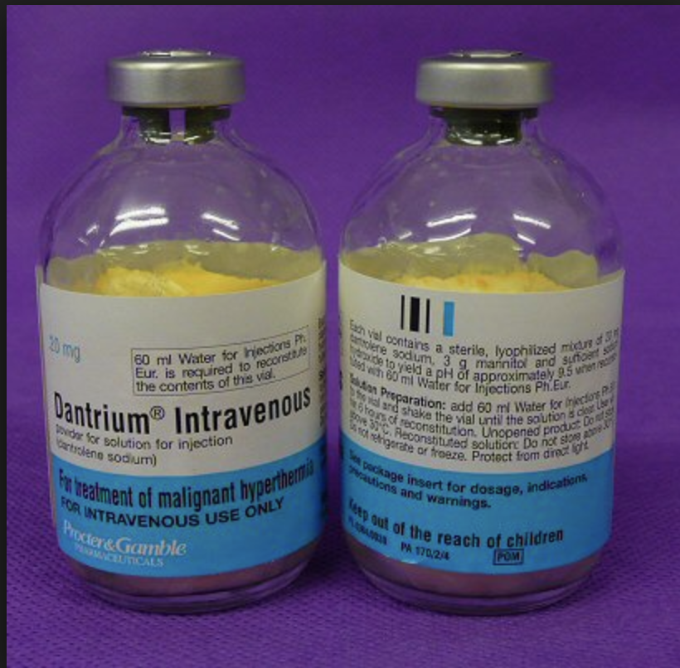
Malignant Hyperthermia
9
1
2
3
4
5
6
7
8
9
10
11
12
13
14
Unexplained increase in ETCO₂ AND tachycardia AND increase in oxygen requirement. Temperature changes are a late sign.
STOP all trigger agents
Call for help, MH Kit, vapour-free AU machine
MH Kit & machine: Opposite D1 (EOT)
Delegate roles as per MH Action Cards (in MH Kit)
Obtain E-trolley & defibrillator - place in induction room
Move induction room patient to another theatre, with all notes
Hyperventilate with 15L/min 100% Fi O₂
Maintain anaesthesia with IV agents e.g. Propofol
Abandon or finish surgery ASAP, insert IDC
Assist in cooling with intra-abdominal sterile cold saline lavage
Give IV Dantrolene (only found in MH box at MOT)
Highest priority, mobilise pharmacist
Use as many people as are available
Insert intra-arterial line, central venous line
Ix: iStat, UECr, FBC, PT/PTT, CK, urine myoglobin
Insert temp probe, BIS monitor
Initiate aggressive active cooling measures (see notes) and expose patient outside sterile field
Treat associated conditions: Hyperkalemia / Arrhythmias / Acidosis / Myoglobinemia / DIVC
Admit to ICU
Monitor with serial labs e.g. ABG, FBC, electrolytes, CK, coagulation profile; temperature and urine output
DRUG DOSES
Each vial of Dantrolene (20 mg) to be reconstituted with 60 ml sterile water
Give IV Dantrolene 2.5 mg/kg bolus until signs of hypermetabolism i.e. acidosis/pyrexia/muscle rigidity resolve. Repeat 1 mg/kg bolus as required up to max 10 mg/kg. Note: Dantrolene can interact with calcium channel blockers (e.g. Verapamil) and precipitate profound hypotension
Propofol: TIVA 4 mcg/ml or 30 – 50 ml/hr in adults
Treatment for associated conditions
Hyperkalemia | - 0.3 ml/kg 10% Ca Gluconate OR 0.1ml/kg 10% CaCl2 - 10U actrapid insulin with 50 ml 50% dextrose - Consider IV 8.4% sodium bicarbonate
Arrhythmias | - Consider magnesium; - Amiodarone 3mg/kg; - Metoprolol1-2mg IV prm; - Lignocaine 1mg/kg IV, - Procaina,mide 300mg over 15 mins, if adult - Avoid calcium channel blockers
Myoglobinemia/Renal protection | - Always ensure aggressive fluid resuscitation has been initiated before considering pharmacological diuresis - Maintain urine output ≥ 2 ml/kg/hr by maintaining intravasular volume with normal saline and mannitol and/or furosemide - Mannitol 0.5 g/kg (Including 3g mannitol/vial of dantrolene) - Forced alkaline diuresis - Consider sodium bicarbonate 0.5 -1 mmol/kg if pH < 7.2
DIVC | FFP, cryoprecipitate, platelets
Inotropic support | Adrenaline/Noradrenaline prn
Additional notes
Active cooling measures include: intra-abdominal lavage with cold sterile saline at 4°C Cool IV fluids Cool sponging and ice packs (obtain from perfusionist @ NHC or MOT behind OT 26 in Store L12) Lowering theatre temperature: Call 4000 Monitor for acute kidney injury and compartment syndrome Aim urine output >2 ml/kg/hr with pH >7.0 Consider alternative diagnoses (sepsis, phaeochromocytoma, thyroid storm, myopathy
Early recognition and fluid resuscitation is key
Notes:
Location of these MH action cards?
Do we have an MH unit?
To add ICU and lab extension number?

Slide 11
Massive Hemorrhage
10
1
2
3
4
5
6
7
8
9
10
11
12
13
14
> 50% blood volume loss in 3 hours, > 150 ml blood loss / min or loss of one blood volume within 24 hours
Call for help and E-trolley
Confirm there is surgical effort to control bleeding
Maintain airway, secure with ETT if necessary, ventilate with 100% Fi O₂ until crisis is resolved
Obtain 2 peripheral large bore IV access, run warm fluids fast; actively warm patient
Use fluid pressure bag or rapid infusor +/- cell saver
Contact blood bank (Ext 3666/4852) to activate Massive Transfusion Protocol (MTP) and crossmatch blood early
Send GXM for urgent determination
Consider O-positive e-blood for all patients except Indian, Caucasians of child-bearing potential (O-negative blood); AB-positive FFP to all patients
D-negative or positive red cell alloantibodies should be excluded from MTP – use O negative emergency blood if necessary but contact BTS MO urgently for advice
Call blood bank directly for release of MTP Pack 1, 2 but inform BTS MO after delivery of MTP Pack 2 for release of MTP Pack 3;
Inform BTS MO when MTP ceases
Consider the use of anti-fibrinolytic therapy
Establish bedside monitoring: Arterial line, urinary catheter, CVP, temperature, TEG or ROTEM
Monitor serial lab tests: ABG, FBC, PT/PTT, electrolytes, Ca/Mg/PO₄, fibrinogen
DRUG DOSES for vasopressor infusions
Noradrenaline | 0.01 – 0.2 mcg/kg/min IV
Adrenaline | 10 mcg boluses (1 ml of 1:100000 dilution) 0.01 – 0.2 mcg/kg/min IV
Dopamine | 5 – 20 mcg/kg/min IV
Notes
MTP Packs: Pack 1: 4 units PCT, 4 units FFP, 1 unit pooled platelets Pack 2: 4 units PCT, 4 units FFP, 1 unit pooled platelets Pack 3: 4 units PCT, 4 units FFP, 1 unit pooled platelets, 2 units pooled cryoprecipitate BTS MO must be informed after activation of Pack 2 in case Pack 3 is required
Therapy | Indication | Dosage
FFP | PT, aPTT <1.5 normal, fibrinogen <1g/l | 15 ml/kg
Cryoprecipitate | Fibrinogen <1g/l | 5 – 10 ml/kg
Factor VIIa | As above | 90 mcg/kg
Tranexamic acid | Fibrinolysis | 1 g IV over 10 min then 1 g over 8 hours
Platelets | Platelet count <75x10⁹ | 15 – 20 ml/kg

Slide 12
Ventricular Fibrillation/Tachycardia (VF/VT)
11
1
2
3
4
5
6
7
8
9
10
11
12
13
14
Shockable pulseless cardiac arrest
Call for help and E-trolley
Ask: “Who will be the crisis manager?”
Say: “Shock patient as soon as defibrillator arrives”
Turn FiO₂ to 100%, turn off volatile anaesthetics Ventilate at 8 – 10 breaths/min. Do not overventilate
SHOCK at 150 Joules immediately. Resume CPR - Assess every 2 minutes. Aim for any pause to be < 5 seconds - Instruct change of CPR compression provider as and when necessary. - Check EtCO₂
If < 10mmHg, evaluate CPR technique
If sudden increase to > 40mmHg, may indicate ROSC
SHOCK at 2 minutes. Resume CPR
SHOCK at 4 minutes. Give Adrenaline 1mg. Resume CPR. Drugs are given immediately following shock
SHOCK at 6 minutes. Give Amiodarone 300mg. Resume CPR.
Continue to shock every 2 minutes and treat reversible causes, consider reading aloud Hs and Ts
For resistant VF/VT, give adrenaline 1mg every 2 minutes (alternate shocks) and further 150mg of amiodarone followed by infusion of 900mg over 24 hours
Following ROSC, commence post resuscitation care
DRUG DOSES and treatments
Adrenaline | 1 mg in 10ml (1:10,000) IV, repeat 2 minutes
ANTIARRHYTHMICS
Amiodarone | 300 mg IV over 15 mins
Magnesium | 1 to 2 g IV/IO over 3 mins for Torsades de Pointes
Lignocaine | 1mg/kg IV if amiodarone not available
DEFIBRILLATOR instructions
Tear debrillator pads into 2 and place across chest Turn defibrillator ON, set to DEFIB mode and increase ENERGY LEVEL to 150 Joules Deliver shock: Press CHARGE then press SHOCK
Potentially reversible causes (Hs & Ts)
Hydrogen ion (acidosis) Hypo/Hyperkalaemia Hypothermia Hypovolemia Hypoxia | Tamponade (Cardiac) Tension pneumothorax Thrombosis (coronary/pulmonary) Toxins
During CPR
Airway | Adequate ventilation
Circulation | Confirm adequate IV or IO access
Assign roles | Chest compressions, Airway, Vascular access, Documentation, Crash trolley, Time keeping
POST RESUSCITATION
Consider | Referral for urgent percutaneous intervention Therapeutic hypothermia
Avoid | Hyperglycaemia (treat > 10 mmol/L) Hyperoxaemia (keep SpO2 94-98%) Hypercarbia

Slide 13
Important Numbers and Drug Dilutions
12
1
2
3
4
5
6
7
8
9
10
11
12
13
14
 | Contact number / Location
BTS MO | 9186 4133
Blood Bank | 3666 or 4852
EOT Nurse Clinician in-charge | 8125 1945
Massive Transfusion Protocol | Intranet
Malignant Hyperthermia Kit | Opposite EOT
Intralipid 20% | AU store between R1 and R2
Difficult Airway Cart | Outside EOT; Needle cricothyroidotomy set available in 2nd drawer of each AU machine
E-trolley | Outside EOT, Recovery 1 & 2
Drug | Dose Range | Dilution
Dopamine | 2 – 15 mcg/kg/min | 200 mg in 100 ml NS/D5%
Dobutamine | 2 – 15 mcg/kg/min | 250 mg in 100 ml NS/D5%
Adrenaline Noradrenaline | 0.01 – 0.5 mcg/kg/min | 4 mg in 50ml NS/D5%
Nitroprusside | 0.5 – 0.8 mcg/kg/min | 50 mg in 50mls D5% Protect from sunlight
Nitroglycerin | 1 – 2 mg/hr | 50 mg in 50 mls
Morphine | 1 -2 mg/hr | 20 mg in 20 mls
Insulin | 1 – 2 units/hr | 20 units in 20 mls
Labetolol | 1 - 2 mg/hr | 50 mg in 50 mls
Furosemide | 10 – 30 mg/hr | 500 mg in 50 mls
Somatostatin | 250 mcg/hr | 3000 mcg in 30 mls
To use N/S 0.9% unless otherwise stated

Slide 14
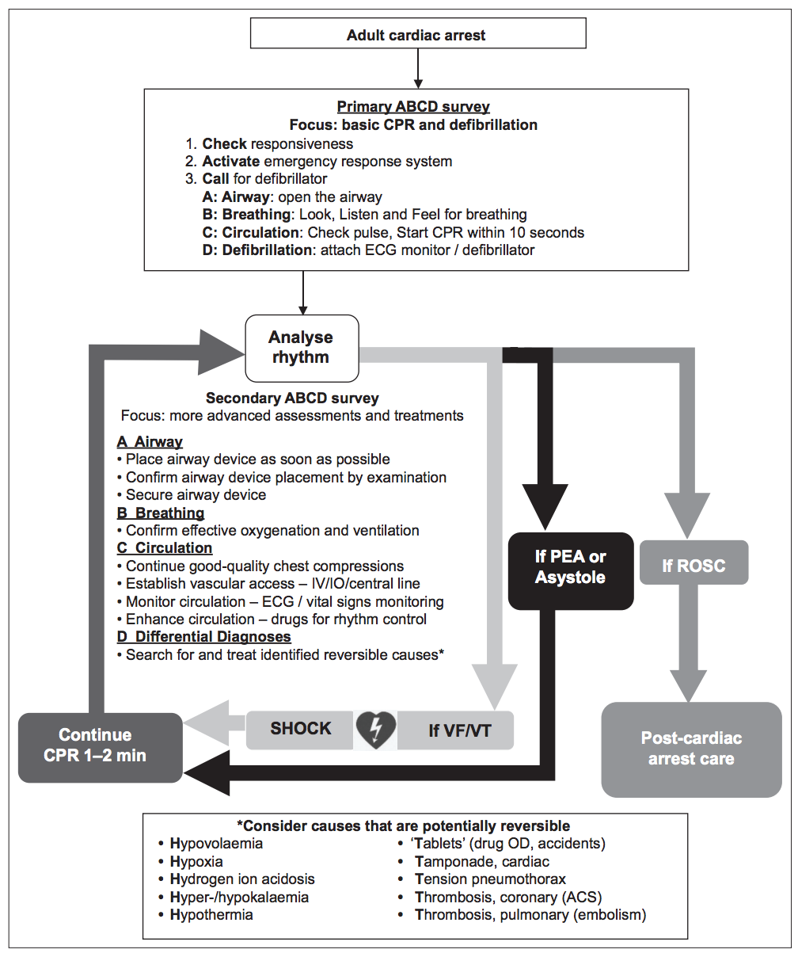
Code Algorithms: PEA/Asystole
13
1
2
3
4
5
6
7
8
9
10
11
12
13
14
National Resuscitation Council Singapore
Advanced Cardiac Life Support Provider Manual
Updated 2016

Slide 15
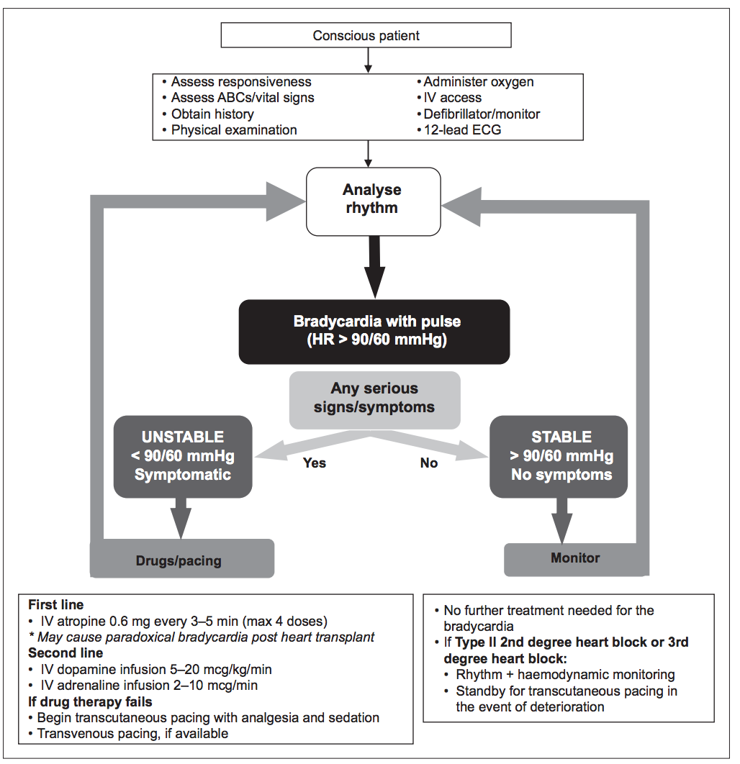
Code Algorithms: Bradycardia
13
1
2
3
4
5
6
7
8
9
10
11
12
13
14
National Resuscitation Council Singapore
Advanced Cardiac Life Support Provider Manual
Updated 2016

Slide 16
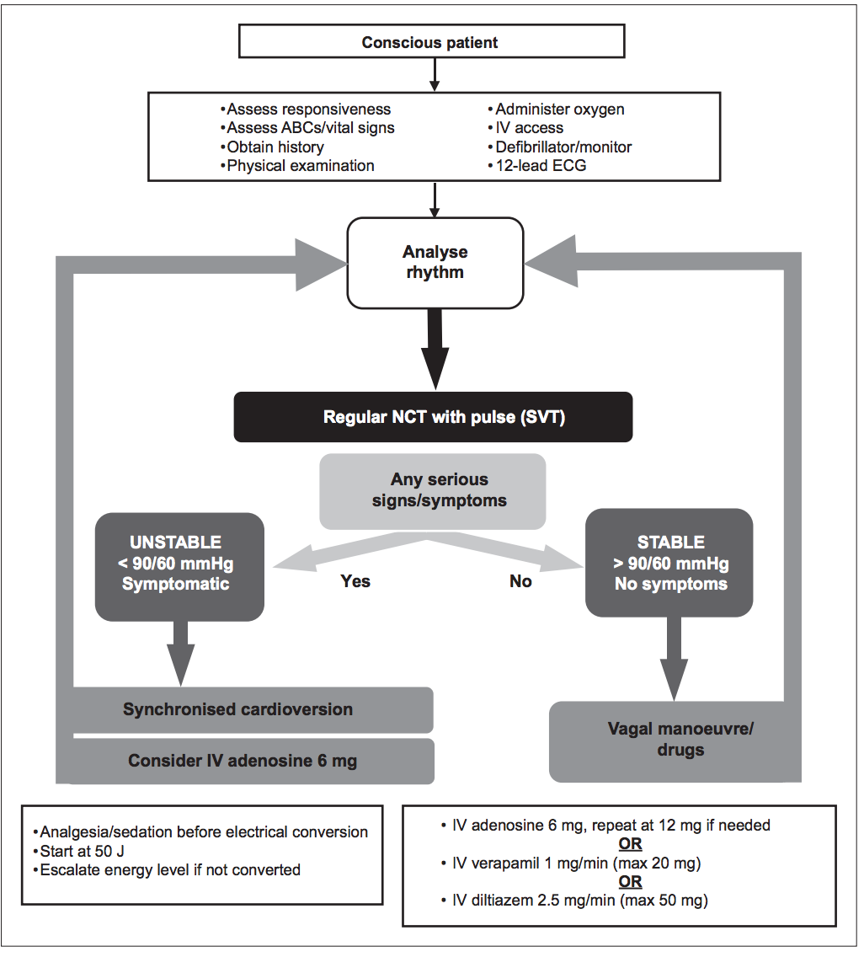
Code Algorithms: Supraventricular Tachycardia (SVT)
13
1
2
3
4
5
6
7
8
9
10
11
12
13
14
National Resuscitation Council Singapore
Advanced Cardiac Life Support Provider Manual
Updated 2016

Slide 17
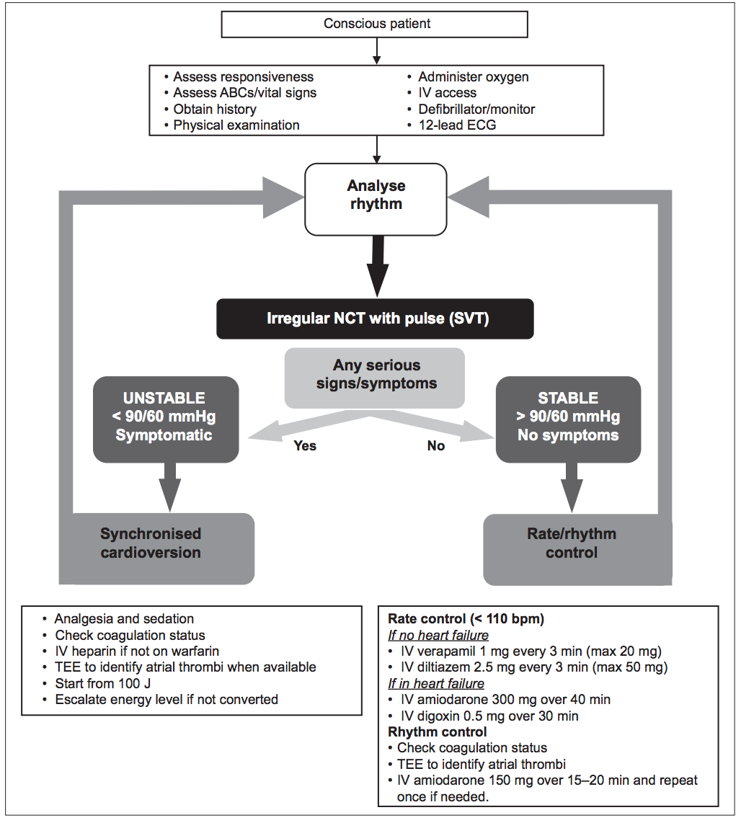
Code Algorithms: Irregular Narrow Complex Tachycardia
13
1
2
3
4
5
6
7
8
9
10
11
12
13
14
National Resuscitation Council Singapore
Advanced Cardiac Life Support Provider Manual
Updated 2016

Slide 18
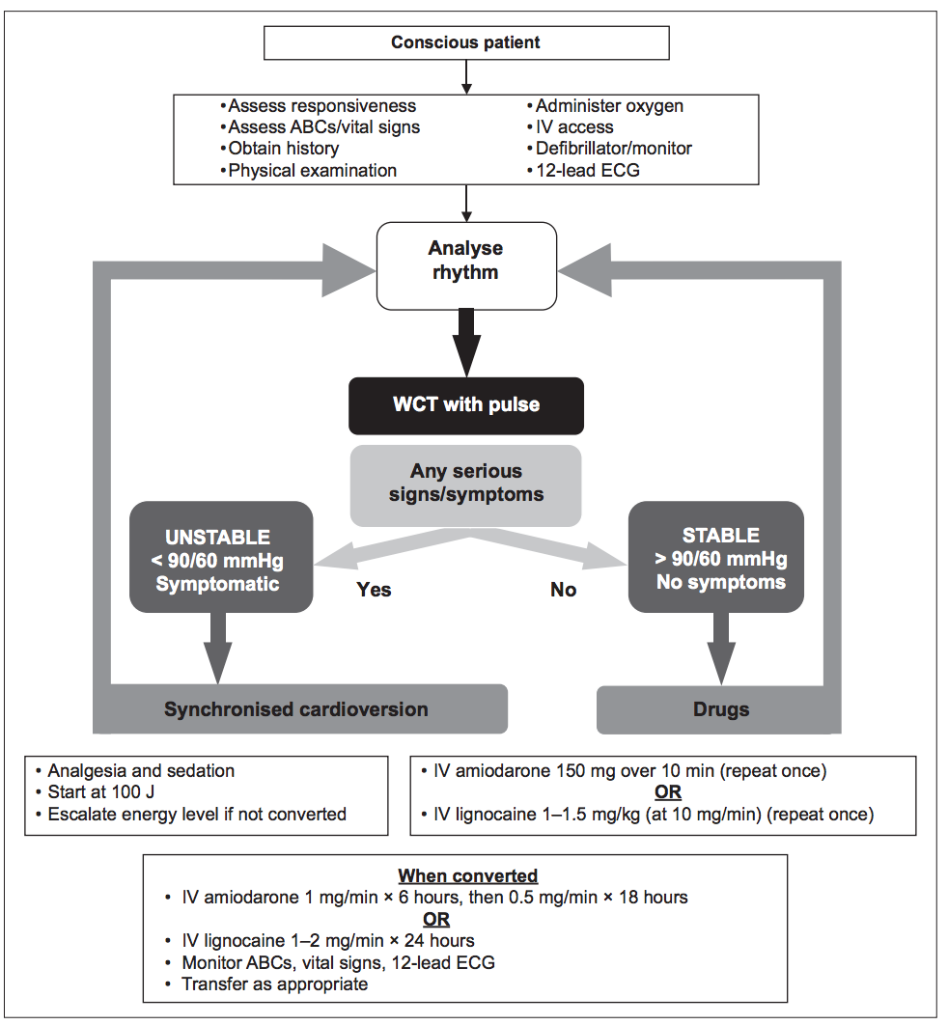
Code Algorithms: Wide Complex Tachycardia
13
1
2
3
4
5
6
7
8
9
10
11
12
13
14
National Resuscitation Council Singapore
Advanced Cardiac Life Support Provider Manual
Updated 2016

Slide 19
Debriefing after a Crisis
14
1
2
3
4
5
6
7
8
9
10
11
12
13
14
To promote guided reflection as a way to improve and maintain patient safety, increase efficiency and contribute to a supportive culture of dialogue and learning in any clinical environment
Starting to TALK
Step 1 | Tell: Share your perspective on the clinical situation Target: Agree on what is important to discuss
What shall we discuss to improve patient care? Share your perspective – How do you see the situation?
Step 2 | Analyse: Explore specific points of patient care as appropriate
What helped or hindered: Communication Decision making Situational awareness Efficiency |  | The way forward How can we repeat successful performance? How can we improve?
Step 3 | Learning Points
What can the team learn from the experience?
Step 4 | Key actions
What can we do to improve and maintain patient safety? Let’s find solutions and agree on responsibilities
Values
Positivity | Identify positive strategies and behaviours. Avoid negative comments
Focus on finding solution, rather than pointing out blame.
Professional communication, valuing everyone’s input.
Step by step: Identify small objectives and follow up outcomes.
If you need to speak to someone in-confidence, we have a peer support network in place:
SGH SAFE (Support Action For Employees): Supports institutions on SGH Campus | Tel: 6576 2012 9am – 6pm (weekdays)
CGH PEER Network Hotline | Tel: 8125 8452 9am – 5pm (weekdays)
SKH PALS (Peers Actively Leading Support) Hotline | Tel: 6379 3370 8.30am – 5.30pm (weekdays)
KKH Carers’ Support Helpline | Tel: 8181 7655 8.30am – 5.30pm (weekdays)

