Slide 1
Apache Flink
The Stream Processor

Slide 2
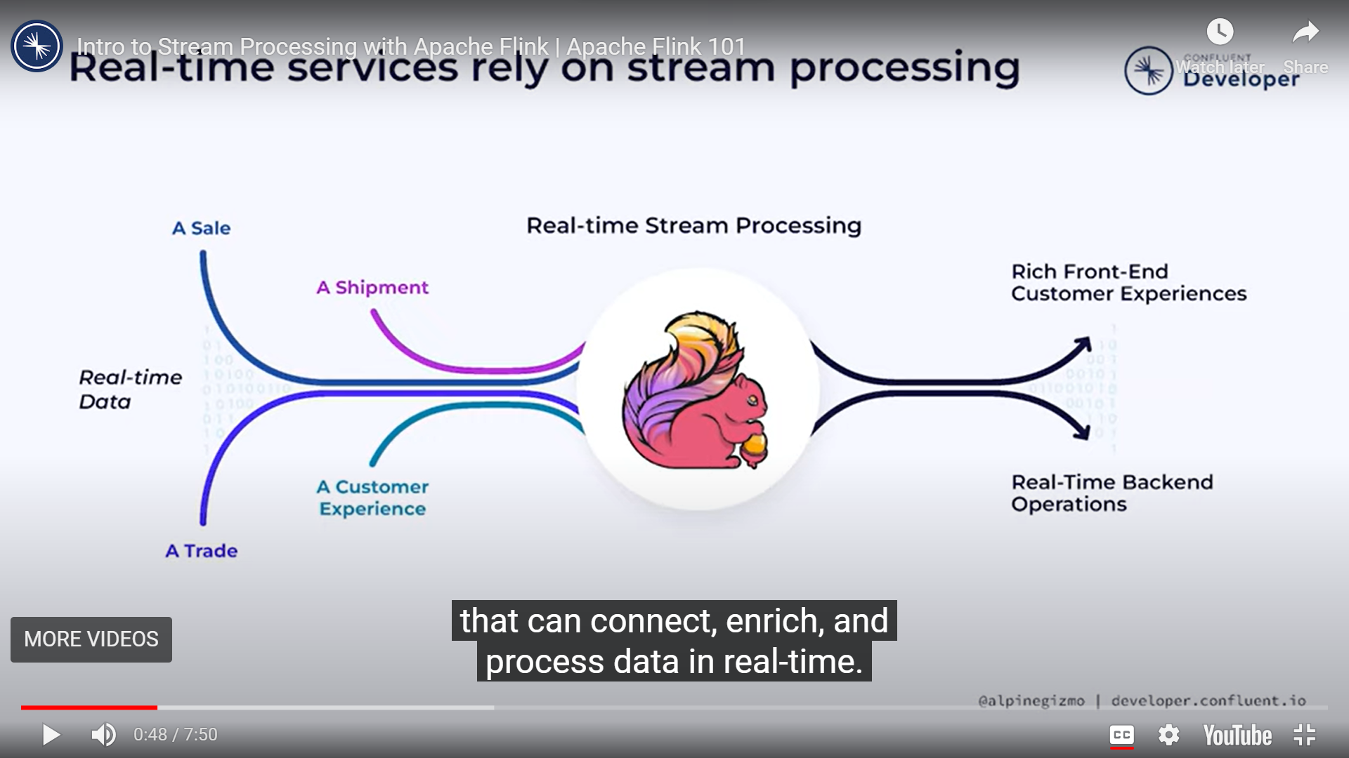

Slide 3
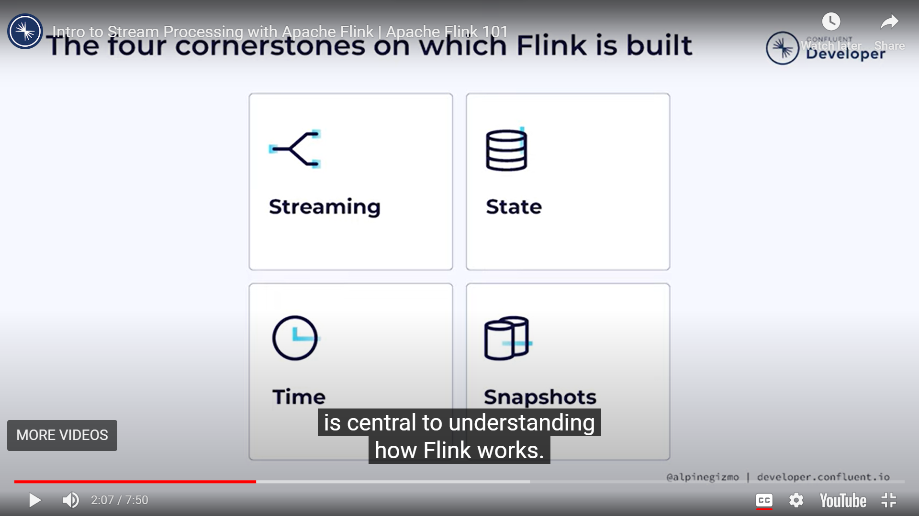

Slide 4
