Slide 1
Data Processing
Apache Flink

Slide 2
What - Data Processing/Management
Manipulation and transformation of raw data into meaningful insights or information.
Involves various operations like filtering, aggregating, transforming, and analysing data.
Essential for extracting value from large volumes of data generated by modern applications and systems.
Provides the framework for turning raw data into actionable information, empowering organizations to drive efficiency, innovation, and competitiveness.

Slide 3
Why - Data Processing
Importance
Process data in real-time or near-real-time
Enables organizations to make data-driven decisions.
Improves efficiency and productivity by automating repetitive tasks.
Facilitates real-time insights and responses to changing conditions.
Foundation for various applications such as business intelligence, machine learning, and predictive analytics.
Challenges
Managing large volumes of data efficiently.
Requires robust infrastructure and algorithms capable of handling the complexities.
Ensuring data quality and reliability.
Handling diverse data formats and sources.
Data Volume and Velocity.

Slide 4





Open-Source Data Infrastructure
Applications
Data processing engines
App and resource management
Storage, streams
Hive
Mahout
Pig
Cascading
Map Reduce
Storm
Flink
Spark
Tez
YARN
MESOS
HDFS
HBASE
Kafka
source: Flink Forward

Slide 5
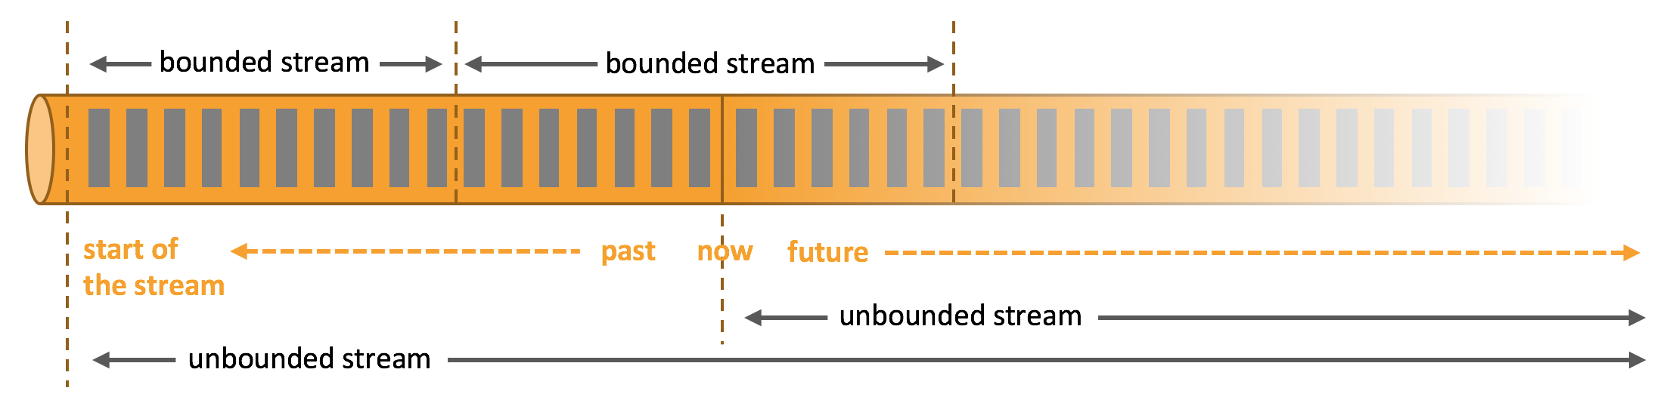
Bounded and Unbounded Data Stream
Bounded
Have a defined start and end
Ex: Imagine the retail business wants to analyse sales data for the past year to gain insights into customer behaviour, product performance, and seasonal trends. Since they are only interested in historical data up to the present moment, this dataset has a clear beginning and end.
Unbounded
Have a start but no defined end
Ex: Now, let's consider the real-time aspect of the retail business. They also want to monitor sales in real-time to detect trends, manage inventory, and send personalized promotions to customers
source: Apache Flink Official Site

Slide 6
Apache Flink
“Apache Flink is a framework and distributed processing engine for stateful computations over unbounded and bounded data streams. Flink has been designed to run in all common cluster environments, perform computations at in-memory speed and at any scale.
source: Apache Flink Official Site

Slide 7
Use Cases
Below, we explore the most common type of application that are powered by Flink
Event Driven Applications
Data Analytics Applications
Data Pipeline Applications

Slide 8
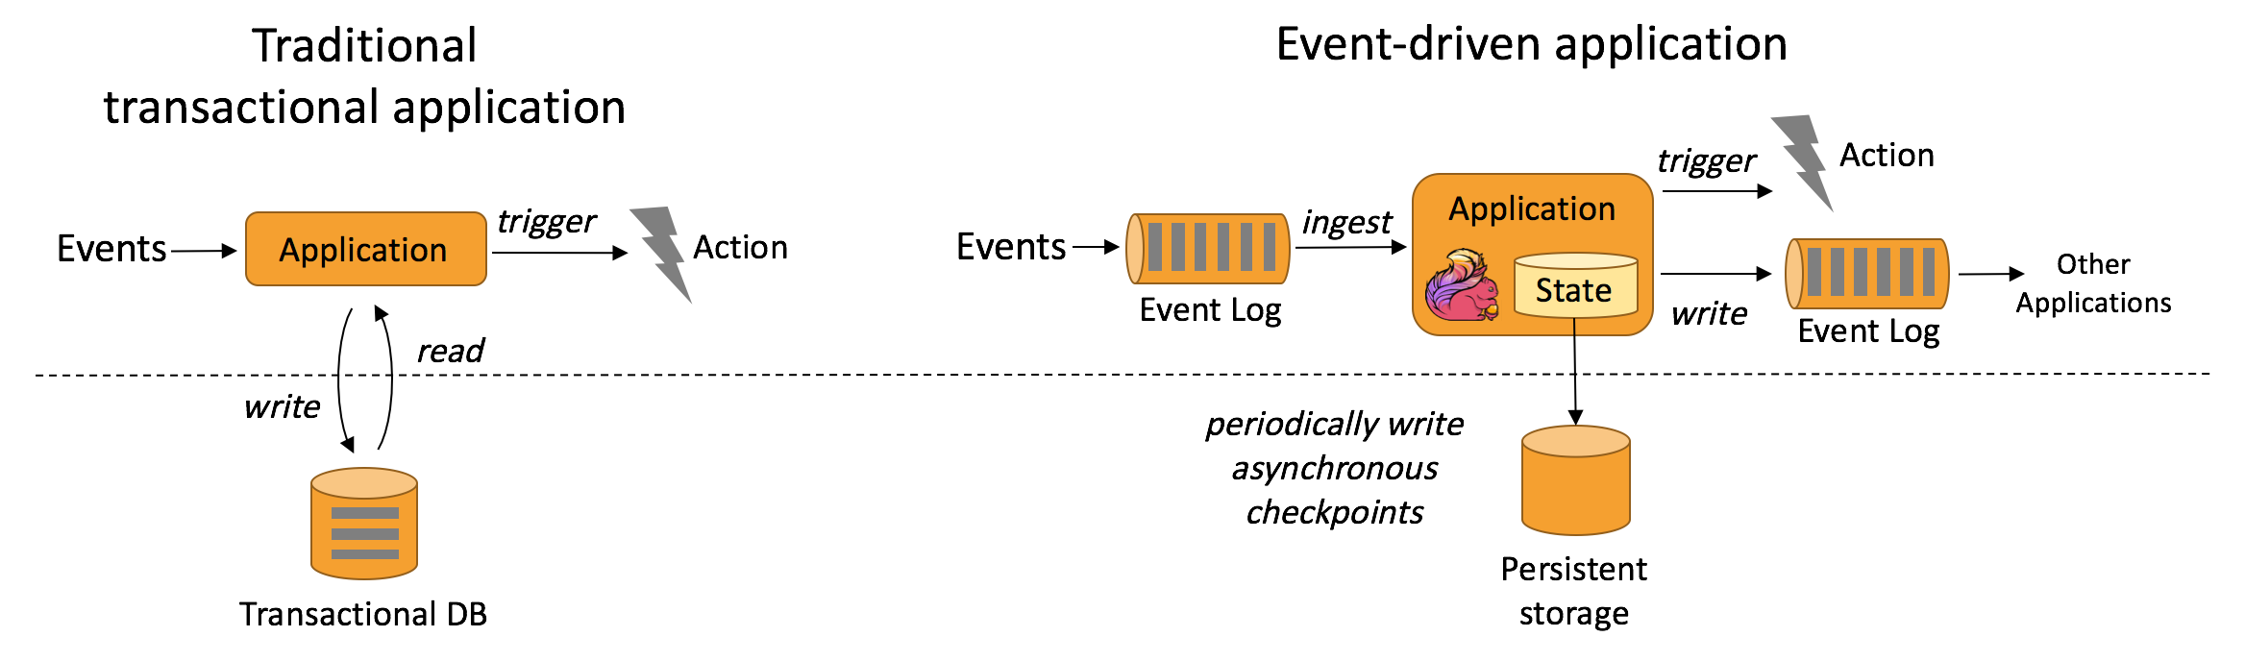
Event Driven Applications
An event-driven application is a stateful application that ingest events from one or more event streams and reacts to incoming events by triggering computations, state updates, or external actions.
Fraud detection
Anomaly detection
Rule-based alerting
Business process monitoring
Web application (social network)

Slide 9
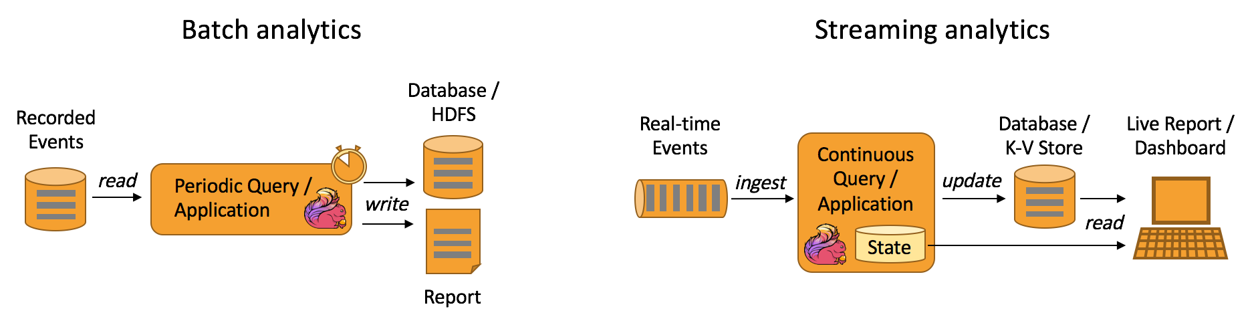
Data Analytics Applications
Traditionally, analytics are performed as batch queries or applications on bounded data sets of recorded events. To incorporate the latest data into the result of the analysis, it must be added to the analysed data set and the query or application is rerun. The results are written to a storage system or emitted as reports. Quality monitoring of Telco networks
Analysis of product updates & experiment evaluation in mobile applications
Ad-hoc analysis of live data in consumer technology
Large-scale graph analysis

Slide 10
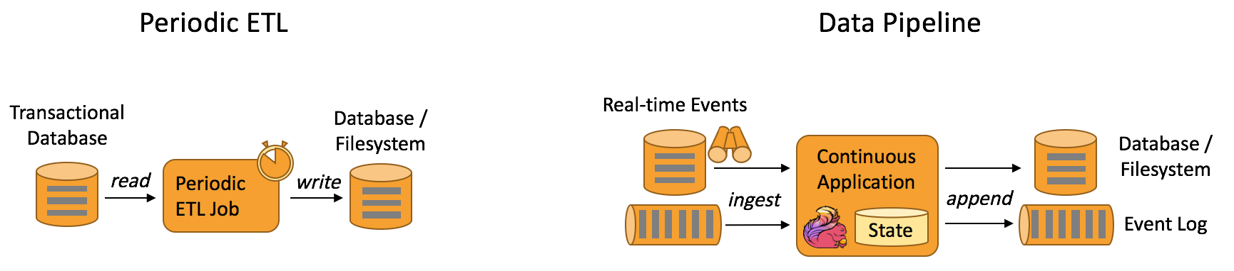
Data Pipeline Applications
Extract-transform-load (ETL) is a common approach to convert and move data between storage systems. Often ETL jobs are periodically triggered to copy data from transactional database systems to an analytical database or a data warehouse.
Real-time search index building in e-commerce
Continuous ETL in e-commerce

Slide 11
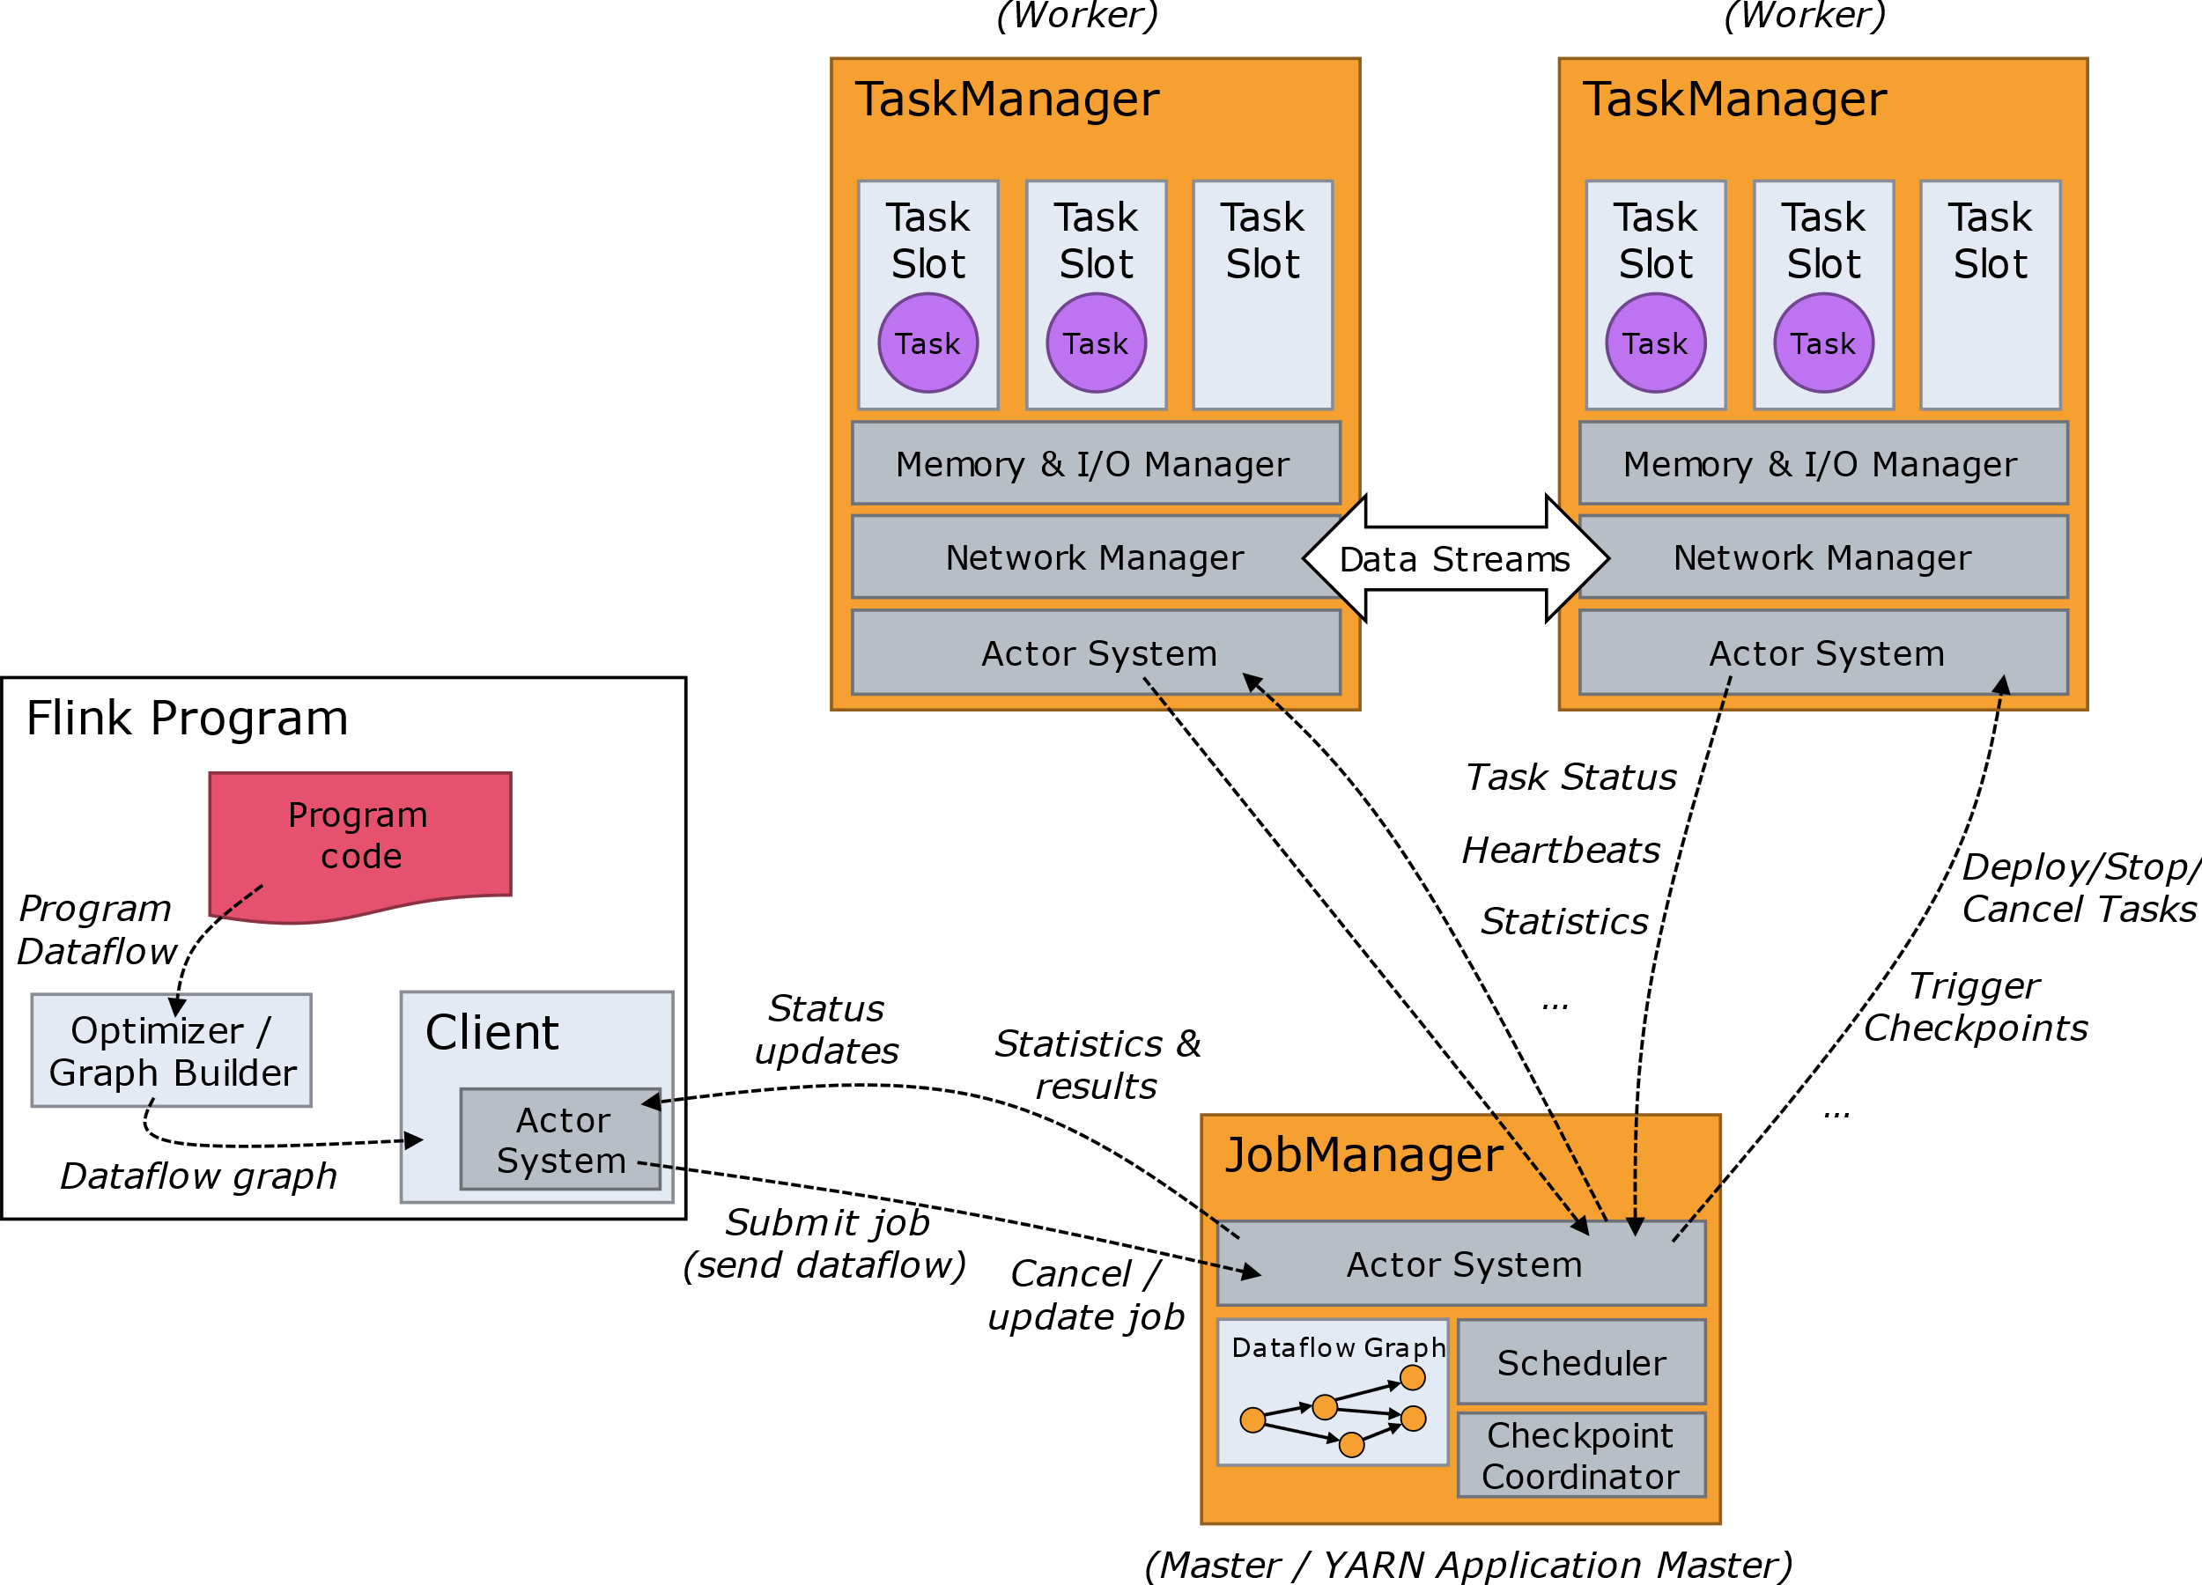
The Flink Cluster
The Flink runtime consists of two types of processes: a Job Manager and one or more Task Managers.

Slide 12
Job Manager
Coordinates distributed execution of Flink Applications.
Decides scheduling of tasks.
Reacts to finished tasks or execution failures.
Coordinates checkpoints and recovery on failures.
Resource Manager
Responsible for resource de-/allocation and provisioning.
Dispatcher
Provides a REST interface to submit Flink applications.
Job Master
Manages the execution of a single JobGraph.
Manages task slots.
Implements multiple ResourceManagers for different environments (e.g., YARN, Kubernetes, standalone deployments).
In standalone setup, distributes slots of available TaskManagers but cannot start new TaskManagers.
Starts a new JobMaster for each submitted job.
Runs the Flink WebUI for job execution information.
Allows multiple simultaneous jobs in a Flink cluster, each with its own JobMaster.

Slide 13
Task Manager
TaskManagers (Workers):
Execute tasks of a dataflow.
Buffer and exchange data streams.
Minimum Requirement:
At least one TaskManager must always be present.
Task Slot:
Smallest unit of resource scheduling in a TaskManager.
Number of task slots indicates the number of concurrent processing tasks.
Multiple operators may execute in a task slot.

Slide 14
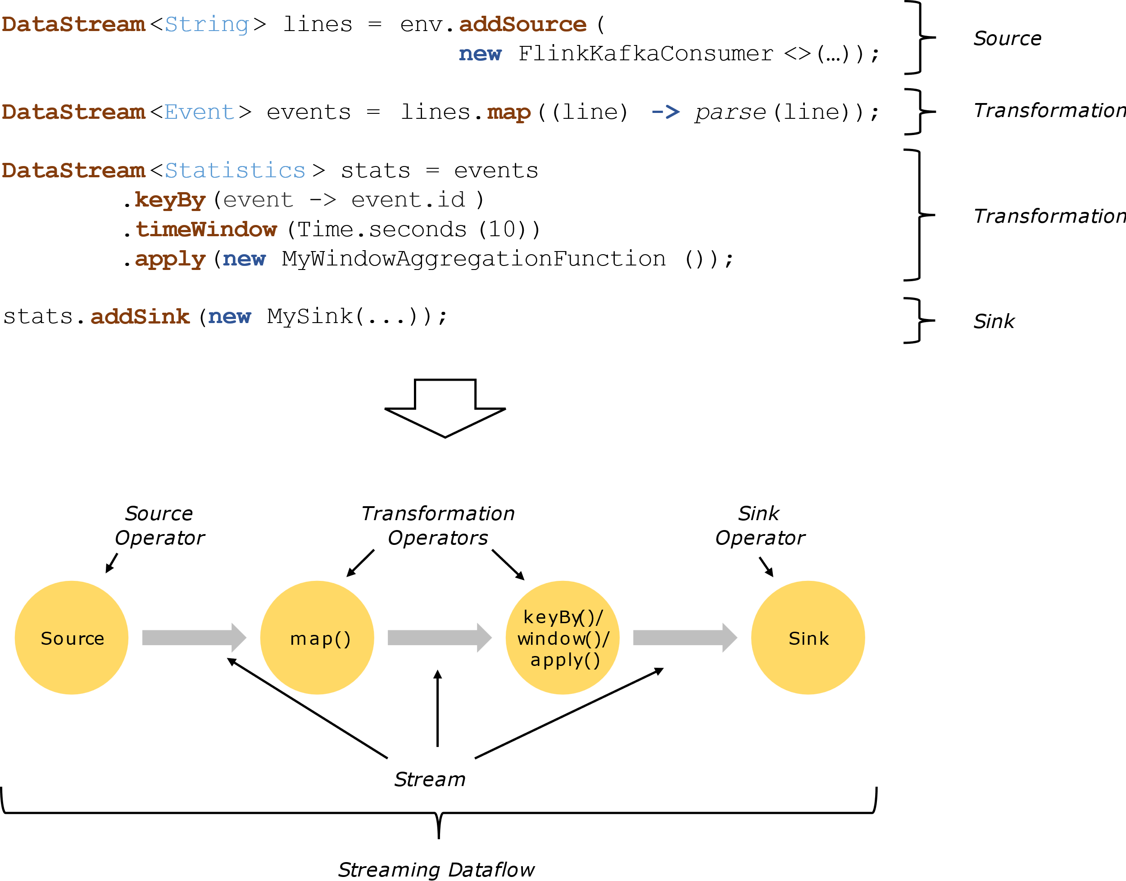
Data Flow

