Slide 1
Data Processing
Apache Flink

Slide 2
What - Data Processing/Management
Manipulation and transformation of raw data into meaningful insights or information.
Involves various operations like filtering, aggregating, transforming, and analysing data.
Essential for extracting value from large volumes of data generated by modern applications and systems.
Provides the framework for turning raw data into actionable information, empowering organizations to drive efficiency, innovation, and competitiveness.

Slide 3
Why - Data Processing
Importance
Process data in real-time or near-real-time
Enables organizations to make data-driven decisions.
Improves efficiency and productivity by automating repetitive tasks.
Facilitates real-time insights and responses to changing conditions.
Foundation for various applications such as business intelligence, machine learning, and predictive analytics.
Challenges
Managing large volumes of data efficiently.
Requires robust infrastructure and algorithms capable of handling the complexities.
Ensuring data quality and reliability.
Handling diverse data formats and sources.
Data Volume and Velocity.

Slide 4





Open-Source Data Infrastructure
Applications
Data processing engines
App and resource management
Storage, streams
Hive
Mahout
Pig
Cascading
Map Reduce
Storm
Flink
Spark
Tez
YARN
MESOS
HDFS
HBASE
Kafka

Slide 6
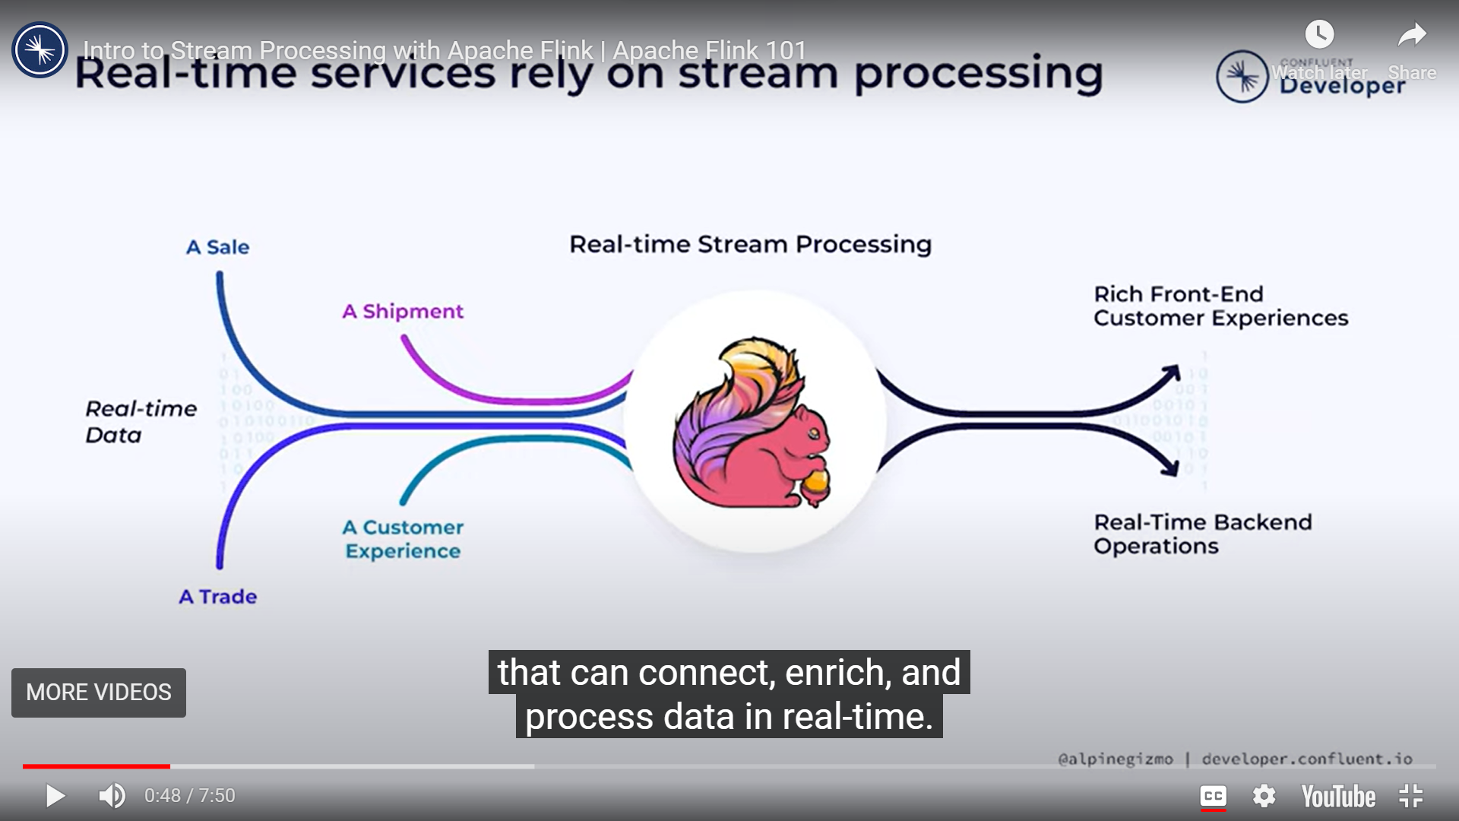

Slide 7
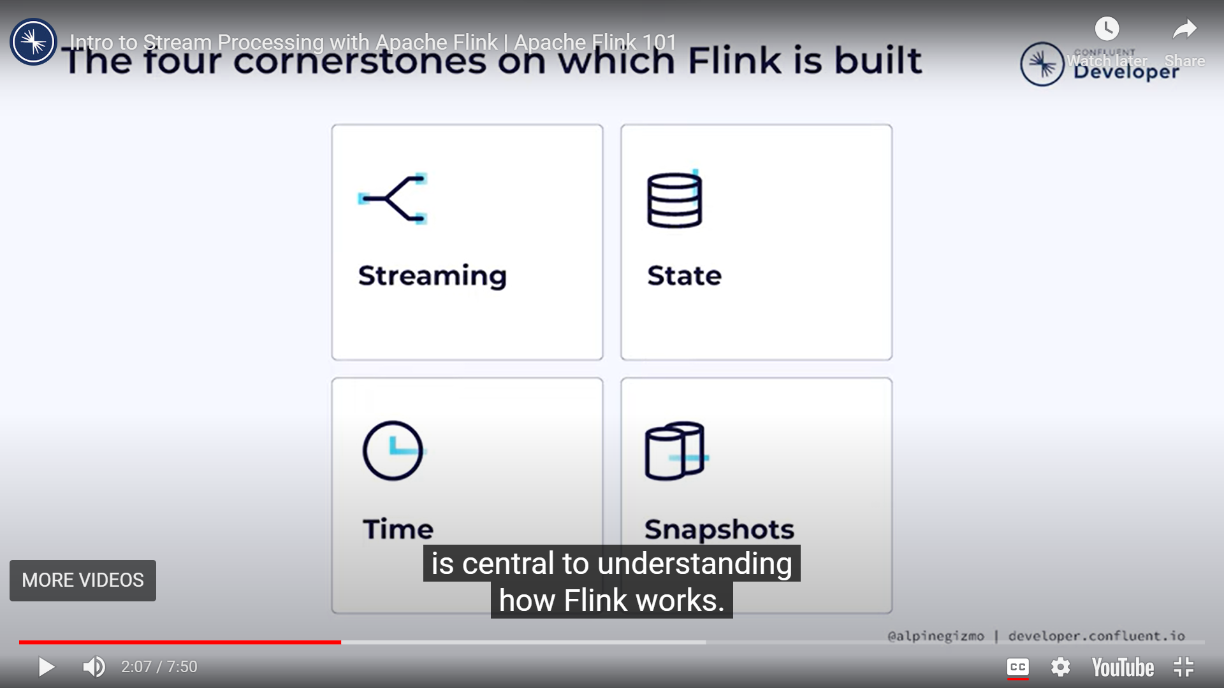

Slide 8
