Slide 1
Spring Boot Microservices

Slide 2
What is Spring Boot?
A framework that it easy to
Create stand-alone, production-grade Spring-based applications
Run applications with minimal configuration ("just run")
Embed Tomcat, Jetty or Undertow directly (no need to deploy WAR files)
Provide opinionated 'starter' dependencies to simplify your build configuration
Automatically configure Spring and 3rd party libraries whenever possible
Provide production-ready features such as metrics, health checks, and externalized configuration
Absolutely no code generation and no requirement for XML configuration

Slide 3
Spring CLI
The Spring Boot CLI is a command line tool that you can use to bootstrap a new project.
https://docs.spring.io/spring-boot/installing.html#getting-started.installing.cli
Some Commands
spring version
spring init --dependencies=web,data-jpa my-project

Slide 4
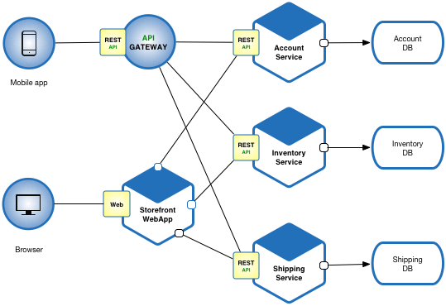
Microservices
Microservices - also known as the microservice architecture- is an architectural style that structures an application as a collection of services that are:
Independently deployable
Loosely coupled
Services are typically organized around business capabilities. Each service is often owned by a single, small team.

Slide 5
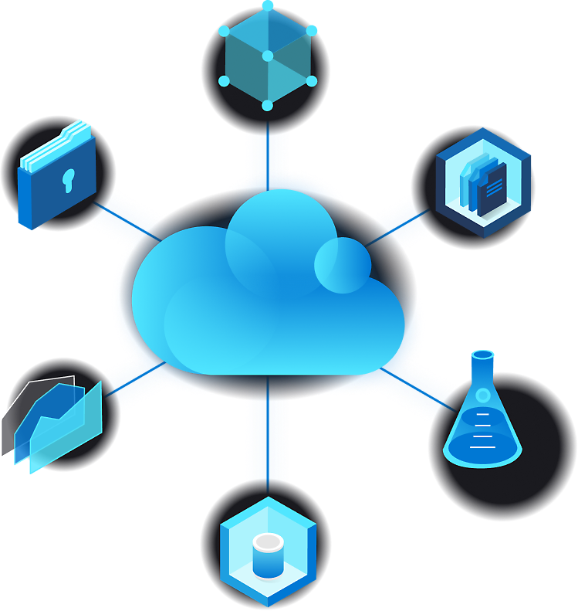
Cloud Computing
Cloud computing is the delivery of various computing services over the Internet ("the cloud").
Services include servers, storage, databases, networking, software, analytics, and intelligence.
It offers faster innovation, flexible resources, and economies of scale.
You typically pay only for the cloud services you use.
Helps in lowering operating costs.
Allows running infrastructure more efficiently.
Supports scaling as business needs change.

Slide 6
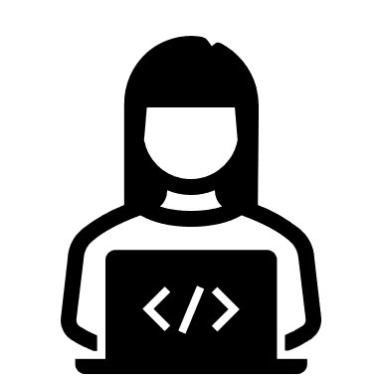

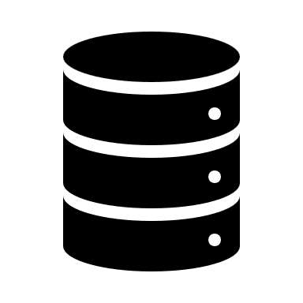

Rest Template
RestTemplate is a class in Spring Framework used to make HTTP requests to RESTful services.
It provides methods for common HTTP operations like GET, POST, PUT, DELETE, etc.
Simplifies communication between microservices or external APIs.
Automatically handles data conversion between Java objects and HTTP responses using serializers like JSON or XML.
Can easily integrate with authentication, headers, and other HTTP configurations.
UI/REST Client
REST Template
HTTP

Slide 7
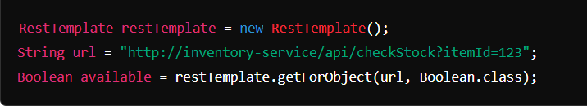
Rest Template
Use Case
A RestTemplate can be used in an Order Service to send a request to an Inventory Service to check if items are available. The Order Service calls the Inventory Service's API using RestTemplate to retrieve the stock availability before confirming the order.

Slide 8
Content Negotiation
In Spring Boot, Content Negotiation allows your RESTful web services to serve different formats of data, such as JSON and XML, based on the client's request. By default, Spring Boot supports JSON, but it also allows serving XML if needed. Content negotiation happens based on the Accept header or the file extension provided in the request.

Slide 9
How Content Negotiation Works
Client Request: The client specifies the format it wants (JSON, XML, etc.) using the Accept header or a file extension in the URL (like .json or .xml).
Spring Response: Spring Boot checks the requested media type and returns the response in that format if it's supported.
Spring Boot includes the jackson-databind dependency by default for JSON. For XML support, you'll need the Jackson XML dependency.
Steps to Enable JSON and XML Content Negotiation in Spring Boot
@GetMapping(value = "/order", produces = { "application/json", "application/xml" })
@JacksonXmlRootElement(localName = "order") public class Order {}

Slide 10
Spring JMS
Java Message Service (JMS) is an API for messaging between applications.
It enables asynchronous communication, decoupling the sender and receiver.
Commonly used for messaging in microservices, enterprise applications, etc.
Key Features:
Provides messaging reliability and durability.
Supports both point-to-point (queues) and publish-subscribe (topics) messaging models.
Integrated in Spring for seamless usage.

Slide 11
JmsTemplate
Overview:
JmsTemplate is a central class in Spring’s JMS support, offering a simplified API for sending and receiving messages.
Handles connection management and simplifies sending/receiving JMS messages.
Key Methods:
convertAndSend() - Sends a message to a specified destination.
receiveAndConvert() - Receives a message from the destination and converts it.

Slide 12

Health Endpoint
Overview
Purpose: To provide the health status of a Spring Boot application.
Component: Part of Spring Boot’s Actuator module.
Access: Accessible via /actuator/health.
Key Features of the Health Endpoint
Auto-configuration: Spring Boot auto-configures the health check endpoint when Actuator is added as a dependency.
Customizable: Developers can create custom health indicators to enhance application monitoring.

Slide 13

How to Enable the Health Endpoint
Add Dependency implementation 'org.springframework.boot:spring-boot-starter-actuator’
Enable in application.properties management.endpoints.web.exposure.include=health

